Slide 1
Who is this?
Mark 1:21–45

Slide 2
Mark’s Gospel
Mark is a Gospel of action; Jesus is like a Marvel comic character.

Slide 3
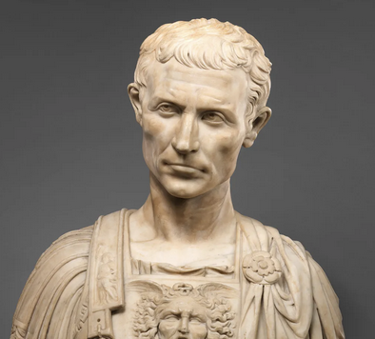
Purpose
To present Jesus as God’s anointed king (Messiah and Son of God) in opposition to Caesar, the other Son of God.
1:1; 8:29; 12:35; 14:61; 15:32, 39.

Slide 4
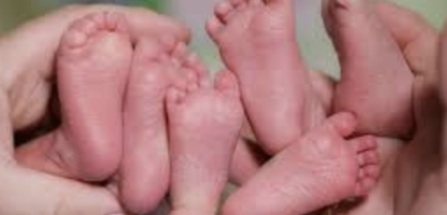
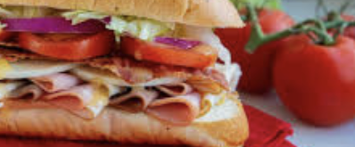
Structure
Triplets presented like a sandwich structure

Slide 5
Today’s Triplet
Healing of a Person with an Unclean Spirit (1:21–28).
Healing of Peter’s Mother-in-law with a Fever (1:29–38).
Healing of the Leper (1:40–45).

Slide 6
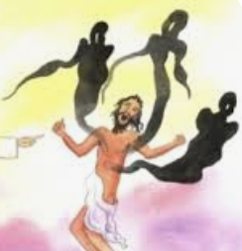
Healing #1 (1:21–28)
Capernaum = a “village of consolation” (kefir = village; nahum = comfort or consolation)
His teaching had authority (exousia)
A man with an unclean spirit
Jesus of Nazareth, the Holy One of God

Slide 7
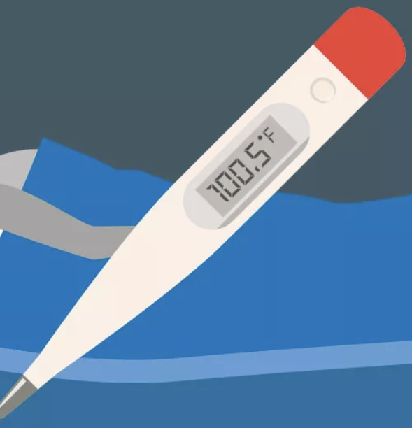
Healing #2 (1:29–38)
Peter’s mother-in-law’s house
Deuteronomy 28:22
Jesus touches her and heals her
And she serves them

Slide 8
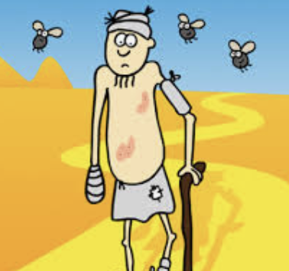
Healing #3 (1:40–45)
“If you wish, you can cleanse me”
Jesus is moved with compassion (splangnizome)
“I am willing. You be cleansed” (not healed)
He disobeys Jesus’s instruction

Slide 9
Lessons
Jesus heals three uncleanliness: spiritual, physical, and emotional.
The miracles answer who Jesus is — Jesus of Nazareth, the Holy One of God, follows Moses’s laws.
Jesus’s compassion (splangnizome) and his use of physical touch to heal and restore the untouchables.
The healed one’s reactions: indifference, servitude, and hindrance.

Slide 10
Questions for us
What’s our attitude to Jesus in our lives?
Do we acknowledge his authority to heal us emotionally, physically, and spiritually and make us whole?

