Slide 1
Last Command
Matthew 28:16-20

Slide 4
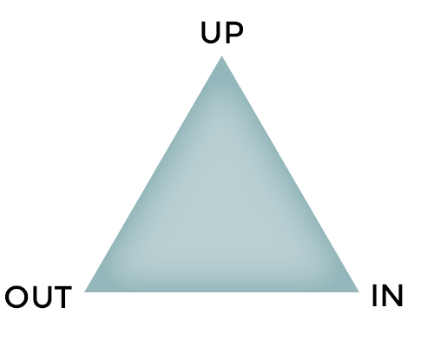
The Church of Jesus Christ

Slide 5
A People of
Prayer and Praise
The Church of Jesus Christ

Slide 6
A People of
Prayer and Praise
The Church of Jesus Christ
A Community of Truth and Grace

Slide 7
A People of
Prayer and Praise
The Church of Jesus Christ
A Mission Force
Of Word and Works
A Community of Truth and Grace

Slide 8
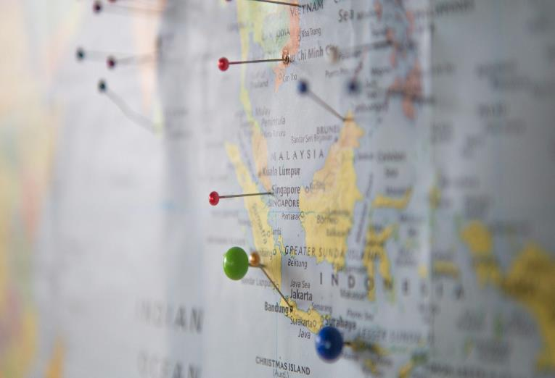
If you led ONE person to Christ and discipled them in a year, to do the same (i.e. next year both of you repeat the process with TWO others) …
in 34 years, we would have reached everyone on earth with the Gospel!

Slide 9
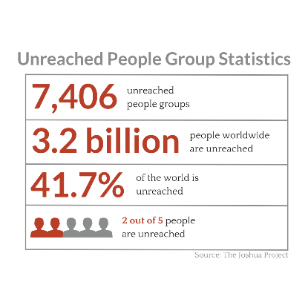

Slide 10
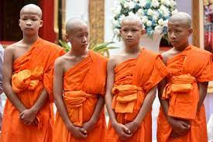
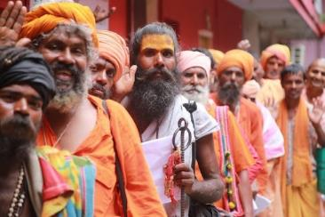
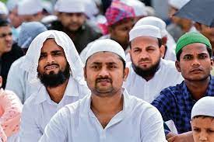
Did you know that 87% of all Buddhists, Muslims and Hindus in the world today do not personally know a Christian?
Source: https://www.gordonconwell.edu/wp-content/uploads/2022/02/Zurlo-Johnson-Crossing-IBMR-2022-World-Christianity-and-Religions-2022-A-Complicated-Relationship.pdf

Slide 11
¹⁶ Now the eleven disciples went to Galilee, to the mountain to which Jesus had directed them. ¹⁷ And when they saw him they worshiped him, but some doubted. ¹⁸ And Jesus came and said to them, “All authority in heaven and on earth has been given to me. ¹⁹ Go therefore and make disciples of all nations, baptizing them in the name of the Father and of the Son and of the Holy Spirit, ²⁰ teaching them to observe all that I have commanded you. And behold, I am with you always, to the end of the age.”

Slide 12
Matthew 28 – The Context
Vs 1-9 – The women, the empty tomb, the angelic announcements and the Risen Jesus!
Vs 10 - Instructions to disciples to meet him in Galilee.
Vs 11-15 – the resurrection explained away.
Vs 16: “Now the eleven disciples went to Galilee, to the mountain to which Jesus had directed them.”

Slide 13
¹⁶ Now the eleven disciples went to Galilee, to the mountain to which Jesus had directed them. ¹⁷ And when they saw him they worshiped him, but some doubted. ¹⁸ And Jesus came and said to them, “All authority in heaven and on earth has been given to me. ¹⁹ Go therefore and make disciples of all nations, baptizing them in the name of the Father and of the Son and of the Holy Spirit, ²⁰ teaching them to observe all that I have commanded you. And behold, I am with you always, to the end of the age.”

Slide 14
Matthew 28:16-20 – The Last Command
The 4 “ALLs”:
All Places – vs 18

Slide 16
Matthew 28:16-20 – The Last Command
The 4 “ALLs”:
All Places – vs 18.
The indicative clause (‘Jesus has all authority in
heaven and earth’) authenticates and necessitates
the imperative (‘..therefore …make disciples of all
peoples.’)

Slide 17
Matthew 28:16-20 – The Last Command
The 4 “ALLs”:
All Places – vs 18.
All Peoples – vs 19.

Slide 18
Μαθητεύω
mathēteuō
lit. Make Disciples

Slide 19
Matthew 28:16-20 – The Last Command
We Make Disciples by:
Going – a movement is called for.

Slide 21
Matthew 28:16-20 – The Last Command
We Make Disciples by:
Going – a movement is called for.
Baptising – in the name of the Triune God.
Teaching them to obey.

Slide 22
Matthew 28:16-20 – The Last Command
The 4 “ALLs”:
All Places – vs 18.
All Peoples – vs 19.
All Things – vs 20.

Slide 23
¹⁶ Now the eleven disciples went to Galilee, to the mountain to which Jesus had directed them. ¹⁷ And when they saw him they worshiped him, but some doubted. ¹⁸ And Jesus came and said to them, “All authority in heaven and on earth has been given to me. ¹⁹ Go therefore and make disciples of all nations, baptizing them in the name of the Father and of the Son and of the Holy Spirit, ²⁰ teaching them to observe all that I have commanded you. And behold, I am with you always, to the end of the age.”

Slide 24
Matthew 28:16-20 – The Last Command
The 4 “ALLs”:
All Places – vs 18.
All Peoples – vs 19.
All Things – vs 20. Teach them to obey (cf Romans 1:5).

Slide 25
Matthew 28:16-20 – The Last Command
The 4 “ALLs”:
All Places – vs 18.
All Peoples – vs 19.
All Things – vs 20. Teach them to obey (cf Romans 1:5).
“Disciple” – used of believers in book of Acts (see Acts 6:1-2,7; 9:1,10, 19, 26, 38; 11:26,29; 13:52; 14:20, 22,28; 15:10;16:1; 18:23,27; 19:1,9, 30; 20:30; 21:4,16, etc.)

Slide 26
Matthew 28:16-20 – The Last Command
The 4 “ALLs”:
All Places – vs 18.
All Peoples – vs 19.
All Things – vs 20.
All Times – vs 20.

Slide 27
APPLICATION – How can we Begin to
Make Disciples?
Pray – regularly and intentionally for non-believers.
Find – someone to meet with regularly. Be Discipled.
3) Talk to Elders at CIC - we are waiting to help you.

Slide 28
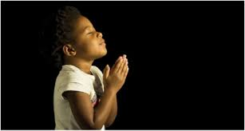
LET US PRAY….

