Slide 1
Believing
C H R I S T
Responding to John’s Gospel

Slide 2
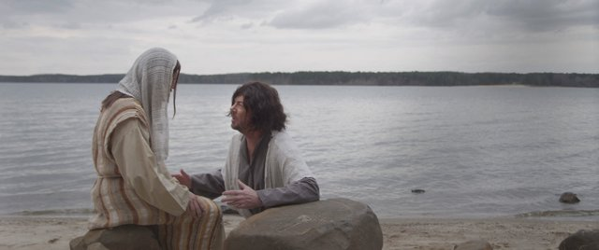
Do You Still Love Me?
John 21:15-25

Slide 3
¹⁵ When they had finished breakfast, Jesus said to Simon Peter, “Simon, son of John, do you love me more than these?” He said to him, “Yes, Lord; you know that I love you.” He said to him, “Feed my lambs.” ¹⁶ He said to him a second time, “Simon, son of John, do you love me?” He said to him, “Yes, Lord; you know that I love you.” He said to him, “Tend my sheep.” ¹⁷ He said to him the third time, “Simon, son of John, do you love me?” Peter was grieved because he said to him the third time, “Do you love me?” and he said to him, “Lord, you know everything; you know that I love you.” Jesus said to him, “Feed my sheep.”

Slide 4
¹⁸ Truly, truly, I say to you, when you were young, you used to dress yourself and walk wherever you wanted, but when you are old, you will stretch out your hands, and another will dress you and carry you where you do not want to go.” ¹⁹ (This he said to show by what kind of death he was to glorify God.) And after saying this he said to him, “Follow me.”
²⁰ Peter turned and saw the disciple whom Jesus loved following them, the one who also had leaned back against him during the supper and had said, “Lord, who is it that is going to betray you?” ²¹ When Peter saw him, he said to Jesus, “Lord, what about this man?” ²² Jesus said to him, “If it is my will that he remain until I come, what is that to you? You follow me!” ²³ So the saying spread abroad among the brothers that this disciple was not to die; yet Jesus did not say to him that he was not to die, but, “If it is my will that he remain until I come, what is that to you?”

Slide 5
²⁴ This is the disciple who is bearing witness about these things, and who has written these things, and we know that his testimony is true.
²⁵ Now there are also many other things that Jesus did. Were every one of them to be written, I suppose that the world itself could not contain the books that would be written.

Slide 6
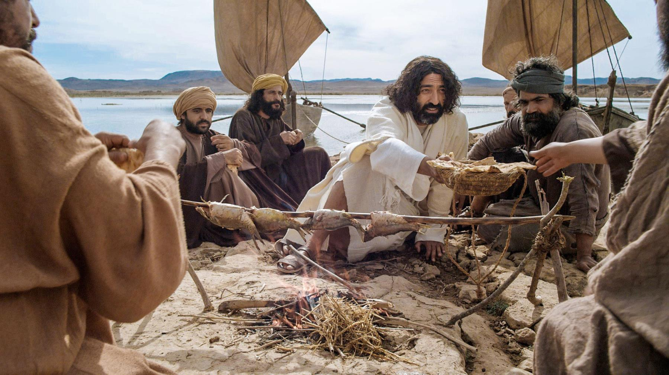

Slide 8
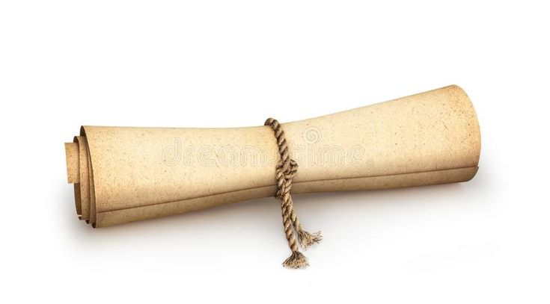

Slide 9
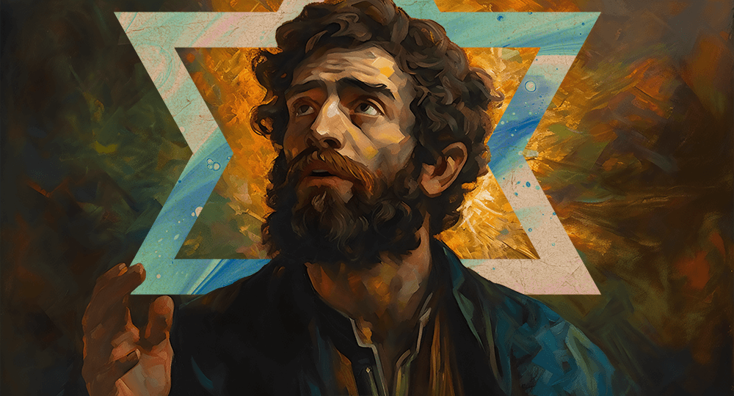
Peter -The Little Rock (Matthew 16:13-20)

Slide 10
¹⁵ When they had finished breakfast, Jesus said to Simon Peter, “Simon, son of John, do you love me more than these?” He said to him, “Yes, Lord; you know that I love you.” He said to him, “Feed my lambs.” ¹⁶ He said to him a second time, “Simon, son of John, do you love me?” He said to him, “Yes, Lord; you know that I love you.” He said to him, “Tend my sheep.” ¹⁷ He said to him the third time, “Simon, son of John, do you love me?” Peter was grieved because he said to him the third time, “Do you love me?” and he said to him, “Lord, you know everything; you know that I love you.” Jesus said to him, “Feed my sheep.”

Slide 11
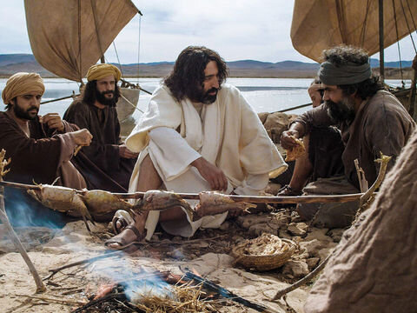

Slide 12
John 21:15-17
Peter denied him before others – Jesus now questions him before the brothers.

Slide 13
John 21:15-17
Peter denied him before others – Jesus now questions him before the brothers.
Peter is questioned the same number of times he denied Jesus.

Slide 14
John 21:15-17
Peter denied him before others – Jesus now questions him before the brothers.
Peter is questioned the same number of times he denied Jesus.
Jesus does not condemn him for his PAST - “Why did you…?” but asks him about his PRESENT relationship – “Do you love me…?”

Slide 15
The question of our love for Jesus “is the basis of all genuine Christianity… The test is not moral perfection, not academic excellence, not brilliance in ministry, not a display of spiritual gifts, not any agenda of our own, but simply a relationship with Jesus the risen Lord, one of wholehearted devotion and love for him. Jesus is interested in one thing – do we love him?”
Jey J. Kanagaraj and Ian S. Kemp, The Gospel According to John, (Singapore: Asia Theological Association, 2002), page 411 and 412.

Slide 16
John 21:15-17
4. ”Do you love me more than these?” – Who or what are the ”these” referred to? Either the other disciples, or the context of where they were – fishing boats, water, the life Peter knew.

Slide 17
John 21:15-17
4. ”Do you love me more than these?” – Who or what are the ”these” referred to – either the other disciples, or the context of where they were – fishing boats, water, the life Peter knew.
5 .Jesus and Peter use different words for love – “Agapao” and “Phileo”.

Slide 20
John 21:15-17
4. ”Do you love me more than these?” – Who or what are the ”these” referred to – either the other disciples, or the context of where they were – fishing boats, water, the life Peter knew.
5 .Jesus and Peter use different words for love – “Agapao” and “Phileo”.
6. Peter is being restored progressively back to full leadership.

Slide 21
¹⁸ Truly, truly, I say to you, when you were young, you used to dress yourself and walk wherever you wanted, but when you are old, you will stretch out your hands, and another will dress you and carry you where you do not want to go.” ¹⁹ (This he said to show by what kind of death he was to glorify God.) And after saying this he said to him, “Follow me.”
²⁰ Peter turned and saw the disciple whom Jesus loved following them, the one who also had leaned back against him during the supper and had said, “Lord, who is it that is going to betray you?” ²¹ When Peter saw him, he said to Jesus, “Lord, what about this man?” ²² Jesus said to him, “If it is my will that he remain until I come, what is that to you? You follow me!” ²³ So the saying spread abroad among the brothers that this disciple was not to die; yet Jesus did not say to him that he was not to die, but, “If it is my will that he remain until I come, what is that to you?”

Slide 23
John 21:15-25 - APPLICATION
How does Peter’s restoration speak to us today?

