Slide 1
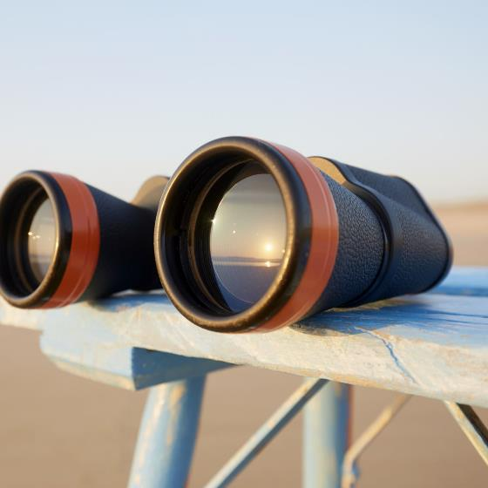
Time to Take a Test

Slide 2
Count how many times
the players wearing white
pass the basketball

Slide 4
Inattentional Blindness
People often miss unexpected events, even when they are looking directly at them, because their attention is focused on something else.

Slide 5
The Resurrection: What were they looking for?
John 20:1-31

Slide 6
Believing
C H R I S T
Responding to John’s Gospel

Slide 7
I am the bread of life (6:35)
I am the light of the world (8:12)
I am the door [of the sheep] (10:7)
I am the good shepherd (10:11, 14)
I am the resurrection and the life (11:25)
I am the way, the truth, and the life (14:6)
I am the true vine (15:1)

Slide 8
WATER TO WINE 2:1-11
HEALING OFFICIAL'S
SON 4:46-54
HEALING PARALYTIC 5:1-18
FEEDING 5000 6:1-15
WALKING ON WATER 6:16-24
HEALING BLIND MAN 9:1-7
RAISING LAZARUS 11:1-45

Slide 10
1. Mary went to the tomb looking for the body of Jesus. (1-2)

Slide 11
¹ Now on the first day of the week Mary Magdalene came to the tomb early, while it was still dark, and saw that the stone had been taken away from the tomb. ² So she ran and went to Simon Peter and the other disciple, the one whom Jesus loved, and said to them, “They have taken the Lord out of the tomb, and we do not know where they have laid him.”
John 20:1-2

Slide 12
John: Mary Magdalene
Matthew: Mary Magdalene and the other Mary
Mark: Mary Magdalene, Mary the mother of
James, and Salome
Luke: Mary Magdalene and Joanna and Mary
the mother of James and the other
women with them
Notes:
Image by jplenio1 on Freepik
https://www.freepik.com/free-photo/piano-keys_12686534.htm#fromView=image_search_similar&page=1&position=0&uuid=7f762733-a432-4f0a-a957-76dec2573b21

Slide 13
Harmonized Account
of the Resurrection

Slide 14
The resurrection accounts from the four Gospels are superbly consistent eyewitness testimonies. The central truths - that Jesus was resurrected from the dead and that the resurrected Jesus appeared to many people - are clearly taught in each of the four Gospels.
Side issues . . . . Inconsistent . . .

Slide 15
The resurrection accounts from the four Gospels are superbly consistent eyewitness testimonies. The central truths - that Jesus was resurrected from the dead and that the resurrected Jesus appeared to many people - are clearly taught in each of the four Gospels.
Side issues . . . . Inconsistent . . . it cannot be proven that the accounts are contradictory

Slide 16
You seek Jesus of Nazareth, who was crucified. He has risen; he is not here. See the place where they laid him. ⁷ But go, tell his disciples and Peter that . . .
Mark 16:6-7

Slide 17
You seek Jesus of Nazareth, who was crucified. He has risen; he is not here. See the place where they laid him. ⁷ But go, tell his disciples and Peter that . . .
Mark 16:6-7

Slide 18
¹⁰ Now it was Mary Magdalene and Joanna and Mary the mother of James and the other women with them who told these things to the apostles, ¹¹ but these words seemed to them an idle tale, and they did not believe them.
Luke 24:10-11

Slide 19
¹⁰ Now it was Mary Magdalene and Joanna and Mary the mother of James and the other women with them who told these things to the apostles, ¹¹ but these words seemed to them an idle tale, and they did not believe them.
Luke 24:10-11

Slide 20
to write an orderly account for you . . .that you may have certainty concerning the things you have been taught.
Luke 1:3-4

Slide 21
but these are written so that you may believe that Jesus is the Christ, the Son of God, and that by believing you may have life in his name.
John 20:31

Slide 22
¹ Now on the first day of the week Mary Magdalene came to the tomb early, while it was still dark, and saw that the stone had been taken away from the tomb.
John 20:1

Slide 23
² So she ran and went to Simon Peter and the other disciple, the one whom Jesus loved, and said to them, “They have taken the Lord out of the tomb, and we do not know where they have laid him.”
John 20:2

Slide 25
2. Peter and John went to the tomb looking for the body of Jesus. ( 3-10)

Slide 26
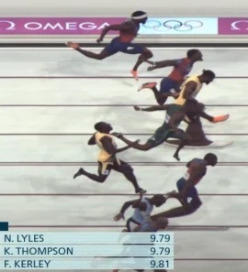
³ So Peter went out with the other disciple, and they were going toward the tomb. ⁴ Both of them were running together,
John 20:3-4
Notes:
https://www.nbcnews.com/sports/olympics/live-blog/olympic-games-2024-live-updates-rcna162869
https://olympics.com/en/news/back-to-beijing-usain-bolt-s-100m-world-record-with-an-untied-shoelace

Slide 27
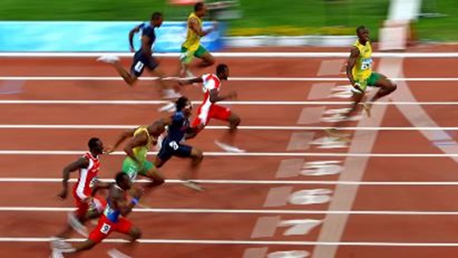
³ So Peter went out with the other disciple, and they were going toward the tomb. ⁴ Both of them were running together, but the other disciple outran Peter and reached the tomb first.
John 20:3-4
Notes:
https://www.nbcnews.com/sports/olympics/live-blog/olympic-games-2024-live-updates-rcna162869
https://olympics.com/en/news/back-to-beijing-usain-bolt-s-100m-world-record-with-an-untied-shoelace

Slide 28
³ So Peter went out with the other disciple, and they were going toward the tomb. ⁴ Both of them were running together, but the other disciple outran Peter and reached the tomb first.
⁵ And stooping to look in, he saw the
linen cloths lying there,
but he did not go in.
John 20:5
Notes:
https://www.nbcnews.com/sports/olympics/live-blog/olympic-games-2024-live-updates-rcna162869
https://olympics.com/en/news/back-to-beijing-usain-bolt-s-100m-world-record-with-an-untied-shoelace

Slide 29
⁶ Then Simon Peter came, following him, and went into the tomb.
John 20:6-9

Slide 30
⁶ Then Simon Peter came, following him, and went into the tomb. ⁸ Then the other disciple, who had reached the tomb first, also went in, and he saw and believed; ⁹ for as yet they did not understand the Scripture, that he must rise from the dead.
John 20:6-9

Slide 31
⁶ Then Simon Peter came, following him, and went into the tomb. ⁸ Then the other disciple, who had reached the tomb first, also went in, and he saw and believed; ⁹ for as yet they did not understand the Scripture, that he must rise from the dead.
1 Cor 15:4 that he was buried, that he was raised on the third day in accordance with the Scriptures,
Messiah
Isa 53:10-12
Ps 16:10
Third Day
Jonah 1:17
Hos 6:2
For you will not abandon my soul to Sheol, or let your holy one see corruption.

Slide 32
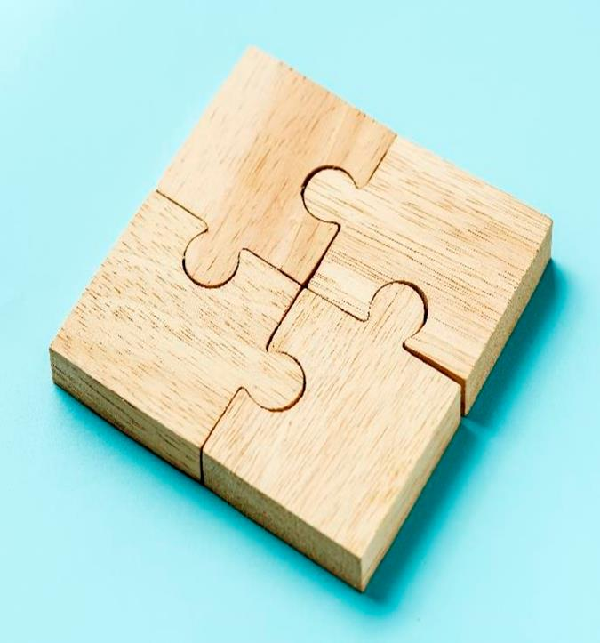
Bloom’s
Taxonomy
Evaluation
Synthesis
Analysis
Application
Comprehension
Knowledge

Slide 33
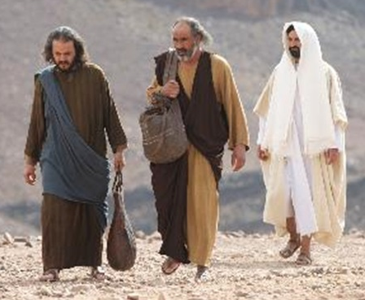
Road to
Emmaus
Comprehension
Knowledge
Notes:
https://www.freebibleimages.org/photos/lumo-emmaus/

Slide 34
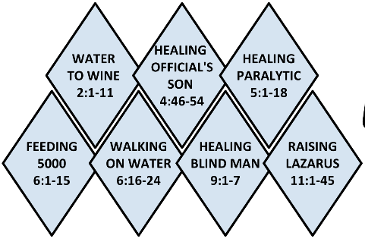
Luke 24:19-21 . . . Jesus of Nazareth, a man who was a prophet mighty in deed and word before God and all the people, ²⁰ and how our chief priests and rulers delivered him up to be condemned to death, and crucified him. ²¹ But we had hoped that he was the one to redeem Israel. Yes, and besides all this, it is now the third day since these things happened.
Knowledge

Slide 35
Luke 24:19-21 . . . Jesus of Nazareth, a man who was a prophet mighty in deed and word before God and all the people, ²⁰ and how our chief priests and rulers delivered him up to be condemned to death, and crucified him. ²¹ But we had hoped that he was the one to redeem Israel. Yes, and besides all this, it is now the third day since these things happened.
Knowledge

Slide 36
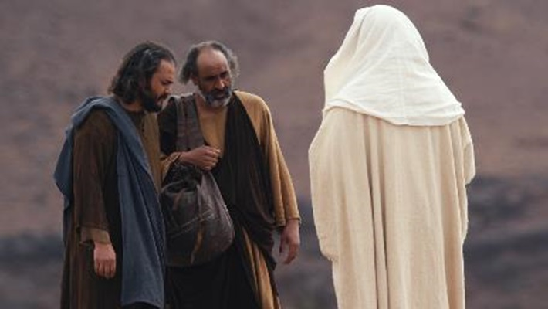
Luke 24:25-25 . . . “O foolish ones, and slow of heart to believe all that the prophets have spoken! ²⁶ Was it not necessary that the Christ should suffer these things and enter into his glory?” ²⁷ And beginning with Moses and all the Prophets, he interpreted to them in all the Scriptures the things concerning himself.
Comprehension
Knowledge
Notes:
https://www.freebibleimages.org/photos/lumo-emmaus/

Slide 37
⁶ Then Simon Peter came, following him, and went into the tomb. ⁸ Then the other disciple, who had reached the tomb first, also went in, and he saw and believed; ⁹ for as yet they did not understand the Scripture, that he must rise from the dead. ¹⁰ Then
the disciples went back to their homes.
John 20:6-10

Slide 38
The Empty Tomb Revealed the Resurrection
Prompting Belief Despite Confusion and Uncertainty!
Notes:
https://www.freebibleimages.org/illustrations/gnpi-101-jesus-resurrection/

Slide 40
3. Mary continued to look for Jesus (11-18)

Slide 41
¹¹ But Mary stood weeping outside the tomb, and as she wept she stooped to look into the tomb. ¹² And she saw two angels in white, sitting where the body of Jesus had lain, one at the head and one at the feet.
¹³ They said to her, “Woman, why are you weeping?” She said to them, “They have taken away my Lord, and I do not know where they have laid him.”
John 20:11-13

Slide 42
¹⁴ Having said this, she turned around and saw Jesus standing, but she did not know that it was Jesus.
¹⁵ Jesus said to her, “Woman, why are you weeping? Whom are you seeking?” Supposing him to be the gardener, she said to him, “Sir, if you have carried him away, tell me where you have laid him, and I will take him away.”
John 20:14-15

Slide 43
¹⁶ Jesus said to her, “Mary.” She turned and said to him in Aramaic, “Rabboni!” (which means Teacher).
¹⁷ Jesus said to her, “Do not cling to me, for I have not yet ascended to the Father; but go to my brothers and say to them, ‘I am ascending to my Father and your Father, to my God and your God.’”
John 20:16-17

Slide 44
¹⁶ Jesus said to her, “Mary.” She turned and said to him in Aramaic, “Rabboni!” (which means Teacher).
¹⁷ Jesus said to her, “Do not cling to me, for I have not yet ascended to the Father; but go to my brothers and say to them, ‘I am ascending to my Father and your Father, to my God and your God.’”
John 20:16-17

Slide 45
Through His resurrection, believers now have direct access to God as their Father
Notes:
https://www.freebibleimages.org/illustrations/gnpi-101-jesus-resurrection/

Slide 46
Exo 6:7 I will take you to be my people, and I will be your God,
Lev 26:12 And I will walk among you and will be your God, and you shall be my people
Ruth 1:16 Your people shall be my people, and your God my God.
Hosea 1:9 And the Lord said, “Call his name Not My People, for you are not my people, and I am not your God.”
Hosea 4:6 My people are destroyed for lack of knowledge; because you have rejected knowledge, I reject you from being a priest to me. And since you have forgotten the law of your God, I also will forget your children.

Slide 47
Jer 11:4 Listen to my voice, and do all that I command you. So shall you be my people, and I will be your God,
Jer 30:22 And you shall be my people, and I will be your God.”
Jer 31:31-33 “Behold, the days are coming, declares the Lord, when I will make a new covenant . . . 33 . . . I will put my law within them, and I will write it on their hearts. And I will be their God, and they shall be my people.

Slide 48
Luke 22:20 And likewise the cup after they had eaten, saying, “This cup that is poured out for you is the new covenant in my blood.
2 Cor 3:6 who has made us sufficient to be ministers of a new covenant, not of the letter but of the Spirit. For the letter kills, but the Spirit gives life.
Hebrews 9:15 Therefore he is the mediator of a new covenant, so that those who are called may receive the promised eternal inheritance, since a death has occurred that redeems them from the transgressions committed under the first covenant.

Slide 49
¹⁸ Mary Magdalene went and announced to the disciples, “I have seen the Lord”—and that he had said these things to her.
John 20:18

Slide 50
The Empty Tomb Revealed the Resurrection
Prompting Belief Despite Confusion and Uncertainty!
Through His resurrection, believers now have direct access to God as their Father

Slide 52
4. Disciples are looking for Jesus
by hiding in a locked room (19-23)

Slide 53
¹⁹ On the evening of that day, the first day of the week, the doors being locked where the disciples were for fear of the Jews,
John 20:19-20

Slide 54
Bloom’s
Taxonomy
Evaluation
Synthesis
Analysis
Application
Comprehension
Knowledge

Slide 55
Bloom’s
Taxonomy
Evaluation
Synthesis
Analysis
Application
Comprehension
Knowledge

Slide 56
¹⁹ On the evening of that day, the first day of the week, the doors being locked where the disciples were for fear of the Jews, Jesus came and stood among them and said to them, “Peace be with you.” ²⁰ When he had said this, he showed them his hands and his side. Then the disciples were glad when they saw the Lord.
1 John 1:1 We proclaim to you the one who existed from the beginning, whom we have heard and seen. We saw him with our own eyes and touched him with our own hands. He is the Word of life.
John 20:19-20

Slide 57
²¹ Jesus said to them again, “Peace be with you. As the Father has sent me, even so I am sending you.”
“sent me” Matt – 1x
Mark – 1x
Luke – 3x
John – 34x
John 7:16 So Jesus answered them, “My teaching is not mine, but his who sent me.
John 7:29 I know him, for I come from him, and he sent me.”
John 17:17-18 Sanctify them in the truth; your word is truth. As you sent me into the world, so I have sent them into the world.
ἀποστέλλω
apostellō

Slide 58
²¹ Jesus said to them again, “Peace be with you. As the Father has sent me, even so I am sending you.” ²² And when he had said this, he breathed on them and said to them, “Receive the Holy Spirit. ²³ If you forgive the sins of any, they are forgiven them; if you withhold forgiveness from any, it is withheld.”
John 20:21-23

Slide 59
Matt 4:17 From then on Jesus began to preach, “Repent of your sins and turn to God, for the Kingdom of Heaven is near.”
Matt 16:19 I will give you the keys of the kingdom of heaven, and whatever you bind on earth shall be bound in heaven, and whatever you loose on earth shall be loosed in heaven.”

Slide 60
Matt 28:18-20 ¹⁸ Jesus came and told his disciples, “I have been given all authority in heaven and on earth. ¹⁹ Therefore, go and make disciples of all the nations, baptizing them in the name of the Father and the Son and the Holy Spirit. ²⁰ Teach these new disciples to obey all the commands I have given you. And be sure of this: I am with you always, even to the end of the age.”

Slide 61
The Empty Tomb Revealed the Resurrection (1-10)
Prompting Belief Despite Confusion and Uncertainty!
Through His resurrection, believers now have direct access to God as their Father (11-18)
Disciples are empowered to be apostles and continue Jesus’ mission (19-23)

Slide 63
5. Thomas was looking for proof of Jesus’ resurrection

Slide 64
²⁴ Now Thomas, one of the twelve, called the Twin, was not with them when Jesus came. ²⁵ So the other disciples told him, “We have seen the Lord.” But he said to them, “Unless I see in his hands the mark of the nails, and place my finger into the mark of the nails, and place my hand into his side, I will never believe.”
John 20:24-25

Slide 65
F O M O
ear
f
issing
ut
Inattentive
Blindness

Slide 66
²⁶ Eight days later, his disciples were inside again, and Thomas was with them. Although the doors were locked, Jesus came and stood among them and said, “Peace be with you.” ²⁷ Then he said to Thomas, “Put your finger here, and see my hands; and put out your hand, and place it in my side.
John 20:26-27

Slide 67
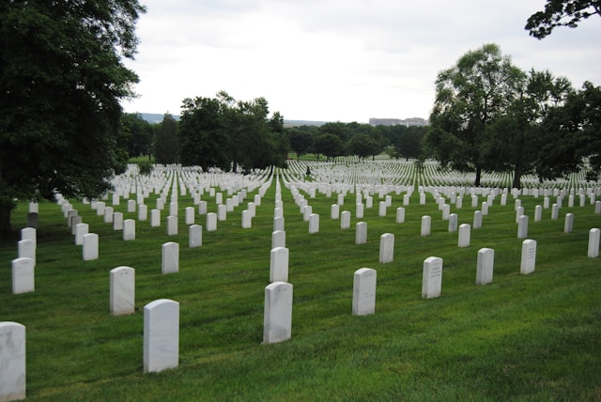
“Let’s go, too—and die with Jesus.”
John 11:16
Notes:
https://unsplash.com/photos/white-cross-on-green-grass-field-during-daytime-ESBjOXo2ens

Slide 68
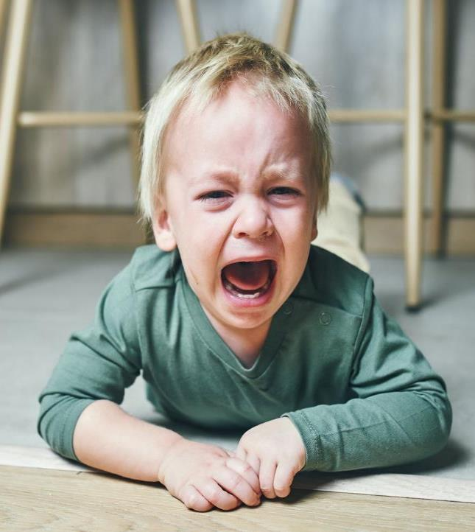
“No, we don’t know, Lord,” Thomas said. “We have no idea where you are going, so how can we know the way?”
John 14:5
Notes:
https://www.huffpost.com/entry/how-to-deal-temper-tantrums_l_621d138fe4b06e1cc5938c39

Slide 69
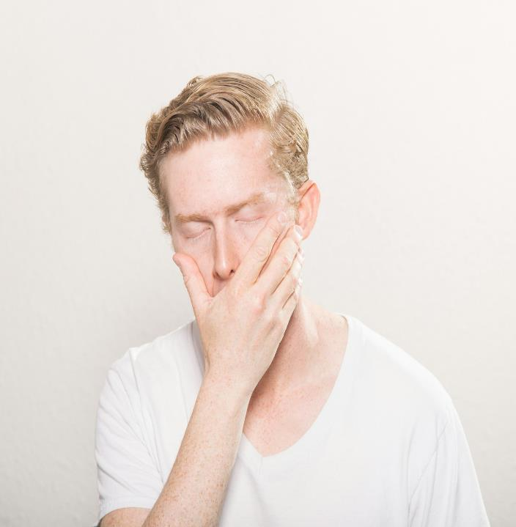
“. . . “I won’t believe it unless I see the nail wounds in his hands, put my fingers into them, and place my hand into the wound in his side.”
John 20:25
Notes:
https://unsplash.com/photos/man-covering-his-mouth-uFjORuZQczQ

Slide 70
²⁶ Eight days later, his disciples were inside again, and Thomas was with them. Although the doors were locked, Jesus came and stood among them and said, “Peace be with you.” ²⁷ Then he said to Thomas, “Put your finger here, and see my hands; and put out your hand, and place it in my side. Do not disbelieve, but believe.”
John 20:26-27

Slide 71
The Empty Tomb Revealed the Resurrection (1-10)
Prompting Belief Despite Confusion and Uncertainty!
Through His resurrection, believers now have direct access to God as their Father (11-18)
Disciples are empowered to be apostles and continue Jesus’ mission (19-23)
Trust in what is true, even if it
challenges our expectations (24-31)

Slide 72
²⁸ Thomas answered him, “My Lord and my God!”
²⁹ Jesus said to him, “Have you believed because you have seen me? Blessed are those who have not seen and yet have believed.”
John 20:28-29

Slide 73
Mary went to the tomb looking for the body of Jesus.
Peter and John went to the tomb looking for the body of Jesus.
Mary continued to look for Jesus.
Disciples are looking for Jesus by hiding in a locked room.
Thomas was looking for proof of Jesus’ resurrection.

Slide 74
Have you found what you are looking for?

Slide 75
³⁰ Now Jesus did many other signs in the presence of the disciples, which are not written in this book; ³¹ but these are written so that you may believe that Jesus is the Christ, the Son of God, and that by believing you may have life in his name.
John 20:30-31

