Slide 1
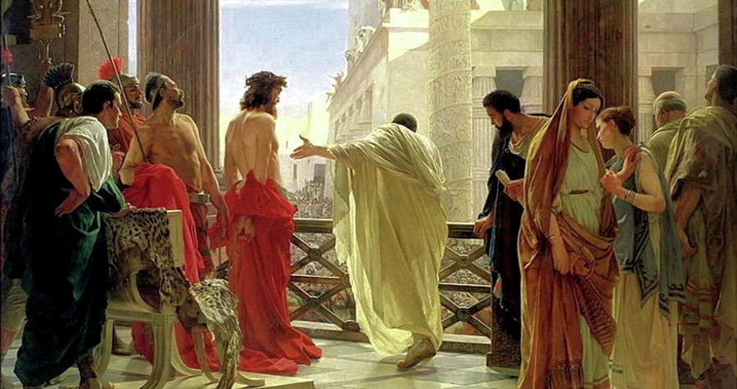
Take Me to the Pilate
-the trial of the indecisive-
John 18:28-19:16

Slide 2
Whether we want to or not, we must decide about Christ, (18:28-32)
Deuteronomy 21:22-23
²² “And if a man has committed a crime punishable by death and he is put to death, and you hang him on a tree, ²³ his body shall not remain all night on the tree, but you shall bury him the same day, for a hanged man is cursed by God. You shall not defile your land that the Lord your God is giving you for an inheritance.

Slide 3
Whether we want to or not, we must decide about Christ, (18:28-32)
Whether we listen to it or not, we will hear the truth (18:33-38)
Whether we know it or not, we tend to avoid commitment to Christ (18:38-19:8)

Slide 4
Avoidance tactic 1: I get out of this, and no one gets hurt (38-40)
Avoidance tactic 2: I get out of this, and someone gets a little hurt (1-8)
Avoidance tactic 3: I get out of this by letting someone else make a decision (9-11)

Slide 5
Whether we want to or not, we must decide about Christ, (18:28-32)
Whether we listen to it or not, we will hear the truth (18:33-38)
Whether we know it or not, we tend to avoid commitment to Christ (18:38-19:8)
We make excuses for our decisions: I had no choice (19:12-16)

Slide 6
“A study of the attitudes of Pilate thus reveals that he passed from perfunctory official indifference through curiosity to intense personal concern, and then, because he did not dare to act on what he knew was right, he gave way to hesitation, fear, arrogance, and bitterness. He was aroused by Jesus’ presence and bearing, but he was reluctant to conform to the truth as the occasion presented it, and so he lost Jesus altogether. The story of Pilate is the tragedy of unbelief.”
Merrill Tenney

