Slide 1
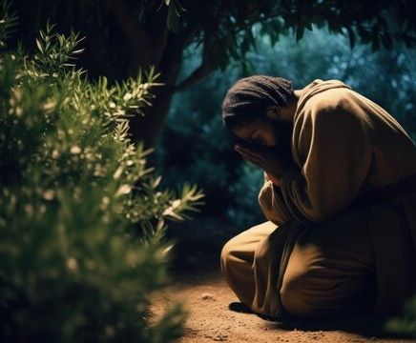

Jesus Prays
The intercession of Christ on behalf of his disciples
John 17:1-26

Slide 2
Luke 22:31-32
31 “Simon, Simon, behold, Satan demanded to have you, that he might sift you like wheat, 32 but I have prayed for you that your faith may not fail. And when you have turned again, strengthen your brothers.”
Hebrews 5:7
In the days of his flesh, Jesus offered up prayers and supplications, with loud cries and tears, to him who was able to save him from death, and he was heard because of his reverence.

Slide 3
Hebrews 7:25
Consequently, he is able to save to the uttermost those who draw near to God through him, since he always lives to make intercession for them.
Romans 8:34
Who is condemn? Christ Jesus is the one who died – more than that, who was raised -who is at the right hand of God, who indeed is interceding for us

Slide 4
Jesus prays that his work will be honored (vs. 1-5)
Jesus is honored by completing atonement for sin (1)
Jesus is honored by granting knowledge of God to select people (2-3)
Jesus is honored by restoring his preexisting glory (4-5)

Slide 5
Jesus prays that his work will be honored (vs. 1-5)
Jesus prays that the disciples will be matured in faith and prepared for mission (vs. 6-19)
He prays for their preservation for the purpose of unity (13)
He prays for holiness for the purpose of mission (14-19)

Slide 6
The Work of Christ to Produce His Church
Jesus comes into the world –
some believe; some do not
Jesus prays that the Father is glorified by his atoning sacrifice
Those believing in him know God and are part of those given to the Son
Jesus prays that his disciples are kept in faith, made holy by God’s Word, and witness to the truth
Strong, holy, and unified church sent into the world to be witnesses of truth

Slide 7
Jesus prays that his work will be honored (vs. 1-5)
Jesus prays that the disciples will be matured in faith and prepared for mission (vs. 6-19)
Jesus prays that future disciples will be unified for effective mission (vs. 20-26)
He prays for repeated unity so that the mission will continue (20-23)
He prays that the church will be focused on the hope for the future in heavenly glory (24)
He prays for believers to love each other (25-36)

