Slide 1
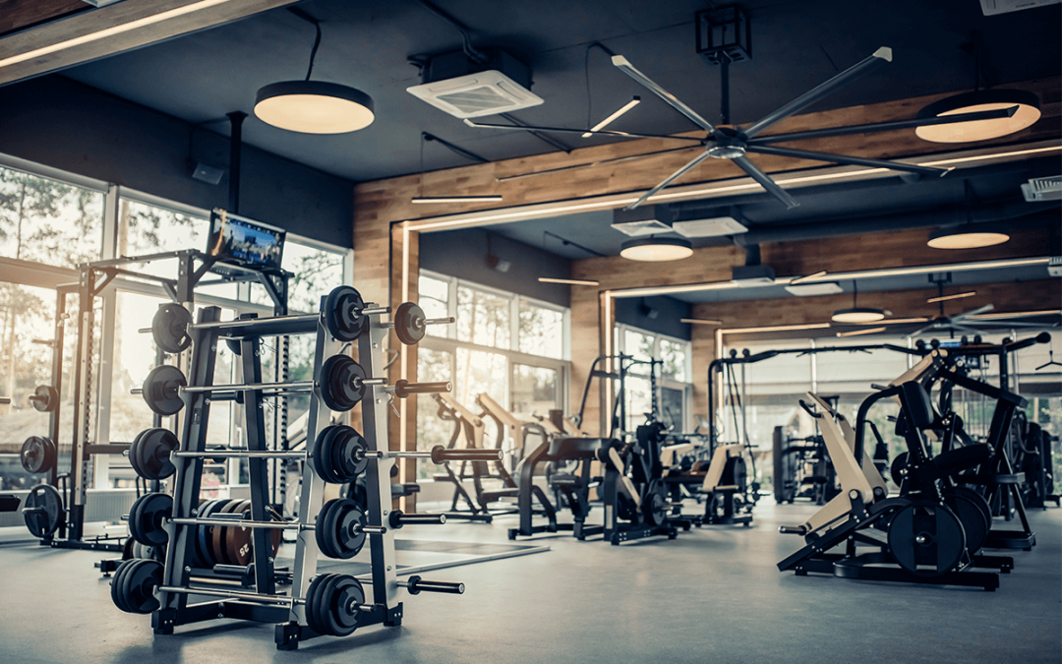
Upper Room Faith
Strengthening our Trust in Christ
John 16:4-33

Slide 2
Let me wash your feet
One of you will betray me
You will deny me
I am going away to the Father
I am the Father
I will send a Helper
You will bear fruit
The world will hate you

Slide 3
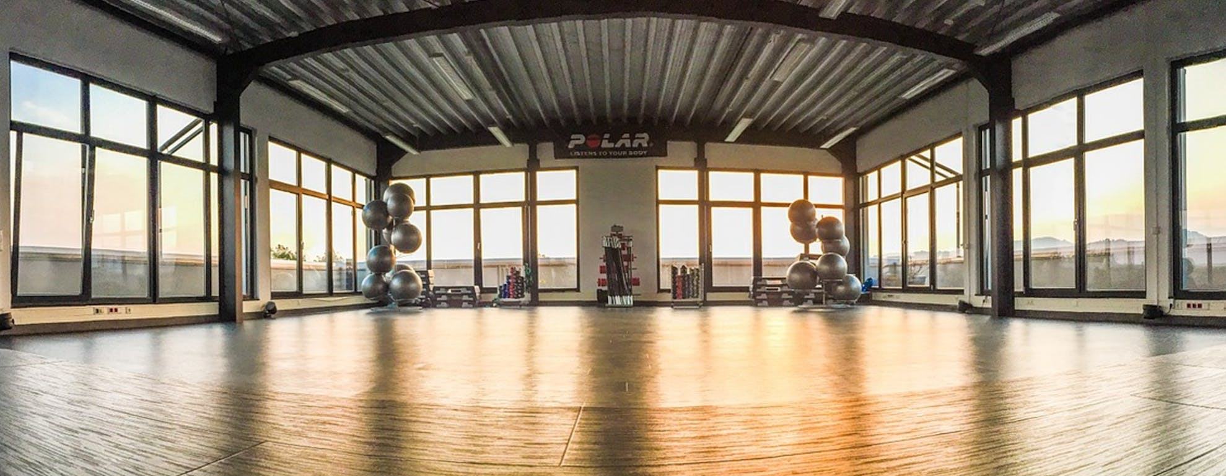
Our faith strengthens as we understand the work of the Holy Spirit (vs. 4-15)
Our faith strengthens as we wait for God to clear up confusion over traumatic events (vs. 16-22)
Our faith strengthens as we learn to pray to God with greater clarity (vs. 23-28)
Our faith strengthens through failure and suffering (vs. 29-33)

