Slide 1
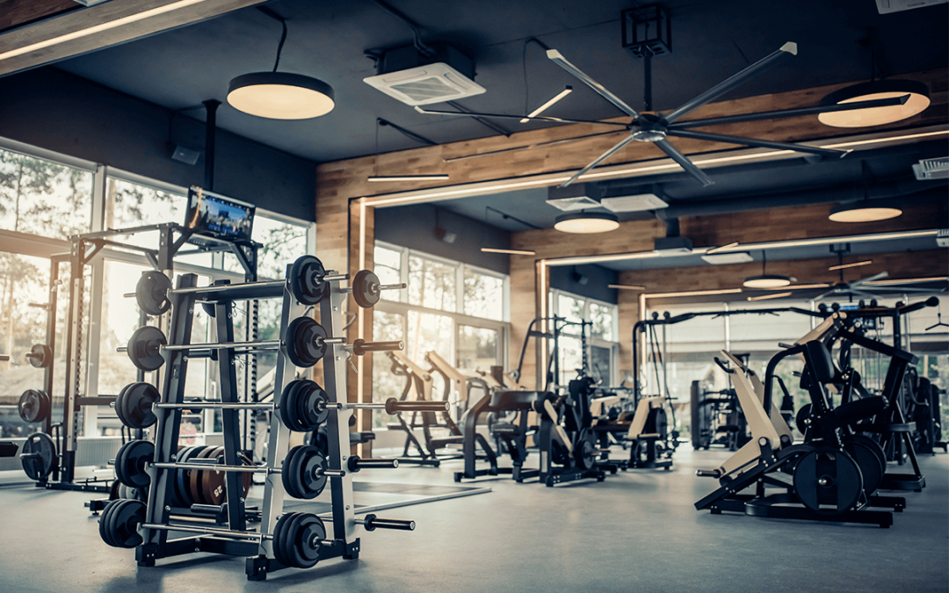
Upper Room Faith
Strengthening our Trust in Christ
John 16:4-33

Slide 2
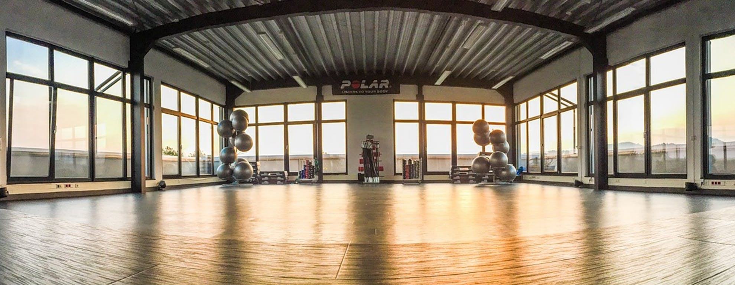
Our faith strengthens as we understand the work of the Holy Spirit (vs. 4-15)
The Holy Spirit is necessary to fulfill God’s work (vs. 4-7)
The Holy Spirit works to convict unbelievers (vs. 8-11)
“He will not simply convict the world as sinful, as without righteousness, as under judgment, but He will shew beyond contradiction that it is wanting in the knowledge of what sin, righteousness, and judgment really are; and therefore in need of a complete change.”
B. F. Westcott

Slide 3
Our faith strengthens as we understand the work of the Holy Spirit (vs. 4-15)
The Holy Spirit is necessary to fulfill God’s work (vs. 4-7)
The Holy Spirit works to convict unbelievers (vs. 8-11)
He convicts people that they lack righteousness in themselves (9)
“If Jesus is the Son of God, as this Gospel declares him to be, then rejection of Him is the greatest and most fatal sin of all. Such sin is the product of an ingrained distaste for righteousness. It is the deliberate refusal of God’s will. It cannot be attributed to ignorance only, or to misfortune, or to fate, or to any one of a thousand reasons by which men excuse their behavior; for Christ is self-authenticating, and those who reject Him do so because they do not want Him.”
Merrill Tenney

Slide 4
Our faith strengthens as we understand the work of the Holy Spirit (vs. 4-15)
The Holy Spirit is necessary to fulfill God’s work (vs. 4-7)
The Holy Spirit works to convict unbelievers (vs. 8-11)
He convicts people that they lack righteousness in themselves (9)
He convicts people that Jesus is the only righteousness that God accepts (10)

Slide 5
Hebrews 1:3
He is the radiance of the glory of God and the exact imprint of his nature, and he upholds the universe by the word of his power. After making purification for sins, he sat down at the right hand of the Majesty on high,
Hebrews 10:12
But when Christ had offered for all time a single sacrifice for sins, he sat down at the right hand of God
Hebrews 12:2
looking to Jesus, the founder and perfecter of our faith, who for the joy that was set before him endured the cross, despising the shame, and is seated at the right hand of the throne of God.

Slide 6
Our faith strengthens as we understand the work of the Holy Spirit (vs. 4-15)
The Holy Spirit is necessary to fulfill God’s work (vs. 4-7)
The Holy Spirit works to convict unbelievers (vs. 8-11)
He convicts people that they lack righteousness in themselves (9)
He convicts people that Jesus is the only righteousness that God accepts (10)
He convicts people that his death on the cross took their judgment (11)

Slide 7
Our faith strengthens as we understand the work of the Holy Spirit (vs. 4-15)
The Holy Spirit is necessary to fulfill God’s work (vs. 4-7)
The Holy Spirit works to convict unbelievers (vs. 8-11)
The Holy Spirit works to confirm believers (vs. 12-15)

