Slide 1
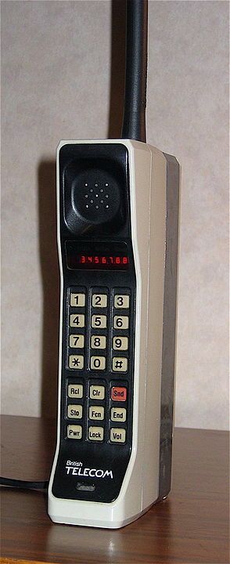
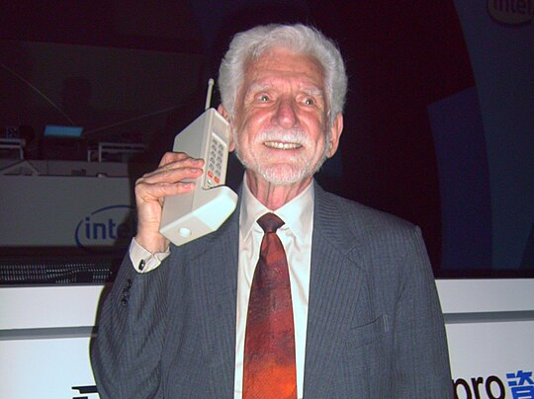
Notes:
By Rico Shen, CC BY-SA 3.0, https://commons.wikimedia.org/w/index.php?curid=2205234
By Redrum0486 - http://en.wikipedia.org/wiki/File:DynaTAC8000X.jpg, CC BY-SA 3.0, https://commons.wikimedia.org/w/index.php?curid=6421950

Slide 2
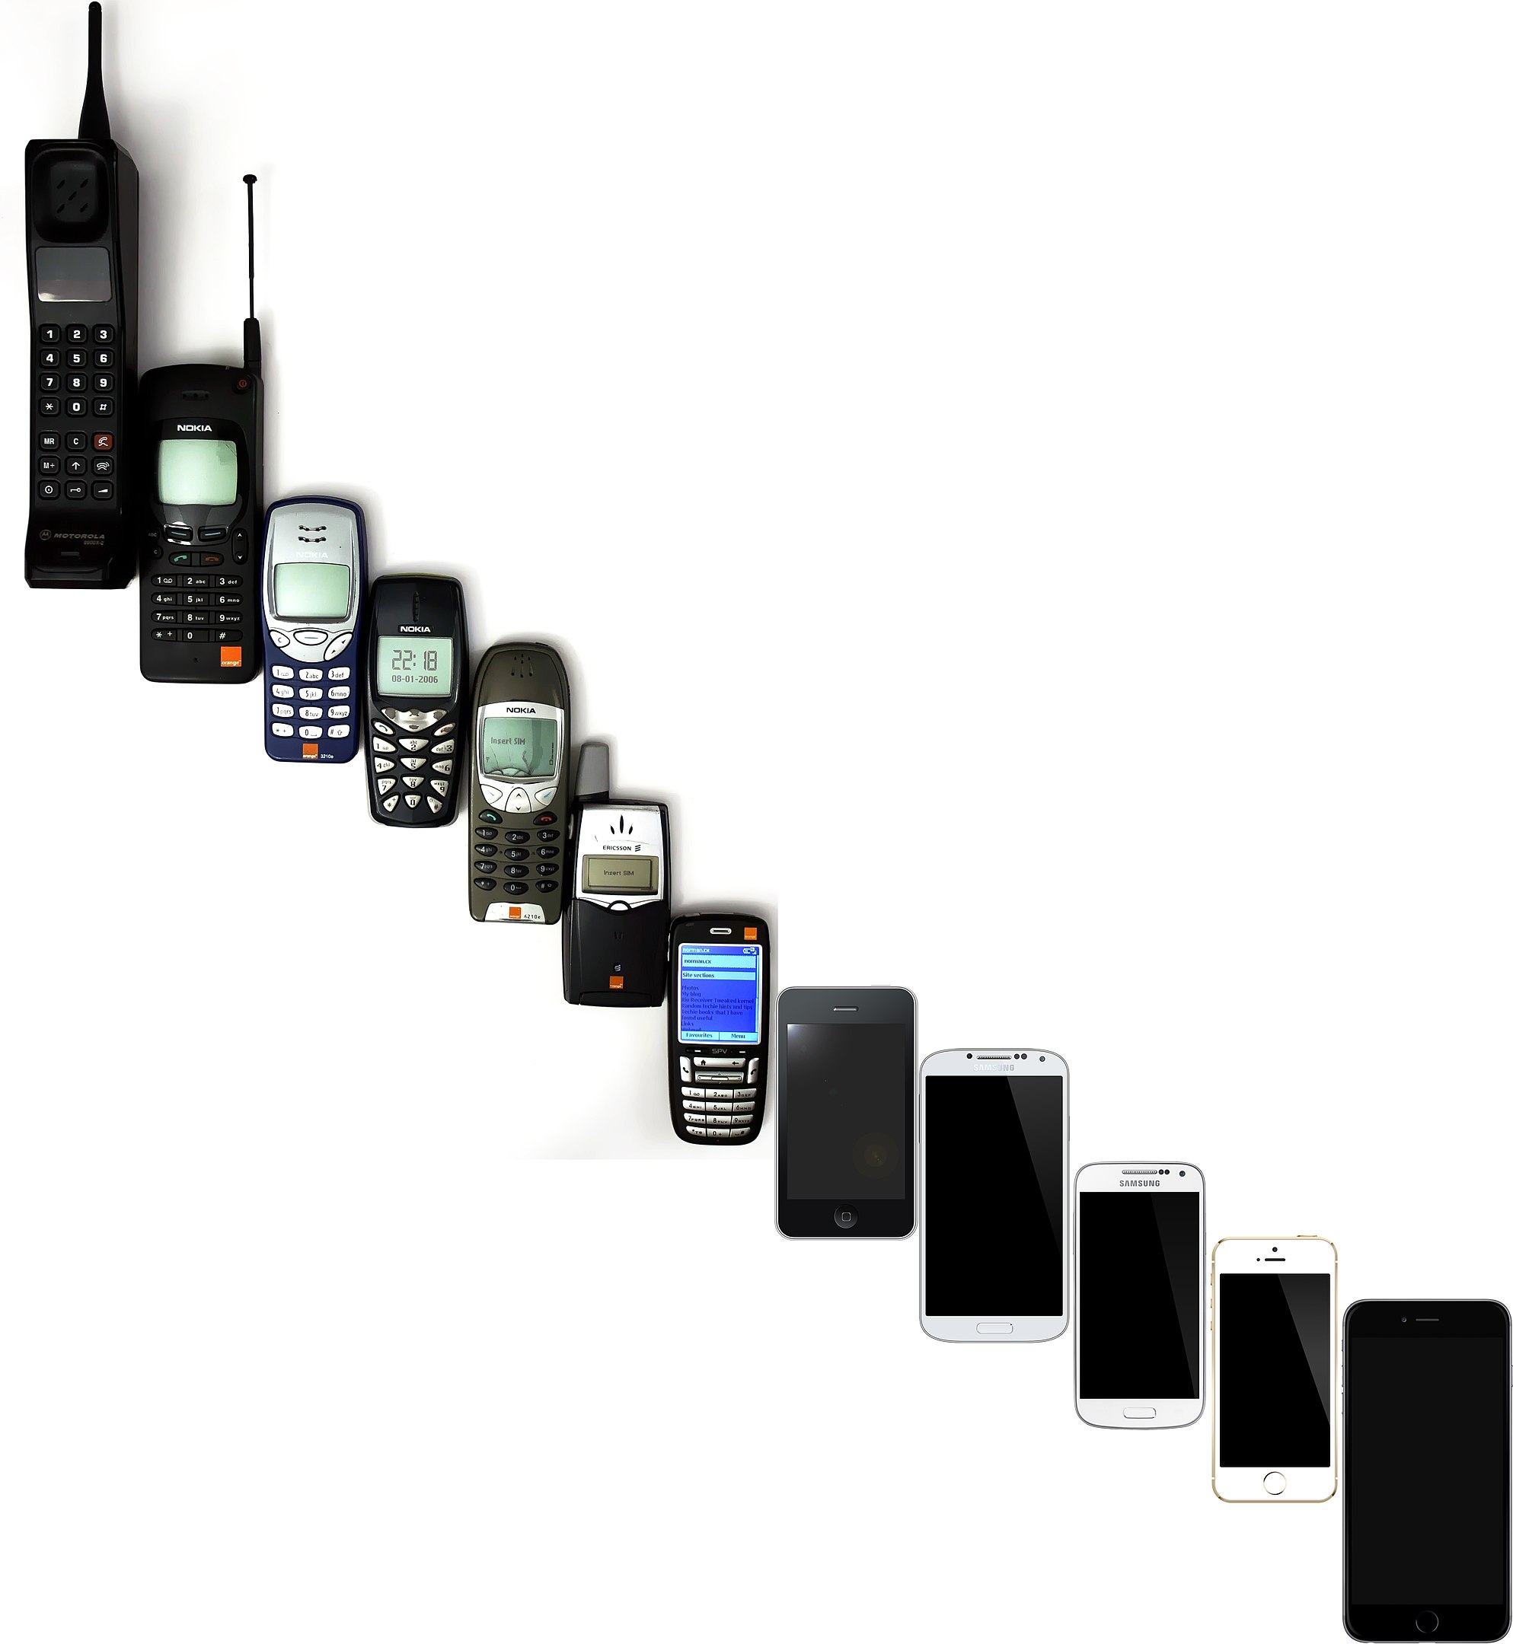
Evolution of Hand Phones
Notes:
By Jojhnjoy Public Domain https://en.wikipedia.org/wiki/Mobile_phone#/media/File:Mobile_Phone_Evolution_1992_-_2014.jpg

Slide 3
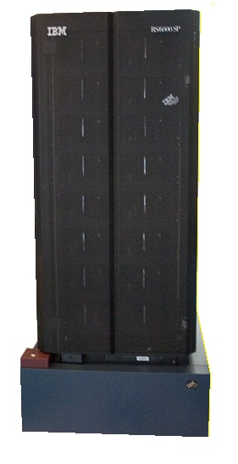
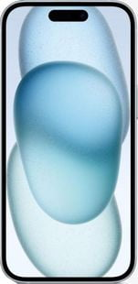
IBM Deep Blue
1997
11.38 GFLOPS
Iphone 15
2023
~1800 GFLOPS
Notes:
By James the photographer - https://www.flickr.com/photos/22453761@N00/592436598/, CC BY 2.0, https://commons.wikimedia.org/w/index.php?curid=3511068
https://nanoreview.net/en/phone/apple-iphone-15

Slide 4
Notes:
https://nanoreview.net/en/phone/apple-iphone-15

Slide 5
²⁶ Then God said, “Let us make mankind in our image, . . .
²⁷ So God created mankind in his own image, in the image of God he created them; male and female he created them.
Gen 1:26-27 (NIV)
Notes:
https://en.wikipedia.org/wiki/The_Creation_of_Adam#/media/File:Michelangelo_-_Creation_of_Adam_(cropped).jpg
Public Domain

Slide 6
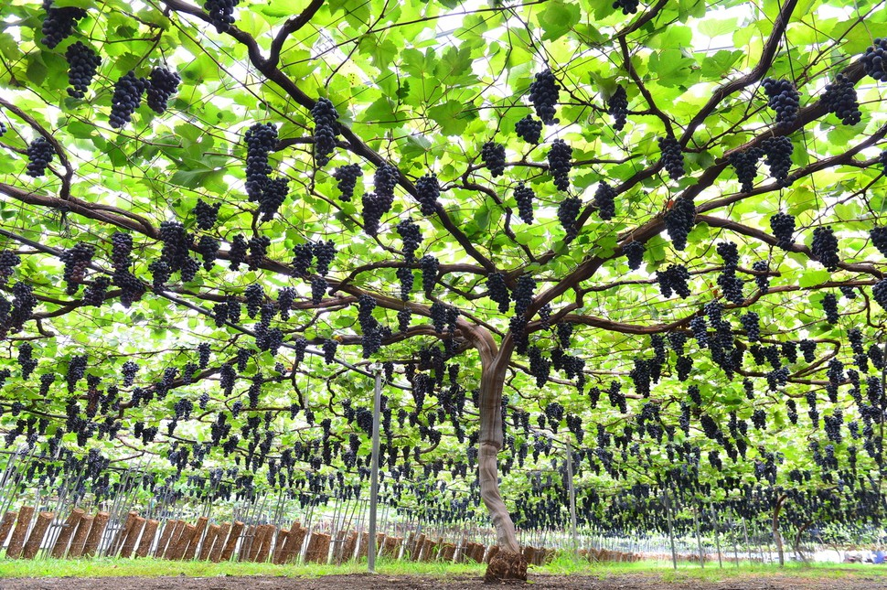
Remain In Me: Living and Loving through Christ
John 15:1-17
Notes:
https://www.flickr.com/photos/4thglryofgod/8609030890

Slide 7
Believing
C H R I S T
Responding to John’s Gospel

Slide 8
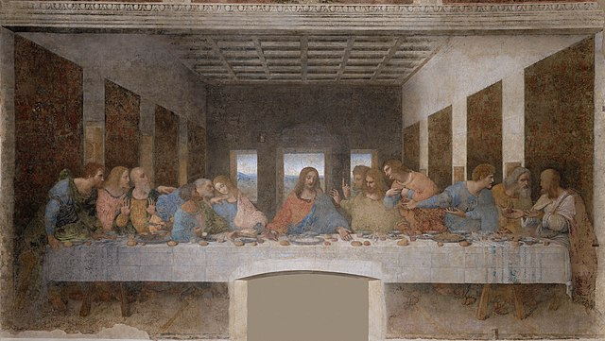
The Last Supper
Notes:
https://en.wikipedia.org/wiki/The_Last_Supper_(Leonardo)#/media/File:%C3%9Altima_Cena_-_Da_Vinci_5.jpg

Slide 9
The Last Supper in John’s Gospel
John 13:1-17 Jesus washes disciples' feet
John 13:18-30 Jesus predicts Judas' betrayal
John 13:31-38 Jesus predicts Peter's denial
Jesus' farewell discourse
John 14:1-14 Jesus as the way, truth, and the light
John 14:15-31 Jesus promises the Holy Spirit
John 15:1-17 Jesus as the true vine
John 15:18-27 World's hatred for Jesus (and followers)
John 16:1-15 Persecution and work of the Holy Spirit
John 16:16-33 Sadness turned to Joy

Slide 10
An Unending
Hope
John 14:1-15
1. The source of our hope
2. The means of our hope
3. The glory of our hope
1. Love explained:
examples of love
2. Love exposed:
the revelation of love
3. Love experienced:
The outcome of love
Love
Actually
John 14:15-31

Slide 11
Heaven ─ The Father's House
Jesus ─The Father's Reflection
Faith ─ The Father's Glory
Holy Spirit
─ The Father's Counselor
Peace ─ The Father's Gift
1. The source of our hope
2. The means of our hope
3. The glory of our hope
1. Love explained:
examples of love
2. Love exposed:
the revelation of love
3. Love experienced:
The outcome of love

Slide 12
Staying in Sync with the Source (1-8)
Spreading the Love (9-17)
Remain In Me: Living and Loving through Christ
John 15:1-17
Notes:
https://www.flickr.com/photos/4thglryofgod/8609030890

Slide 13
¹ “I am the true vine, and my Father is the gardener.
Before After
Notes:
https://www.starkbros.com/growing-guide/how-to-grow/berry-plants/grape-vines/pruning

Slide 14
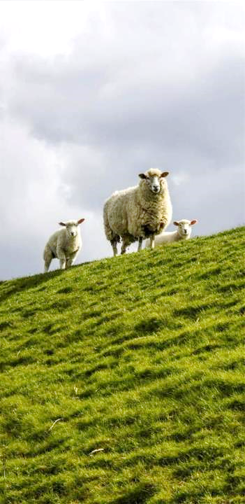
ἐγώ εἰμί
I am the bread of life (6:35)
I am the light of the world (8:12)
I am the door [of the sheep] (10:7)
I am the good shepherd (10:11, 14)
I am the resurrection and the life (11:25)
I am the way, the truth, and the life (14:6)
I am the true vine (15:1)

Slide 15
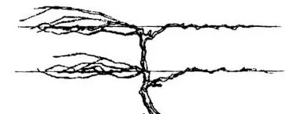
¹ “I am the true vine, and my Father is the gardener. ² He cuts off every branch in me that bears no fruit, while every branch that does bear fruit he prunes so that it will be even more fruitful.
Before After
Notes:
https://www.starkbros.com/growing-guide/how-to-grow/berry-plants/grape-vines/pruning

Slide 16
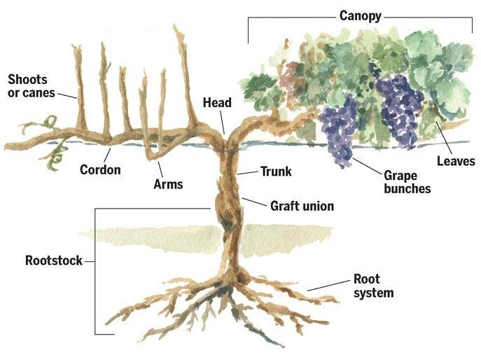
God
Jesus
Notes:
https://www.evineyardapp.com/blog/2017/05/30/overview-of-grapevine-structure-and-function/

Slide 17
¹ “I am the true vine, and my Father is the gardener. ² He cuts off every branch in me that bears no fruit, while every branch that does bear fruit he prunes so that it will be even more fruitful. ³ You are already clean because of the word I have spoken to you.

Slide 18
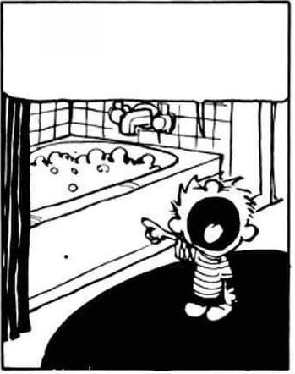
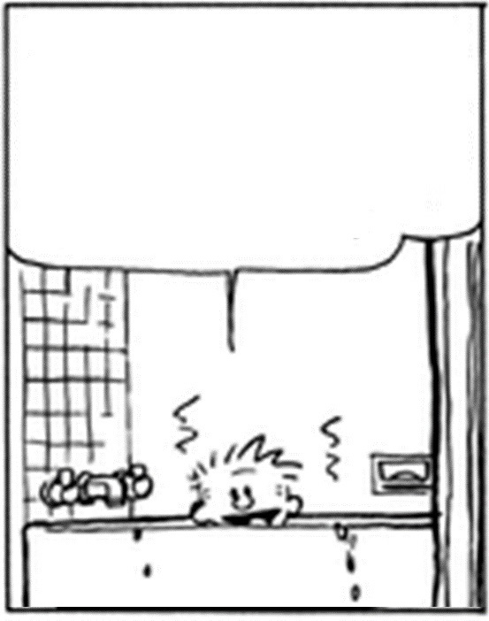
“No,” Peter protested, “you will never ever wash my feet!” John 13:8
Simon Peter exclaimed, “Then wash my hands and head as well, Lord, not just my feet!”
John 13:9
Jesus said, “Unless I wash you, you won’t belong to me.”

Slide 19
¹⁰ Jesus replied, “A person who has bathed all over does not need to wash, except for the feet, to be entirely clean.
And you disciples are clean,
but not all of you.” ¹¹ For Jesus knew who would betray him. That is what he meant when he said, “Not all of you are clean.”

Slide 20
¹ “I am the true vine, and my Father is the gardener. ² He cuts off every branch in me that bears no fruit, while every branch that does bear fruit he prunes so that it will be even more fruitful. ³ You are already clean because of the word I have spoken to you.
prune καθαίρει
clean καθαροί

Slide 21
Or “trims”; Grk “cleanses” (a wordplay with “clean” in v. 3). Καθαίρει (kathairei) is not the word one would have expected here, but it provides the transition from the vine imagery to the disciples—there is a wordplay (not reproducible in English) footnote NET
3 You have already been pruned and purified by the message I have given you. John 15:3 NLT
prune^{[f]} καθαίρει
clean καθαροί

Slide 22
¹ “I am the true vine, and my Father is the gardener. ² He cuts off every branch in me that bears no fruit, while every branch that does bear fruit he prunes so that it will be even more fruitful. ³ You are already clean because of the word I have spoken to you. ⁴ Remain in me, as I also remain in you.

Slide 23
Staying in Sync with the Source (1-8)
Remain In Me: Living and Loving through Christ
John 15:1-17
Notes:
https://www.flickr.com/photos/4thglryofgod/8609030890

Slide 24
¹ “I am the true vine, and my Father is the gardener. ² He cuts off every branch in me that bears no fruit, while every branch that does bear fruit he prunes so that it will be even more fruitful. ³ You are already clean because of the word I have spoken to you. ⁴ Remain in me, as I also remain in you. No branch can bear fruit by itself; it must remain in the vine. Neither can you bear fruit unless you remain in me.

Slide 25
¹ “I am the true vine, and my Father is the gardener. ² He cuts off every branch in me that bears no fruit, while every branch that does bear fruit he prunes so that it will be even more fruitful. ³ You are already clean because of the word I have spoken to you. ⁴ Remain in me, as I also remain in you. No branch can bear fruit by itself; it must remain in the vine. Neither can you bear fruit unless you remain in me.

Slide 26
⁵ “I am the vine; you are the branches.

Slide 27
disciples
God
Jesus
Notes:
https://www.evineyardapp.com/blog/2017/05/30/overview-of-grapevine-structure-and-function/

Slide 28
⁵ “I am the vine; you are the branches. If you remain in me and I in you, you will bear much fruit; apart from me you can do nothing.

Slide 29
disciples
God
Jesus
Notes:
https://www.evineyardapp.com/blog/2017/05/30/overview-of-grapevine-structure-and-function/

Slide 30
Staying in Sync with the Source (1-8)
Remain connected to Jesus, the true vine,
for spiritual vitality and fruitfulness.
Remain In Me: Living and Loving through Christ
John 15:1-17
Notes:
https://www.flickr.com/photos/4thglryofgod/8609030890

Slide 31
⁵ “I am the vine; you are the branches. If you remain in me and I in you, you will bear much fruit; apart from me you can do nothing. ⁶ If you do not remain in me, you are like a branch that is thrown away and withers; such branches are picked up, thrown into the fire and burned.

Slide 32
disciples
God
Jesus
Notes:
https://www.evineyardapp.com/blog/2017/05/30/overview-of-grapevine-structure-and-function/

Slide 33
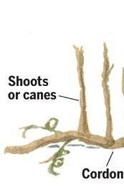
NOT believers who forfeit their salvation because of unfruitfulness.
John 10:28-29 Security of the Believer
²⁸ I give them eternal life, and they will never perish, and no one will snatch them out of my hand. ²⁹ My Father, who has given them to me, is greater than all, and no one is able to snatch them out of the Father's hand.
Notes:
https://www.evineyardapp.com/blog/2017/05/30/overview-of-grapevine-structure-and-function/
https://tenor.com/search/fire-gifs

Slide 34
NOT believers who forfeit their salvation because of unfruitfulness.
imagery of being cast into the fire constitutes a reference to eternal judgment,
Judas is example of branch that is cut off
False believers: Those who profess to belong to Jesus but who in reality do not belong to him
Notes:
https://www.evineyardapp.com/blog/2017/05/30/overview-of-grapevine-structure-and-function/
https://tenor.com/search/fire-gifs

Slide 35
⁵ “I am the vine; you are the branches. If you remain in me and I in you, you will bear much fruit; apart from me you can do nothing. ⁶ If you do not remain in me, you are like a branch that is thrown away and withers; such branches are picked up, thrown into the fire and burned. ⁷ If you remain in me and my words remain in you, ask whatever you wish, and it will be done for you. ⁸ This is to my Father’s glory, that you bear much fruit, showing yourselves to be my disciples.

Slide 36
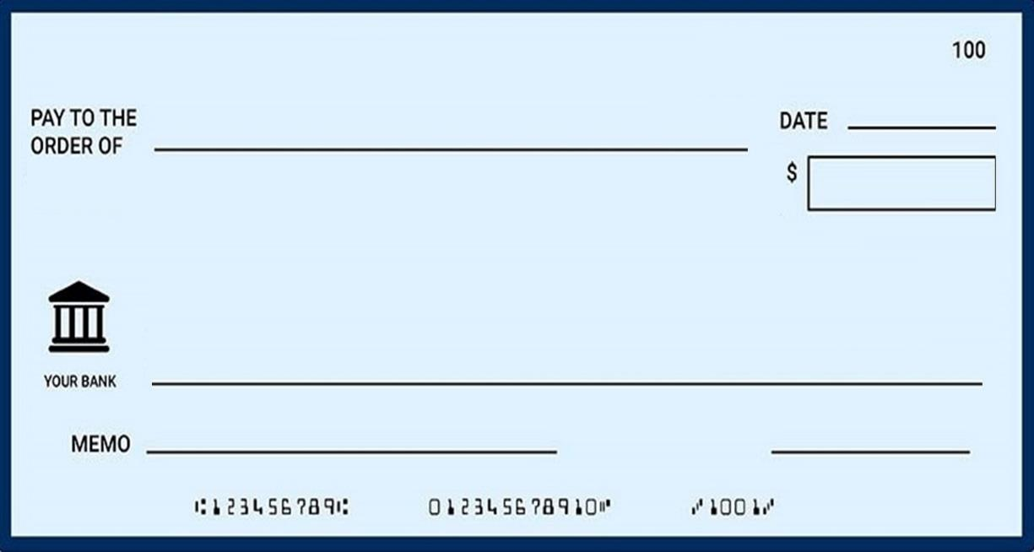
⁷ If you remain in me and
my words remain in you,
ask whatever you wish, and it will be done for you.
John 15:7
^{Signature}
Notes:
https://onlinecheckwriter.com/what-is-a-blank-check/

Slide 37
¹² “Truly, truly, I say to you, whoever believes in me . . .
¹³ Whatever you ask in my name,
this I will do, that the Father may be glorified in the Son. ¹⁴ If you ask me anything in my name, I will do it.
John 14:12-14
^{Signature}
Notes:
https://onlinecheckwriter.com/what-is-a-blank-check/

Slide 38
Ch 14 believes => do works
=>Father Glorified
Ch 14 love => keep my commandments.
=> Helper => peace
Ch 15 remain => bear fruit

Slide 39
⁵ “I am the vine; you are the branches. If you remain in me and I in you, you will bear much fruit; apart from me you can do nothing. ⁶ If you do not remain in me, you are like a branch that is thrown away and withers; such branches are picked up, thrown into the fire and burned. ⁷ If you remain in me and my words remain in you, ask whatever you wish, and it will be done for you. ⁸ This is to my Father’s glory, that you bear much fruit, showing yourselves to be my disciples.

Slide 40
Ch 14 believes => do works
=>Father Glorified
Ch 14 love => keep my commandments.
=> Helper => peace
Ch 15 remain => bear fruit
=> Father Glorified

Slide 41
Staying in Sync with the Source (1-8)
Remain connected to Jesus, the true vine,
for spiritual vitality and fruitfulness.
Remain In Me: Living and Loving through Christ
John 15:1-17
Notes:
https://www.flickr.com/photos/4thglryofgod/8609030890

Slide 42
Staying in Sync with the Source (1-8)
Spreading the Love (9-17)
Remain In Me: Living and Loving through Christ
John 15:1-17
Notes:
https://www.flickr.com/photos/4thglryofgod/8609030890

Slide 43
⁹ “As the Father has loved me, so have I loved you.
John 14:15-16 ¹⁵ “If you love me, you will keep my commandments. ¹⁶ And I will ask the Father, and he will give you another Helper, to be with you forever,
Love explained: examples of love (15-17)

Slide 44
⁹ “As the Father has loved me, so have I loved you. Now remain in my love. ¹⁰ If you keep my commands, you will remain in my love, just as I have kept my Father’s commands and remain in his love.
Ch 14 love => keep my commandments
Ch 15 keep my commands => remain in my love

Slide 45
⁹ “As the Father has loved me, so have I loved you. Now remain in my love. ¹⁰ If you keep my commands, you will remain in my love, just as I have kept my Father’s commands and remain in his love. ¹¹ I have told you this so that my joy may be in you and that your joy may be complete. ¹² My command is this: Love each other as I have loved you. ¹³ Greater love has no one than this: to lay down one’s life for one’s friends.

Slide 46
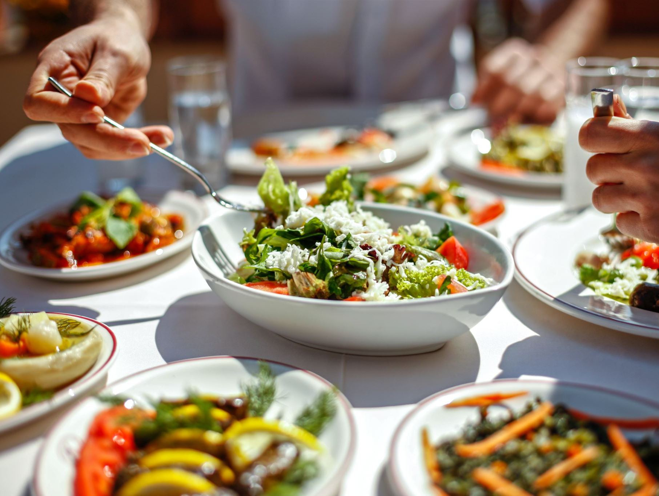
John 4 ³¹ Meanwhile the disciples were urging him,
saying, “Rabbi, eat.” ³² But he said to them, “I
have food to eat that you do not know
about.” ³³ So the disciples said to one
another, “Has anyone brought him
something to eat?” ³⁴ Jesus said to
them, “My food is to do the will of
him who sent me and to
accomplish his work.

Slide 47
Jesus’ joy came from doing the Father’s will,
and the joy of disciples will come
from doing what Jesus commands them
Kruse, C. G. (2003).
John: an introduction and
commentary (Vol. 4, p. 316).
InterVarsity Press.

Slide 48
⁹ “As the Father has loved me, so have I loved you. Now remain in my love. ¹⁰ If you keep my commands, you will remain in my love, just as I have kept my Father’s commands and remain in his love. ¹¹ I have told you this so that my joy may be in you and that your joy may be complete. ¹² My command is this: Love each other as I have loved you. ¹³ Greater love has no one than this: to lay down one’s life for one’s friends.

Slide 49
Staying in Sync with the Source (1-8)
Spreading the Love (9-17)
True, selfless love for others stems from our connection to Christ.
Remain In Me: Living and Loving through Christ
John 15:1-17
Notes:
https://www.flickr.com/photos/4thglryofgod/8609030890

Slide 50
¹⁴ You are my friends if you do what I command.
Ch 14 love => keep my commandments
Ch 15 keep my commands => remain in my love
CH 15 keep my commands => are my friends

Slide 51
¹⁴ You are my friends if you do what I command.
¹⁵ I no longer call you servants, because a servant does not know his master’s business. Instead, I have called you friends, for everything that I learned from my Father I have made known to you. ¹⁶ You did not choose me, but I chose you and appointed you so that you might go and bear fruit—fruit that will last—and so that whatever you ask in my name the Father will give you. ¹⁷ This is my command: Love each other.

Slide 52
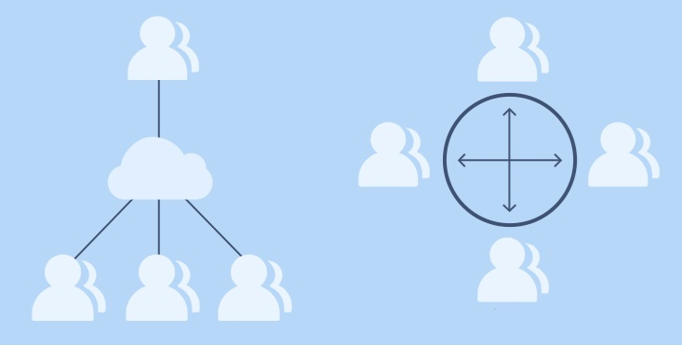
¹⁴ If I then, your Lord and Teacher, have washed your feet, you also ought to wash one another's feet. ¹⁵ For I have given you an example, that you also should do just as I have done to you. ¹⁶ Truly, truly, I say to you, a servant is not greater than his master, nor is a messenger greater than the one who sent him.

Slide 53
¹⁵ I no longer call you servants, because a servant does not know his master’s business. Instead, I have called you friends, for everything that I learned from my Father I have made known to you.

Slide 54
¹⁴ You are my friends if you do what I command.
¹⁵ I no longer call you servants, because a servant does not know his master’s business. Instead, I have called you friends, for everything that I learned from my Father I have made known to you. ¹⁶ You did not choose me, but I chose you and appointed you so that you might go and bear fruit—fruit that will last—and so that whatever you ask in my name the Father will give you. ¹⁷ This is my command: Love each other.

Slide 55
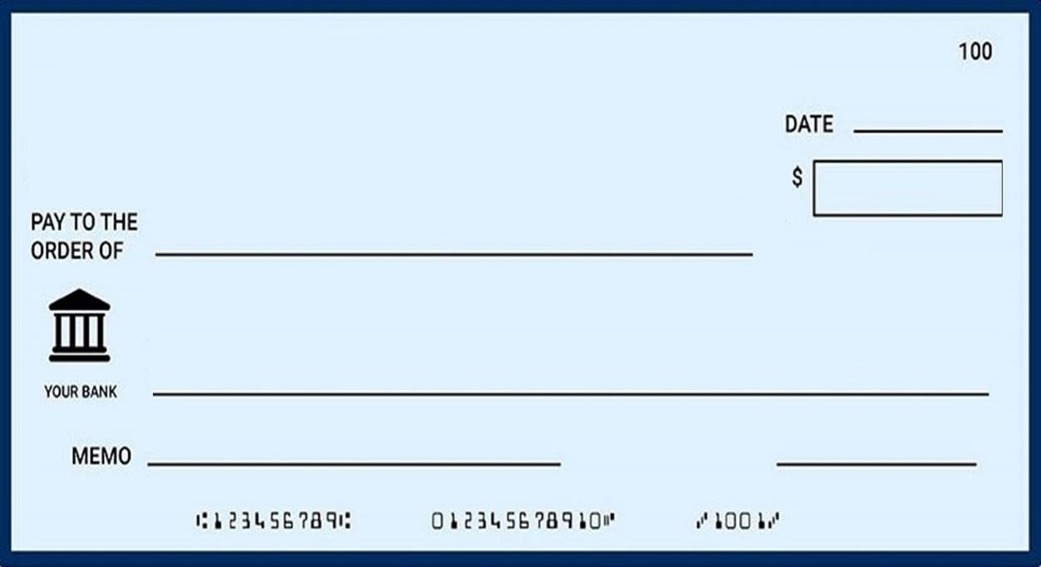
¹⁶ . . . I chose you and appointed you so that you might go and bear fruit—fruit that will last—
and so that whatever you ask in my name the Father will give you. .
John 15:16
^{Signature}
Notes:
https://onlinecheckwriter.com/what-is-a-blank-check/

Slide 56
¹⁴ You are my friends if you do what I command.
¹⁵ I no longer call you servants, because a servant does not know his master’s business. Instead, I have called you friends, for everything that I learned from my Father I have made known to you. ¹⁶ You did not choose me, but I chose you and appointed you so that you might go and bear fruit—fruit that will last—and so that whatever you ask in my name the Father will give you. ¹⁷ This is my command: Love each other.

Slide 57
How can we love one another?

Slide 58
⁷ But if we are living in the light, as God is in the light, then we have fellowship with each other, and the blood of Jesus, his Son, cleanses us from all sin.
⁸ If we claim we have no sin, we are only fooling ourselves and not living in the truth. ⁹ But if we confess our sins to him, he is faithful and just to forgive us our sins and to cleanse us from all wickedness.
1 John 1:7-9

