Slide 1
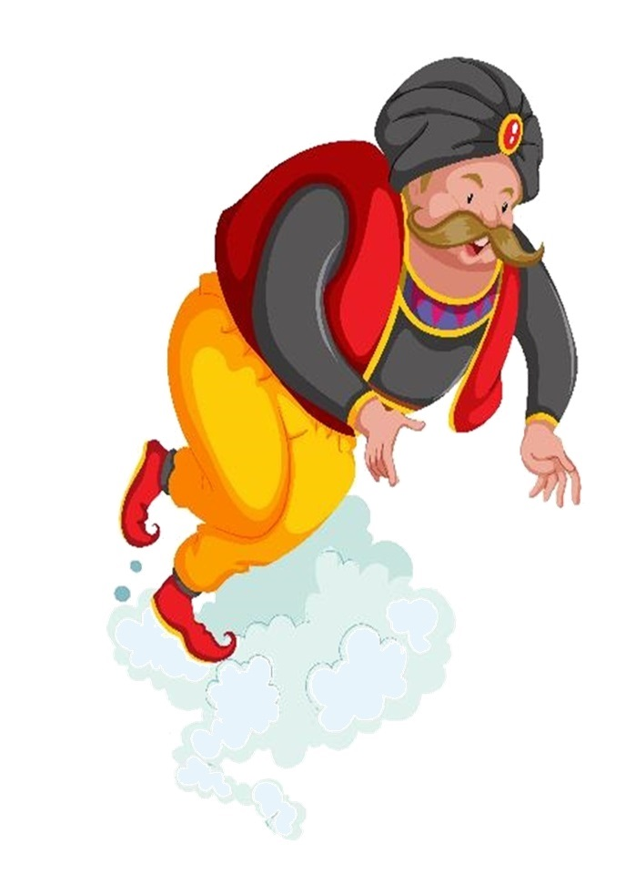
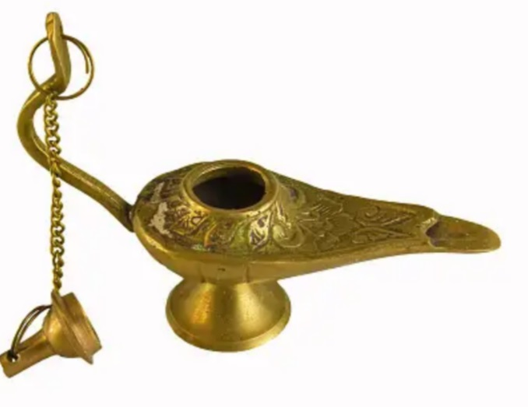
3
Notes:
https://www.amazon.sg/Unintended-Consequences-Things-Happen-Decisions/dp/1789042887
Image by brgfx on Freepik
https://www.freepik.com/free-vector/genie-coming-out-magic-lamp-cartoon-character-sticker_19747581.htm#fromView=search&page=1&position=10&uuid=e80898e9-3a8f-41c3-8482-89f55341dbbd

Slide 2
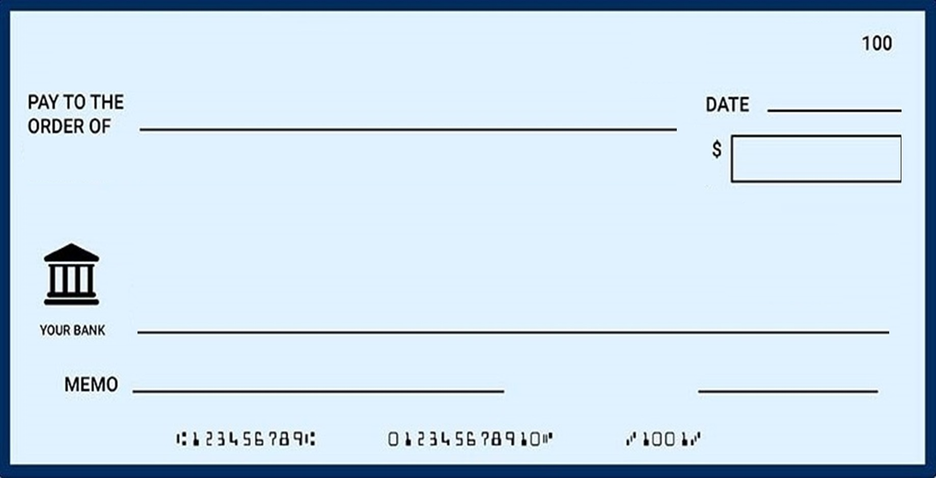
¹² “Truly, truly, I say to you, whoever believes in me
¹³ Whatever you ask in my name,
this I will do, that the Father may be glorified in the Son. ¹⁴ If you ask me anything in my name, I will do it.
John 14:12-14
^{Signature}
Notes:
https://onlinecheckwriter.com/what-is-a-blank-check/

Slide 3
John 13:1-17 Jesus washes disciples' feet
John 13:18-30 Jesus predicts Judas' betrayal
John 13:31-38 Jesus predicts Peter's denial
Jesus' farewell discourse
John 14:1-14 Jesus as the way, truth, and the light
John 14:15-31 Jesus promises the Holy Spirit
John 15:1-17 Jesus as the true vine
John 15:18-27 World's hatred for Jesus (and followers)
John 16:1-15 Persecution and work of the Holy Spirit
John 16:16-33 Sadness turned to Joy

Slide 4
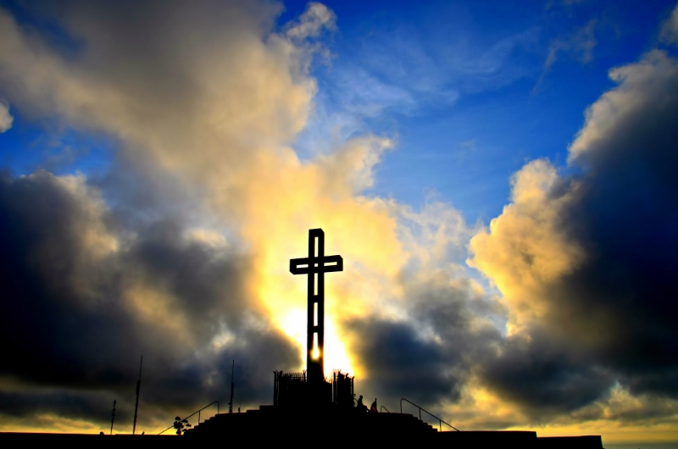
Love Actually
John 14:15-31
Notes:
https://www.flickr.com/photos/4thglryofgod/8609030890

Slide 5
Love explained: examples of love (15-17)
Love exposed: the revelation of love (18-24)
Love experienced: the outcome of love (25-31)
Love Actually
John 14:15-31
Notes:
https://www.flickr.com/photos/4thglryofgod/8609030890

Slide 6
The Last Supper
the all-encompassing transformative power of love
John 14:15-31
Notes:
By May be found at the following website: http://www.impawards.com/2003/love_actually_ver3.html, Fair use, https://en.wikipedia.org/w/index.php?curid=1134141
https://www.flickr.com/photos/4thglryofgod/8609030890

Slide 7
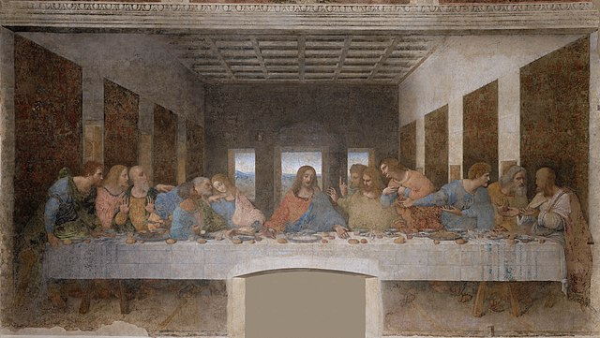
The Last Supper
Notes:
https://en.wikipedia.org/wiki/The_Last_Supper_(Leonardo)#/media/File:%C3%9Altima_Cena_-_Da_Vinci_5.jpg

Slide 8
The Last Supper in John’s Gospel
John 13:1-17 Jesus washes disciples' feet
John 13:18-30 Jesus predicts Judas' betrayal
John 13:31-38 Jesus predicts Peter's denial
Jesus' farewell discourse
John 14:1-14 Jesus as the way, truth, and the light
John 14:15-31 Jesus promises the Holy Spirit
John 15:1-17 Jesus as the true vine
John 15:18-27 World's hatred for Jesus (and followers)
John 16:1-15 Persecution and work of the Holy Spirit
John 16:16-33 Sadness turned to Joy

Slide 9
Believing
C H R I S T
Responding to John’s Gospel

Slide 10
The Last Supper in John’s Gospel
John 13:1-17 Jesus washes disciples' feet
John 13:18-30 Jesus predicts Judas' betrayal
John 13:31-38 Jesus predicts Peter's denial
Jesus' farewell discourse
John 14:1-14 Jesus as the way, truth, and the light
John 14:15-31 Jesus promises the Holy Spirit
John 15:1-17 Jesus as the true vine
John 15:18-27 World's hatred for Jesus (and followers)
John 16:1-15 Persecution and work of the Holy Spirit
John 16:16-33 Sadness turned to Joy

Slide 11
An Unending Hope
1. The source of our hope
2. The means of our hope
3. The glory of our hope
John 14:1-14

Slide 12
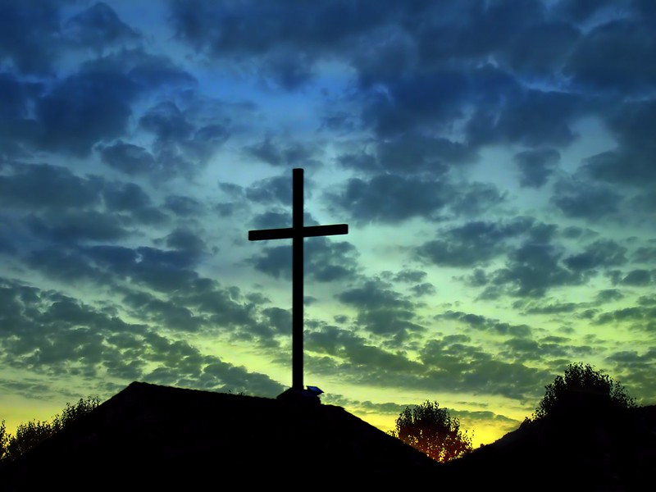
¹² “Truly, truly, I say to you, whoever believes in me will also do the works that I do; and greater works than these will he do, because I am going to the Father.
1. Work of Messiah Continues
3 assurances
John 14:12-21
Notes:
https://www.flickr.com/photos/4thglryofgod/8018427237/

Slide 13
¹⁵ “If you love me, you will keep my commandments. ¹⁶ And I will ask the Father, and he will give you another Helper, to be with you forever,
2. Promise of the Holy Spirit
3 assurances
John 14:12-21
Notes:
https://www.flickr.com/photos/4thglryofgod/8018427237/

Slide 14
¹⁵ “If you love me, you will keep my commandments.
If indicates a level of uncertainty
John 14:15-17

Slide 15
³ And if I go and prepare a place for you, I will come again and will take you to myself,
¹⁴ If you ask me anything in my name, I will do it.
¹⁵ “If you love me, you will keep my commandments.
²³ Jesus answered him, “If anyone loves me, he will keep my word, and my Father will love him,
John 14:15-17

Slide 16
¹⁵ “If you love me, you will keep my commandments.
John 13:14-15 -- serve one another in humility
John 13:34 -- love another
John 14:1 -- Believe in God and also in me
John 14:15-17

Slide 17
¹⁵ “If you love me, you will keep my commandments. ¹⁶ And I . . .
κἀγὼ - from καί and ἐγώ
Aiyo (ai-yo): A multi-purpose Singlish word that can be used to express disappointment, annoyance or sympathy.
Ex: “Aiyo, why did you fall down again?”
Aiyo, the magic genie dun grant my wish, now everything all mess up lah!

Slide 18
¹⁵ “If you love me, you will keep my commandments. ¹⁶ And I will ask the Father, and he will give you another Helper, to be with you forever,
Love explained: examples of love (15-17)
Love Actually
John 14:15-31
John 14:15-17

Slide 19
¹⁵ “If you love me, you will keep my commandments. ¹⁶ And I will ask the Father, and he will give you another Helper, to be with you forever,
παράκλητος
paraklētos
Advocate, or Counselor; Comforter, or Encourager,
John 14:15-17

Slide 20
¹⁵ “If you love me, you will keep my commandments. ¹⁶ And I will ask the Father, and he will give you another Helper, to be with you forever, ¹⁷ even the Spirit of truth, whom the world cannot receive, because it neither sees him nor knows him.
John 14:15-17

Slide 21
¹⁶ And I will ask the Father
and another Helper he will give to you
to be with you forever
¹⁷ even the Spirit of truth
whom the world cannot receive
because it neither sees him nor knows him
You know him
for he dwells with you
and will be in you
John 14:15-17

Slide 22
another Helper, to be with you forever
, ¹⁷ even the Spirit of truth, whom the world cannot, . . .
ESV
NLT
. ¹⁷ He is the Holy Spirit, who leads into all truth. The world cannot
— ¹⁷ the Spirit of truth. The world cannot . . .
NIV
— ¹⁷ the Spirit of truth, whom the world cannot . . .
NET

Slide 23
www.cicfamily.com
=> about us
=> our beliefs
4.3 The Holy Spirit – The Holy Spirit is God who is actively at work in the world. He dwells permanently in every Christian, helps us to pray, equips and empowers us to serve God, strengthens and molds us to be more like Christ, and protects us to guarantee our eternal life.
(Acts 5:3-4; Romans 8:14-16, 26; Ephesians 1:13-14)

Slide 24
The Nicene Creed
AD 381
We believe in the Holy Spirit, the Lord, the giver of life, who proceeds from the Father and the Son. With the Father and the Son he is worshiped and glorified. He has spoken through the Prophets

Slide 25
¹⁶ And I will ask the Father
and another Helper he will give to you
to be with you forever
¹⁷ the Spirit of truth
whom the world cannot receive
because it neither sees him nor knows him
You know him
for he dwells with you
and will be in you
My little children, I am writing these things to you so that you may not sin. But if anyone does sin, we have an advocate with the Father, Jesus Christ the righteous.
1 John 2:1
John 14:15-17

Slide 26
Love explained: examples of love (15-17)
Love exposed: the revelation of love (18-24)
Love Actually
John 14:15-31
Notes:
https://www.flickr.com/photos/4thglryofgod/8609030890

Slide 27
¹⁸ “I will not leave you as orphans; I will come to you.
Work of Messiah Continues
Promise of the Holy Spirit
Jesus will make himself known
3 assurances
John 14:12-21
Notes:
https://www.flickr.com/photos/4thglryofgod/8018427237/

Slide 28
¹⁸ “I will not leave you as orphans; I will come to you.
³ if I go and prepare a place for you, I will come again and will take you to myself, that where I am you may be also.
John 14:18-21

Slide 29
¹⁸ “I will not leave you as orphans; I will come to you. ¹⁹ Yet a little while and the world will see me no more, but you will see me. Because I live, you also will live. ²⁰ In that day you will know that I am in my Father, and you in me, and I in you.
When is “that day?”
John 14:18-21

Slide 30
¹⁸ “I will not leave you as orphans; I will come to you. ¹⁹ Yet a little while and the world will see me no more, but you will see me. Because I live, you also will live. ²⁰ In that day you will know that I am in my Father, and you in me, and I in you. ²¹ Whoever has my commandments and keeps them, he it is who loves me.
John 14:18-21

Slide 31
¹⁸ “I will not leave you as orphans; I will come to you. ¹⁹ Yet a little while and the world will see me no more, but you will see me. Because I live, you also will live. ²⁰ In that day you will know that I am in my Father, and you in me, and I in you. ²¹ Whoever has my commandments and keeps them, he it is who loves me. And he who loves me will be loved by my Father, and I will love him and manifest myself to him.”
John 14:18-21

Slide 32
²² Judas (not Iscariot) said to him, “Lord, how is it that you will manifest yourself to us, and not to the world?”
In 2021 there were only 23 baby boys named Judas
John 14:22

Slide 33
“Lord, how is it that you will manifest yourself to us, and not to the world?” ESV
“Lord, why are you going to reveal yourself only to us and not to the world at large?” NLT
“But, Lord, why do you intend to show yourself to us and not to the world?” NIV
“what has happened that you are going to reveal^{[c]} yourself to us and not to the world?” NET
John 14:22

Slide 34
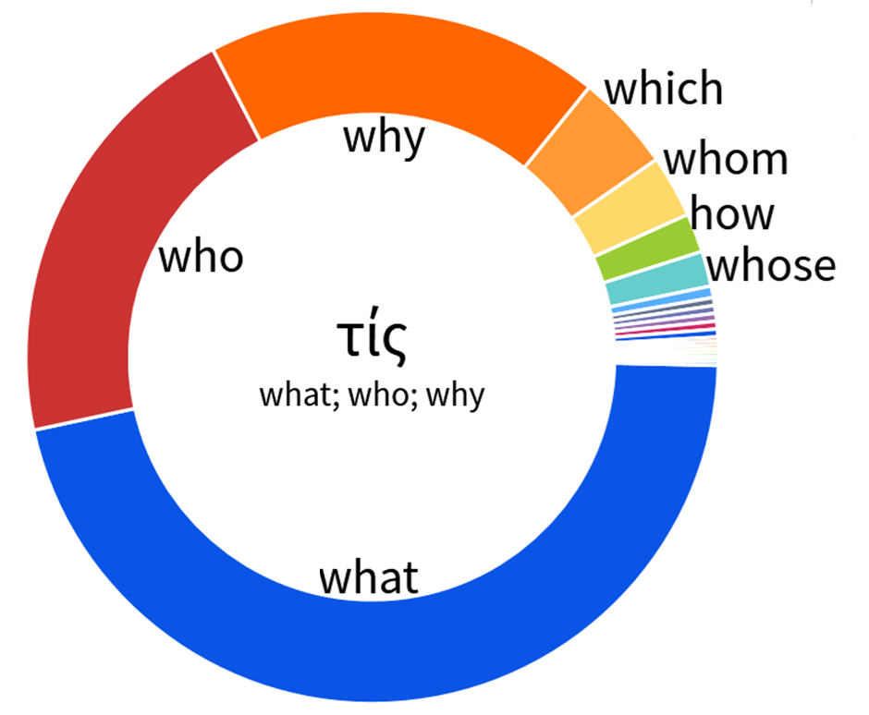
reveal yourself only to us and not to
the world

Slide 35
The Last Supper in John’s Gospel
John 13:1-17 Jesus washes disciples' feet

Slide 36
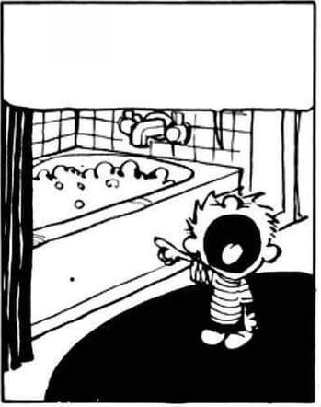
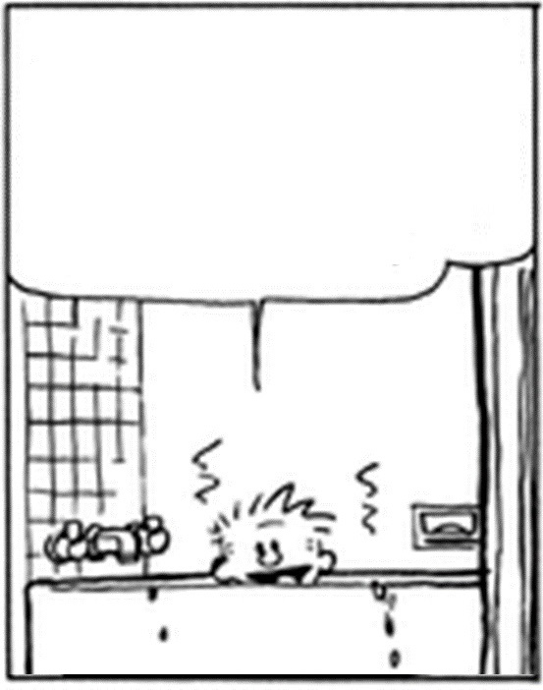
“No,” Peter protested, “you will never ever wash my feet!” John 13:8
Simon Peter exclaimed, “Then wash my hands and head as well, Lord, not just my feet!”
John 13:9

Slide 37
The Last Supper in John’s Gospel
John 13:1-17 Jesus washes disciples' feet
John 13:18-30 Jesus predicts Judas' betrayal

Slide 38
Simon Peter motioned to him to ask, Who’s he talking about? So that disciple leaned over to Jesus and asked, “Lord, who is it?
John 13:24-25
Notes:
https://unsplash.com/photos/girl-in-white-shirt-kissing-girl-in-blue-and-white-stripe-shirt-ybHstqVRuXY

Slide 39
The Last Supper in John’s Gospel
John 13:1-17 Jesus washes disciples' feet
John 13:18-30 Jesus predicts Judas' betrayal
John 13:31-38 Jesus predicts Peter's denial

Slide 40
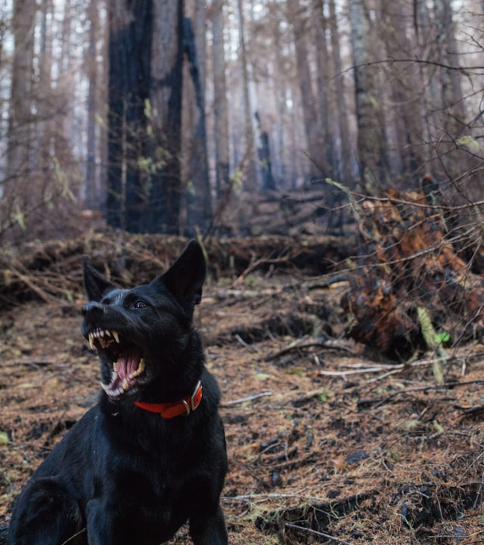
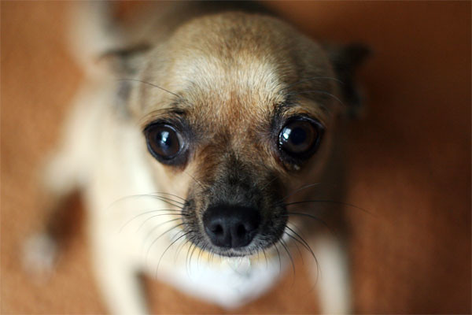
³⁷ “But why can’t I come now, Lord?” he asked. “I’m ready to die for you.”
³⁸ Jesus answered, “Die for me? I tell you the truth, Peter—before the rooster crows tomorrow morning, you will deny three times that you even know me.
Notes:
https://unsplash.com/photos/dog-barking-in-the-forest-bbiDkAEmC9s
https://www.flickr.com/photos/coveted/5058001690

Slide 41
The Last Supper in John’s Gospel
John 13:1-17 Jesus washes disciples' feet
John 13:18-30 Jesus predicts Judas' betrayal
John 13:31-38 Jesus predicts Peter's denial
Jesus' farewell discourse
John 14:1-14 Jesus as the way, truth, and the light

Slide 42
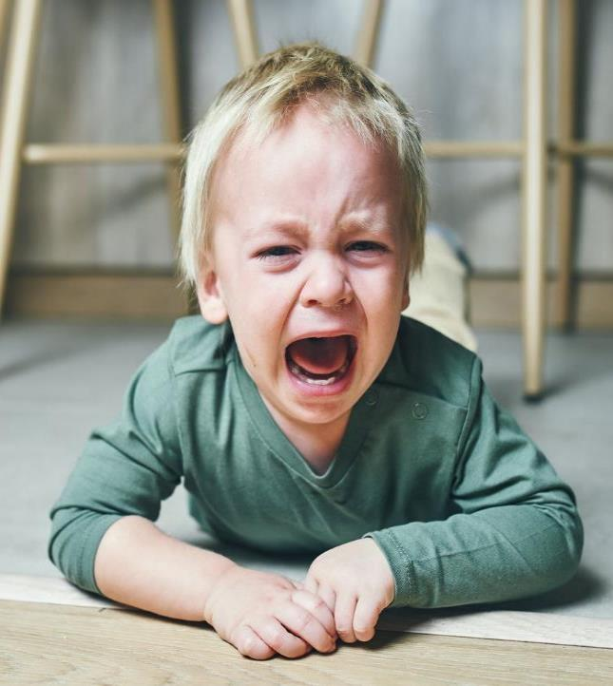
⁵ “No, we don’t know, Lord,” Thomas said. “We have no idea where you are going, so how can we know the way?”
John 14:5
Notes:
https://www.huffpost.com/entry/how-to-deal-temper-tantrums_l_621d138fe4b06e1cc5938c39

Slide 43
⁸ Philip said, “Lord, show us the Father, and we will be satisfied.”
John 14:8
Notes:
https://unsplash.com/photos/man-holding-flashlight-standing-on-rock-fNUNt9w3m-Q

Slide 44
The Last Supper in John’s Gospel
John 13:1-17 Jesus washes disciples' feet
John 13:18-30 Jesus predicts Judas' betrayal
John 13:31-38 Jesus predicts Peter's denial
Jesus' farewell discourse
John 14:1-14 Jesus as the way, truth, and the light
John 14:15-31 Jesus promises the Holy Spirit

Slide 45
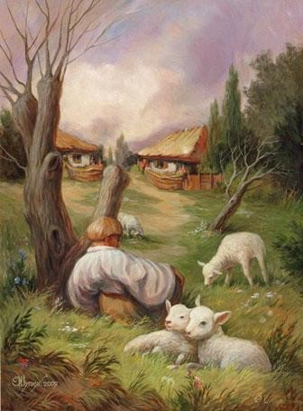
²² “Lord, why are you going to reveal yourself only to us and not to the world at large?”
John 14:22
Notes:
https://www.csjcanada.org/blog/2018/1/31/hidden-in-plain-sight.html

Slide 46
²³ Jesus answered him, “If anyone loves me, he will keep my word,
²¹ Whoever has my commandments and keeps them, he it is who loves me.
John 14:23-24

Slide 47
²³ Jesus answered him, “If anyone loves me, he will keep my word, and my Father will love him, and we will come to him and make our home with him.
²¹ Whoever has my commandments and keeps them, he it is who loves me.
John 14:23-24

Slide 48
²³ Jesus answered him, “If anyone loves me, he will keep my word, and my Father will love him, and we will come to him and make our home with him.
Love exposed: the revelation of love (18-24)
²¹ Whoever has my commandments and keeps them, he it is who loves me. And he who loves me will be loved by my Father, and I will love him and manifest myself to him.”
John 14:23-24

Slide 49
Love explained: examples of love (15-17)
Love exposed: the revelation of love (18-24)
God loves the world (John 3:16)
. . . that whoever believes . . .
Ch 14 ¹ “Let not your hearts be troubled. Believe in God; believe also in me.
Ch 14 ¹¹ Believe me that I am in the Father and the Father is in me, or else believe on account of the works themselves.
Notes:
https://www.flickr.com/photos/4thglryofgod/8609030890

Slide 50
²³ Jesus answered him, “If anyone loves me, he will keep my word, and my Father will love him, and we will come to him and make our home with him. ²⁴ Whoever does not love me does not keep my words. And the word that you hear is not mine but the Father's who sent me.
John 14:23-24

Slide 51
Love explained: examples of love (15-17)
Love exposed: the revelation of love (18-24)
Love experienced: the outcome of love (25-31)
Love Actually
John 14:15-31
Notes:
https://www.flickr.com/photos/4thglryofgod/8609030890

Slide 52
²⁵ “These things I have spoken to you while I am still with you. ²⁶ But the Helper, the Holy Spirit, whom the Father will send in my name, he will teach you all things and bring to your remembrance all that I have said to you.
John 14:25-26

Slide 53
²⁷ Peace I leave with you; my peace I give to you. Not as the world gives do I give to you. Let not your hearts be troubled, neither let them be afraid.
Love experienced: the outcome of love (25-31)
John 14:27-29

Slide 54
John 14:1 & 27
¹ “Let not your hearts be troubled. Believe in God; believe also in me.
²⁷ Peace I leave with you; my peace I give to you. Not as the world gives do I give to you. Let not your hearts be troubled, neither let them be afraid.

Slide 55
²⁷ Peace I leave with you; my peace I give to you. Not as the world gives do I give to you. Let not your hearts be troubled, neither let them be afraid. ²⁸ You heard me say to you, ‘I am going away, and I will come to you.’ If you loved me, you would have rejoiced, because I am going to the Father, for the Father is greater than I. ²⁹ And now I have told you before it takes place, so that when it does take place you may believe.
John 14:27-29

Slide 56
³⁰ I will no longer talk much with you, for the ruler of this world is coming. He has no claim on me, ³¹ but I do as the Father has commanded me, so that the world may know that I love the Father. Rise, let us go from here.
John 14:30-31

Slide 57
Does the Ruler of this world have a claim on you?

Slide 58
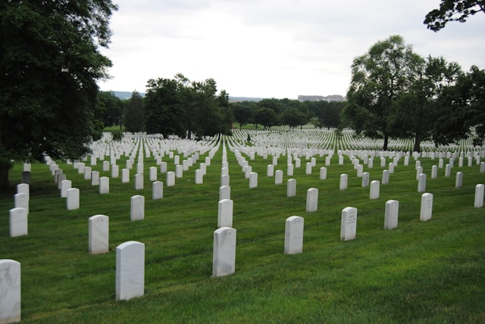
“Let’s go, too—and die with Jesus.”
John 11:16
Notes:
https://unsplash.com/photos/white-cross-on-green-grass-field-during-daytime-ESBjOXo2ens

Slide 59
“No, we don’t know, Lord,” Thomas said. “We have no idea where you are going, so how can we know the way?”
John 14:5
Notes:
https://www.huffpost.com/entry/how-to-deal-temper-tantrums_l_621d138fe4b06e1cc5938c39

Slide 60
“. . . “I won’t believe it unless I see the nail wounds in his hands, put my fingers into them, and place my hand into the wound in his side.”
John 20:25
Notes:
https://unsplash.com/photos/man-covering-his-mouth-uFjORuZQczQ

Slide 61
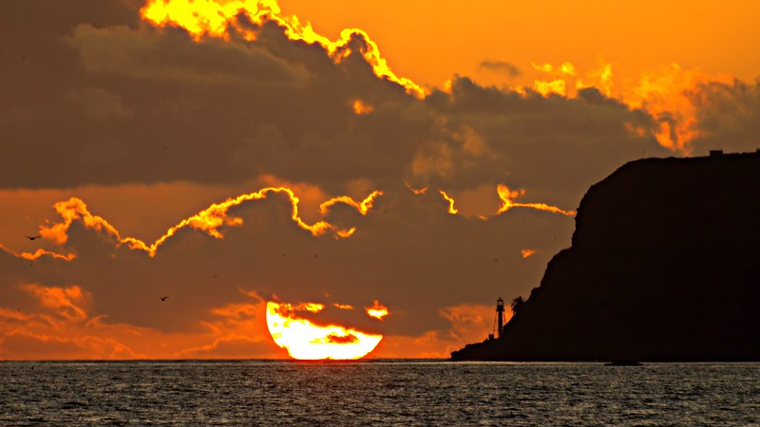
My Lord and
my God!
John 20:28
Notes:
https://www.flickr.com/photos/4thglryofgod/8063647040/

Slide 62
Love explained: examples of love (15-17)
Love exposed: the revelation of love (18-24)
Love experienced: the outcome of love (25-31)
Love Actually
John 14:15-31
Notes:
https://www.flickr.com/photos/4thglryofgod/8609030890

