Slide 1
Believing
C H R I S T
Responding to John’s Gospel

Slide 2
An Unending Hope
John 14:1-14

Slide 3
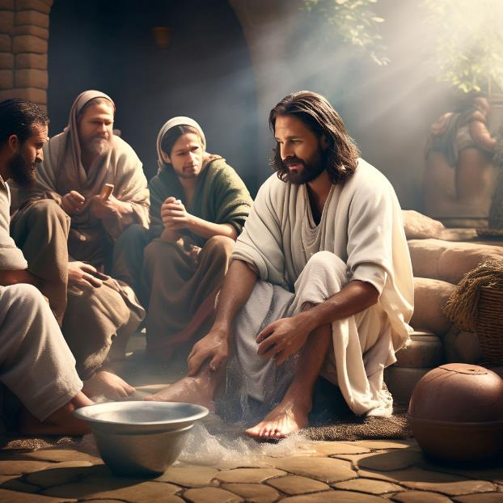

Slide 4
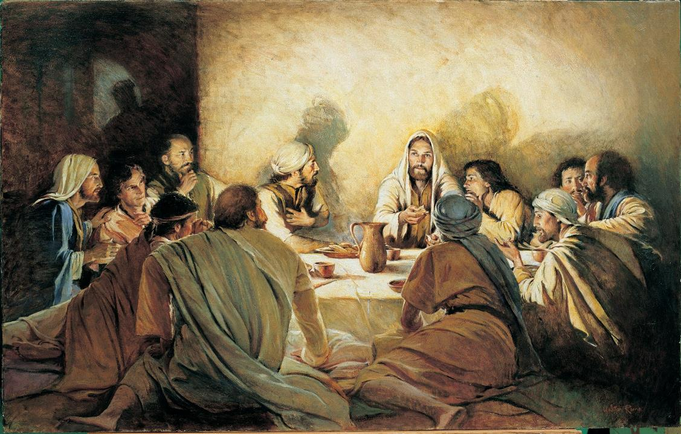

Slide 6
An Unending Hope – John 14: 1-14
1. The source of our hope (vs 1-3)
2. The means of our hope (vs 4-11)
3. The glory of our hope (vs 12-14)

Slide 7
¹ “Let not your hearts be troubled. Believe in God; believe also in me. ² In my Father's house are many rooms. If it were not so, would I have told you that I go to prepare a place for you? ³ And if I go and prepare a place for you, I will come again and will take you to myself, that where I am you may be also.

Slide 8
An Unending Hope – John 14: 1-14
KEEP YOUR HEART!
Keep your heart with all vigilance, for from it flow the springs of life. (Proverbs 4:23)
Create in me a clean heart, O God, and renew a right spirit within me. (Psalm 51:10)
The heart is deceitful above all things, and desperately sick; who can understand it? (Jeremiah 17:9)
“Blessed are the pure in heart, for they shall see God. (Matthew 5:8)

Slide 9
⁴ And you know the way to where I am going.” ⁵ Thomas said to him, “Lord, we do not know where you are going. How can we know the way?” ⁶ Jesus said to him, “I am the way, and the truth, and the life. No one comes to the Father except through me. ⁷ If you had known me, you would have known my Father also. From now on you do know him and have seen him.”
⁸ Philip said to him, “Lord, show us the Father, and it is enough for us.” ⁹ Jesus said to him, “Have I been with you so long, and you still do not know me, Philip? Whoever has seen me has seen the Father. How can you say, ‘Show us the Father’? ¹⁰ Do you not believe that I am in the Father and the Father is in me? The words that I say to you I do not speak on my own authority, but the Father who dwells in me does his works. ¹¹ Believe me that I am in the Father and the Father is in me, or else believe on account of the works themselves.

Slide 10
An Unending Hope – John 14: 1-14
The source of our hope (vs 1-3)
Protect your heart from fear and despair. – vs 1a
Rather, Actively put your faith in God who is above us and God who is with us – vs 1b.
On what grounds is this hope: Jesus is coming back to take us to be with him.

Slide 11
An Unending Hope – John 14: 1-14
The means of our hope (vs 4-6)
Thomas knows neither destination nor way! (vs 5)
Jesus is the way, in a world that is lost.
Jesus is the truth, in a world of lies that is deceived.
Jesus is the life, in a world that knows only death. (vs 6)

Slide 13
⁴ And you know the way to where I am going.” ⁵ Thomas said to him, “Lord, we do not know where you are going. How can we know the way?” ⁶ Jesus said to him, “I am the way, and the truth, and the life. No one comes to the Father except through me. ⁷ If you had known me, you would have known my Father also. From now on you do know him and have seen him.”
⁸ Philip said to him, “Lord, show us the Father, and it is enough for us.” ⁹ Jesus said to him, “Have I been with you so long, and you still do not know me, Philip? Whoever has seen me has seen the Father. How can you say, ‘Show us the Father’? ¹⁰ Do you not believe that I am in the Father and the Father is in me? The words that I say to you I do not speak on my own authority, but the Father who dwells in me does his works. ¹¹ Believe me that I am in the Father and the Father is in me, or else believe on account of the works themselves.

Slide 14
An Unending Hope – John 14: 1-14
The means of our hope (vs 7-11)
Jesus reiterates that knowing him is the same as knowing and seeing God. - vs 7
Philip asks, like Moses (Exodus 33:18-23) to see the Father – vs 8.
Jesus questions Philip’s lack of understanding. Jesus and the Father are one - vs 9.

Slide 15
Seeing the Son is seeing the Father
“… in Christ, Philip has before him the full embodiment of God as it can be seen by humanity. Nevertheless, Jesus now says with utter clarity what Philip could not comprehend before (14:9).”
Gary M. Burge, The NIV Application Commentary: John, (Zondervan, 2009)

Slide 16
An Unending Hope – John 14: 1-14
The means of our hope (vs 7-11)
Father and Son are essentially one – vs 10.
So that the words Jesus speaks are not just his - they are the result of God working in him.
He appeals to them at least to believe on account on the signs and miracles they seen – vs 11.

Slide 17
¹² “Truly, truly, I say to you, whoever believes in me will also do the works that I do; and greater works than these will he do, because I am going to the Father. ¹³ Whatever you ask in my name, this I will do, that the Father may be glorified in the Son. ¹⁴ If you ask me anything in my name, I will do it.

Slide 18
An Unending Hope – John 14: 1-14
The glory of our hope (vs 12-14)
What greater works? In terms of scale and impact. (vs 12)
And privileged prayer (vs 13-14).

Slide 19
Greater Works than these
"The 'greater works’ of which he now spoke to them would still be his own works, accomplished no longer by his visible presence among them but by his Spirit within them. And it was only by his going to the Father that the Paraclete would come to them (John 16:7)."
F.F. Bruce, The Gospels & Epistles of John, (William B Eerdmans, 1983): page 300.

Slide 20
Application
LET GOD’S
TRANSFORM YOU!

Slide 21
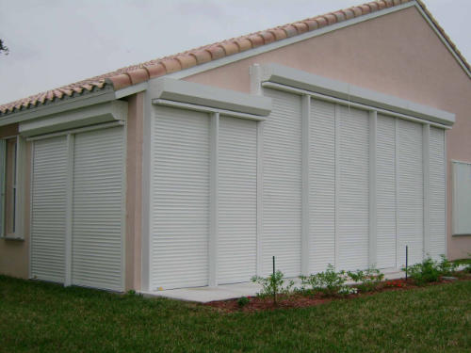

Slide 22
Application
LET GOD’S
TRANSFORM YOU!

