Slide 1
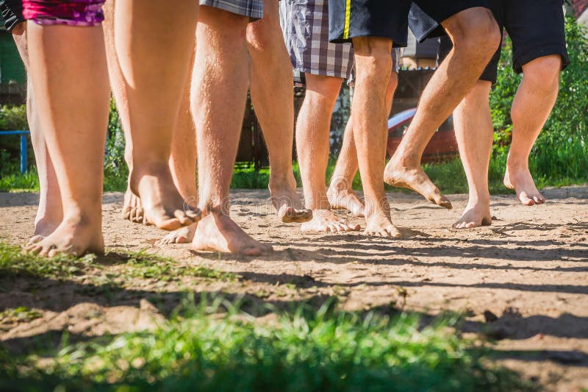

Slide 2

Believing
C H R I S T
Responding to John’s Gospel

Slide 3
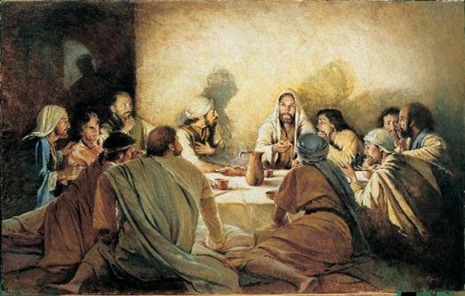
John 13:31-38
As I have loved you…

Slide 4

The Gospel of John

Slide 5
³¹ When he had gone out, Jesus said, “Now is the Son of Man glorified, and God is glorified in him. ³² If God is glorified in him, God will also glorify him in himself, and glorify him at once. ³³ Little children, yet a little while I am with you. You will seek me, and just as I said to the Jews, so now I also say to you, ‘Where I am going you cannot come.’

Slide 6
John 13:31-33
Glorification (God the Father and Son being glorified) is a key theme in the Gospel of John.
This is echoed throughout John’s Gospel – see John 11:4, 40; 12:41; 14:13; 17:1, 5, 22, 24.

Slide 7
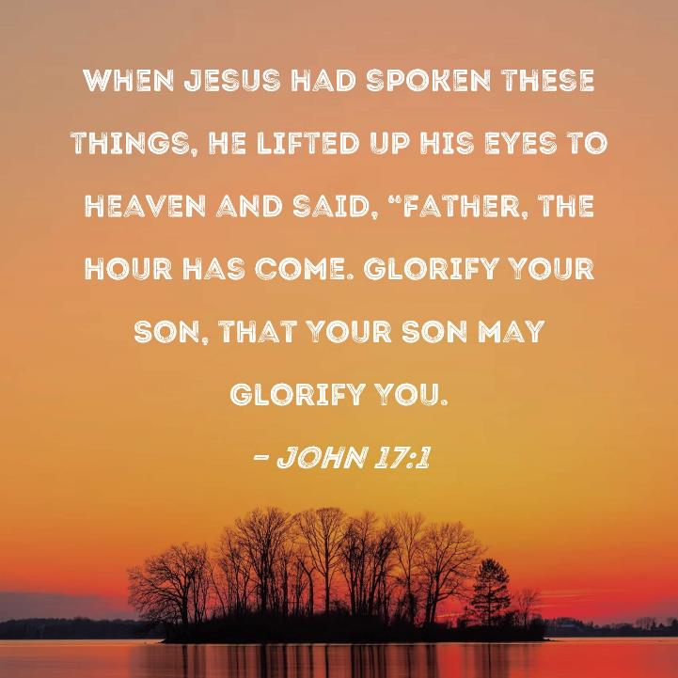

Slide 8


Slide 9
The Pendulum Swings….
Prologue (Jn 1:1-18)
High Point: John 1:1 – The Word exists with God
Low Point: John 1:10-11 – Rejected by Men
High Point: John 1:18 – At the Father’s Side

Slide 10
The Pendulum Swings….
John’s Gospel:
High Point: The incarnate Jesus reveals his glory in 7 signs (Chapters 2-11)
Low Point: Jesus is betrayed, arrested, crucified and buried (Chapters 13-19)
THE CROSS IS THE TURNING POINT
High Point: Jesus is resurrected and ascended (Chapters 20-21)

Slide 11

The Cross of Glory
"The Son of Man will be "lifted up" (12:32), and when he is, he will draw everyone to himself (cf. 3:13-14: 8:28). In 19:19-20, when Jesus is on the cross, he is proclaimed "king" in all the chief languages of the world. The cross is thus where Jesus is "elevated" above all, hailed as glorious ruler: through his resurrection, he is empowered to return to his place in heaven.’ “
Gary M. Burge, The NIV Application Commentary: John, (Zondervan, 2009)

Slide 12
³¹ When he had gone out, Jesus said, “Now is the Son of Man glorified, and God is glorified in him. ³² If God is glorified in him, God will also glorify him in himself, and glorify him at once. ³³ Little children, yet a little while I am with you. You will seek me, and just as I said to the Jews, so now I also say to you, ‘Where I am going you cannot come.’

Slide 13
³⁴ A new commandment I give to you, that you love one another: just as I have loved you, you also are to love one another. ³⁵ By this all people will know that you are my disciples, if you have love for one another.”

Slide 14
John 13:34-35
In what sense is this a new commandment?
The Law already called us to “love our neighbour as ourselves” (Leviticus 19:18 – which Jesus acknowledges in Matthew 22:39).
The “new command” is that we must love as Jesus loved us. His love is now our standard.

Slide 15
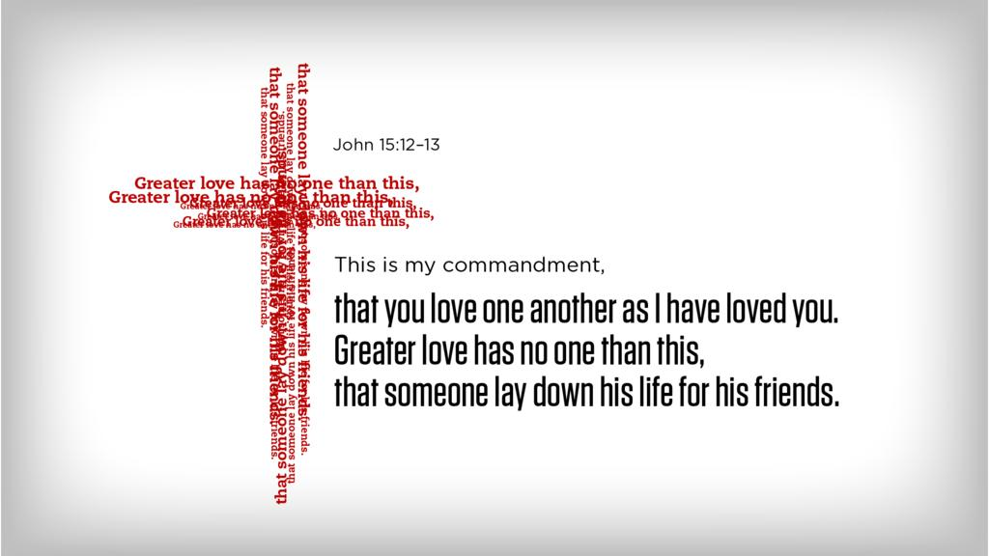

Slide 16
³⁴ A new commandment I give to you, that you love one another: just as I have loved you, you also are to love one another. ³⁵ By this all people will know that you are my disciples, if you have love for one another.”

Slide 18
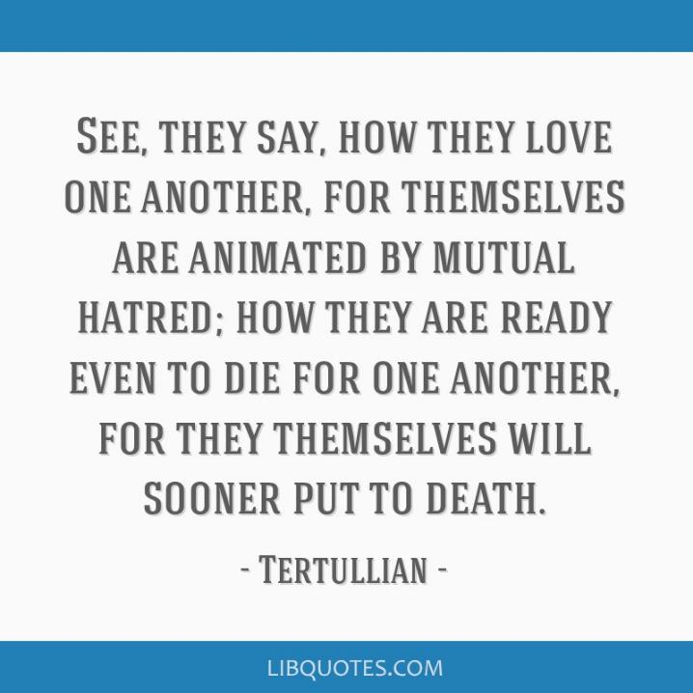
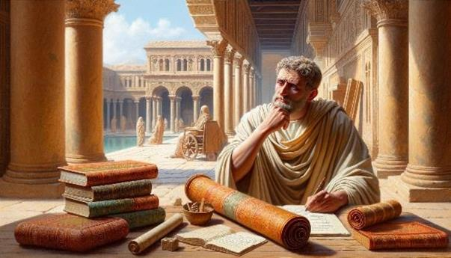
Tertullian, 2nd Century AD Early Church Father, quoting the reaction of non-Christians after encountering Christian believers.

Slide 19
The “My Disciples” Passages
Only 9 times in Gospels where Jesus specifically uses the word “My disciples” descriptively.
3 times when specifically referring to the 12 (Matthew 26:18; Mark 14:14; Luke 22:11).
3 times in Luke 14:25-33 on the PRIORITIES OF DISCIPLESHIP.

Slide 20
²⁵ Now great crowds accompanied him, and he turned and said to them, ²⁶ “If anyone comes to me and does not hate his own father and mother and wife and children and brothers and sisters, yes, and even his own life, he cannot be my disciple. ²⁷ Whoever does not bear his own cross and come after me cannot be my disciple. ²⁸ For which of you, desiring to build a tower, does not first sit down and count the cost, whether he has enough to complete it? ²⁹ Otherwise, when he has laid a foundation and is not able to finish, all who see it begin to mock him, ³⁰ saying, ‘This man began to build and was not able to finish.’ ³¹ Or what king, going out to encounter another king in war, will not sit down first and deliberate whether he is able with ten thousand to meet him who comes against him with twenty thousand? ³² And if not, while the other is yet a great way off, he sends a delegation and asks for terms of peace. ³³ So therefore, any one of you who does not renounce all that he has cannot be my disciple.

Slide 21
The “My Disciples” Passages
Only 9 times in Gospels where Jesus specifically uses the word “My disciples” descriptively.
3 times when specifically referring to the 12 (Matthew 26:18; Mark 14:14; Luke 22:11).
3 times in Luke 14:25-33 on the PRIORITIES OF DISCIPLESHIP.
3 times in John’s Gospel on the PRACTICES OF DISCIPLESHIP.

Slide 22
John 8:31-32
³¹ So Jesus said to the Jews who had believed him, “If you abide in my word, you are truly my disciples, ³² and you will know the truth, and the truth will set you free.”

Slide 23
John 13:34-35
³⁴ A new commandment I give to you, that you love one another: just as I have loved you, you also are to love one another. ³⁵ By this all people will know that you are my disciples, if you have love for one another.”

Slide 24
John 8:31-328
⁸ By this my Father is glorified, that you bear much fruit and so prove to be my disciples.

Slide 25
The “My Disciples” Passages
3 times in Luke 14:25-33 on the PRIORITIES OF DISCIPLESHIP.
3 times in John’s Gospel on the PRACTICES OF DISCIPLESHIP.
1) John 8:31-32: ABIDE IN MY WORD (Personal Devotion/Formation)
2) John 13:34-35: LOVE ONE ANOTHER (Communal Commitment)
3) John 15:8: BEAR FRUIT (Missional Multiplication)

Slide 26

3 Elements of being “MY Disciples”
PERSONAL
FORMATION
(Jn 8:31)
MISSIONAL
GROWTH
(John 15:8)
COMMUNAL
DEVOTION
(Jn 13:34,35)
Notes:
Fundamental identity (in Christ – new creation, children of God), Formational Community (under Christ – maturity), Participatory Mission (With/For Christ – multiplication)

Slide 27
³⁶ Simon Peter said to him, “Lord, where are you going?” Jesus answered him, “Where I am going you cannot follow me now, but you will follow afterward.” ³⁷ Peter said to him, “Lord, why can I not follow you now? I will lay down my life for you.” ³⁸ Jesus answered, “Will you lay down your life for me? Truly, truly, I say to you, the rooster will not crow till you have denied me three times.

Slide 28
Judas’ Betrayal Versus Peter’s Denial
Judas
Peter
For Selfish Gain
Premeditated
Devotion to a Preconceived Idea
Remorse without Repentance
Suicide, the Ultimate Act of Self-centeredness
For Self Preservation
Rashly Emotional
Devotion to Jesus
Remorse Leading to Repentance
Sacrifice, the Ultimate Act of Other-centered Love
Source: Lewis Wrinkler’s Sermon at CIC

Slide 29
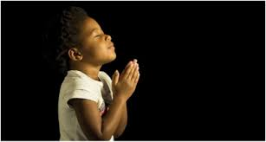
LET US PRAY….

