Slide 1
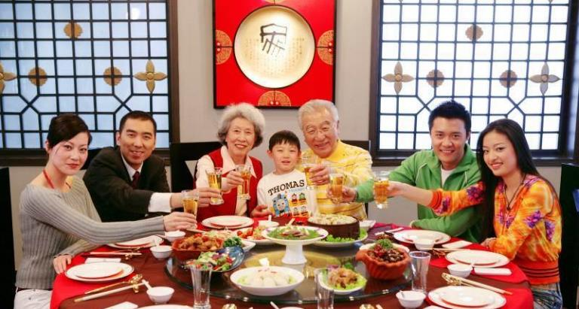
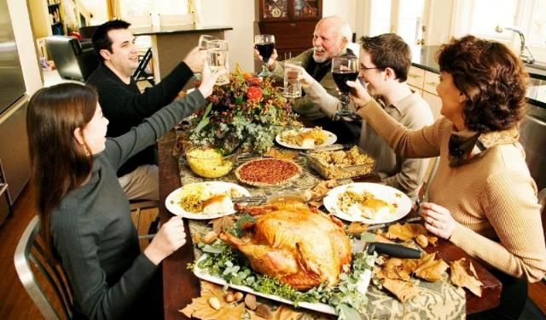
Reunion Dinner
Thanksgiving Dinner
Notes:
https://www.youle.com.sg/2018/02/14/chinese-new-year-reunion-dinner/
https://blog.alekoproducts.com/thanksgiving-a-wonderful-time-for-reunion-enratopm/

Slide 3
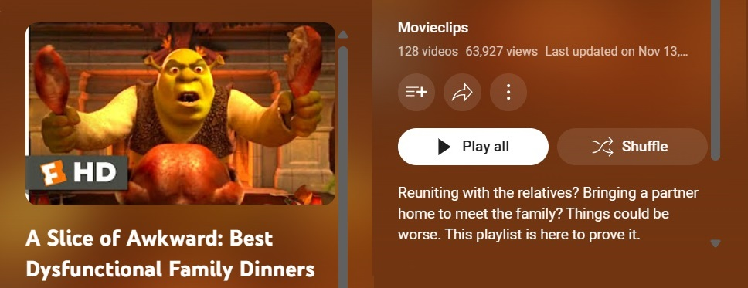

Slide 4
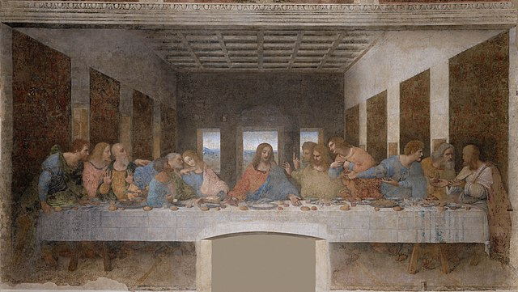
Notes:
https://en.wikipedia.org/wiki/The_Last_Supper_(Leonardo)#/media/File:%C3%9Altima_Cena_-_Da_Vinci_5.jpg

Slide 5
The Last Supper in John’s Gospel
John 13:1-17 Jesus washes disciples' feet
John 13:18-30 Jesus predicts Judas' betrayal
John 13:31-38 Jesus predicts Peter's denial
John 14:1-14 Jesus' farewell discourse
John 14:15-31 Jesus promises the Holy Spirit
John 15:1-17 Jesus as the true vine
John 15:18-27 World's hatred for Jesus (and followers)
John 16:1-15 Persecution and work of the Holy Spirit
John 16:16-33 Sadness turned to Joy

Slide 6
Understanding Unfaithfulness
Unpacking Judas’ Betrayal
John 13:18-30
Notes:
https://lightcentre.com/the-5-soul-wound-4-the-wound-of-betrayal/

Slide 7
Believing
C H R I S T
Responding to John’s Gospel

Slide 8
¹⁸ “I am not saying these things to all of you; I know the ones I have chosen. But this fulfills the Scripture that says, ‘The one who eats my food has turned against me.’^{[a]}
John 13:18-20

Slide 9
¹⁸ “I am not saying these things to all of you; I know the ones I have chosen. But this fulfills the Scripture that says, ‘The one who eats my food has turned against me.’^{[a]}
John 13:18-20

Slide 10
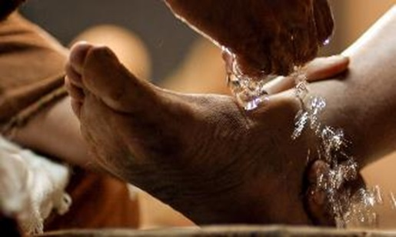
¹⁸ “I am not saying these things to all of you; I know the ones I have chosen.
by accepting divine authority (1-3)
by receiving God’s means for forgiveness of sin (4-11)
by imitating Christ’s condescending service to other Christians (12-17)
Developing True Humility
John 13:1-17

Slide 11
¹² After washing their feet, he put on his robe again and sat down and asked, “Do you understand what I was doing? ¹³ You call me ‘Teacher’ and ‘Lord,’ and you are right, because that’s what I am. ¹⁴ And since I, your Lord and Teacher, have washed your feet, you ought to wash each other’s feet. ¹⁵ I have given you an example to follow. Do as I have done to you. ¹⁶ I tell you the truth, slaves are not greater than their master. Nor is the messenger more important than the one who sends the message. ¹⁷ Now that you know these things, God will bless you for doing them.
Developing True Humility
John 13:1-17

Slide 12
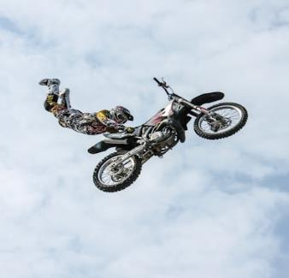
¹⁷ Now that you know these things, God will bless you for doing them.
Imitating Christ’s Condescending Service
/ Extreme Servanthood
Notes:
https://unsplash.com/photos/person-in-brown-jacket-doing-snow-ski-blade-trick-xZIFEPtRsRI
https://unsplash.com/photos/low-angle-photography-of-motocross-player-performing-motocross-flying-style-eSzWOpp1rgw
https://unsplash.com/photos/man-riding-on-utv-on-desert-during-daytime-WvRMzYER6FM
https://unsplash.com/photos/man-climbing-cliff-beside-beach-FZ0qzjVF_-c

Slide 13
¹⁸ “I am not saying these things to all of you; I know the ones I have chosen. But this fulfills the Scripture that says, ‘The one who eats my food has turned against me.’^{[a]}
Footnote
Psalm 41:9
John 13:18-20

Slide 14
Psalm 41:9
⁹ Even my best (close) friend,
the one I trusted completely, the one who shared my food,
has turned against me.

Slide 15
Psalm 41:9
¹ Oh, the joys of those who are kind to the poor! The Lord rescues them when they are in trouble. ² The Lord protects them and keeps them alive. He gives them prosperity in the land and rescues them from their enemies. ³ The Lord nurses them when they are sick and restores them to health.
⁴ “O Lord,” I prayed, “have mercy on me. Heal me, for I have sinned against you.”

Slide 16
Psalm 41:9
⁵ But my enemies say nothing but evil about me. “How soon will he die and be forgotten?” they ask. ⁶ They visit me as if they were my friends, but all the while they gather gossip, and when they leave, they spread it everywhere. ⁷ All who hate me whisper about me, imagining the worst. ⁸ “He has some fatal disease,” they say. “He will never get out of that bed!”
⁹ Even my best friend, the one I trusted completely, the one who shared my food, has turned against me

Slide 17
Psalm 41:9
¹⁰ Lord, have mercy on me. Make me well again, so I can pay them back! ¹¹ I know you are pleased with me, for you have not let my enemies triumph over me.
¹² You have preserved my life because I am innocent; you have brought me into your presence forever.
¹³ Praise the Lord, the God of Israel, who lives from everlasting to everlasting. Amen and amen!

Slide 18
¹⁸ “I am not saying these things to all of you; I know the ones I have chosen. But this fulfills the Scripture that says, ‘The one who eats my food has turned against me.’^{[a]} ¹⁹ I tell you this beforehand, so that when it happens you will believe that I am the Messiah.^{[b]}
John 13:18-20

Slide 19
¹⁸ “I am not saying these things to all of you; I know the ones I have chosen. But this fulfills the Scripture that says, ‘The one who eats my food has turned against me.’^{[a]} ¹⁹ I tell you this beforehand, so that when it happens you will believe that I am the Messiah.^{[b]}
John 13:18-20

Slide 20
Not one, but two!!

Slide 21
¹⁸ “I am not saying these things to all of you; I know the ones I have chosen. But this fulfills the Scripture that says, ‘The one who eats my food has turned against me.’^{[a]} ¹⁹ I tell you this beforehand, so that when it happens you will believe that I am the Messiah.^{[b]}
John 13:18-20

Slide 22
Matthew 16:16
¹⁶ Simon Peter replied, “You are the Christ, the Son of the living God.”
John 11:27
²⁷ She said to him, “Yes, Lord; I believe that you are the Christ, the Son of God, who is coming into the world.”

Slide 23
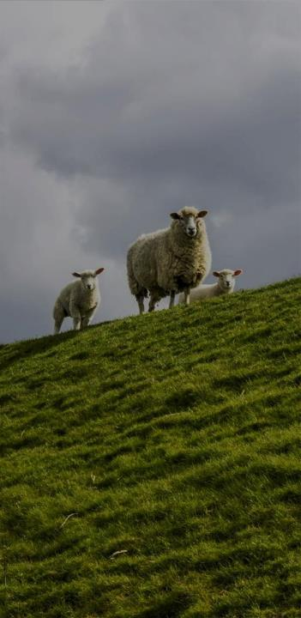
ἐγώ εἰμί
I am the bread of life (6:35)
I am the light of the world (8:12)
I am the door [of the sheep] (10:7)
I am the good shepherd (10:11, 14)
I am the resurrection and the life (11:25)
I am the way, the truth, and the life (14:6)
I am the true vine (15:1)

Slide 24
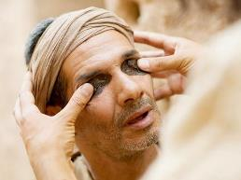
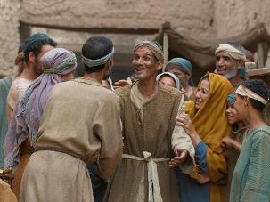
9:9 ἄλλοι ἔλεγον ὅτι οὗτός ἐστιν
Others were saying this is he
ἄλλοι ἔλεγον οὐχί ἀλλὰ ὅμοιος αὐτῷ ἐστιν
still others were saying, “No, but like him, he is.”
ἐκεῖνος ἔλεγεν
He kept saying
ἐκεῖνος ἔλεγεν ὅτι ἐγώ εἰμι
He kept saying I am the one
GNT Greek New Testament
NASB New American Standard Bible
Notes:
https://www.freebibleimages.org/photos/jesus-blind-man-pharisees/

Slide 25
Then Jesus told her, “I am the Messiah! (4:26)
That is why I said that you will die in your sins; for unless you believe that I am who I claim to be, you will die in your sins.”(8:24)
So Jesus said, “When you have lifted up the Son of Man on the cross, then you will understand that I am he. (8:28)
Jesus answered, “I tell you the truth, before Abraham was even born, I am! (8:58)
Notes:
declarations of God’s name, as applied by Jesus to Himself.

Slide 26
¹⁸ “I am not saying these things to all of you; I know the ones I have chosen. But this fulfills the Scripture that says, ‘The one who eats my food has turned against me.’^{[a]} ¹⁹ I tell you this beforehand, so that when it happens you will believe that I am the Messiah.^{[b]} ²⁰ I tell you the truth, anyone who welcomes my messenger is welcoming me, and anyone who welcomes me is welcoming the Father who sent me.”
John 13:18-20

Slide 27
¹⁸ “I am not saying these things to all of you; I know the ones I have chosen. But this fulfills the Scripture that says, ‘The one who eats my food has turned against me.’^{[a]} ¹⁹ I tell you this beforehand, so that when it happens you will believe that I am the Messiah.^{[b]} ²⁰ I tell you the truth, anyone who welcomes my messenger is welcoming me, and anyone who welcomes me is welcoming the Father who sent me.”
John 13:18-20

Slide 28
Jesus is the Messiah (18-20)
Jesus was Troubled (21)
Understanding Unfaithfulness
Unpacking Judas’ Betrayal
John 13:18-30
Notes:
https://lightcentre.com/the-5-soul-wound-4-the-wound-of-betrayal/

Slide 29
²¹ Now Jesus was deeply troubled, and he exclaimed, “I tell you the truth, one of you will betray me!”
John 13:21
Notes:
Heart and cross image from the logo of https://heartofgodchurch.org/

Slide 30
²¹ Now Jesus was deeply troubled, and he exclaimed, “I tell you the truth, one of you will betray me!”
John 13:21
Notes:
Heart and cross image from the logo of https://heartofgodchurch.org/

Slide 31
1 Timothy 2:1-4
¹ I urge you, first of all, to pray for all people. Ask God to help them; intercede on their behalf, and give thanks for them. ² Pray this way for kings and all who are in authority so that we can live peaceful and quiet lives marked by godliness and dignity. ³ This is good and pleases God our Savior, ⁴ who wants everyone to be saved and to understand the truth

Slide 32
2 Peter 3:9
⁹ The Lord isn’t really being slow about his promise, as some people think. No, he is being patient for your sake. He does not want anyone to perish, but wants everyone to repent.

Slide 33
²¹ Now Jesus was deeply troubled, and he exclaimed, “I tell you the truth, one of you will betray me!”
John 13:21
Notes:
Heart and cross image from the logo of https://heartofgodchurch.org/

Slide 34
John 11:33
³³ When Jesus saw her weeping and saw the other people wailing with her, a deep anger welled up within him, and he was deeply troubled.
Notes:
Heart and cross image from the logo of https://heartofgodchurch.org/

Slide 35
John 12:27
²⁷ “Now my soul is deeply troubled. Should I pray, ‘Father, save me from this hour’? But this is the very reason I came! ²⁸ Father, bring glory to your name.”
Notes:
Heart and cross image from the logo of https://heartofgodchurch.org/

Slide 36
Jesus felt troubled,
but we don't have to.
Notes:
Heart and cross image from the logo of https://heartofgodchurch.org/
"Jesus was troubled, so we don’t need to be!"

Slide 37
The Last Supper in John’s Gospel
John 13:1-17 Jesus washes disciples' feet
John 13:18-30 Jesus predicts Judas' betrayal
John 13:31-38 Jesus predicts Peter's denial
John 14:1-14 Jesus' farewell discourse
John 14:15-31 Jesus promises the Holy Spirit
John 15:1-17 Jesus as the true vine
John 15:18-27 World's hatred for Jesus (and followers)
John 16:1-15 Persecution and work of the Holy Spirit
John 16:16-33 Sadness turned to Joy

Slide 38
John 14:1 & 27
¹ “Don’t let your hearts be troubled. Trust in God, and trust also in me.
²⁷ “I am leaving you with a gift—peace of mind and heart. And the peace I give is a gift the world cannot give. So don’t be troubled or afraid.

Slide 39
And in this Gospel the church is one
We do not walk alone
We have His Spirit as we press on
To lead us safely home
And when in glory still I will sing
Of this old story that rescued me
Praise to my Saviour the King of life
I stand in the Gospel of Jesus Christ
V4

Slide 40
Jesus was troubled,
we don’t need to be!"
Notes:
Heart and cross image from the logo of https://heartofgodchurch.org/
"Jesus was troubled, so we don’t need to be!"

Slide 41
Jesus is the Messiah (18-20)
Jesus was Troubled (21)
Jesus was in Control
Jesus revealed his Betrayer (22-26)
Understanding Unfaithfulness
Unpacking Judas’ Betrayal
John 13:18-30
Notes:
https://lightcentre.com/the-5-soul-wound-4-the-wound-of-betrayal/

Slide 42
²² The disciples looked at each other, wondering whom he could mean.
John 13:22-26

Slide 43
Matthew 26:22
And they were very sorrowful and began to say to him one after another, “Is it I, Lord?”
Mark 14:19
They began to be sorrowful and to say to him one after another, “Is it I?”

Slide 44
²² The disciples looked at each other, wondering whom he could mean. ²³ The disciple Jesus loved was sitting next to Jesus at the table.^{[d]}
John 13:22-26

Slide 45
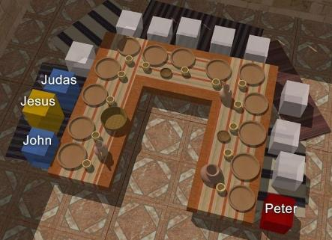
Jesus to All:
“I tell you the truth, one of you will betray me!”
Notes:
https://media.ascensionpress.com/podcast/the-seating-arrangement-at-the-last-supper/

Slide 46
²² The disciples looked at each other, wondering whom he could mean. ²³ The disciple Jesus loved was sitting next to Jesus at the table.^{[d]} ²⁴ Simon Peter motioned to him to ask, “Who’s he talking about?”
John 13:22-26

Slide 47
Peter motions to John:
“ask, “Who’s he talking about!”
Notes:
https://media.ascensionpress.com/podcast/the-seating-arrangement-at-the-last-supper/

Slide 48
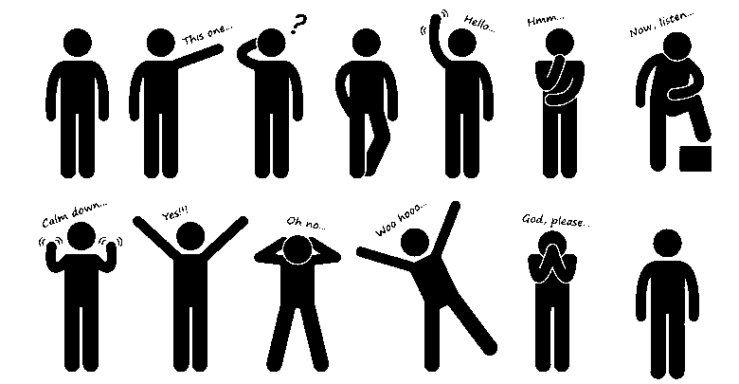

Slide 49
²² The disciples looked at each other, wondering whom he could mean. ²³ The disciple Jesus loved was sitting next to Jesus at the table.^{[d]} ²⁴ Simon Peter motioned to him to ask, “Who’s he talking about?” ²⁵ So that disciple leaned over to Jesus and asked, “Lord, who is it?”
John 13:22-26

Slide 50
John leans over to Jesus:
“Lord, who is it?”
Notes:
https://media.ascensionpress.com/podcast/the-seating-arrangement-at-the-last-supper/

Slide 51
²² The disciples looked at each other, wondering whom he could mean. ²³ The disciple Jesus loved was sitting next to Jesus at the table.^{[d]} ²⁴ Simon Peter motioned to him to ask, “Who’s he talking about?” ²⁵ So that disciple leaned over to Jesus and asked, “Lord, who is it?” ²⁶ Jesus responded, “It is the one to whom I give the bread I dip in the bowl.” And when he had dipped it, he gave it to Judas, son of Simon Iscariot.
John 13:22-26

Slide 52
Jesus responds to John:
“the one to whom I give the bread I dip in the bowl”
Notes:
https://media.ascensionpress.com/podcast/the-seating-arrangement-at-the-last-supper/

Slide 53
Jesus is the Messiah (18-20)
Jesus was Troubled (21)
Jesus was in Control
Jesus revealed his Betrayer (22-26)
Understanding Unfaithfulness
Unpacking Judas’ Betrayal
John 13:18-30
Notes:
https://lightcentre.com/the-5-soul-wound-4-the-wound-of-betrayal/

Slide 54
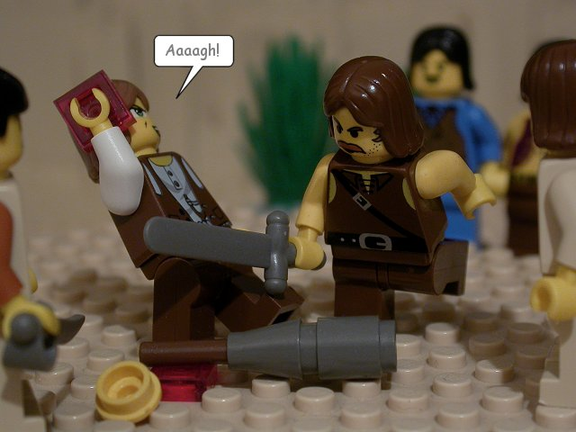
John 13:37
³⁷ “I’m ready to
die for you.”
John 18:10
¹⁰ Then Simon Peter drew a sword and slashed off the right ear of Malchus, the high priest’s slave.
Notes:
https://thebrickbible.com/legacy/the_life_of_jesus/jesus_is_arrested/jn18_10.html

Slide 55
Jesus is the Messiah (18-20)
Jesus was Troubled (21)
Jesus was in Control
Jesus revealed his Betrayer (22-26)
Jesus allowed Judas to Depart (27-30)
Understanding Unfaithfulness
Unpacking Judas’ Betrayal
John 13:18-30
Notes:
https://lightcentre.com/the-5-soul-wound-4-the-wound-of-betrayal/

Slide 56
²⁷ When Judas had eaten the bread, Satan entered into him. Then Jesus told him, “Hurry and do what you’re going to do.”
John 13:27-30

Slide 57
²⁷ When Judas had eaten the bread, Satan entered into him.
Σατανᾶς - Satanâs
² It was time for supper, and the devil had already prompted Judas, son of Simon Iscariot, to betray Jesus.
διάβολος - diábolos

Slide 58
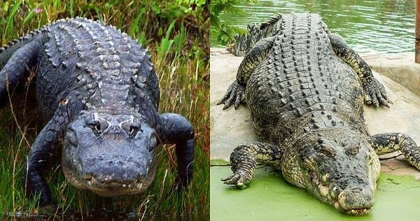

Slide 59
In the New Testament, the terms "Satan" and "the devil" are often used interchangeably to refer to the same entity, although there are subtle nuances in their usage.
1 Peter 5:8 (ESV)
⁸ Be sober-minded; be watchful. Your adversary the devil prowls around like a roaring lion, seeking someone to devour.
James 4:7 (ESV)
⁷ Submit yourselves therefore to God. Resist the devil, and he will flee from you.

Slide 60
²⁷ When Judas had eaten the bread, Satan entered into him. Then Jesus told him, “Hurry and do what you’re going to do.” ²⁸ None of the others at the table knew what Jesus meant. ²⁹ Since Judas was their treasurer, some thought Jesus was telling him to go and pay for the food or to give some money to the poor.
John 13:27-30

Slide 61
²⁷ When Judas had eaten the bread, Satan entered into him. Then Jesus told him, “Hurry and do what you’re going to do.” ²⁸ None of the others at the table knew what Jesus meant. ²⁹ Since Judas was their treasurer, some thought Jesus was telling him to go and pay for the food or to give some money to the poor. ³⁰ So Judas left at once, going out into the night.
John 13:27-30

Slide 62
I wandered so aimless, life filed with sin
I wouldn't let my dear Savior in
Then Jesus came like a stranger in the night
Praise the Lord, I saw the light
Just like a blind man, I wandered along
Worries and fears I claimed for my own
Then like the blind man that God gave back his sight
Praise the Lord, I saw the light
I was a fool to wander and stray
For straight is the gate and narrow's the way
Now I have traded the wrong for the right
Praise the Lord, I saw the light
I saw the light,
I saw the light
No more darkness,
no more night
Now I'm so happy,
no sorrow in sight
Praise the Lord,
I saw the light

Slide 63
John 1
⁴ In him was life, and the life was the light of men. ⁵ The light shines in the darkness, and the darkness has not overcome it.
The World is in the Dark

Slide 64
Jesus is the Messiah (18-20)
Jesus was Troubled (21)
Jesus was in Control
Jesus revealed his Betrayer (22-26)
Jesus allowed Judas to Depart (27-30)
Examine Our Loyalty and Understanding of God's Plan
Understanding Unfaithfulness
Unpacking Judas’ Betrayal
John 13:18-30
Notes:
https://lightcentre.com/the-5-soul-wound-4-the-wound-of-betrayal/

