Slide 1
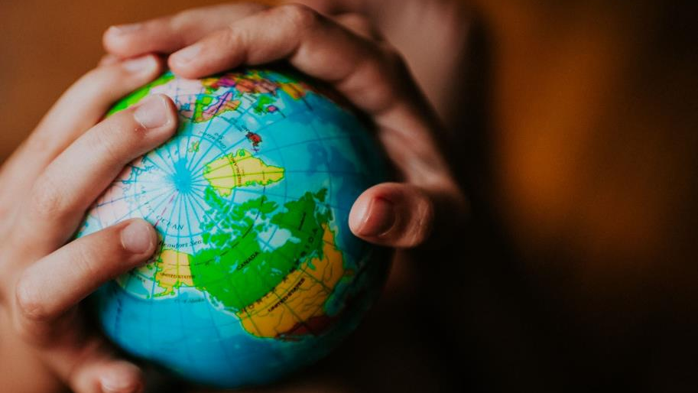
The Earth is not round!

Slide 2
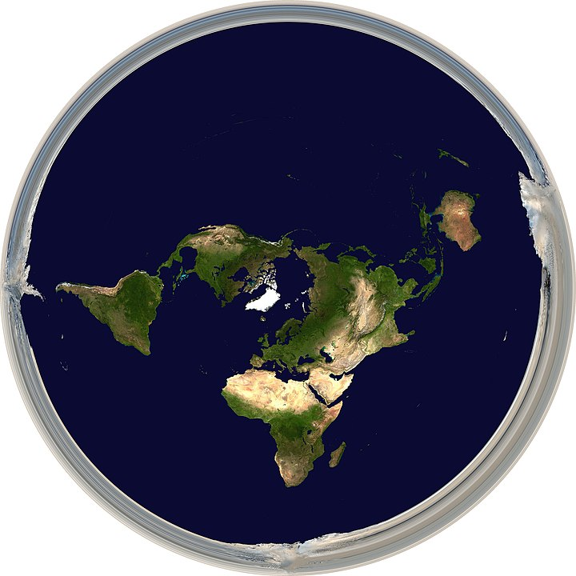
Azimuthal equidistant
projection
Notes:
all points on the map are at proportionally correct distances from the center point

Slide 3
Azimuthal equidistant
projection
Emblem of the
United Nations
A flat disc surrounded by an ice wall
Evidence of a global conspiracy

Slide 4
But despite all the evidence of modern science,
Flat-earthers still do not believe the earth is round.
A flat disc surrounded by an ice wall
Evidence of a global conspiracy

Slide 5
³⁷ But despite all the miraculous signs Jesus had done, most of the people still did not believe in him.
John 12:37-50

Slide 6
³⁷ But despite all the miraculous signs Jesus had done, most of the people still did not believe in him.
WATER TO WINE 2:1-11
HEALING OFFICIAL'S
SON 4:46-54
HEALING PARALYTIC 5:1-18
FEEDING 5000 6:1-15
WALKING ON WATER 6:16-24
HEALING BLIND MAN 9:1-7
RAISING LAZARUS 11:1-45
John 12:37-50

Slide 7
to Eternal Rewards
John 12:37-50
Unyielding Unbelief

Slide 8
Believing
C H R I S T
Responding to John’s Gospel

Slide 9
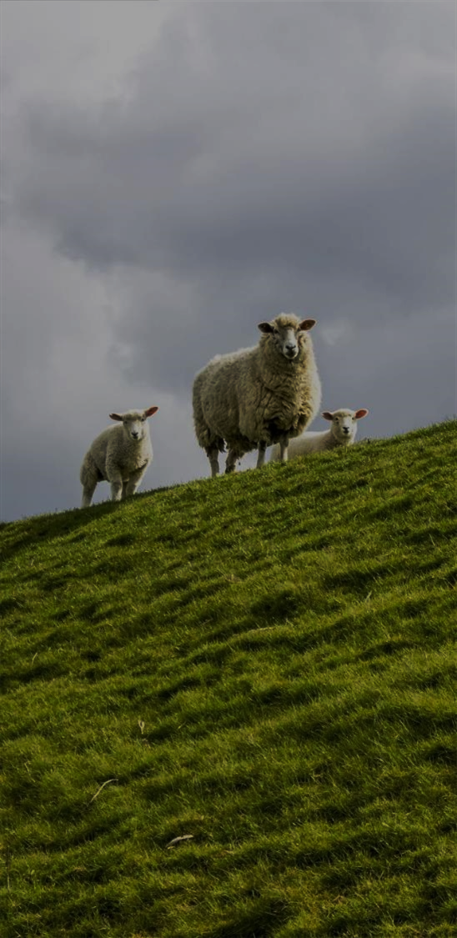
I am the bread of life (6:35)
I am the light of the world (8:12)
I am the door [of the sheep] (10:7)
I am the good shepherd (10:11, 14)
I am the resurrection and the life (11:25)
I am the way, the truth, and the life (14:6)
I am the true vine (15:1)

Slide 10
Following Jesus means
accepting his sacrificed life (vs. 20-24)
losing worldly honor (vs. 25-26)
living for God’s honor (vs. 27-28)
responding to the call of Christ (vs. 29-36)
-Following Jesus to the cross-
John 12:20-36

Slide 11
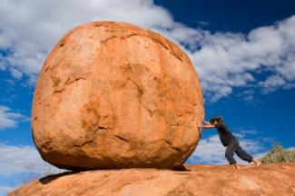
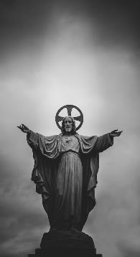
Unbelief was expected (37-41)
Unyielding Unbelief to Eternal Rewards
John 12:37-50
Notes:
https://www.independentbaptist.com/dealing-with-a-hardened-heart/
https://unsplash.com/photos/grayscale-photograph-of-jesus-christ-statue-CvnVk7GGQCg

Slide 12
³⁷ But despite all the miraculous signs Jesus had done, most of the people still did not believe in him. ³⁸ This is exactly what Isaiah the prophet had predicted:
“Lord, who has believed our message? To whom has the Lord revealed his powerful arm?”
³⁹ But the people couldn’t believe, for as Isaiah also said,
⁴⁰ “The Lord has blinded their eyes and hardened their hearts— so that their eyes cannot see, and their hearts cannot understand, and they cannot turn to me and have me heal them.”
⁴¹ Isaiah was referring to Jesus when he said this, because he saw the future and spoke of the Messiah’s glory.

Slide 13
³⁷ But despite all the miraculous signs Jesus had done, most of the people still did not believe in him. ³⁸ This is exactly what Isaiah the prophet had predicted:
“Lord, who has believed our message? To whom has the Lord revealed his powerful arm?”
³⁹ But the people couldn’t believe, for as Isaiah also said,
⁴⁰ “The Lord has blinded their eyes and hardened their hearts— so that their eyes cannot see, and their hearts cannot understand, and they cannot turn to me and have me heal them.”
⁴¹ Isaiah was referring to Jesus when he said this, because he saw the future and spoke of the Messiah’s glory.

Slide 14
³⁷ But despite all the miraculous signs Jesus had done, most of the people still did not believe in him. ³⁸ This is exactly what Isaiah the prophet had predicted:
“Lord, who has believed our message? To whom has the Lord revealed his powerful arm?”
³⁹ But the people couldn’t believe, for as Isaiah also said,
⁴⁰ “The Lord has blinded their eyes and hardened their hearts— so that their eyes cannot see, and their hearts cannot understand, and they cannot turn to me and have me heal them.”
⁴¹ Isaiah was referring to Jesus when he said this, because he saw the future and spoke of the Messiah’s glory.

Slide 15
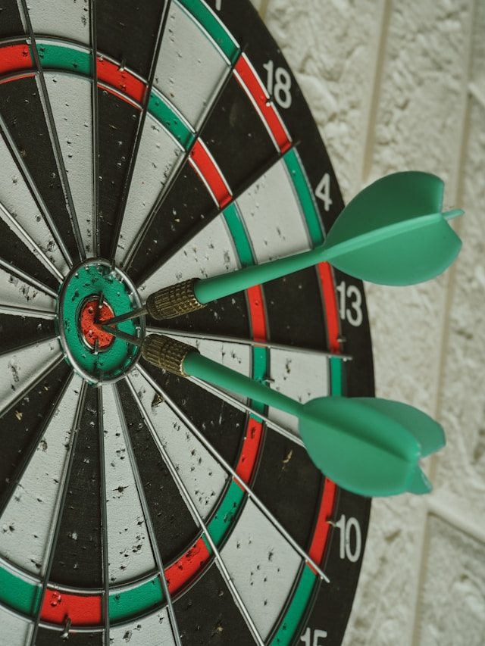
³⁸ This is exactly what Isaiah the prophet had predicted
Notes:
Photo by Afif Ramdhasuma on Unsplash
https://unsplash.com/photos/red-and-black-round-metal-jl4BQJs87Do

Slide 16
“Lord, who has believed our message? To whom has the Lord revealed his powerful arm?”
Footnote
Isa 53.1
Isaiah 53
¹ Who has believed our message? To whom has the Lord revealed his powerful arm? ² My servant grew up in the Lord’s presence like a tender green shoot, like a root in dry ground. There was nothing beautiful or majestic about his appearance, nothing to attract us to him.

Slide 17
“Lord, who has believed our message? To whom has the Lord revealed his powerful arm?”
Servant songs
A figure bearing the sins of others, enduring affliction for their redemption, often interpreted as messianic.
Isaiah 42:1–4
Isaiah 49:1–6
Isaiah 50:4–11
Isaiah 52:13–53:12

Slide 18
“Lord, who has believed our message? To whom has the Lord revealed his powerful arm?”
Servant songs
³⁸ This is exactly what Isaiah the prophet had predicted
⁴¹ Isaiah was referring to Jesus when he said this, because he saw the future and spoke of the Messiah’s glory.
Isaiah 42:1–4
Isaiah 49:1–6
Isaiah 50:4–11
Isaiah 52:13–53:12

Slide 19
³⁹ But the people couldn’t believe, for as Isaiah also said,
⁴⁰ “The Lord has blinded their eyes and hardened their hearts— so that their eyes cannot see, and their hearts cannot understand, and they cannot turn to me and have me heal them.”
Footnote
Isa 6:10

Slide 20
Isaiah’s Calling
and Judah’s response
Isaiah 6: It was in the year King Uzziah died that I saw the Lord. He was sitting on a lofty throne, and the train of his robe filled the Temple. ² Attending him were mighty seraphim, each having six wings. With two wings they covered their faces, with two they covered their feet, and with two they flew. ³ They were calling out to each other,
“Holy, holy, holy is the Lord of Heaven’s Armies! The whole earth is filled with his glory!”

Slide 21
Isaiah’s Calling
and Judah’s response
¹⁰ Harden the hearts of these people. Plug their ears and shut their eyes. That way, they will not see with their eyes, nor hear with their ears, nor understand with their hearts and turn to me for healing.”

Slide 22
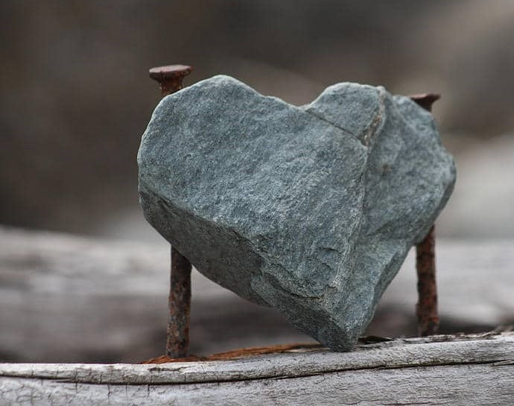
Hardened hearts
It is important that this truth is balanced by the fact that people so blinded and hardened had also made their own choice to reject the message, and for their own reasons
Kruse, C. G. (2003). Tyndall New Testament Commentary
Notes:
Hardened Heart from https://www.independentbaptist.com/dealing-with-a-hardened-heart/

Slide 23
1. Blood: Pharaoh’s heart “became hard” (7:22)
2. Frogs: Pharaoh “hardened his own heart” (8:15)
3. Gnats: Pharaoh’s heart “was hard” (8:19)
4. Flies: “Pharaoh hardened his own heart” (8:32)
5. Livestock die: Pharaoh’s heart “was hard” (9:7)
6. Boils: “The Lord hardened Pharaoh’s heart” (9:12)
7. Hail: Pharaoh “hardened his own heart” (9:34)
Locusts: God announces that he has “hardened Pharaoh’s
heart” (10:1,10:20)
9. Darkness: God “hardened Pharaoh’s heart” (10:27)
10. Death of the firstborn: God “hardened Pharaoh’s heart”
(11:10)
Who hardened Pharoah’s heart?

Slide 24
Hardened hearts in the NT?
John
Romans
Prologue
Thesis
John 1:1-18
Rom 1:16-17
¹⁶ For I am not ashamed of the gospel, because it is the power of God that brings salvation to everyone who believes: first to the Jew, then to the Gentile. ¹⁷ For in the gospel the righteousness of God is revealed—a righteousness that is by faith from first to last, just as it is written: “The righteous will live by faith.”

Slide 25
¹⁸ The wrath of God is being revealed from heaven against all the godlessness and wickedness of people, who suppress the truth by their wickedness, ¹⁹ since what may be known about God is plain to them, because God has made it plain to them. ²⁰ For since the creation of the world God’s invisible qualities—his eternal power and divine nature—have been clearly seen, being understood from what has been made, so that people are without excuse.
²¹ For although they knew God, they neither glorified him as God nor gave thanks to him, but their thinking became futile and their foolish hearts were darkened. ²² Although they claimed to be wise, they became fools ²³ and exchanged the glory of the immortal God for images made to look like a mortal human being and birds and animals and reptiles.
²⁴ Therefore God gave them over in the sinful desires of their hearts to sexual impurity for the degrading of their bodies with one another. ²⁵ They exchanged the truth about God for a lie, and worshiped and served created things rather than the Creator—who is forever praised. Amen.
²⁶ Because of this, God gave them over to shameful lusts. Even their women exchanged natural sexual relations for unnatural ones. ²⁷ In the same way the men also abandoned natural relations with women and were inflamed with lust for one another. Men committed shameful acts with other men, and received in themselves the due penalty for their error.
²⁸ Furthermore, just as they did not think it worthwhile to retain the knowledge of God, so God gave them over to a depraved mind, so that they do what ought not to be done.

Slide 26
Unbelief was expected (37-41)
Shallow Faith (42-43)
Unyielding Unbelief to Eternal Rewards
John 12:37-50
Notes:
https://www.independentbaptist.com/dealing-with-a-hardened-heart/
https://unsplash.com/photos/grayscale-photograph-of-jesus-christ-statue-CvnVk7GGQCg

Slide 27
⁴² Many people did believe in him, however, including some of the Jewish leaders. But they wouldn’t admit it for fear that the Pharisees would expel them from the synagogue.
John 7:13: But no one had the courage to speak favorably about him in public, for they were afraid of getting in trouble with the Jewish leaders.
John 9:22 His parents said this because they were afraid of the Jewish leaders, who had announced that anyone saying Jesus was the Messiah would be expelled from the synagogue.
John 20:19 That Sunday evening the disciples were meeting behind locked doors because they were afraid of the Jewish leaders.

Slide 28
⁴² Many people did believe in him, however, including some of the Jewish leaders. But they wouldn’t admit it for fear that the Pharisees would expel them from the synagogue.
2 Timothy 3:12 Yes, and everyone who wants to live a godly life in Christ Jesus will suffer persecution.
Philippians 1:29 For you have been given not only the privilege of trusting in Christ but also the privilege of suffering for him.

Slide 29
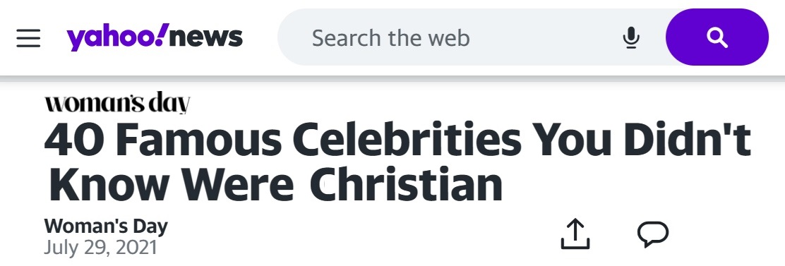
⁴² Many people did believe in him, however, including some of the Jewish leaders. But they wouldn’t admit it for fear that the Pharisees would expel them from the synagogue. ⁴³ For they loved human praise more than the praise of God.

Slide 30
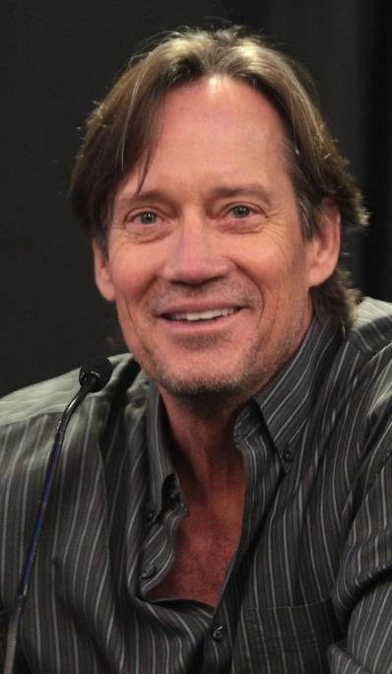
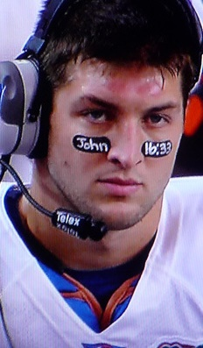

Slide 31
⁴² Many people did believe in him, however, including some of the Jewish leaders. But they wouldn’t admit it for fear that the Pharisees would expel them from the synagogue. ⁴³ For they loved human praise more than the praise of God.
Romans 1:16
For I am not ashamed of the gospel, because it is the power of God that brings salvation to everyone who believes: first to the Jew, then to the Gentile.

Slide 32
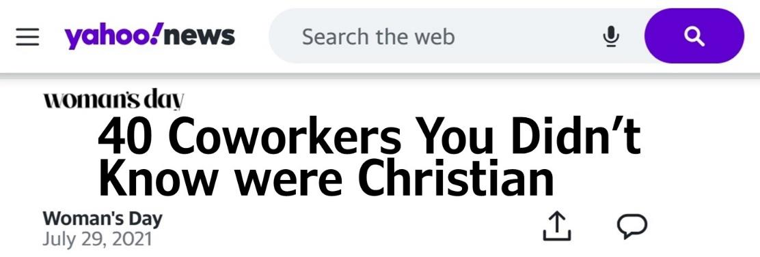
Are you ashamed?

Slide 33
A common media stereotype is that of the 'Christian extremist': a Christian who holds radical religious viewpoints and who will go to radical extremes to assert them. These beliefs and behaviors are presented as dramatic, unusual and excessive, almost always within a negative context.
World View of Christians

Slide 34
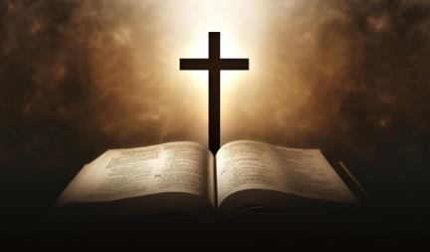
John 13:15 I have given you an example to follow. Do as I have done to you.
John 13:35 Your love for one another will prove to the world that you are my disciples.”
Biblical View of Christians

Slide 35
Problem: Most People do not Respond to the Gospel
Unbelief was expected (37-41)
Shallow Faith (42-43)
Solution: Embrace Faith and Reap Eternal Rewards
Unyielding Unbelief to Eternal Rewards
John 12:37-50
Notes:
https://www.independentbaptist.com/dealing-with-a-hardened-heart/
https://unsplash.com/photos/grayscale-photograph-of-jesus-christ-statue-CvnVk7GGQCg

Slide 36
Unbelief was expected (37-41)
Shallow Faith (42-43)
Embracing Faith (44-46)
Unyielding Unbelief to Eternal Rewards
John 12:37-50
Notes:
https://www.independentbaptist.com/dealing-with-a-hardened-heart/
https://unsplash.com/photos/grayscale-photograph-of-jesus-christ-statue-CvnVk7GGQCg

Slide 37
⁴⁴ Jesus shouted to the crowds, “If you trust me, you are trusting not only me, but also God who sent me. ⁴⁵ For when you see me, you are seeing the one who sent me. ⁴⁶ I have come as a light to shine in this dark world, so that all who put their trust in me will no longer remain in the dark.

Slide 38
⁴⁴ Jesus shouted to the crowds,
κράζω
krazō
cry out aloud, speak with a loud voice
John 1:15 John testified about him when he shouted . . .
John 7:27 . . . Jesus . . . called out . . . I’m not here on my
own. The one who sent me is true
John 12:38 Jesus . . . shouted . . . “Anyone who is thirsty
may come to me!

Slide 39
κράζω μέγας φωνή
krazō megas phōnē
Revelation 7:10
¹⁰ And they cried out in a loud voice:
“Salvation belongs to our God, who sits on the throne, and to the Lamb.”

Slide 40
⁴⁴ Jesus shouted to the crowds, “If you trust me, you are trusting not only me, but also God who sent me. ⁴⁵ For when you see me, you are seeing the one who sent me. ⁴⁶ I have come as a light to shine in this dark world, so that all who put their trust in me will no longer remain in the dark.
Emphasizes unity and identity
with God the father

Slide 41
John 1: ¹ In the beginning was the Word, and the Word was with God, and the Word was God. ² He was in the beginning with God. ³ All things were made through him, and without him was not any thing made that was made.
. . . ¹⁸ No one has ever seen God; the only God, who is at the Father's side, he has made him known.
Emphasizes unity and identity
with God the father

Slide 42
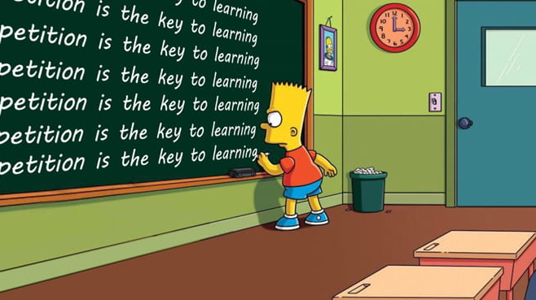

Slide 43
John 7:16
So Jesus told them, “My message is not my own; it comes from God who sent me.
John 10:37-38
³⁷ Don’t believe me unless I carry out my Father’s work. ³⁸ But if I do his work, believe in the evidence of the miraculous works I have done, even if you don’t believe me. Then you will know and understand that the Father is in me, and I am in the Father.”

Slide 44
John 14:10-11
¹⁰ Don’t you believe that I am in the Father and the Father is in me? The words I speak are not my own, but my Father who lives in me does his work through me. ¹¹ Just believe that I am in the Father and the Father is in me. Or at least believe because of the work you have seen me do.
John 14:24
Anyone who doesn’t love me will not obey me. And remember, my words are not my own. What I am telling you is from the Father who sent me.
unity and identity

Slide 45
Do you have any doctrinal views or practices that are not commonly accepted by evangelical Christians?
Have you worked on international or cross-cultural teams?
Describe any doctrinal emphases or church practices with which you would not be willing to work?
unity and identity

Slide 46
Dallas Theological Seminary
Wheaton College
Asbury
Singapore Bible College
Southern Baptist Theological Seminary
The Open Mind Institute of Divine Interpretation
unity and identity

Slide 47
Nicene Creed
We believe in one Lord, Jesus Christ,
the only Son of God,
eternally begotten of the Father,
God from God, Light from Light,
true God from true God,
begotten, not made,
consubstantial to the father (one in being with the father)
Phil 2:6
unity and identity

Slide 48
⁴⁴ Jesus shouted to the crowds, “If you trust me, you are trusting not only me, but also God who sent me. ⁴⁵ For when you see me, you are seeing the one who sent me. ⁴⁶ I have come as a light to shine in this dark world, so that all who put their trust in me will no longer remain in the dark.
Jesus as Light of the World

Slide 49
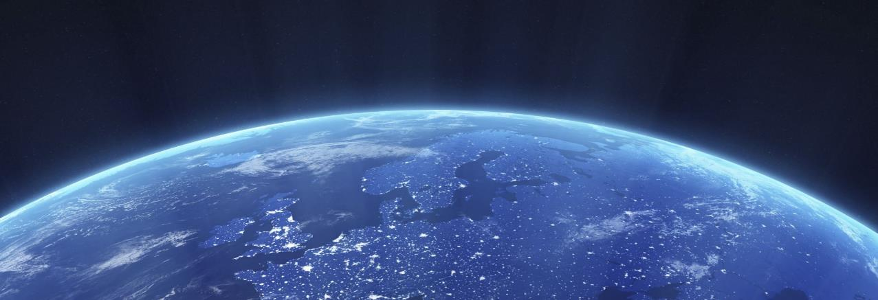
"Jesus is the Light of the world. In fact, there is no light other than Christ. Those who walk in darkness are those who don't know the Savior of the World, the Author of Light.“
Franklin Graham

Slide 50
John 1:1-3, 18 Unity and Identity with God
John 1:4-9 Jesus as light of the World
⁴ In him was life, and the life was the light of men. ⁵ The light shines in the darkness, and the darkness has not overcome it.
6-8 John the Baptist as a witness to the light
⁹ The true light, which gives light to everyone, was coming into the world.

Slide 51
Problem: Most People do not Respond to the Gospel
Unbelief was expected (37-41)
Shallow Faith (42-43)
Embracing Faith (44-46)
Reaping eternal rewards (47-50)
Unyielding Unbelief to Eternal Rewards
John 12:37-50
Notes:
https://www.independentbaptist.com/dealing-with-a-hardened-heart/
https://unsplash.com/photos/grayscale-photograph-of-jesus-christ-statue-CvnVk7GGQCg

Slide 52
⁴⁷ I will not judge those who hear me but don’t obey me, for I have come to save the world and not to judge it. ⁴⁸ But all who reject me and my message will be judged on the day of judgment by the truth I have spoken. ⁴⁹ I don’t speak on my own authority. The Father who sent me has commanded me what to say and how to say it. ⁵⁰ And I know his commands lead to eternal life; so I say whatever the Father tells me to say.”
Consequences of Believing

Slide 53
John 1:1-3, 18 Unity and Identity with God
John 1:4-9 Jesus as light of the World
John 1:10-13 Consequences of believing
¹⁰ He was in the world, and the world was made through him, yet the world did not know him. ¹¹ He came to his own, and his own people did not receive him. ¹² But to all who did receive him, who believed in his name, he gave the right to become children of God, ¹³ who were born, not of blood nor of the will of the flesh nor of the will of man, but of God.

Slide 54
⁴⁷ I will not judge those who hear me but don’t obey me, for I have come to save the world and not to judge it. ⁴⁸ But all who reject me and my message will be judged on the day of judgment by the truth I have spoken. ⁴⁹ I don’t speak on my own authority. The Father who sent me has commanded me what to say and how to say it. ⁵⁰ And I know his commands lead to eternal life; so I say whatever the Father tells me to say.”
Consequences of NOT Believing

Slide 55
John 3:17-18 ¹⁷ God sent his Son into the world not to judge the world, but to save the world through him. ¹⁸ “There is no judgment against anyone who believes in him. But anyone who does not believe in him has already been judged for not believing in God’s one and only Son.
Consequences of NOT Believing

Slide 56
John 3:17 God sent his Son into the world not to judge the world, but to save the world through him.
John 12:47 I will not judge those who hear me but don’t obey me, for I have come to save the world and not to judge it.

Slide 57
John 5:22-29 ²² In addition, the Father judges no one. Instead, he has given the Son absolute authority to judge,
²⁵ “And I assure you that the time is coming, indeed it’s here now, when the dead will hear my voice—the voice of the Son of God. And those who listen will live. ²⁶ The Father has life in himself, and he has granted that same life-giving power to his Son. ²⁷ And he has given him authority to judge everyone because he is the Son of Man. ²⁸ Don’t be so surprised! Indeed, the time is coming when all the dead in their graves will hear the voice of God’s Son, ²⁹ and they will rise again. Those who have done good will rise to experience eternal life, and those who have continued in evil will rise to experience judgment

Slide 58
Nicene Creed
For our sake he was crucified under Pontius Pilate; he suffered death and was buried. On the third day he rose again in accordance with the Scriptures; he ascended into heaven and is seated at the right hand of the Father.
He will come again in glory to judge the living and the dead, and his kingdom will have no end.

Slide 59
Time Periods of the Prophets
New Heavens & New Earth
Christ’s
Second
Coming to
Reign in
Millennium
Christ’s
First
Coming
to Suffer
Exile & Return
Isaiah’s Own Time
Adapted significantly from Salem Kirban, Charts on Revelation (1979), 49

Slide 60
John 3:17 God sent his Son into the world not to judge the world, but to save the world through him.
New Heavens & New Earth
Christ’s
Second
Coming to
Reign in
Millennium
Christ’s
First
Coming
to Suffer
Exile & Return
Isaiah’s Own Time
Adapted significantly from Salem Kirban, Charts on Revelation (1979), 49

Slide 61
He will come again in glory to judge the living and the dead, and his kingdom will have no end.
New Heavens & New Earth
Christ’s
Second
Coming to
Reign in
Millennium
Christ’s
First
Coming
to Suffer
Exile & Return
Isaiah’s Own Time
Adapted significantly from Salem Kirban, Charts on Revelation (1979), 49

Slide 62
⁴⁷ I will not judge those who hear me but don’t obey me, for I have come to save the world and not to judge it. ⁴⁸ But all who reject me and my message will be judged on the day of judgment by the truth I have spoken. ⁴⁹ I don’t speak on my own authority. The Father who sent me has commanded me what to say and how to say it. ⁵⁰ And I know his commands lead to eternal life; so I say whatever the Father tells me to say.”
Unity and Identity

Slide 63
WATER TO WINE 2:1-11
HEALING OFFICIAL'S
SON 4:46-54
HEALING PARALYTIC 5:1-18
FEEDING 5000 6:1-15
WALKING ON WATER 6:16-24
HEALING BLIND MAN 9:1-7
RAISING LAZARUS 11:1-45
For our sake he was crucified under Pontius Pilate;
he suffered death and was buried.
On the third day he rose again in accordance with the Scriptures;

Slide 64
Problem: Most People do not Respond to the Gospel
Unbelief was expected (37-41)
Shallow Faith (42-43)
Embracing Faith (44-46)
Reaping eternal rewards (47-50)
Unyielding Unbelief to Eternal Rewards
John 12:37-50
Notes:
https://www.independentbaptist.com/dealing-with-a-hardened-heart/
https://unsplash.com/photos/grayscale-photograph-of-jesus-christ-statue-CvnVk7GGQCg

