Slide 1
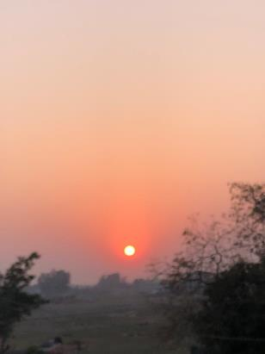
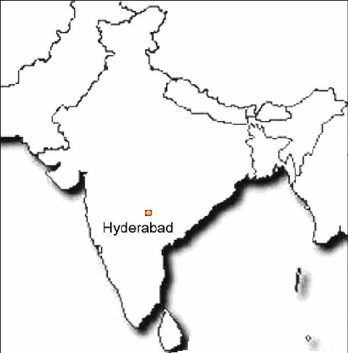
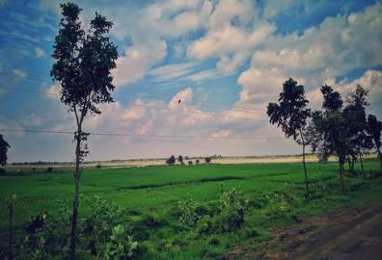
India Trip March 2024
Hyderabad and the States of Orissa and West Bengal
Gazole, West Bengal
Jatni, Orissa

Slide 2
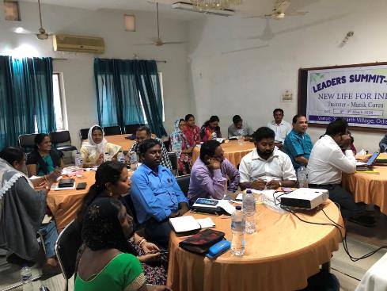
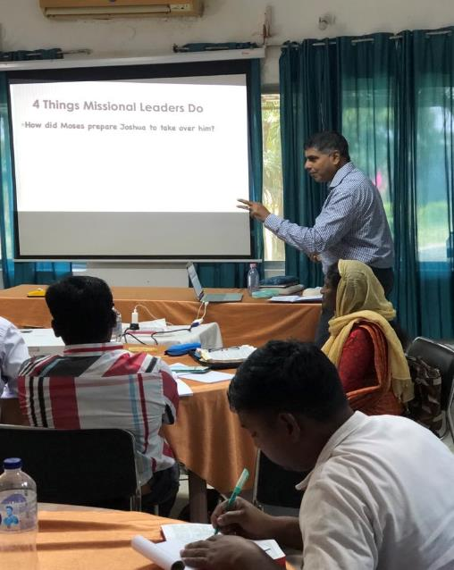
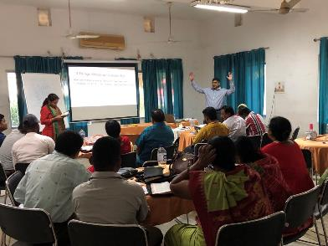

Slide 3
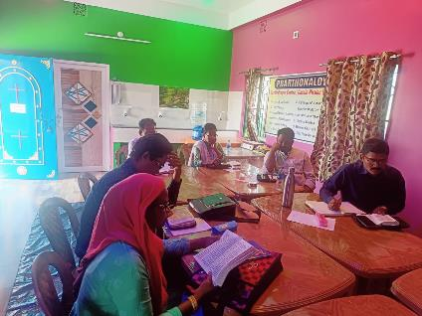
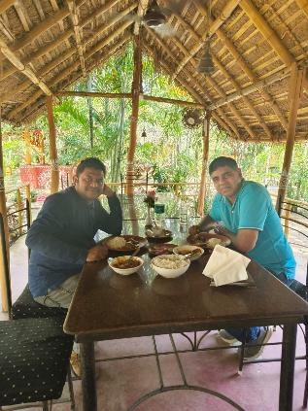
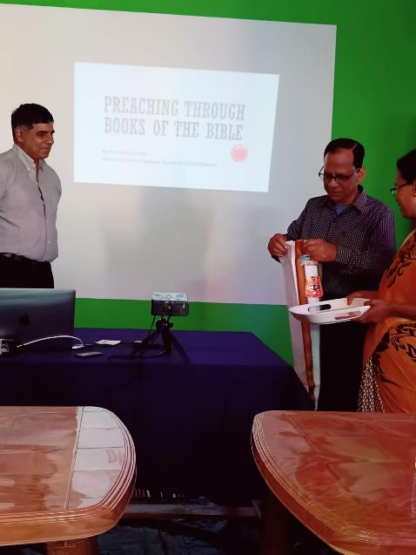
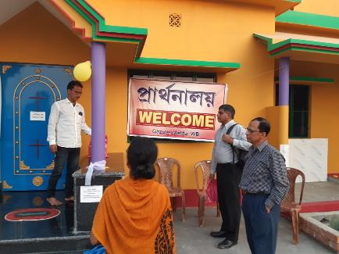
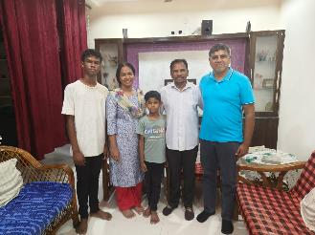

Slide 4
Believing
C H R I S T
Responding to John’s Gospel
Notes:
Today’s sermon is the third in a series called Believing Christ, Responding to John’s Gospel account.
And here is a spoiler alert: everyone who hears the gospel, or good news, in our story today, in verses 35-51, responds by believing that Jesus is the Christ.
But, even though we know how they responded, we can still learn something by looking at the various circumstances leading up to,
as well as the differences in their actual reactions.

Slide 5
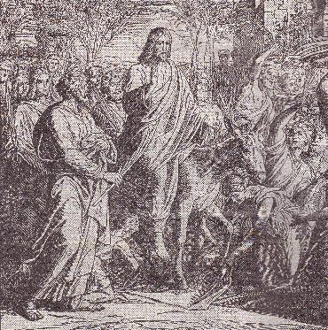
John 12:1-19
The Acts before the Final Act

Slide 7
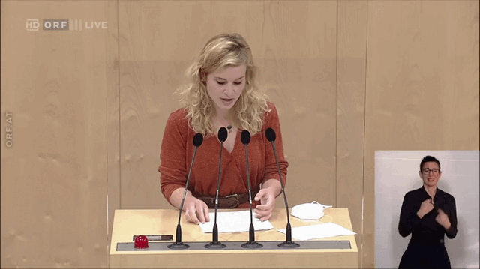
UKRAINE PRESIDENTIAL ELECTIONS 2004

Slide 8
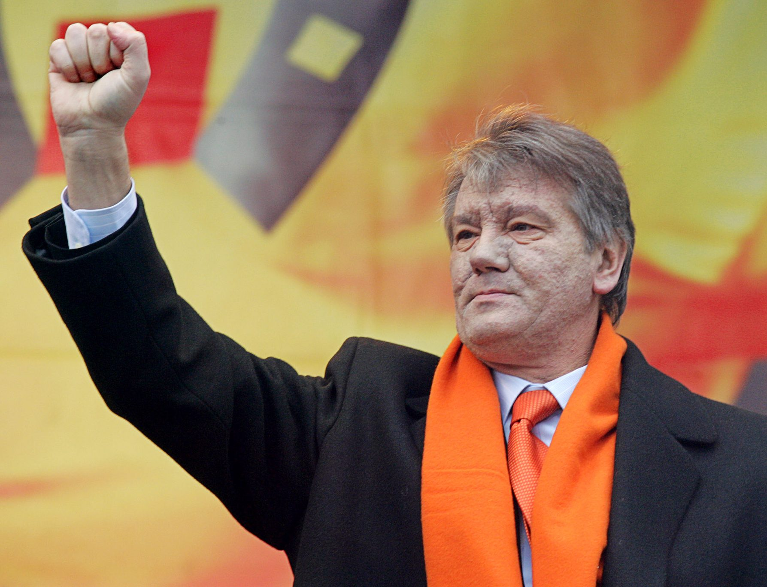
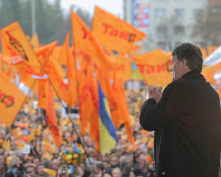
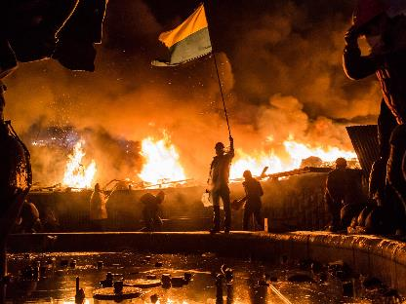
The Orange Revolution

Slide 9
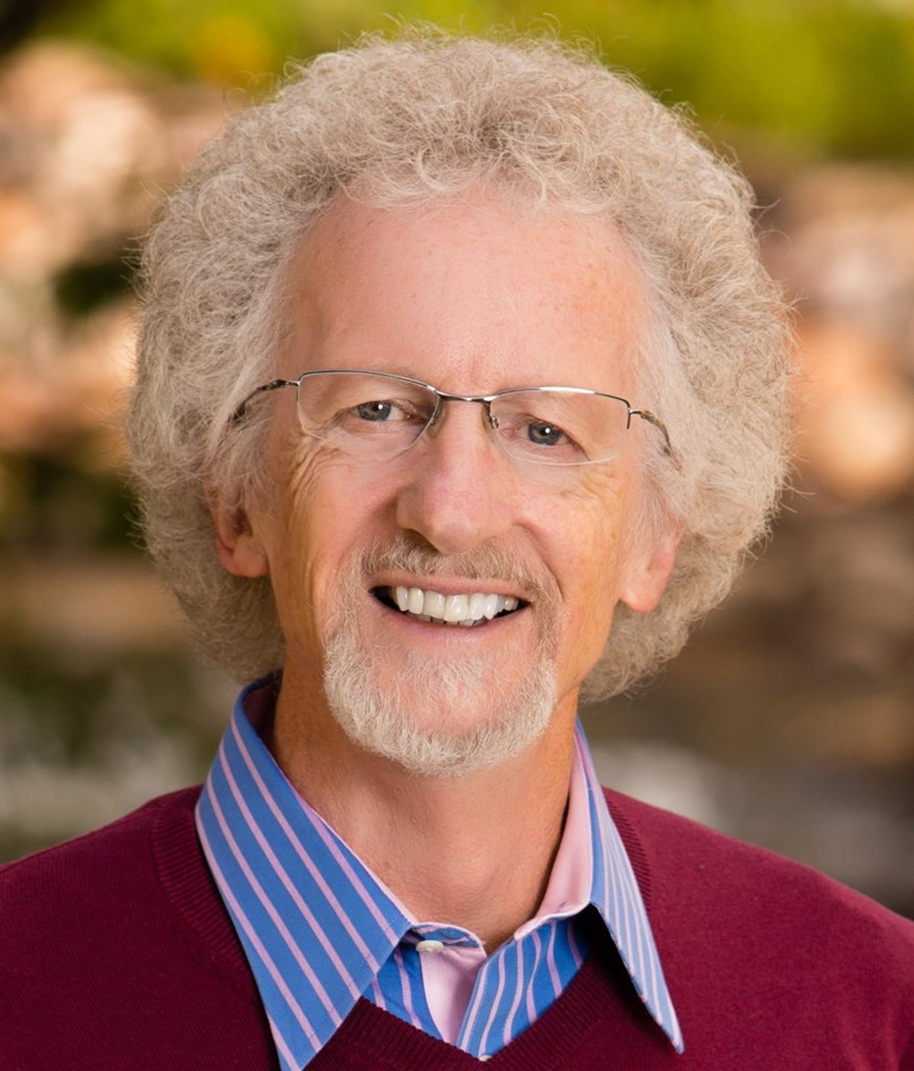
Philip Yancey
Like the sign language translator in the lower right hand corner of the screen, along comes a person named Jesus who says in effect,
Don’t believe the big screen—they’re lying….Those who go through life thinking they’re on top will end up on the bottom. And those who go through life feeling they’re at the very bottom will end up on top. After all, what does it profit a person to gain the whole world and lose his soul?
Philip Yancey, What Good is God, Faithworks:2012, page 184-186 .
Notes:
Paul upset because Peter has stopped eating with Gentile believers and separated himself from the Gentile Christians when the Jerusalem part came. Peter on other hand, afraid of offending these Jews of the 'circumcision party' - who held that Jews and uncircumcised Gentiles should not mix, let alone eat together or share their food.
Read vs 14. Paul basically said to Peter that he did not follow the law of Moses as a Christian. "Peter, you eat bacon and ham and lobster now. You have not been keeping a Kosher diet. Yet now, before these certain men from James, you act as though you keep these laws all the time."

Slide 10
John 12:1-19
The Acts before the Final Act

Slide 11
ACT 1 – John 12:1-8 Anointed for Burial
Category John 12 John 13
Time: Six days before Passover Before Passover
Companion: Lazarus Beloved disciple
Washing feet: Mary washed Jesus Jesus washed disciples
Jesus’ death: Day of my burial Took off robe (implied)
Jesus’ departure: You do not always have me Hour to depart from the world
(Source: R. Alan Culpepper, The Gospel and Letters of John, Nashville: Abingdo, 1998. page 202-3)

Slide 12
¹Six days before the Passover, Jesus therefore came to Bethany, where Lazarus was, whom Jesus had raised from the dead. ² So they gave a dinner for him there. Martha served, and Lazarus was one of those reclining with him at table. ³ Mary therefore took a pound of expensive ointment made from pure nard, and anointed the feet of Jesus and wiped his feet with her hair. The house was filled with the fragrance of the perfume. ⁴ But Judas Iscariot, one of his disciples (he who was about to betray him), said, ⁵ “Why was this ointment not sold for three hundred denarii and given to the poor?” ⁶ He said this, not because he cared about the poor, but because he was a thief, and having charge of the moneybag he used to help himself to what was put into it. ⁷ Jesus said, “Leave her alone, so that she may keep it for the day of my burial. ⁸ For the poor you always have with you, but you do not always have me.”

Slide 13
ACT 1 – John 12:1-8 Anointed for Burial
Vs 1 – Six days before Passover – last week of Jesus’ earthly ministry
Vs 2 – Dinner for Jesus – Martha serving and Lazarus reclining with Jesus.

Slide 14
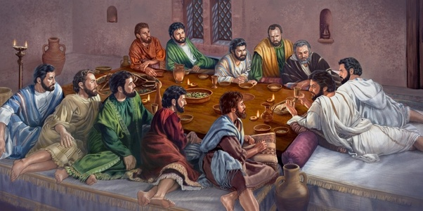

Slide 15
ACT 1 – John 12:1-8 Anointed for Burial
Vs 3 – Mary anoints Jesus’ feet – an act of worship (cf Mark 4:13). With expensive nard important from North India.
Vs 4-6 – Worth one’s year salary of labourer. Yet, Judas was a thief, stealing from their common purse.

Slide 16
ACT 1 – John 12:1-8 Anointed for Burial
Vs 7-8 – “Leave Her Alone” – it was preparation for Jesus’ burial. Unlike the poor, Jesus will not soon be with them.

Slide 17
⁹ When the large crowd of the Jews learned that Jesus was there, they came, not only on account of him but also to see Lazarus, whom he had raised from the dead. ¹⁰ So the chief priests made plans to put Lazarus to death as well, ¹¹ because on account of him many of the Jews were going away and believing in Jesus.

Slide 18
Interlude – John 12:9-11
Vs 9 – Lazarus was now also drawing crowds,
Vs 10-11 – Chief Priests wanted to kill Lazarus too, because on account of him, many were now believing in Jesus.

Slide 19
¹² The next day the large crowd that had come to the feast heard that Jesus was coming to Jerusalem. ¹³ So they took branches of palm trees and went out to meet him, crying out, “Hosanna! Blessed is he who comes in the name of the Lord, even the King of Israel!” ¹⁴ And Jesus found a young donkey and sat on it, just as it is written,
¹⁵ “Fear not, daughter of Zion; behold, your king is coming, sitting on a donkey's colt!”
¹⁶ His disciples did not understand these things at first, but when Jesus was glorified, then they remembered that these things had been written about him and had been done to him. ¹⁷ The crowd that had been with him when he called Lazarus out of the tomb and raised him from the dead continued to bear witness. ¹⁸ The reason why the crowd went to meet him was that they heard he had done this sign. ¹⁹ So the Pharisees said to one another, “You see that you are gaining nothing. Look, the world has gone after him.”

Slide 20
ACT 2 – John 12:12-19 ARRIVAL INTO JERUSALEM

Slide 21
ACT 2 – John 12:12-19 ARRIVAL INTO JERUSALEM
Entry into Jerusalem recorded in all 4 Gospels (Matt 21:1-11; Mark 11:1-11; Luke 19:28-40).
Vs 14 – Jesus found a donkey and sat on it. But actual event was staged by Jesus.
Jerusalem swollen with pilgrims for Passover – perhaps as much as 120,000 people.

Slide 22
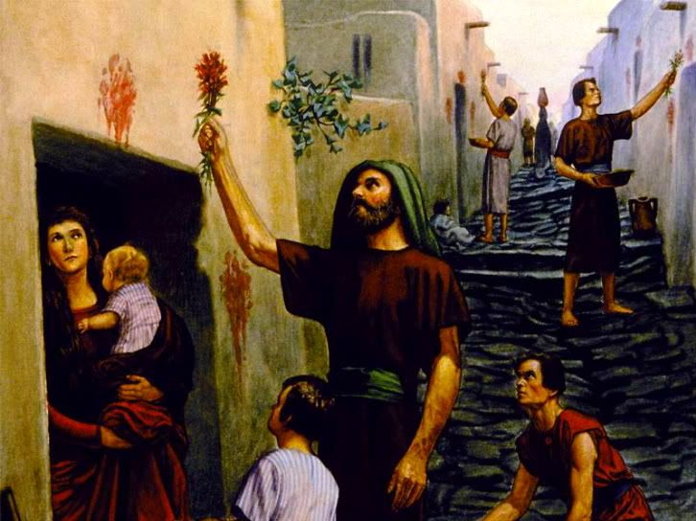

Slide 23
¹² The next day the large crowd that had come to the feast heard that Jesus was coming to Jerusalem. ¹³ So they took branches of palm trees and went out to meet him, crying out, “Hosanna! Blessed is he who comes in the name of the Lord, even the King of Israel!” ¹⁴ And Jesus found a young donkey and sat on it, just as it is written,
¹⁵ “Fear not, daughter of Zion; behold, your king is coming, sitting on a donkey's colt!”
¹⁶ His disciples did not understand these things at first, but when Jesus was glorified, then they remembered that these things had been written about him and had been done to him. ¹⁷ The crowd that had been with him when he called Lazarus out of the tomb and raised him from the dead continued to bear witness. ¹⁸ The reason why the crowd went to meet him was that they heard he had done this sign. ¹⁹ So the Pharisees said to one another, “You see that you are gaining nothing. Look, the world has gone after him.”

Slide 24
ACT 2 – John 12:12-19 ARRIVAL INTO JERUSALEM
Vs 13 – Palms were a symbol of Jewish nationalism.
“Hossanna” – Aramaic phrase that means “Save us now!”
Quotes from Psalm 118:25-26 – a Messianic Psalm.
Vs 14-16 – John quotes from Zechariah 9:9-10 – this was fulfilment which the disciples only later understood.

Slide 25
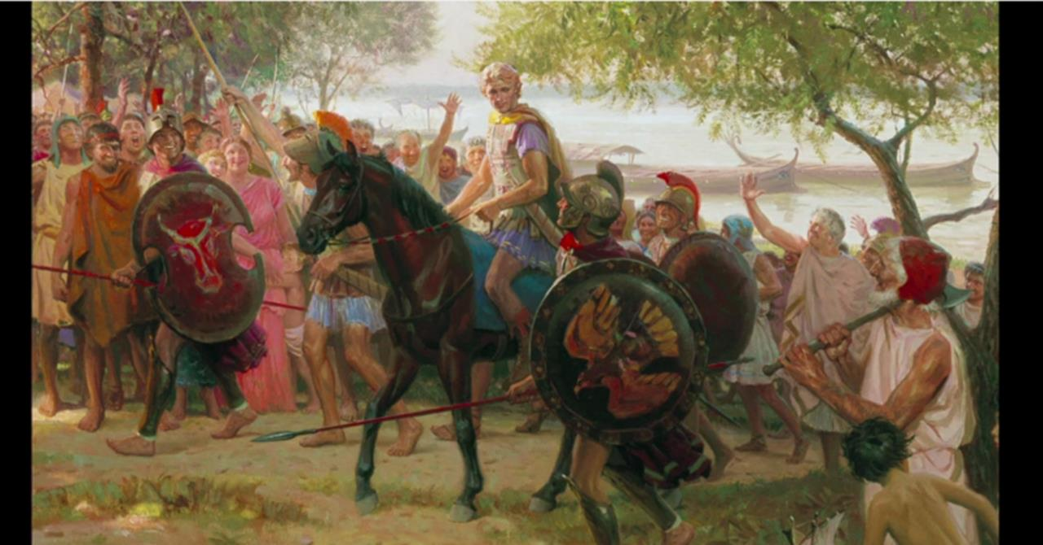

Slide 26
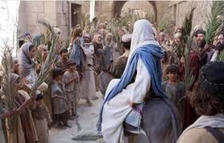

Slide 27
¹² The next day the large crowd that had come to the feast heard that Jesus was coming to Jerusalem. ¹³ So they took branches of palm trees and went out to meet him, crying out, “Hosanna! Blessed is he who comes in the name of the Lord, even the King of Israel!” ¹⁴ And Jesus found a young donkey and sat on it, just as it is written,
¹⁵ “Fear not, daughter of Zion; behold, your king is coming, sitting on a donkey's colt!”
¹⁶ His disciples did not understand these things at first, but when Jesus was glorified, then they remembered that these things had been written about him and had been done to him. ¹⁷ The crowd that had been with him when he called Lazarus out of the tomb and raised him from the dead continued to bear witness. ¹⁸ The reason why the crowd went to meet him was that they heard he had done this sign. ¹⁹ So the Pharisees said to one another, “You see that you are gaining nothing. Look, the world has gone after him.”

Slide 28
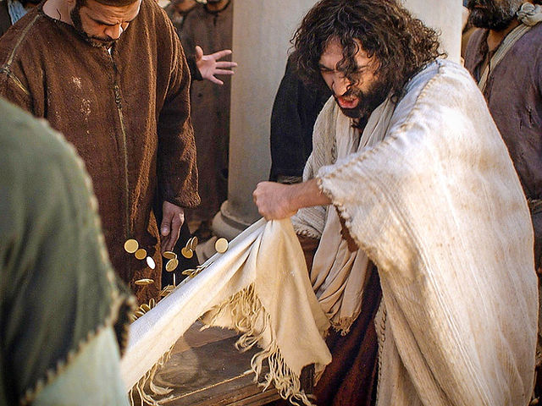

Slide 29
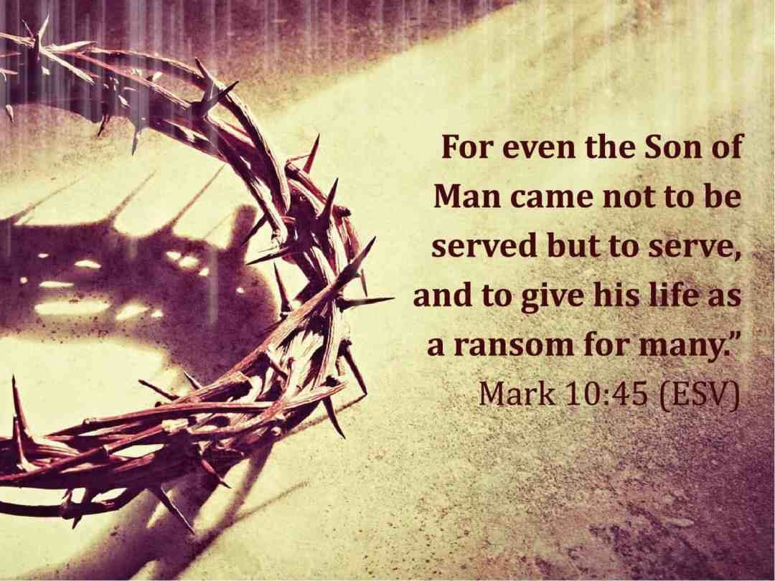

Slide 31
ACT 2 – John 12:12-19 ARRIVAL INTO JERUSALEM
ACT 1 – John 12:1-8 Anointed for Burial
Interlude – John 12:9-11

