Slide 1
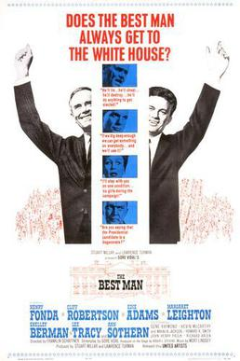
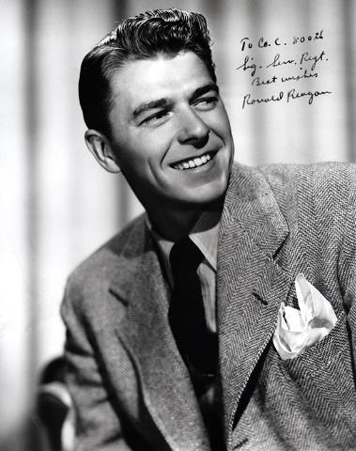
Notes:
Film poster for “The Best Man” https://en.wikipedia.org/wiki/The_Best_Man_(1964_film)#/media/File:Best_man22234.jpg
Photo of Ronald Reagan https://www.reaganlibrary.gov/archives/audiovisual/white-house-photo-collection-galleries/early-ronald-reagan-and-family

Slide 2
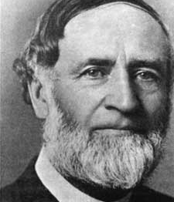
FamilyID=Office_ArchiveTorn
Bishop Milton Wright once famously said:
"Men will never fly, because flying is reserved for the angels.
Notes:
Photo of bishop Milton Wright https://en.wikipedia.org/wiki/Milton_Wright_(bishop)

Slide 3
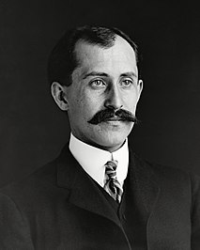
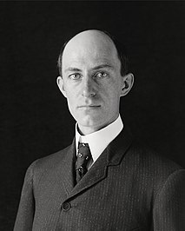
FamilyID=Office_ArchiveTorn
His sons, Orville and Wilbur Wright, are generally credited with inventing, building, and flying the world's first successful airplane.
Notes:
Photo of Wilbur and Orville Wright https://en.wikipedia.org/wiki/Wright_brothers

Slide 4
Evaluating the Evidence:
Responses to Lazarus’ Resurrection
?
John 11:45-57

Slide 5
Believing
C H R I S T
Responding to John’s Gospel

Slide 6
⁴⁵ Many of the Jews therefore, who had come with Mary and had seen what he did, believed in him,
The Believers

Slide 7
Signs in John's Gospel
WATER TO WINE 2:1-11
HEALING OFFICIAL'S
SON 4:46-54
HEALING PARALYTIC 5:1-18
FEEDING 5000 6:1-15
WALKING ON WATER 6:16-24
HEALING BLIND MAN 9:1-7
RAISING LAZARUS 11:1-45

Slide 8
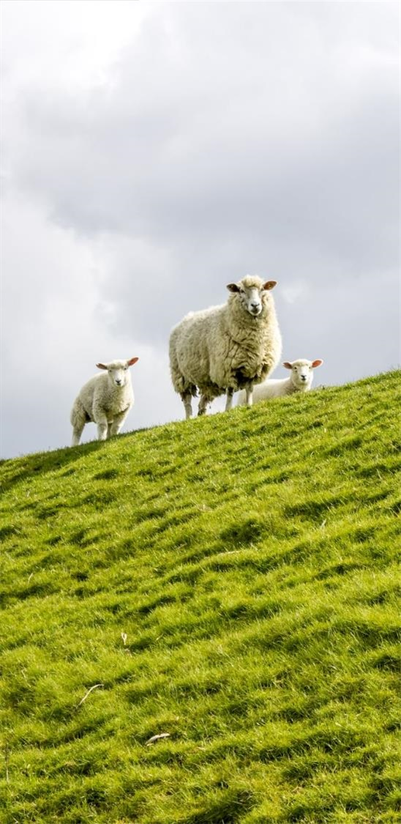
I am the bread of life (6:35)
I am the light of the world (8:12)
I am the door [of the sheep] (10:7)
I am the good shepherd (10:11, 14)
I am the resurrection and the life (11:25)

Slide 9
John 11:27 (ESV)
“Yes, Lord; I believe that you are the Christ, the Son of God, who is coming into the world.”

Slide 10
Defeat Israel's Enemies
Spiritual Renewal and Redemption
Jer 31:31-34
Restore Davidic Kingdom
Isa 11:1
Expectations for
“the Messiah”
Usher in Peace and Justice
Isa 2:4
Gather the Exiles
Isa 11:11-12
Restore the Temple

Slide 11
⁴⁵ Many of the Jews therefore, who had come with Mary and had seen what he did, believed in him,
The Believers

Slide 12
⁴⁶ but some of them went to the Pharisees and told them what Jesus had done.
The Skeptics

Slide 13
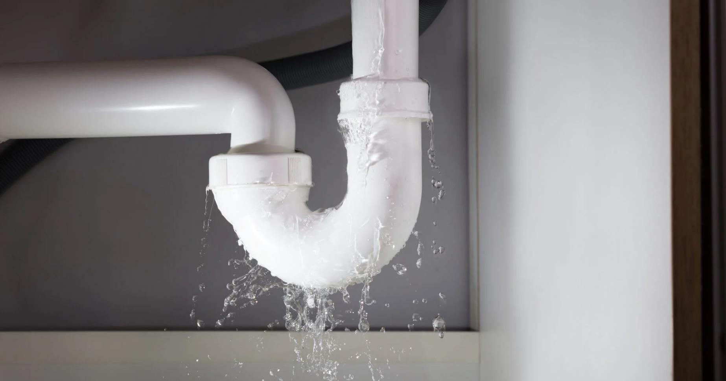

Slide 14
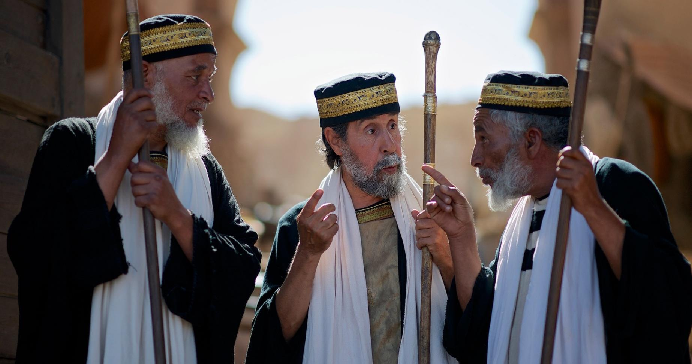
Pharisees (image courtesy of www.freebibleimages.org)

Slide 15
Matthew 23:1-4 (NLT)
¹ Then Jesus said to the crowds and to his disciples, ² “The teachers of religious law and the Pharisees are the official interpreters of the law of Moses. ³ So practice and obey whatever they tell you, but . . .

Slide 16
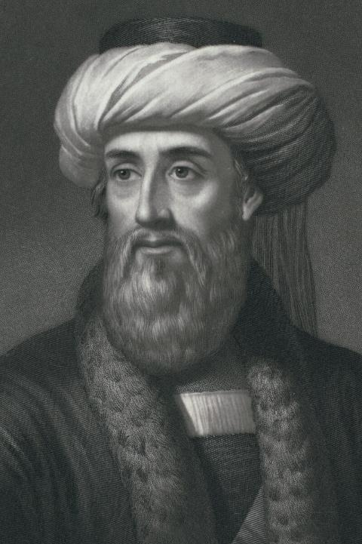
Josephus writes that the Pharisees had
“a great deal of influence among the populace”
and that
“the masses of commoners accepted many of these doctrines, so much so that even the Sadducees were subject to the Pharisees in some measure.”
Notes:
Pharisees: In the Lexham Bible Dictionary

Slide 17
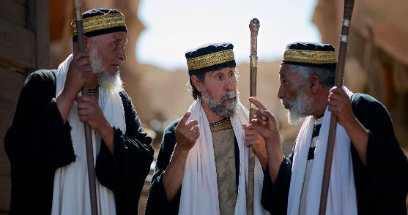
1 John 4:1
Dear friends, do not believe everyone who claims to speak by the Spirit. You must test them to see if the spirit they have comes from God. For there are many false prophets in the world.

Slide 18
⁴⁷ So the chief priests
and the Pharisees
gathered the council
and said, “What are
we to do? For this
man performs many
signs. ⁴⁸ If we let him
go on like this, everyone
will believe in him, and
the Romans will come and
take away both our place and our nation.”
The Reactionaries

Slide 19
⁴⁷ So the chief priests
and the Pharisees
gathered the council
and said, “What are
we to do? For this
man performs many
signs. ⁴⁸ If we let him
go on like this, everyone
will believe in him, and
the Romans will come and
take away both our place and our nation.”
The Reactionaries

Slide 20
⁴⁷ So the chief priests
and the Pharisees
gathered the council
and said, “What are
we to do? For this
man performs many
signs. ⁴⁸ If we let him
go on like this, everyone
will believe in him, and
the Romans will come and
take away both our place and our nation.”
The Reactionaries

Slide 21
Matthew 23:1-4
¹ Then Jesus said to the crowds and to his disciples, ² “The teachers of religious law and the Pharisees are the official interpreters of the law of Moses. ³ So practice and obey whatever they tell you, but don’t follow their example. For they don’t practice what they teach. ⁴ They crush people with unbearable religious demands and never lift a finger to ease the burden.

Slide 22
⁶ And they love to sit at the head table at banquets and in the seats of honor in the synagogues. ⁷ They love to receive respectful greetings as they walk in the marketplaces, and to be called ‘Rabbi.’

Slide 23
⁴⁹ But one of them, Caiaphas, who was high priest that year, said to them, “You know nothing at all. ⁵⁰ Nor do you understand that it is better for you that one man should die for the people, not that the whole nation should perish.”
The Problem Solver

Slide 24
John 5:18 This was why the Jews were seeking all the more to kill him,. . .
John 7:1 . . .He would not go about in Judea, because the Jews were seeking to kill him.
John 7:19 Has not Moses given you the law? Yet none of you keeps the law. Why do you seek to kill me?”
John 7:25 Some of the people of Jerusalem therefore said, “Is not this the man whom they seek to kill?
John 8:37 yet you seek to kill me because my word finds no place in you.
John 8:40 but now you seek to kill me, a man who has told you the truth that I heard from God.

Slide 25
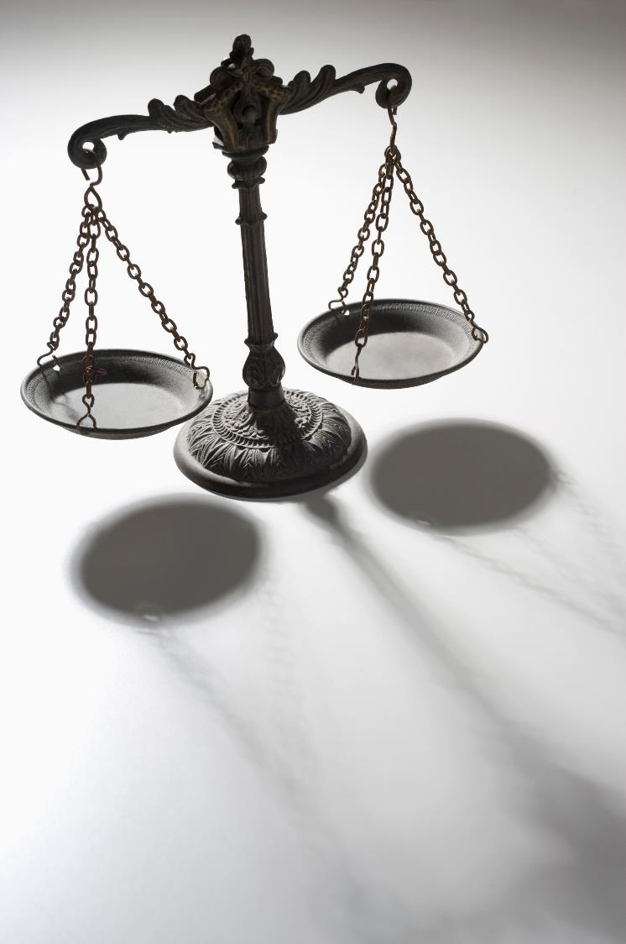
An ounce of prevention is worth a pound of cure.
防患于未然，治疗于事后。(Fáng huàn yú wèi rán,
zhì liáo yú shì hòu.)
"Prevent trouble before it arises; put out the fire before it spreads."

Slide 26
⁴⁹ But one of them, Caiaphas, who was high priest that year, said to them, “You know nothing at all. ⁵⁰ Nor do you understand that it is better for you that one man should die for the people, not that the whole nation should perish.”
The Problem Solver

Slide 27
⁵¹ He did not say this of his own accord, but being high priest that year he prophesied that Jesus would die for the nation, ⁵² and not for the nation only, but also to gather into one the children of God who are scattered abroad.
Expectations for
“the Messiah”
Gather the Exiles
Isa 11:11-12

Slide 28
Matthew 16:21
²¹ From that time Jesus began to show his disciples that he must go to Jerusalem and suffer many things from the elders and chief priests and scribes, and be killed, and on the third day be raised.
Matthew 17:22-23
²² As they were gathering in Galilee, Jesus said to them, “The Son of Man is about to be delivered into the hands of men, ²³ and they will kill him, and he will be raised on the third day.” And they were greatly distressed.
Matthew 20:18-19
¹⁸ “See, we are going up to Jerusalem. And the Son of Man will be delivered over to the chief priests and scribes, and they will condemn him to death ¹⁹ and deliver him over to the Gentiles to be mocked and flogged and crucified, and he will be raised on the third day.”

Slide 29
John 2:19-22
¹⁹ Jesus answered them, “Destroy this temple, and in three days I will raise it up.” ²⁰ The Jews then said, “It has taken forty-six years to build this temple, and will you raise it up in three days?” ²¹ But he was speaking about the temple of his body. ²² When therefore he was raised from the dead, his disciples remembered that he had said this, and they believed the Scripture and the word that Jesus had spoken.

Slide 30
⁴⁹ But one of them, Caiaphas, who was high priest that year, said to them, “You know nothing at all. ⁵⁰ Nor do you understand that it is better for you that one man should die for the people, not that the whole nation should perish.”
The Problem Solver

Slide 31
God used those who RESISTED him, to REVEAL his plan

Slide 32
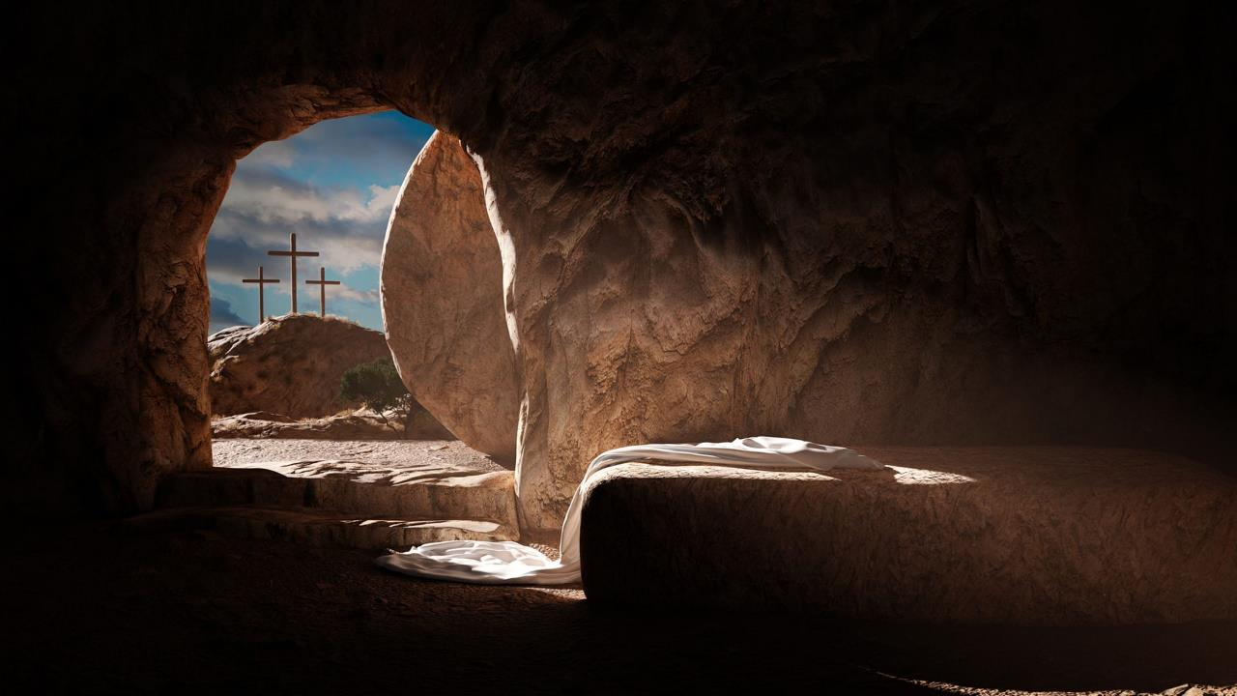
What is God’s Plan?

Slide 33
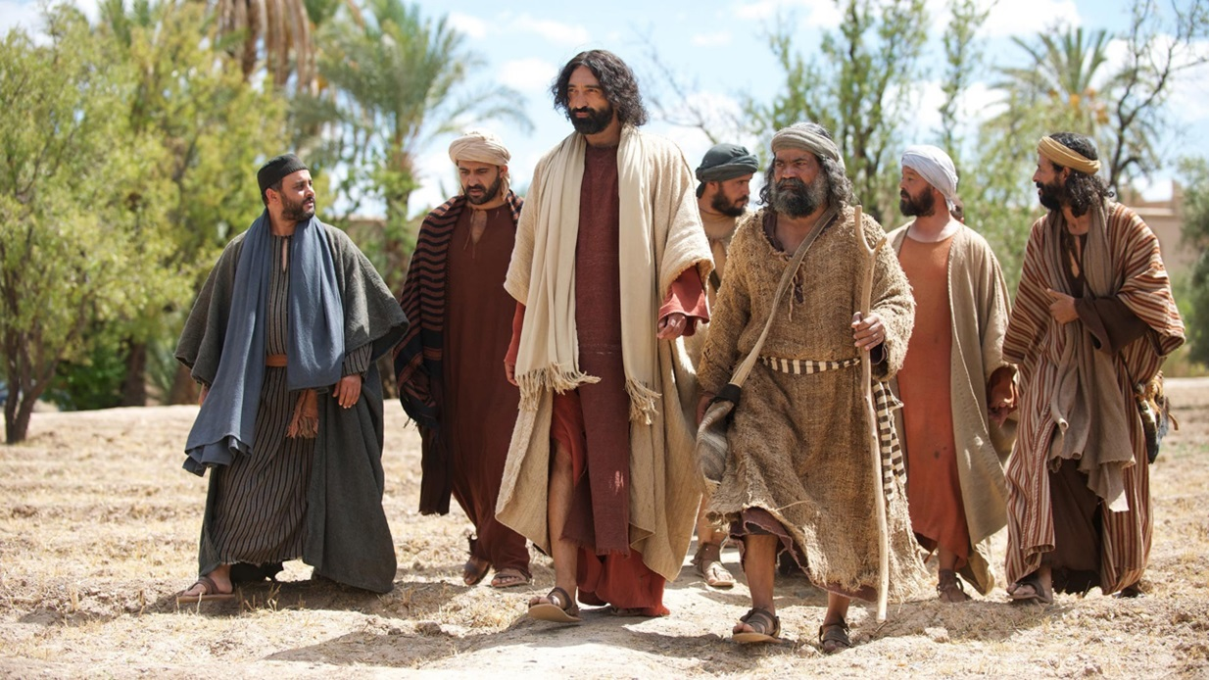
⁵³ So from that day on they made plans to put him to death. ⁵⁴ Jesus therefore no longer walked openly among the Jews,

Slide 34
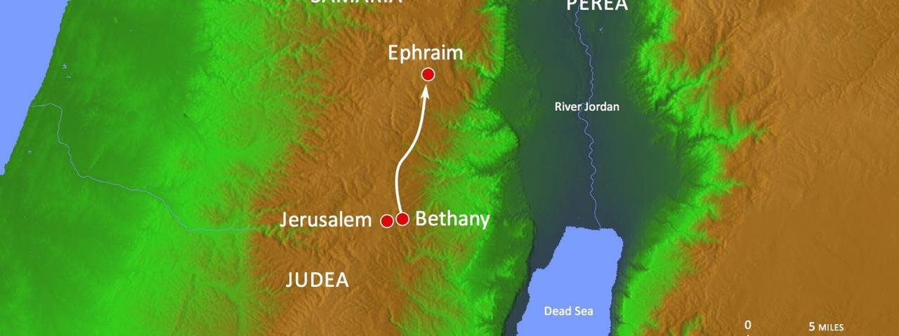
but went from there to the region near the wilderness, to a town called Ephraim, and there he stayed with the disciples.

Slide 35
⁵⁵ Now the Passover of the Jews was at hand, and many went up from the country to Jerusalem before the Passover to purify themselves. ⁵⁶ They were looking for Jesus and saying to one another as they stood in the temple, “What do you think? That he will not come to the feast at all?” ⁵⁷ Now the chief priests and the Pharisees had given orders that if anyone knew where he was, he should let them know, so that they might arrest him.

Slide 36
so that they might arrest him.
to purify themselves
looking for Jesus

Slide 37
⁵⁵ Now the Passover of the Jews was at hand, and many went up from the country to Jerusalem before the Passover to purify themselves. ⁵⁶ They were looking for Jesus and saying to one another as they stood in the temple, “What do you think? That he will not come to the feast at all?” ⁵⁷ Now the chief priests and the Pharisees had given orders that if anyone knew where he was, he should let them know, so that they might arrest him.

Slide 38
Signs in John's Gospel
WATER TO WINE 2:1-11
HEALING OFFICIAL'S
SON 4:46-54
HEALING PARALYTIC 5:1-18
FEEDING 5000 6:1-15
WALKING ON WATER 6:16-24
HEALING BLIND MAN 9:1-7
RAISING LAZARUS 11:1-45
CHRIST'S RESURRECTION 20:1-31

Slide 39
Are you looking for Jesus

