Slide 1
Believing
C H R I S T
Responding to John’s Gospel

Slide 2
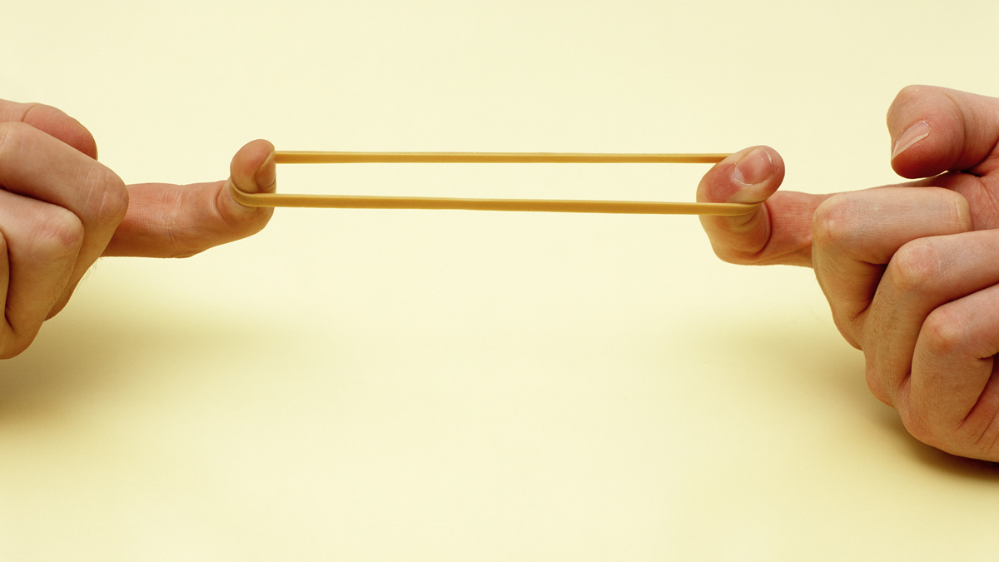
S t r e t c h i n g O u r F a i t h
-Jesus strengthens our belief in him-
(John 11:17-44)

Slide 3
Chronology of death
God warns of death (Gen 2:17)
Sin brings death to all mankind (Rom 5:12-14; 6:23)
Abel dies (Gen 4:8)
More death (Genesis 4-5)
More death in the flood (Gen 7:21)
All creation has suffered physically from the consequences of sin (Rom 8:20-23)
Christ sets us free from cycle of death (1 Corinthians 15)

Slide 4
The progression of stretched faith (vs. 17-27, 39-40)
Recite faith (17-26)
Recite faith
I believe in God
I believe that Jesus can heal
I believe that God hears Jesus
I believe in the resurrection of the dead

Slide 5
The progression of stretched faith (vs. 17-27, 39-40)
Recite faith (17-26)
Personalize faith (25-26)
Personalize Faith
I believe Jesus has power of life
I believe Jesus raises the dead
I believe in him

Slide 6
The progression of stretched faith (vs. 17-27, 39-40)
Recite faith (17-26)
Personalize faith (25-26)
Test faith (27, 39-40)

Slide 7
Recite faith Personalize faith Test faith
Repeat words of truth Increase devotion to Increase desire for
the object of faith devotion
Knowledge in head Pursuit in heart Step forward in life

Slide 8
The progression of stretched faith (vs. 17-27, 39-40)
The trauma of stretched faith (vs. 28-40)
Emotional struggles (28-35)

Slide 9
“Christ does not come to the sepulcher as an idle spectator, but like a wrestler preparing for the contest. Therefore no wonder that He groans again, for the violent tyranny of death which He had to overcome stands before His eyes.”
John Calvin

Slide 10
The progression of stretched faith (vs. 17-27, 39-40)
The trauma of stretched faith (vs. 28-40)
Emotional struggles (28-35)
Confusion (36-40)

Slide 11
The progression of stretched faith (vs. 17-27, 39-40)
The trauma of stretched faith (vs. 28-40)
The confirmation of stretched faith (vs. 41-44)

