Slide 1
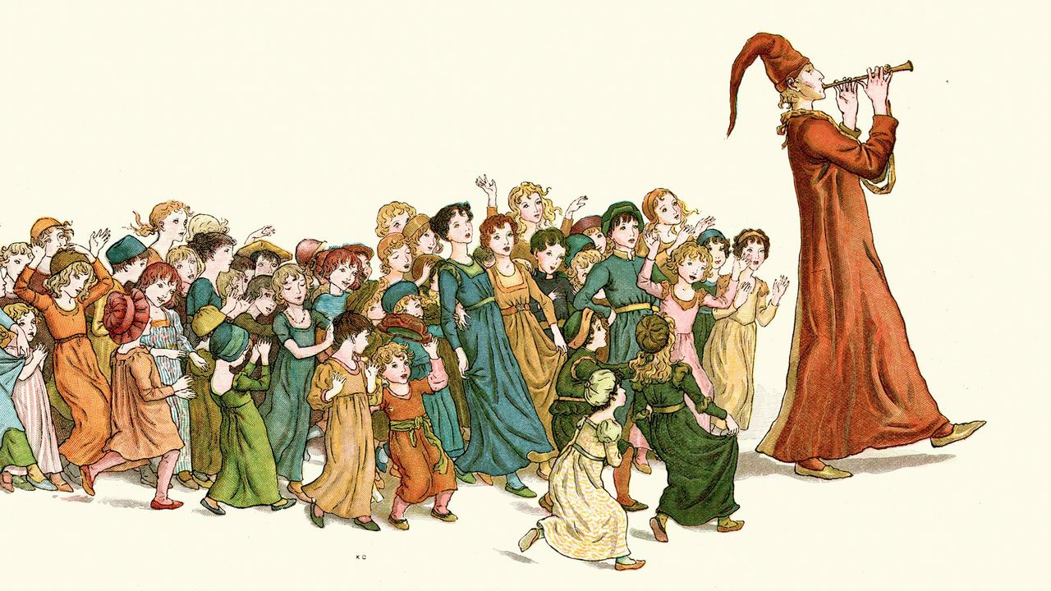

Slide 2
John 10:1-21

Slide 3
Jesus leads you with his voice (vv. 1-6)

Slide 4
“Truly, truly, I say to you, he who does not enter the sheepfold by the door but climbs in by another way, that man is a thief and a robber. 2 But he who enters by the door is the shepherd of the sheep. 3 To him the gatekeeper opens. The sheep hear his voice, and he calls his own sheep by name and leads them out. 4 When he has brought out all his own, he goes before them, and the sheep follow him, for they know his voice. 5 A stranger they will not follow, but they will flee from him, for they do not know the voice of strangers.” 6 This figure of speech Jesus used with them, but they did not understand what he was saying to them.

Slide 5
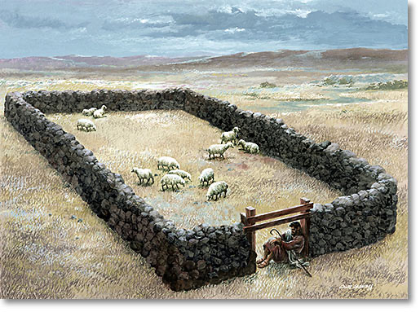

Slide 6
“Truly, truly, I say to you, he who does not enter the sheepfold by the door but climbs in by another way, that man is a thief and a robber. 2 But he who enters by the door is the shepherd of the sheep. 3 To him the gatekeeper opens. The sheep hear his voice, and he calls his own sheep by name and leads them out. 4 When he has brought out all his own, he goes before them, and the sheep follow him, for they know his voice. 5 A stranger they will not follow, but they will flee from him, for they do not know the voice of strangers.” 6 This figure of speech Jesus used with them, but they did not understand what he was saying to them.

Slide 7
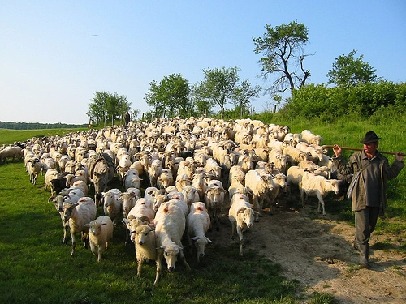

Slide 8
But now thus says the Lord,
he who created you, O Jacob,
he who formed you, O Israel:
“Fear not, for I have redeemed you;
I have called you by name, you are mine.
– Isaiah 43:1

Slide 9
Jesus leads you with his freedom (vv. 7-10)

Slide 10
So Jesus again said to them, “Truly, truly, I say to you, I am the door of the sheep. 8 All who came before me are thieves and robbers, but the sheep did not listen to them. 9 I am the door. If anyone enters by me, he will be saved and will go in and out and find pasture. 10 The thief comes only to steal and kill and destroy. I came that they may have life and have it abundantly

Slide 11

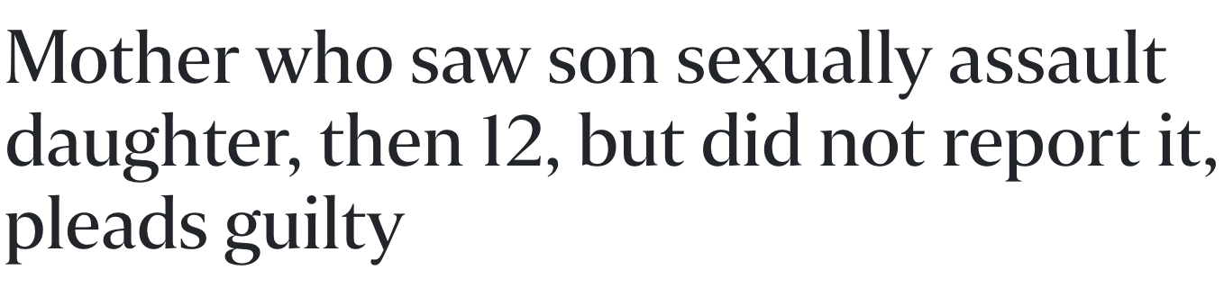
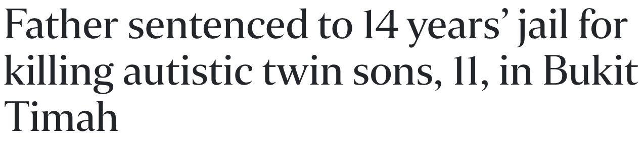

Slide 12
Jesus leads you with his life (vv. 11-16)

Slide 13
I am the good shepherd. The good shepherd lays down his life for the sheep. 12 He who is a hired hand and not a shepherd, who does not own the sheep, sees the wolf coming and leaves the sheep and flees, and the wolf snatches them and scatters them. 13 He flees because he is a hired hand and cares nothing for the sheep. 14 I am the good shepherd. I know my own and my own know me, 15 just as the Father knows me and I know the Father; and I lay down my life for the sheep. 16 And I have other sheep that are not of this fold. I must bring them also, and they will listen to my voice. So there will be one flock, one shepherd.

Slide 14
I am the good shepherd. The good shepherd lays down his life for the sheep. 12 He who is a hired hand and not a shepherd, who does not own the sheep, sees the wolf coming and leaves the sheep and flees, and the wolf snatches them and scatters them. 13 He flees because he is a hired hand and cares nothing for the sheep. 14 I am the good shepherd. I know my own and my own know me, 15 just as the Father knows me and I know the Father; and I lay down my life for the sheep. 16 And I have other sheep that are not of this fold. I must bring them also, and they will listen to my voice. So there will be one flock, one shepherd.

Slide 15
I am the good shepherd. The good shepherd lays down his life for the sheep. 12 He who is a hired hand and not a shepherd, who does not own the sheep, sees the wolf coming and leaves the sheep and flees, and the wolf snatches them and scatters them. 13 He flees because he is a hired hand and cares nothing for the sheep. 14 I am the good shepherd. I know my own and my own know me, 15 just as the Father knows me and I know the Father; and I lay down my life for the sheep. 16 And I have other sheep that are not of this fold. I must bring them also, and they will listen to my voice. So there will be one flock, one shepherd.

Slide 16
“I am the way, and the truth, and the life. No one comes to the Father except through me.” – John 14:6

Slide 17
Jesus leads us as the Good Shepherd
(vv. 17-21)

Slide 18
I am the good shepherd.

Slide 19
“Why do you call me good? No one is good except God alone.”
– Mark 10:18
“No one can give the gift of eternal life except God alone”

Slide 20
“The Father loves me because I sacrifice my life so I may take it back again. 18 No one can take my life from me. I sacrifice it voluntarily. For I have the authority to lay it down when I want to and also to take it up again. For this is what my Father has commanded.”19 When he said these things, the people were again divided in their opinions about him. 20 Some said, “He’s demon possessed and out of his mind. Why listen to a man like that?” 21 Others said, “This doesn’t sound like a man possessed by a demon! Can a demon open the eyes of the blind?”
Special Relationship
Courage against evil
Power over death
Voluntary death
Not a victim
Completed what is commanded

Slide 21
“The Father loves me because I sacrifice my life so I may take it back again. 18 No one can take my life from me. I sacrifice it voluntarily. For I have the authority to lay it down when I want to and also to take it up again. For this is what my Father has commanded.”19 When he said these things, the people were again divided in their opinions about him. 20 Some said, “He’s demon possessed and out of his mind. Why listen to a man like that?” 21 Others said, “This doesn’t sound like a man possessed by a demon! Can a demon open the eyes of the blind?”

