Slide 1
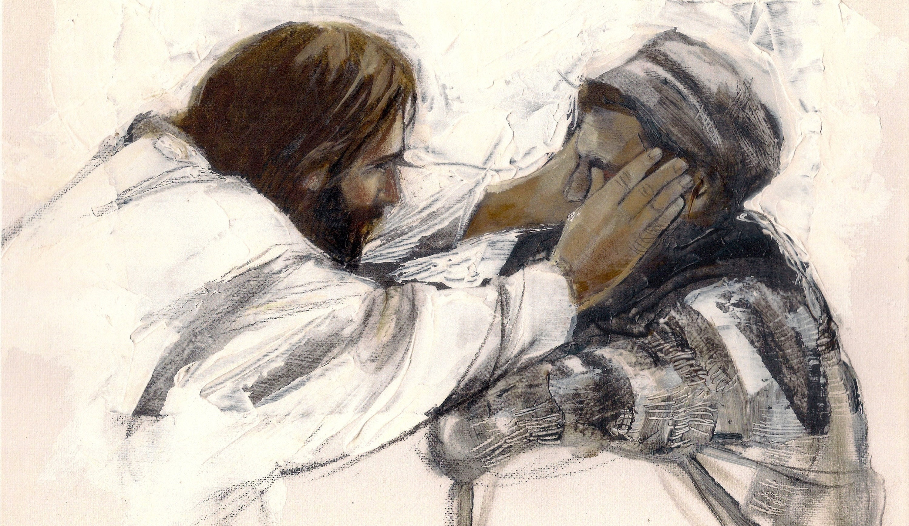
Turning People into Light
-God changing a darkened world one life at a time-
John 9:1-41

Slide 2
Luke 7:21-22
²¹ In that hour he healed many people of diseases and plagues and evil spirits, and on many who were blind he bestowed sight. ²² And he answered them, “Go and tell John what you have seen and heard: the blind receive their sight, the lame walk, lepers are cleansed, and the deaf hear, the dead are raised up, the poor have good news preached to them.

Slide 3
Exodus 4:11
Then the Lord said to him, “Who has made man’s mouth? Who makes him mute, or deaf, or seeing, or blind? Is it not I, the Lord?

Slide 4
Psalm 146:7-8
⁷ The Lord sets the prisoners free; ⁸ the Lord opens the eyes of the blind. The Lord lifts up those who are bowed down; the Lord loves the righteous.

Slide 5
Isaiah 29:18
In that day the deaf shall hear the words of a book, and out of their gloom and darkness the eyes of the blind shall see.

Slide 6
Turning People into Light
-God changing a darkened world one life at a time-
God changes people to make them see (vs. 1-7)
God uses changed people as a testimony of the light (vs. 8-34)
Testimony 1: Answer people’s questions with no further action (8-12)
Testimony 2: Bring clarity among the confusion of critics (13-17)
Testimony 3: Reveal conviction and courage to the timid (18-23)
Testimony 4: Confront hardness of heart and receive consequences (24-34)

Slide 7
Turning People into Light
-God changing a darkened world one life at a time-
God changes people to make them see (vs. 1-7)
God uses changed people as a testimony of the light (vs. 8-34)
The end result: increased light and deeper darkness (vs. 35-41)

