Slide 2
The Challenge of Jesus
John 8:12-30

Slide 3
The Pharisees challenged Jesus’ reality

Slide 4
“A single witness shall not suffice against a person for any crime or for any wrong in connection with any offense that he has committed. Only on the evidence of two witnesses or of three witnesses shall a charge be established.” – Deuteronomy 19:15

Slide 5
Past – Present – Future
Yesterday – Today - Forever
One God, One People, One Future

Slide 6
The People challenged Jesus’ identity

Slide 7
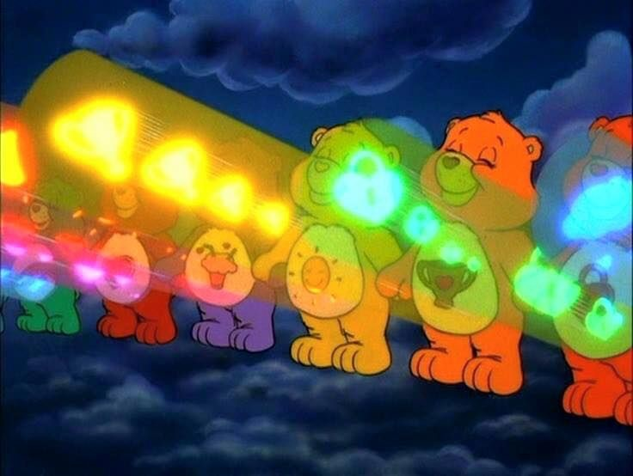

Slide 9
Repeats this in his book:
“We resemble what we revere, either for ruin or restoration!”

Slide 10
Christianity is the only identity that is received,
not achieved

