Slide 2
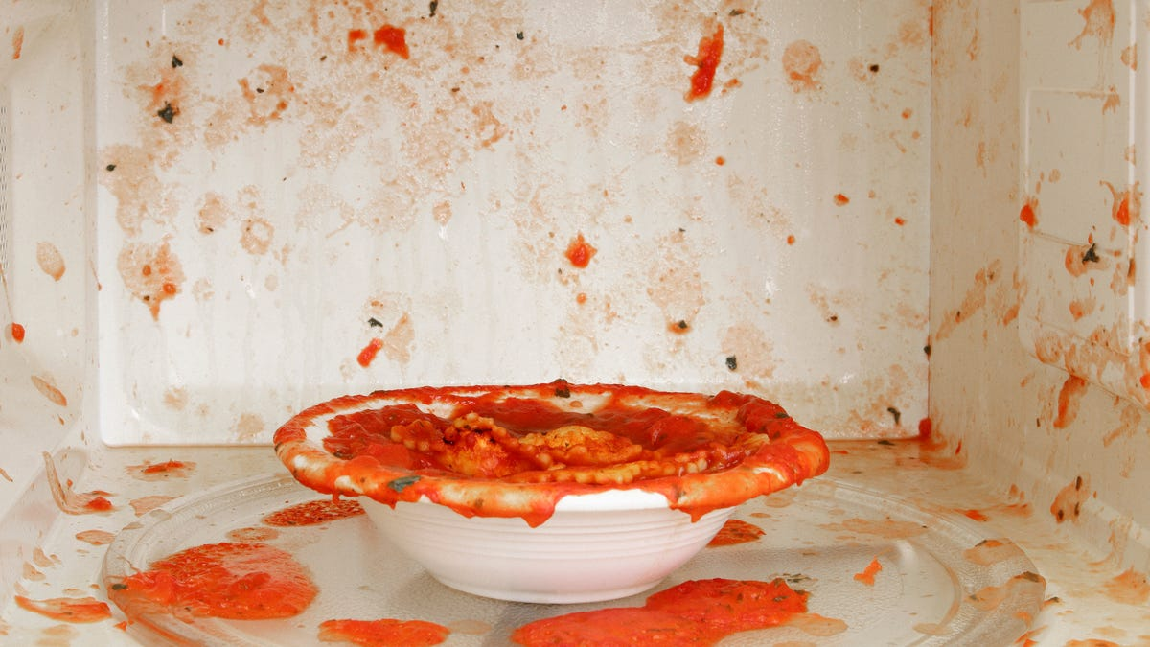
Jesus and Unclean People
John 8:1-11

Slide 3
Believing
C H R I S T
Responding to John’s Gospel

Slide 4
Do not hide your sin in religion and accuse others (vs. 1-9)

Slide 5
Adultery while betrothed = both executed by stoning (Deut 22:23-24)
Adultery while married = both executed (Deut 22:22; Lev 20:10)
Witnesses take responsibility for accusation by being first to cast stones (Deut 17:6-7)
False accusations = execution in like manner as accusation (Deut 19:15-21)

Slide 6
Matthew 1:18-21
¹⁸ Now the birth of Jesus Christ took place in this way. When his mother Mary had been betrothed to Joseph, before they came together she was found to be with child from the Holy Spirit. ¹⁹ And her husband Joseph, being a just man and unwilling to put her to shame, resolved to divorce her quietly. ²⁰ But as he considered these things, behold, an angel of the Lord appeared to him in a dream, saying, “Joseph, son of David, do not fear to take Mary as your wife, for that which is conceived in her is from the Holy Spirit. ²¹ She will bear a son, and you shall call his name Jesus, for he will save his people from their sins.”

Slide 7
Receive grace and repent of sin (vs. 10-11)

