Slide 1
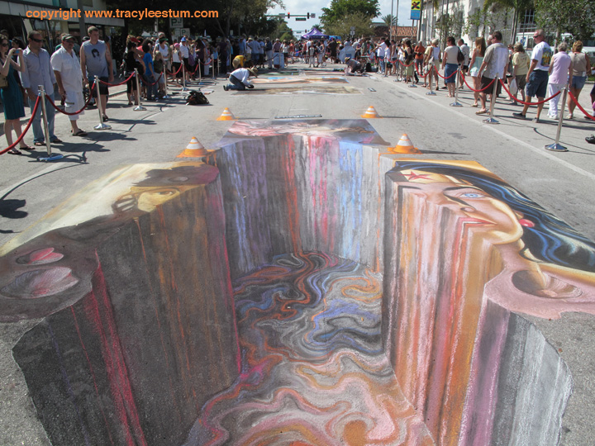

Slide 2
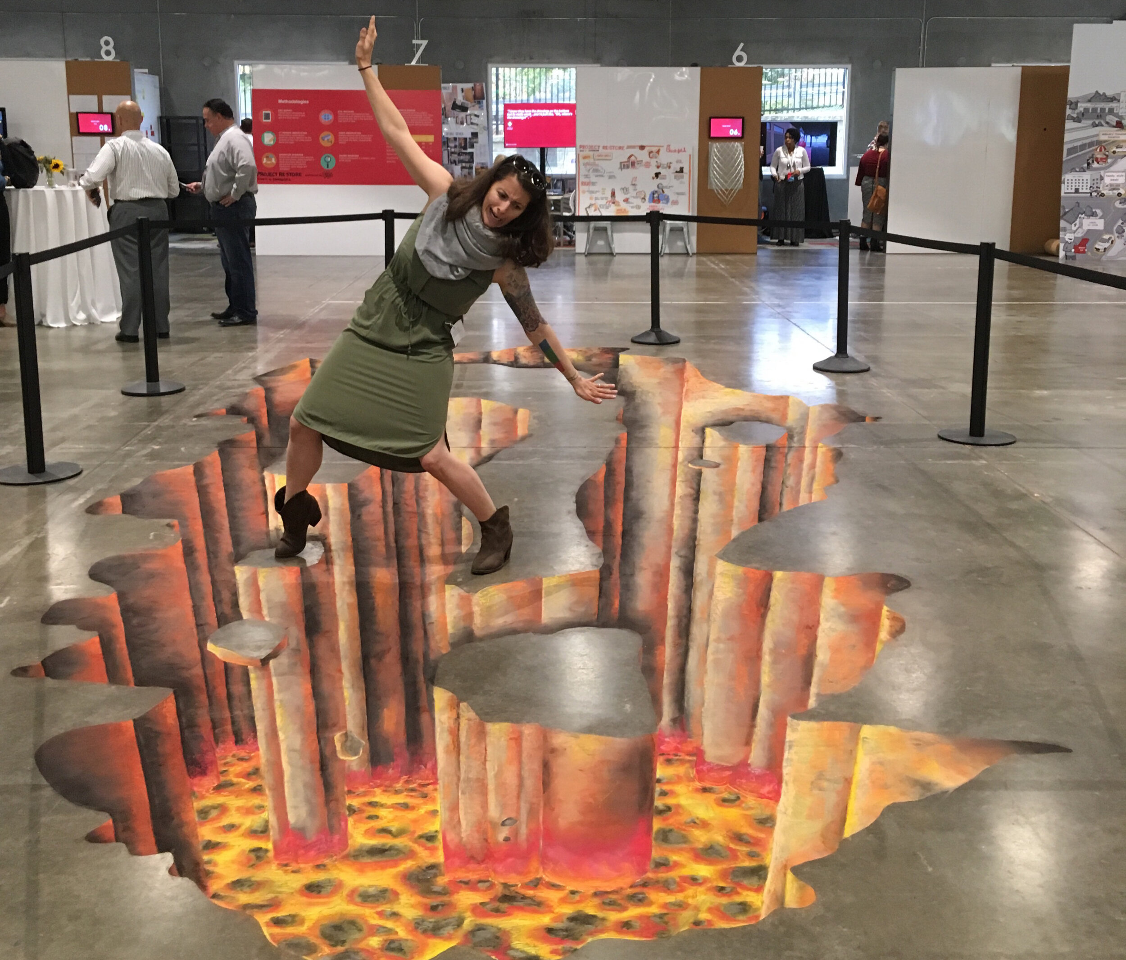

Slide 3
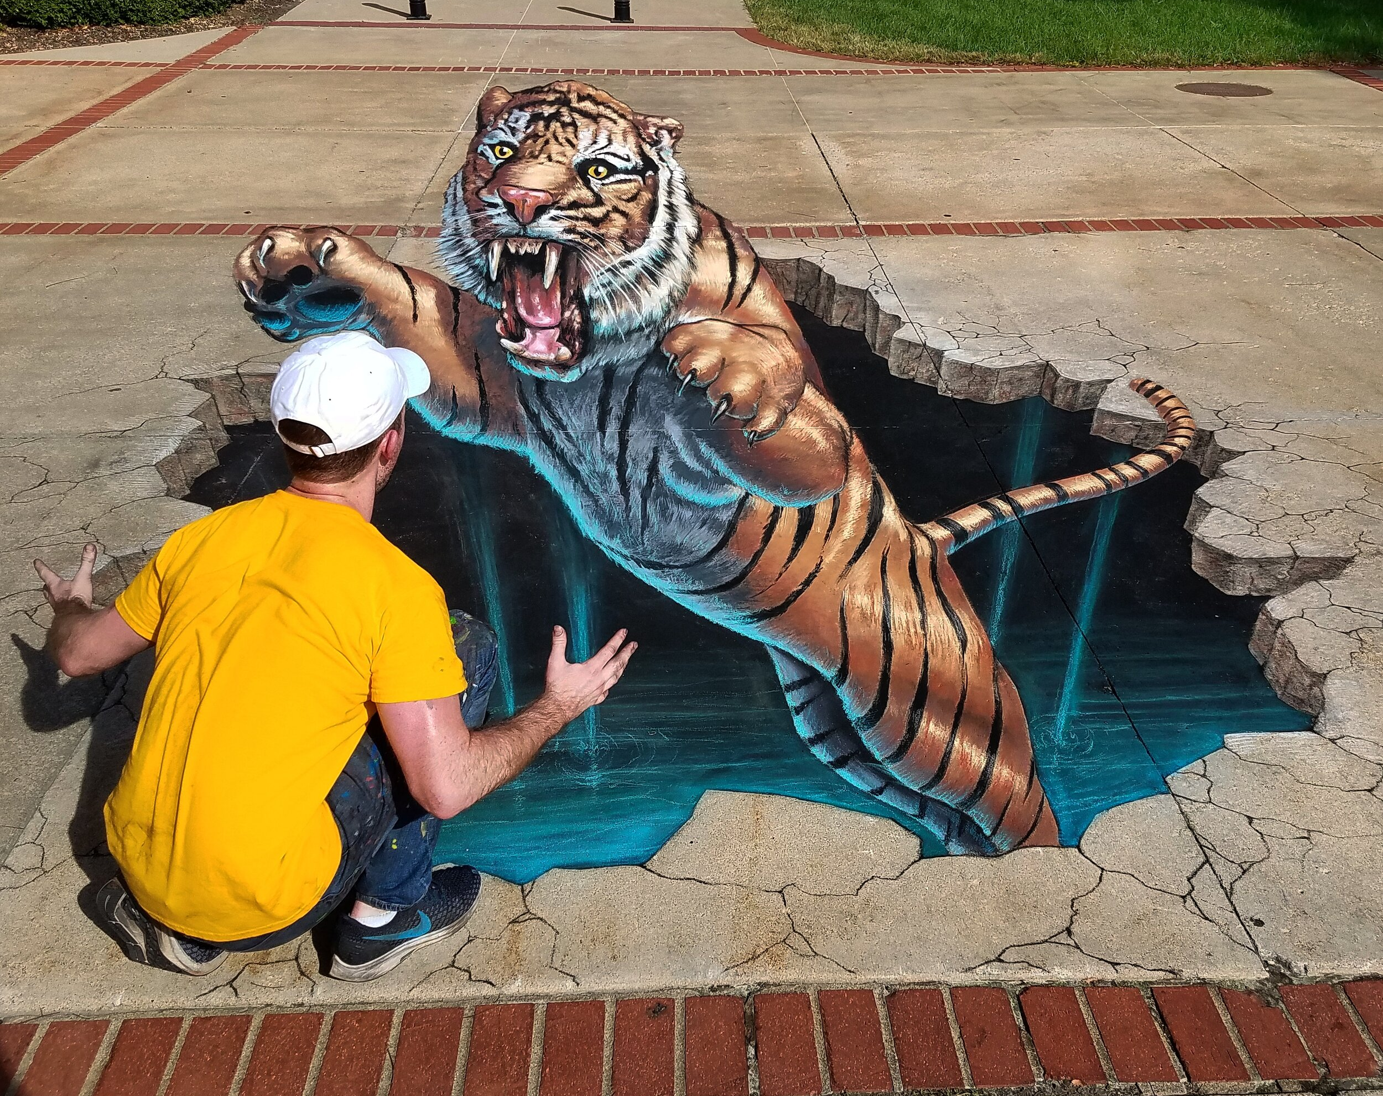
The Sad Case of Sidewalk Art Faith
John 6:41-71

Slide 4
Types of testing in John 6
Test of faith for true disciples to solve impossible problems
Test of faith for the crowd who want external political solutions to life
Test of faith for true disciples in crisis
Test of faith the crowd who argue with the Lord
Test of faith for those who claim to be disciples superficially

Slide 5
Superficial faith grumbles over calls for intensified devotion (vs. 41-51)
Exodus 16:2, 7
² And the whole congregation of the people of Israel grumbled against Moses and Aaron in the wilderness,
⁷ and in the morning you shall see the glory of the Lord, because he has heard your grumbling against the Lord. For what are we, that you grumble against us?”

Slide 6
Superficial faith grumbles over calls for intensified devotion (vs. 41-51)
Numbers 11:1, 4, 10-15
¹ And the people complained in the hearing of the Lord about their misfortunes, and when the Lord heard it, his anger was kindled, and the fire of the Lord burned among them and consumed some outlying parts of the camp.
⁴ Now the rabble that was among them had a strong craving. And the people of Israel also wept again and said, “Oh that we had meat to eat! ⁵ We remember the fish we ate in Egypt that cost nothing, the cucumbers, the melons, the leeks, the onions, and the garlic. ⁶ But now our strength is dried up, and there is nothing at all but this manna to look at.”

Slide 7
¹⁰ Moses heard the people weeping throughout their clans, everyone at the door of his tent. And the anger of the Lord blazed hotly, and Moses was displeased. ¹¹ Moses said to the Lord, “Why have you dealt ill with your servant? And why have I not found favor in your sight, that you lay the burden of all this people on me? ¹² Did I conceive all this people? Did I give them birth, that you should say to me, ‘Carry them in your bosom, as a nurse carries a nursing child,’ to the land that you swore to give their fathers? ¹³ Where am I to get meat to give to all this people? For they weep before me and say, ‘Give us meat, that we may eat.’ ¹⁴ I am not able to carry all this people alone; the burden is too heavy for me. ¹⁵ If you will treat me like this, kill me at once, if I find favor in your sight, that I may not see my wretchedness.”

Slide 8
Superficial faith grumbles over calls for intensified devotion (vs. 41-51)
God does not cater to human pride (42-46)

Slide 9
Matthew 13:53-58
⁵³ And when Jesus had finished these parables, he went away from there, ⁵⁴ and coming to his hometown he taught them in their synagogue, so that they were astonished, and said, “Where did this man get this wisdom and these mighty works? ⁵⁵ Is not this the carpenter's son? Is not his mother called Mary? And are not his brothers James and Joseph and Simon and Judas? ⁵⁶ And are not all his sisters with us? Where then did this man get all these things?” ⁵⁷ And they took offense at him. But Jesus said to them, “A prophet is not without honor except in his hometown and in his own household.” ⁵⁸ And he did not do many mighty works there, because of their unbelief.

Slide 10
Superficial faith grumbles over calls for intensified devotion (vs. 41-51)
God does not cater to human pride (42-46)
God moves us beyond past experiences of growth (47-51)

Slide 11
Superficial faith grumbles over calls for intensified devotion (vs. 41-51)
Superficial faith argues against ongoing and consistent devotion (vs. 52-59)

Slide 12
Exodus 17:1-3
¹ All the congregation of the people of Israel moved on from the wilderness of Sin by stages, according to the commandment of the Lord, and camped at Rephidim, but there was no water for the people to drink. ² Therefore the people quarreled with Moses and said, “Give us water to drink.” And Moses said to them, “Why do you quarrel with me? Why do you test the Lord?” ³ But the people thirsted there for water, and the people grumbled against Moses and said, “Why did you bring us up out of Egypt, to kill us and our children and our livestock with thirst?”

Slide 13
Superficial faith grumbles over calls for intensified devotion (vs. 41-51)
Superficial faith argues against ongoing and consistent devotion (vs. 52-59)
Superficial faith becomes easily offended and quickly decommits (vs. 60-66)
Superficial faith is liable to become deceitful and betray the truth (vs. 67-71)

