Slide 1
Working While Waiting (Matthew 24:42-51)
Manik Corea
10th December 2023

Slide 4
Working While Waiting (Matthew 24:42-51)
Manik Corea
10th December 2023

Slide 5
Sections | Emphasis | Subject
Matthew 1-4 | Introduction | Birth, Baptism and Temptation of Jesus
Matthew 5-7 | TEACHING | 1) The Lifestyle of the Kingdom of God
Matthew 8-9:34 | WORKS
Matthew 9:35-10:42 | TEACHING | 2) The Mission of the Kingdom of God
Matthew 11-12 | WORKS
Matthew 13:1-52 | TEACHING | 3) The Growth and Spread of the Kingdom of God
Matthew 14-17 | WORKS
Matthew 18:1-35 | TEACHING | 4) The Community Life of the Kingdom of God
Matthew 19-23 | WORKS
Matthew 24-25 | TEACHING | 5) The Future of the Kingdom of God
Matthew 26-28 | Conclusion | Death, Resurrection and Commission of Jesus

Slide 6
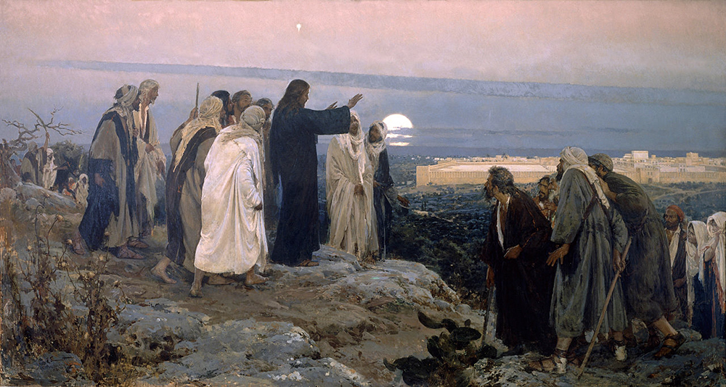

Slide 7
Signs And Events Preceding the Return of Christ
1. Disasters in the world (Matthew 24:4-8): Wars, famines, earthquakes, false Christs.
2. Developments in the church (24:9-14): universal persecution, people's love for God going cold, false prophets, worldwide mission.
3. Dangers centred on the Middle East (24:15-28): Sacrilege, unequalled (but limited) distress, false claims of his return and false prophets.
4. Darkness in the skies (24:29-31): Sun, moon and stars gone until the sign and sight of Jesus’ the Son of Man glorious return with Christians gathered to him!
(Source: David Pawson, Unlocking The Bible, Harper Collins, 2003. page 823)

Slide 8
Matthew 24:42-44
What is the ”Therefore” of vs 42 referring to? See Matthew 24:36-41.
Vs 43: ”Like a Thief in the night” – See 1 Thess. 5:2-4; 2 Peter 3:10, Revelation 3:3, 16:15.
Vs 44 – While we don’t know the hour or the day, we do know Jesus is coming again!

Slide 10
Matthew 24:45-51
2 types of servants
Vs 45-46 – First one is faithful as a steward and provider.
Rewarded with greater responsibility – vs 47.
Vs 48-49 - The wicked servant says “My master is delayed.” (cf Matthew 25:5 and 19). He abuses fellow servants and is derelict in his duties.
Vs 50-51 – Master returns unexpectedly. Second one is judged and condemned with the hypocrites in hell (see Matthew 13:42, 50; see also 8:12; 22:13; 25:30).

Slide 11
Application
1) A Posture of Expectant Waiting.

Slide 12
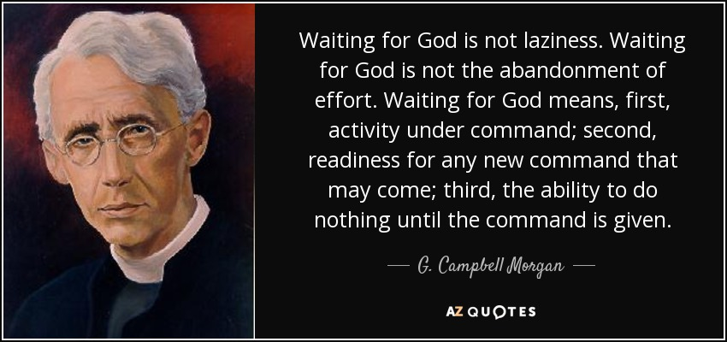

Slide 13
Application
1) A Posture of Expectant Waiting.
2) A Practice of Faithful Stewardship.

Slide 14
Application
1) A Posture of Expectant Waiting.
2) A Practice of Faithful Stewardship.
“Therefore, preparing your minds for action, and being sober-minded, set your hope fully on the grace that will be brought to you at the revelation of Jesus Christ.”
(1 Peter 1:13).

Slide 15
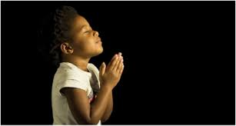
LET US PRAY….

