Slide 1
What?
Healthy Churches
Strong Leaders

Slide 2
How?
Practical ministry
Bible Exposition
Biblical Counseling
Biblical Spirituality
Pastoral leadership
Missions/
Evangelism
Theological conviction
Theology 1,2,3
Interpretation of Scripture
Bible Interpretation
NT Narrative
OT Narrative
Poetry
Prophecy
Epistles

Slide 4
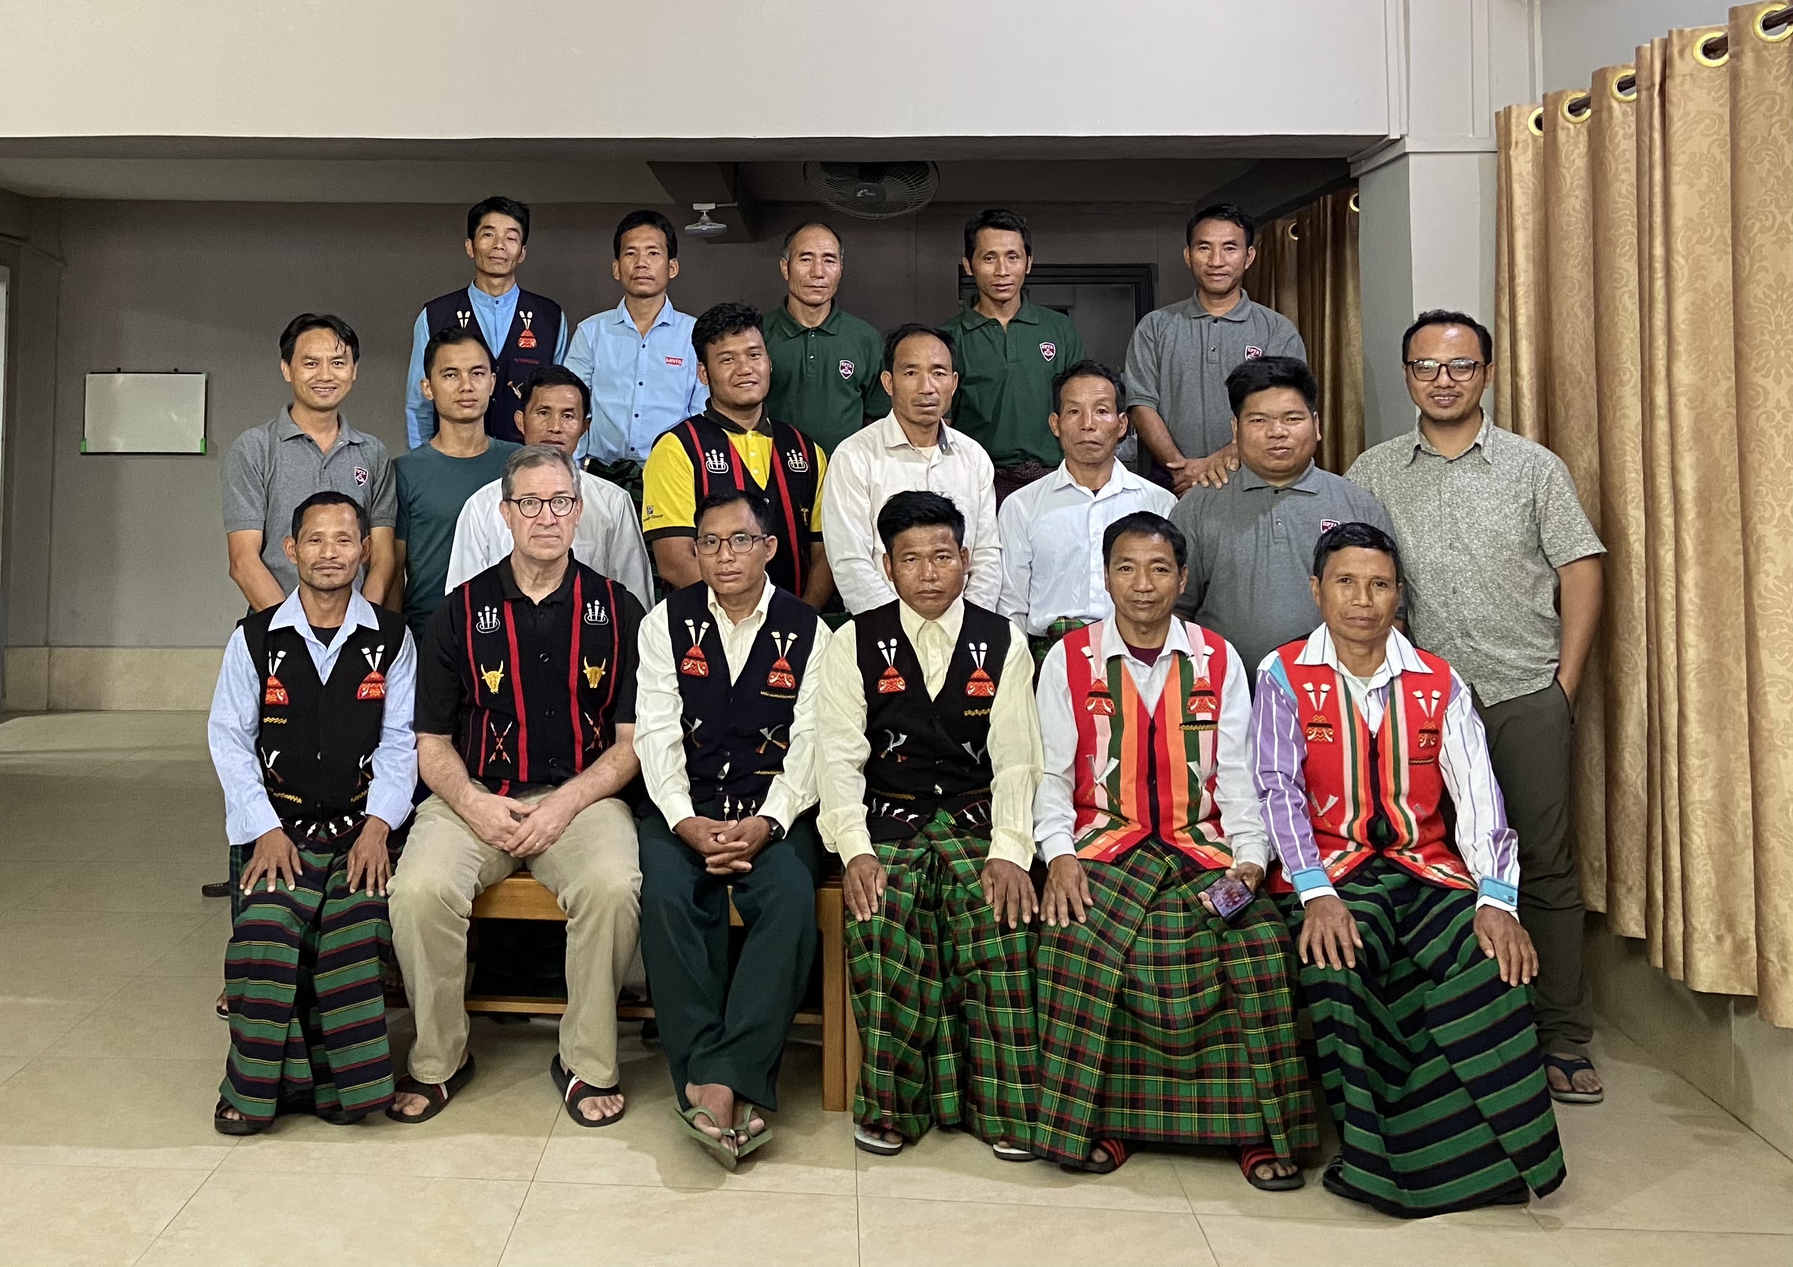
Myanmar

Slide 5
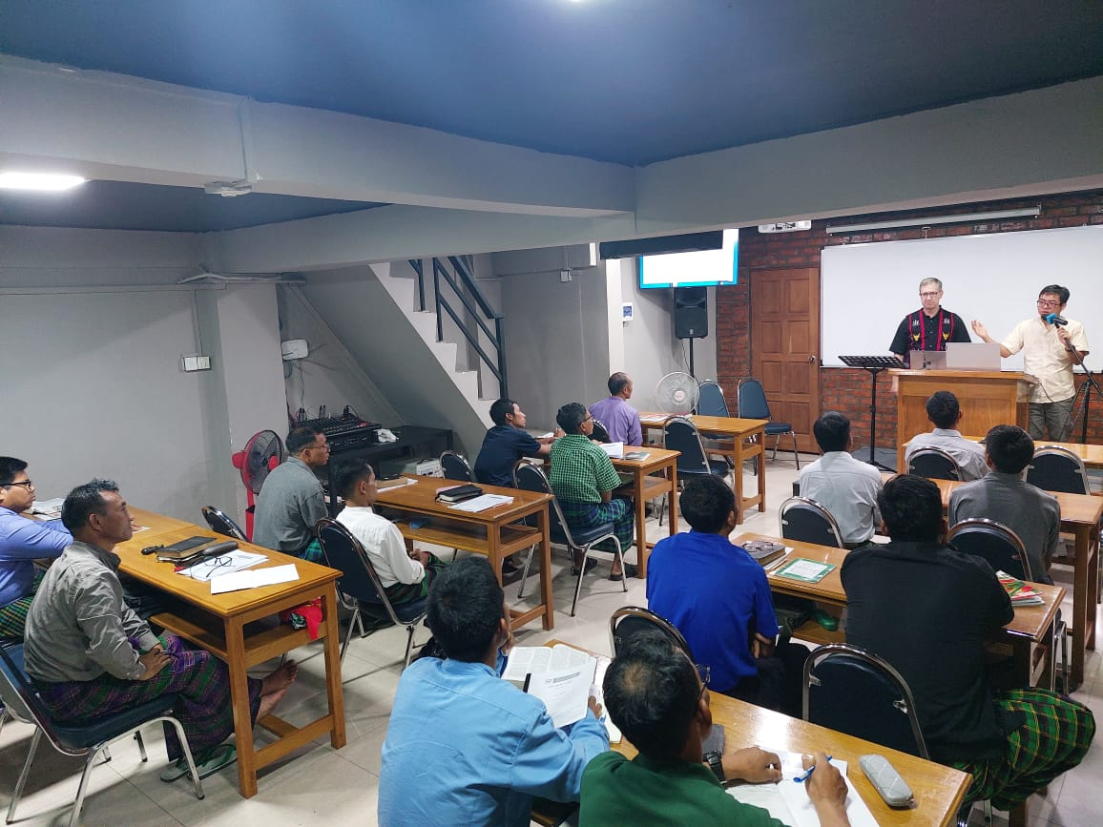

Slide 6
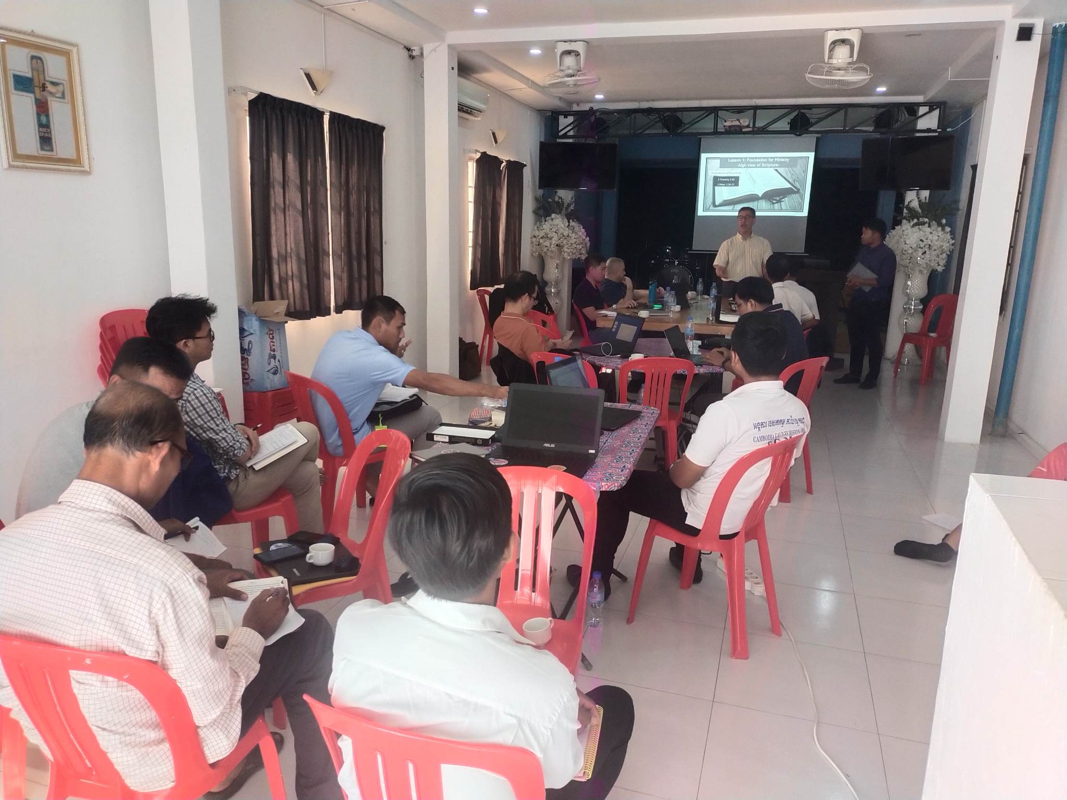
Cambodia

Slide 7
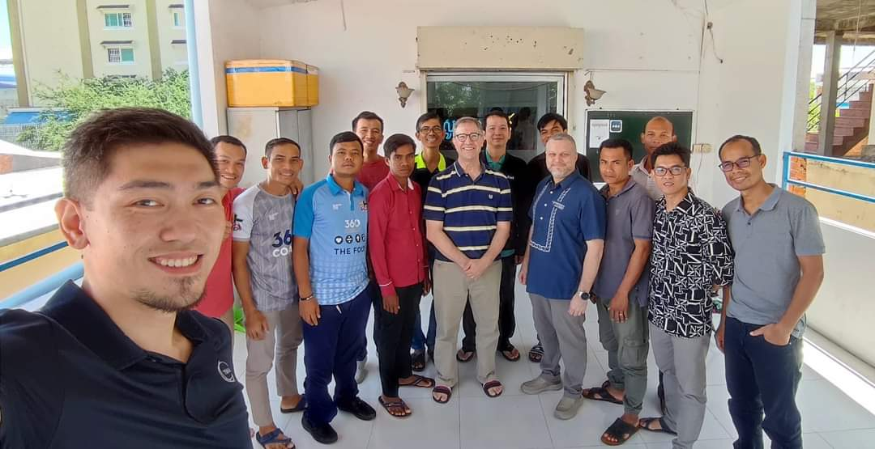

Slide 8
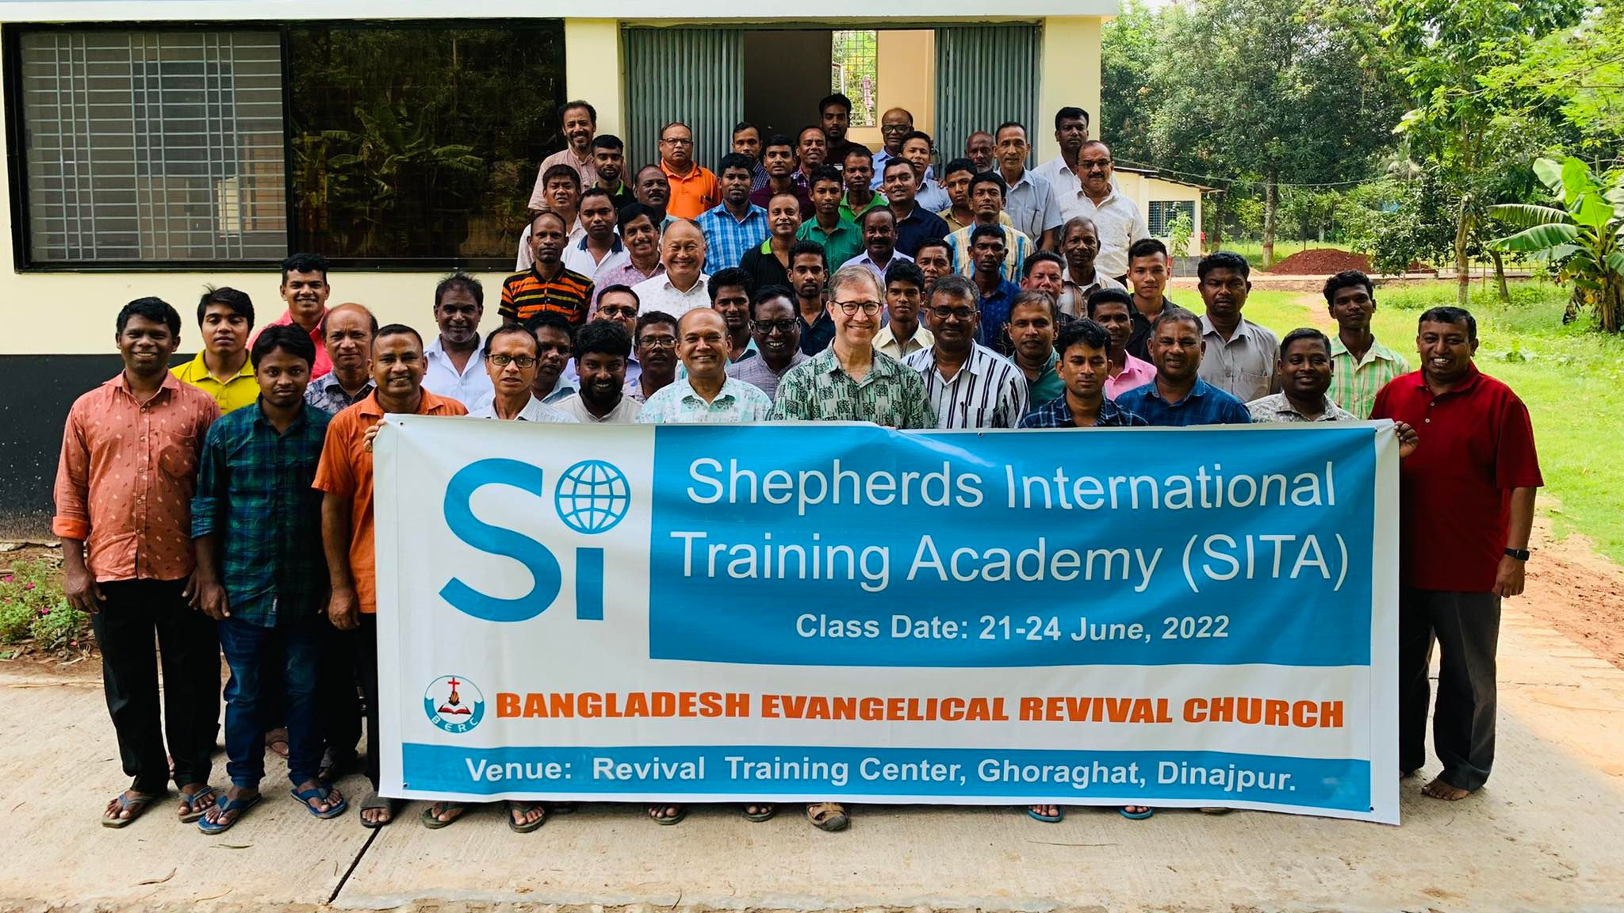
Bangladesh

Slide 9
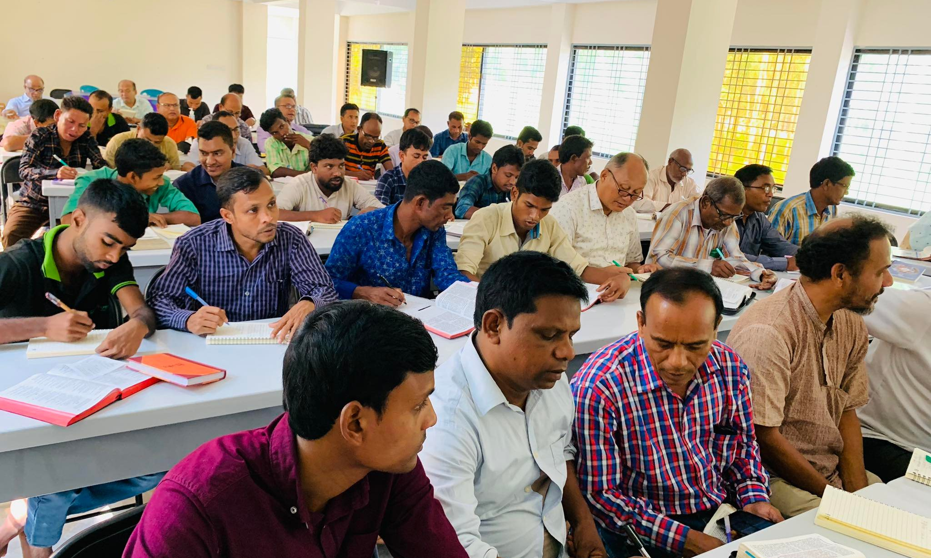

Slide 10
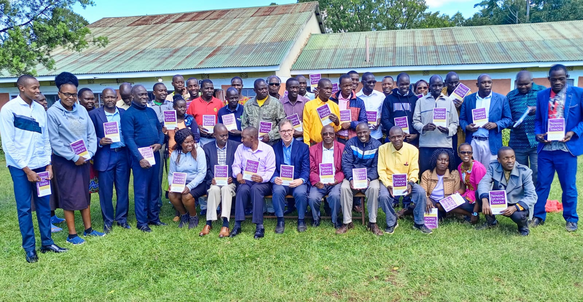
Kenya

Slide 11
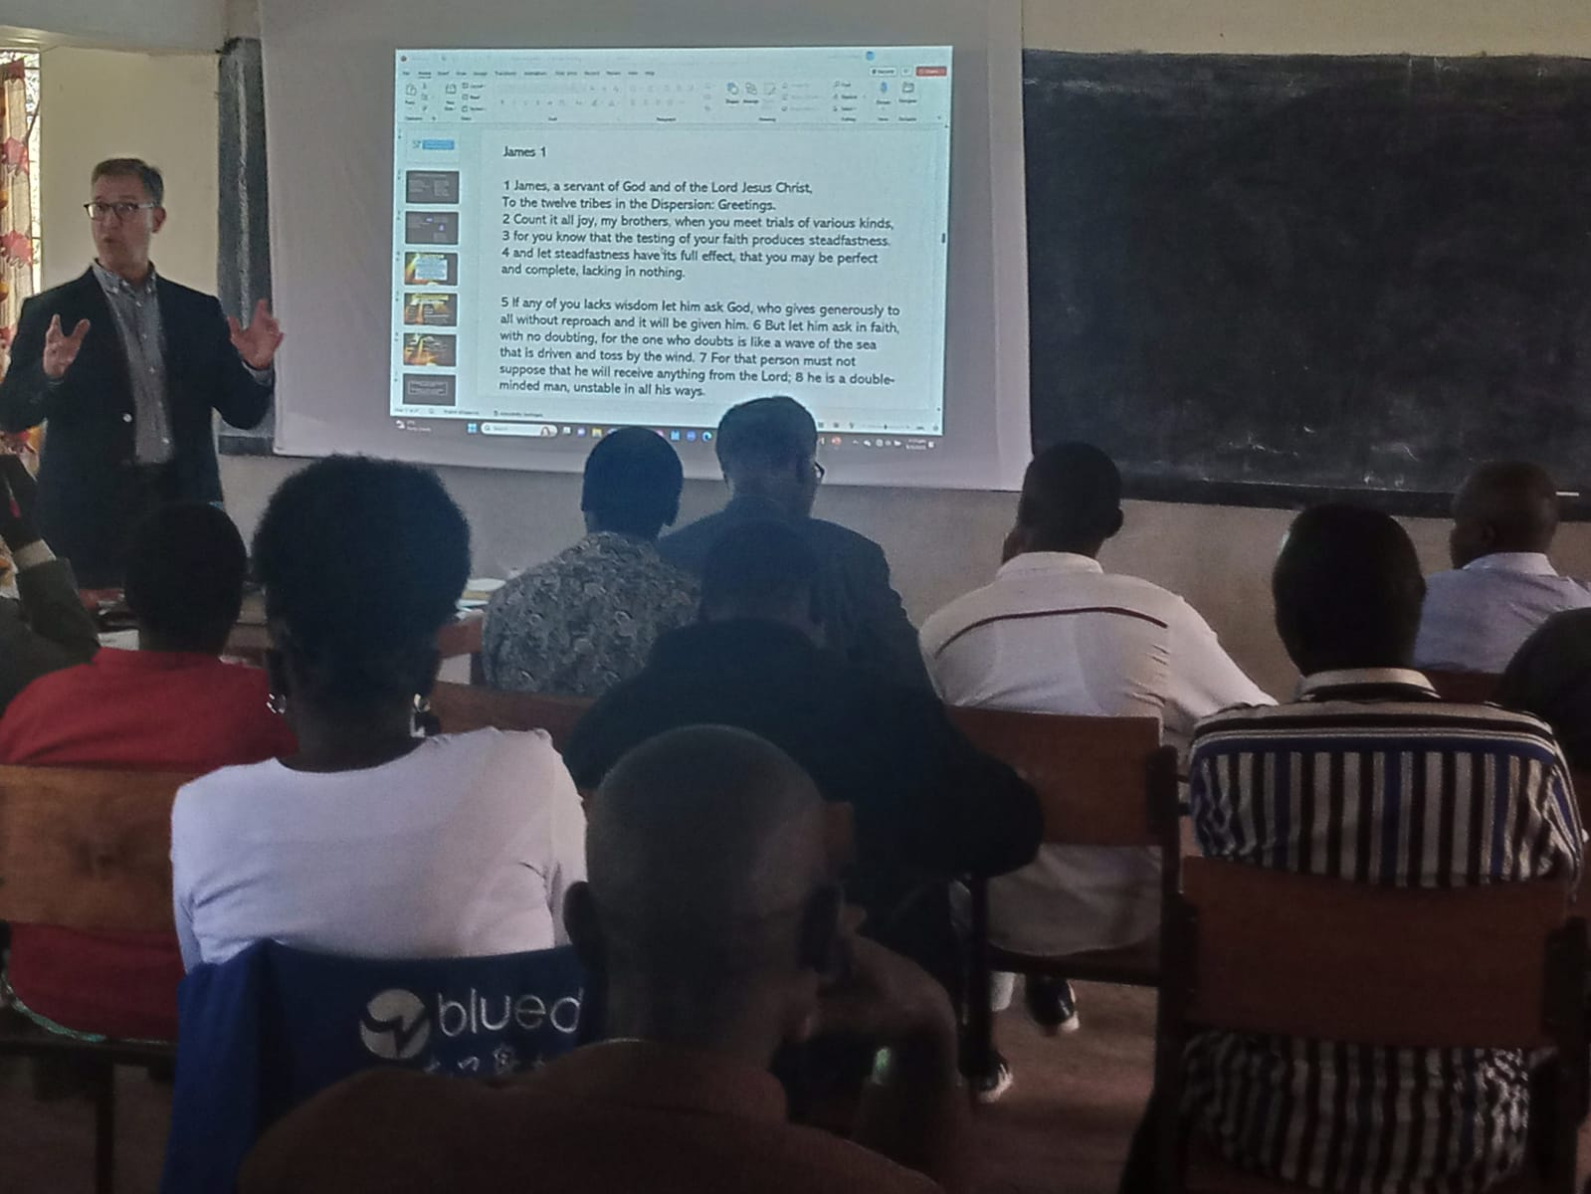

Slide 12
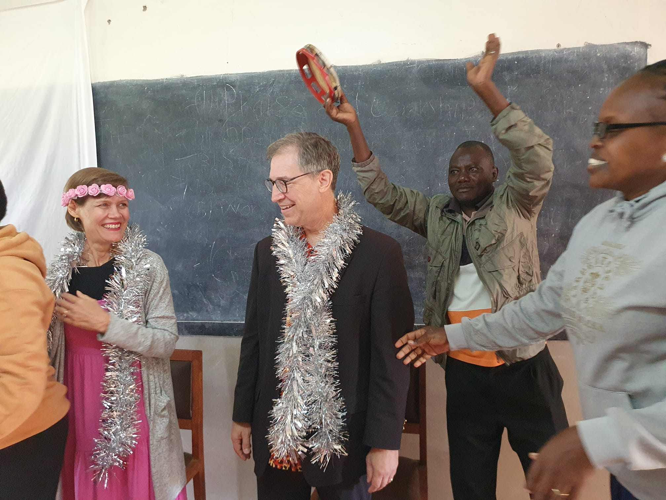

Slide 13
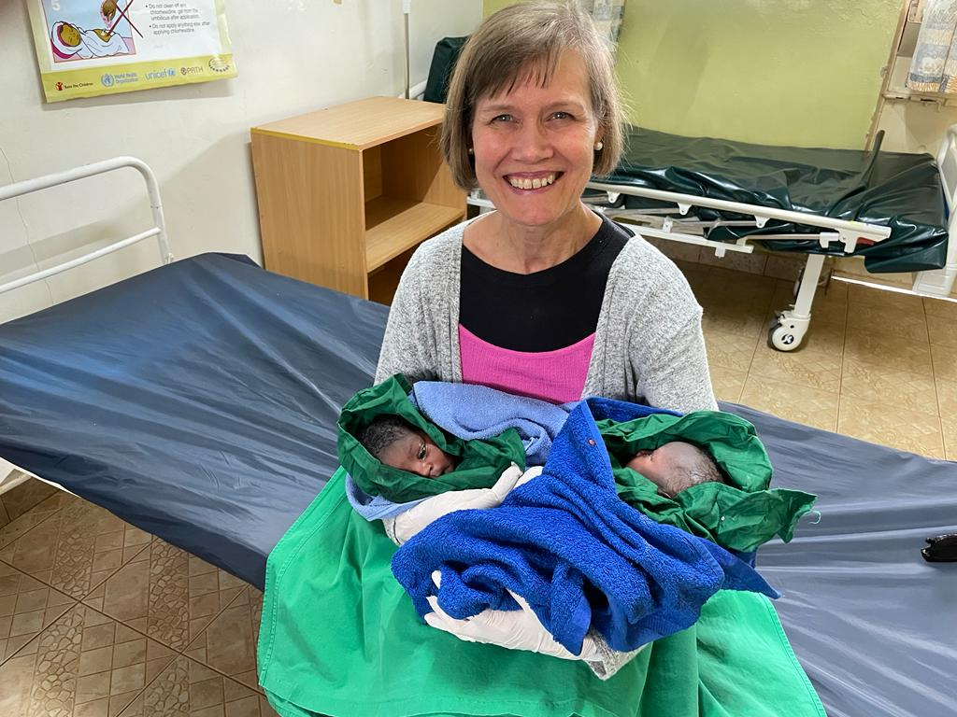

Slide 14
Where?
Asia
Cambodia
Myanmar
Bangladesh
Africa
Kenya
Europe
Albania
Uganda
Indonesia

Slide 15
C H A L L E N G E

Slide 16
C
I
C
Membership
Giving
Fellowship
Ministry
ommit

Slide 17
C
I
C
ommit
ntercede
reate

