Slide 1
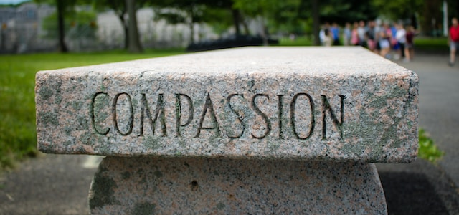
The Healing at the Pool
John 5:1-18

Slide 2
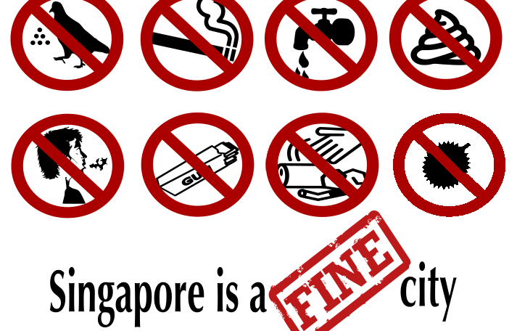
Notes:
If you have been in Singapore for any amount of time,
you have probably seen t-shirts or posters saying that
“Singapore is a fine city.”
The phrase "Singapore is a fine city" is a play on words.
It plays on the double meaning of the word "fine."
In one sense, "fine" is used to describe something that is of high quality or good, like Singapore’s public transit system, HDB housing, and its parks and green spaces.
However, in this context, "fine" is also used to refer to a penalty or a monetary punishment for breaking the law.
This is because Singapore is known for its strict enforcement of various laws and regulations, and there are fines for a wide range of offenses, including littering, smoking, feeding birds, and not flushing the toilet after use.
But these laws aren’t really that strict. In fact, they are pretty much common sense. I know to throw my trash in a rubbish bin, to smoke only in designated areas, and to flush the toilet after I use it. And after smelling a durian, I know to never, ever eat it,

Slide 3
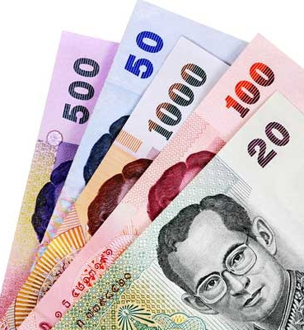
Notes:
I also know that when I travel to different countries,
it is a good idea to know
the laws and customs of the place you are visiting.
When you violate the laws or customs of a place,
whether intentionally or accidentally,
you can end up in a lot of trouble.
For example, if you drop some money while traveling in Thailand
and then step on it to keep it from blowing away,
you are technically violating their Lese Majeste law,
which prohibits defaming or insulting the Thai royal family,
because the King’s picture is on their currency.
While no tourists have been thrown in jail
for accidentally stepping on Thai currency,
if you were to do it on purpose,
many people would be quite critical of you.
In our passage today found in John chapter 5 vs 1-18,
some people are critical of Jesus
They believe he violated their laws and customs.
And not just something small like chewing gum or eating durian
And not for something big like disrespecting the national leader
They believe that Jesus violated God’s laws, and they are angry.
What we will see in John chapter 5 vs 1-18
is that the Jewish leaders were critical of Jesus
because he violated their understanding of God’s laws.
https://www.freepik.com/free-vector/cute-police-holding-megaphone-cartoon-vector-icon-illustration-people-profession-icon-isolated-flat_39659459.htm#query=policeman&position=0&from_view=search&track=sph

Slide 4
Believing
C H R I S T
Responding to John’s Gospel
Notes:
Obviously, the Jewish leaders did not really understand God’s laws.
But sometimes we don’t really understand God’s laws either.
That is why we are studying John’s gospel,
chapter by chapter, and verse by verse,
In our series called Believing CHRIST, responding to John’s gospel
Today, we are looking at the first part of Chapter 5
Before we start, let me quickly summarize the first four chapters
The narrative begins with the prologue, chapter 1 vs 1-18
identifying Jesus as the Word made flesh, emphasizing his divine nature.
He then performs the first of what will be seven signs,
turning water into wine at a wedding, showcasing his divine power.
This is followed by his conversation with Nicodemus,
highlighting the concept of spiritual rebirth through faith in him.
Jesus also engages with a Samaritan woman at a well,
revealing his identity as the Messiah and the living water.
As these events unfold, Jesus initiates his ministry, he gathers disciples,
And his influence begins to spread,
with many people coming to believe in him as the Son of God and the Savior.
Including a certain royal official whose son was sick,
and Jesus healed that son from a great distance
This was the second of what will be seven signs.
And where we finished last week at the end of John ch 4

Slide 5
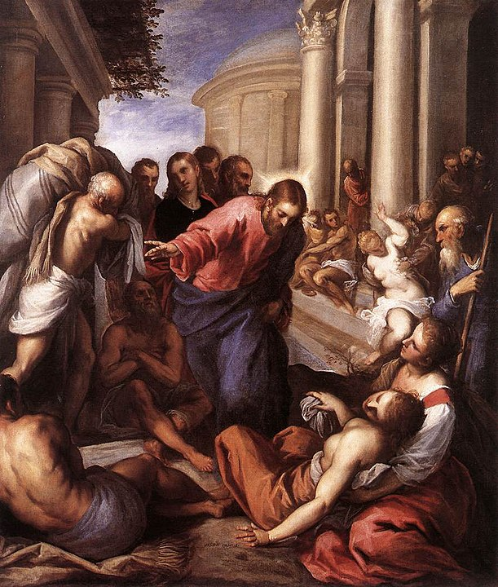
Healing a Paralytic at the Pool of Bethesda
Notes:
Today we will read about the third great sign that Jesus does,
which is to heal a paralytic at the pool of Bethesda
This story is a turning point in John’s gospel
because the Jewish leaders go from simply inquiring about Jesus
to open hostility, persecuting him, and even wanting to kill him.
All because they thought Jesus violated God’s laws.
The Pharisees were blinded by what they thought “religion” should look like
They did not see true religion “Jesus”
who was performing miracles right in front of them
Instead, they simply wanted to bash Jesus over the head
with their way of performing religion
which was with meticulous attention to following the law
at the expense of compassion and even truth!
How is this relevant today?
Many people would say that the church has become like the Pharisees!
Let me quickly explain what I mean when I say that
many people would say that the church has become like the Pharisees!
By Palma il Giovane - Web Gallery of Art: Image Info about artwork, Public Domain, https://commons.wikimedia.org/w/index.php?curid=4204894

Slide 6
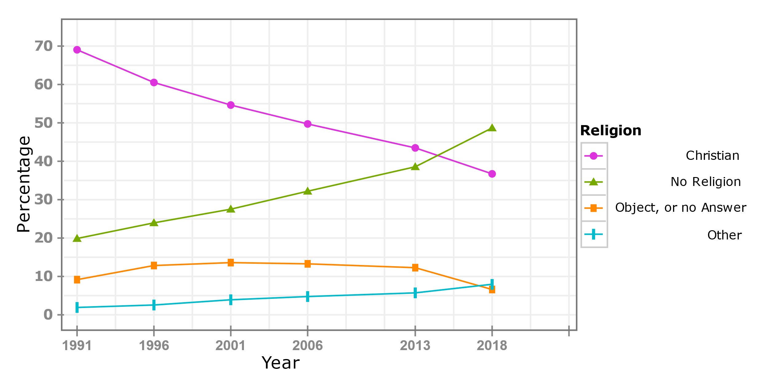
Decline of Christianity in the Western world
In New Zealand, the Population recorded as having 'no religion’
overtook Christianity in the 2018 census
Notes:
In the Western World, Europe, the US, Australia, and New Zealand, Christianity is in decline.
This graph taken from a New Zealand census
shows that the Population recorded as having 'no religion’
overtook Christianity in the 2018 census
Even in Singapore,
The 2020 Census of Population infographic reports that
there is a Higher proportion of residents who reported no religious affiliation
across all age groups.

Slide 7
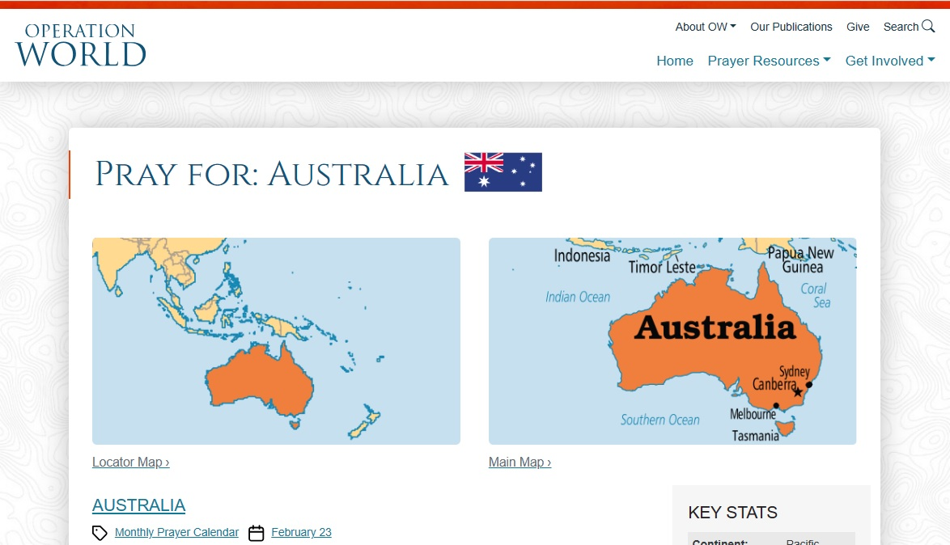
. . . by the 2026 census, “No Religion” will almost certainly become the largest group in Australia.
Notes:
Operation World, widely regarded as
the definitive volume of prayer information about the world,
Says three things about Australia
First is that the strong influence of Christianity declined
And that by the 2026 census,
“No Religion” will almost certainly become the largest group in Australia.
Second, they list as one factor for this decline as
the series of scandals and corruption
in Hillsong and other high-profile churches
which accelerated disillusionment and disgust with Christianity
Now here is where I see the similarities
between what is happening in the Western church today
and what John was writing about in his gospel

Slide 8
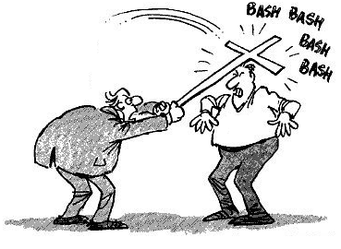
Many Australians see the Church
as intolerant, abusive of its power, and anti-progressive in
its values.
Notes:
Like the Pharisees,
the church is blinded by what it thinks “religion” should look like
The church often does not practice true religion
following Jesus’s example of compassion and truth
Instead, the church bashes people over the head
with their way of performing religion
Look at the third thing that the Operation World website says about Australia”
that many Australians see the Church as intolerant, abusive of its power, and anti-progressive in its values.
Intolerant, abusive of power? Does that sound familiar?

Slide 9
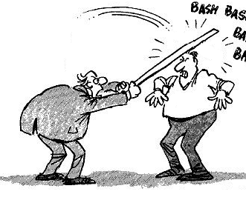
Sabbath
John portrays the Jewish Leaders
as intolerant, abusive of their power, and anti-progressive in
their values.
Notes:
In our story today, John portrays the Jewish leaders as intolerant,
abusive of their power, and anti-progressive in their values.
You can easily substitute
anti-progressive with anti-compassionate in both these statements.
The modern definition of progressive is usually political
and has something to do with social reform.
But did you know the earliest progressive movement
was found in the teachings of the Bible?
Women in ancient Near East society
were often relegated to subordinate roles, with limited legal rights.
But women in the Bible
bear God’s image (Gen 1:27),
Women in the Bible
are described as being involved in commerce (Prov 31:11-18),
Women in the Bible
are even described as assuming leadership roles (e.g., Deborah);
The Bible calls for social reform
because God has compassion for all his creation,
man, woman, slave, free, rich, or poor
But the Jewish leaders lacked compassion
because they are blinded by their faulty understanding of God’s laws
For us to gain a better understanding of God’s laws,
lets take a closer look at the story

Slide 10
Jesus demonstrates his divine power and compassion (1-9)
Jesus’s miracle does not conform to the Jewish leaders view of God’s laws (10-18)
Notes:
Our passage for today can be divided into two parts.
In verses 1 through 9,
Jesus demonstrates his divine power and compassion
by healing a man who had been an invalid for many years
And in verses 10 through 18
The Jewish leaders are upset
Because Jesus’s demonstration of his divine power and compassion
His miracle
does not conform to their view of God’s laws

Slide 11
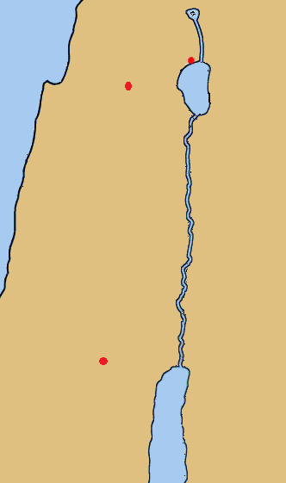
Capernaum
Ch 4
⁴⁶ So he came again to Cana in Galilee, where he had made the water wine.
And at Capernaum . . .
Ch 5
¹ After this there was a feast of the Jews, and Jesus went up to Jerusalem.
Cana
Jerusalem.
Notes:
Our story takes place in Jerusalem.
Beginning in chapter 5 verse 1 John writes that
After this, there was a feast of the jews,
And Jesus went UP to Jerusalem
We know from the previous chapter
that Jesus was in Cana and then Capernaum
We don’t know what the festival was that is mentioned here or
how long after the healing of the royal official’s son that he went up to Jerusalem, but considering it is over 160 km away, it wasn’t the next day
But the key point here is that he is going up to Jerusalem
Two reasons UP:
1) geography, Jerusalem’s elevation
2) Jerusalem was the site of the temple of God,
therefore a place of spiritual ascent.
Psalm 24:3 Who shall ascend the hill of the Lord?
And who shall stand in his holy place?
We know that in reality being high on a mountain does not bring you closer to God. There is nothing we can do to reach God
which is why Jesus came down to earth

Slide 12
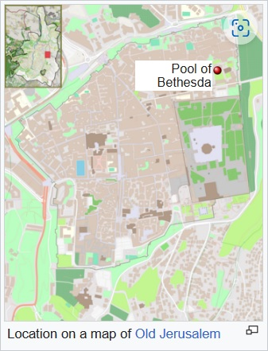
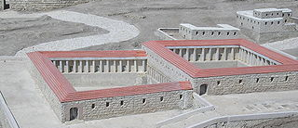
² Now there is in Jerusalem by the Sheep Gate a pool, in Aramaic called Bethesda, which has five roofed colonnades. ³ In these lay a multitude of invalids—blind, lame, and paralyzed.
Model of the Pools at the Israel Museum
Notes:
Verse 2 tells that in Jerusalem by the Sheep Gate
there is a pool, in Aramaic called Bethesda,
which has five roofed colonnades.
In these lay a multitude of invalids—blind, lame, and paralyzed.
The archeological evidence is clear on where the pool is and that the biblical description is accurate.
But the key point here is why this large group of sick people were waiting there.

Slide 13
² Now there is in Jerusalem by the Sheep Gate a pool, in Aramaic called Bethesda, which has five roofed colonnades. ³ In these lay a multitude of invalids—blind, lame, and paralyzed. ^{(c)}
Footnote
Some manuscripts insert, wholly or in part, waiting for the moving of the water; ⁴ for an angel of the Lord went down at certain seasons into the pool, and stirred the water: whoever stepped in first after the stirring of the water was healed of whatever disease he had
Model of the Pools at the Israel Museum
Notes:
The WHY is found in verse 4
which is typically found in the footnotes of most Bibles along with the end of verse 3
Together, these additions say that the invalids Were waiting for the moving of the water;
4 for an angel of the Lord went down at certain seasons into the pool, and stirred the water: whoever stepped in first after the stirring of the water was healed of whatever disease he had
Please note that the WHY is also found in verse 7 which mentions the stirring of the water and the need to be the first one in the pool

Slide 14
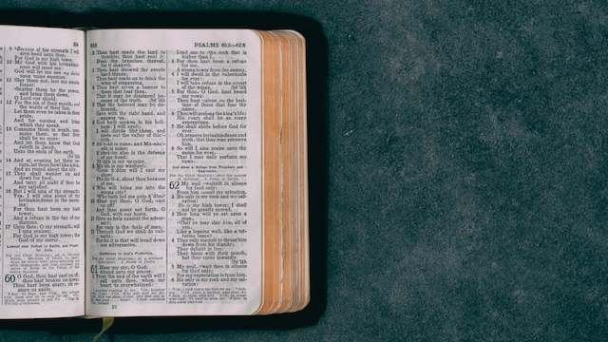
Biblical Inspiration
Notes:
The reason verse 4 is in the footnotes is pretty straight forward
The New Testament has been preserved in more manuscripts than any other ancient work of literature, with over 5,800 complete or fragmented Greek manuscripts catalogued, 10,000 Latin manuscripts and 9,300 manuscripts in various other ancient languages
https://en.wikipedia.org/wiki/Biblical_manuscript
Sometimes there are errors in copying the Greek letters and annotations
Other times, the scribes would add notes, which then get recopied.
This verse is only found in the later manuscripts. A scribe probably thought it added context to what John wrote
It is important to remember that the verses in question are of minor significance.
None of them change in any way the crucial themes of the Bible,
nor do they have any impact on the Bible’s doctrines
—Jesus’ death and resurrection; Christ’s being the only way of salvation;
and the doctrines of heaven and hell, sin and redemption,
and the nature and character of God.
In fact, a lot of the KJV “additions” are rather clear commentary
that affirm these doctrines found elsewhere
Remember the story about Philip and the Ethiopian Eunuch in Acts chapter 8
The eunuch asks “See, here is water! What prevents me from being baptized?
Which is a rhetorical question as vs 38 then states 38 And he commanded the chariot to stop, and they both went down into the water, Philip and the eunuch, and he baptized him.
But Verse 37 in the footnotes adds “And Philip said, “If you believe with all your heart, you may.” And he replied, “I believe that Jesus Christ is the Son of God.”

Slide 15
² Now there is in Jerusalem by the Sheep Gate a pool, in Aramaic called Bethesda, which has five roofed colonnades. ³ In these lay a multitude of invalids—blind, lame, and paralyzed. ^{(c)}
Footnote
Some manuscripts insert, wholly or in part, waiting for the moving of the water; ⁴ for an angel of the Lord went down at certain seasons into the pool, and stirred the water: whoever stepped in first after the stirring of the water was healed of whatever disease he had
Model of the Pools at the Israel Museum
Notes:
This footnote doesn’t tell us about any doctrines,
It really doesn’t add anything to the story
as we will learn from verse 7 why the sick people were waiting at that pool.
The only new bit of information in the addition is the phrase an angel of the Lord, but as we shall soon see, this was no angel of the Lord
Picture this if you can,
A room full of people who are suffering from various diseases and illnesses
They have exhausted all available conventional medical treatments
They have become desperate for any solution or hope for relief.
So they turn to non-conventional treatment, or superstitions
Now turn that into a reality TV show
And the winner in this reality TV show receives healing from their sickness
In order to win, you just must be the first one to step in the water
after it is stirred up
What are the rules? Evidently there are none.
It looks like you can get to the water yourself,
or have someone help you.
Sounds like a cruel and heartless reality show.

Slide 16
That so many people were at the pool waiting for the stirring of the waters suggests there were occasions when people had been healed at Bethesda. There were other healing shrines in the ancient world (e.g. the shrine of Asclepios in Corinth) and evidence exists that people did sometimes receive healing at these sites.
From a Christian perspective such healings would be explained in terms of the ‘lying wonders’ of Satan (2 Thess. 2:9). In Matthew 24:24 / Mark 13:22 Jesus speaks of false Christs and false prophets who will perform great signs and wonders to deceive, if it were possible, even the elect.
Kruse, C. G. (2003). (Vol. 4, p. 148). InterVarsity Press.
Notes:
There is a good reason why this is cruel and heartless.
C. G. Kruse, in his commentary states, “That so many people were at the pool waiting for the stirring of the waters suggests there were occasions when people had been healed at Bethesda. There were other healing shrines in the ancient world (e.g. the shrine of Asclepios in Corinth) and evidence exists that people did sometimes receive healing at these sites.”
He goes on to tell us that, “From a Christian perspective such healings would be explained in terms of the ‘lying wonders’ of Satan (2 Thess. 2:9).
In Matthew 24:24 / Mark 13:22 Jesus speaks of false Christs and false prophets who will perform great signs and wonders to deceive, if it were possible, even the elect.”
When people are deceived by superstitions of healing,
it is certainly cruel and heartless

Slide 17
Jesus demonstrates his divine power and compassion (1-9)
People who are suffering often put their hope in extraordinary and often unbelievable sources (1-5)
⁵ One man was there who had been an invalid for thirty-eight years.
Notes:
For the man in our story today, though, this process was particularly cruel and heartless This man, who was at the pool had been an invalid for 38 years.
We don’t know how long he had been coming to the pool, or even how he got there. Maybe the people who brought him, stayed for a little while but then had to leave, and came to get him later.
But we do know that he was at the pool because people who are suffering often put their hope in extraordinary and often unbelievable sources
When you think you have nowhere to turn to, you often turn to anywhere
Unfortunately, many in this world are suffering, and don’t know where to turn
Just like this man who had been an invalid for 38 years,
who doesn’t know where to turn,
But Jesus turns to him

Slide 18
Jesus demonstrates his divine power and compassion (1-9)
People who are suffering often put their hope in extraordinary and often unbelievable sources (1-5)
Divine healing does not conform to worldly views or need active participation (6-9)
Notes:
And when Jesus turns to the invalid,
he demonstrates his divine power and compassion,
and shows that his divine healing does not conform to worldly views
or even need active participation
Jesus does it his way for his purpose

Slide 19
In the spiritual realm man’s great problem is that either he does not recognize he is sick (cf. Isa. 1:5–6; Luke 5:31) or he does not want to be cured. People are often happy, for a while at least, in their sins.
Bible Knowledge Commentary (Vol. 2, p. 289). Victor Books.
⁶ When Jesus saw him lying there and knew that he had already been there a long time, he said to him, “Do you want to be healed?”
Notes:
Verse 6 tells us that When Jesus saw him lying there and knew that he had already been there a long time, he said to him, “Do you want to be healed?”
So even before the man is healed, we see something supernatural,
Jesus knows
Just like Jesus knew about Nathaniel in chapter 1
and the Samaritan woman in chapter 4, => Jesus knows.
But if Jesus knows, why does he ask the question “do you want to be healed?”
First, its not a rhetorical question, you might thing that someone who is suffering would want to be healed
But sometimes people suffering because of their sinful lifestyle
would rather suffer than change their sinful lifestyle
Such people live in a constant state of denial,
insisting that their choices bring happiness,
even as they battle loneliness, addiction, and despair.
The Bible Knowledge Commentary highlights that In the spiritual realm man’s great problem is that either he does not recognize he is sick (cf. Isa. 1:5–6; Luke 5:31) or he does not want to be cured. People are often happy, for a while at least, in their sins.
And second, why would Jesus sk do you want to be healed. I believe the answer is BECAUSE Jesus knows what true healing looks like.
Even if the man doesn’t, that is why Jesus asks the question.
Sometimes when we are suffering and feel like we are broken, we don’t even know what healing would look like, remember this,
Jesus knows what you need and is offering it to you

Slide 20
hopeless
⁷ The sick man answered him, “Sir, I have no one to put me into the pool when the water is stirred up, and while I am going another steps down before me.”
Notes:
In this case,
it is clear that the invalid does not know how healing can take place
All he knows is that,
“I have no one to put me into the pool when the water is stirred up,
and while I am going another steps down before me.”
Because of the cruel and heartless nature of the world,
compounded by the superstitions about the healing available at the pool
the man has no hope

Slide 21
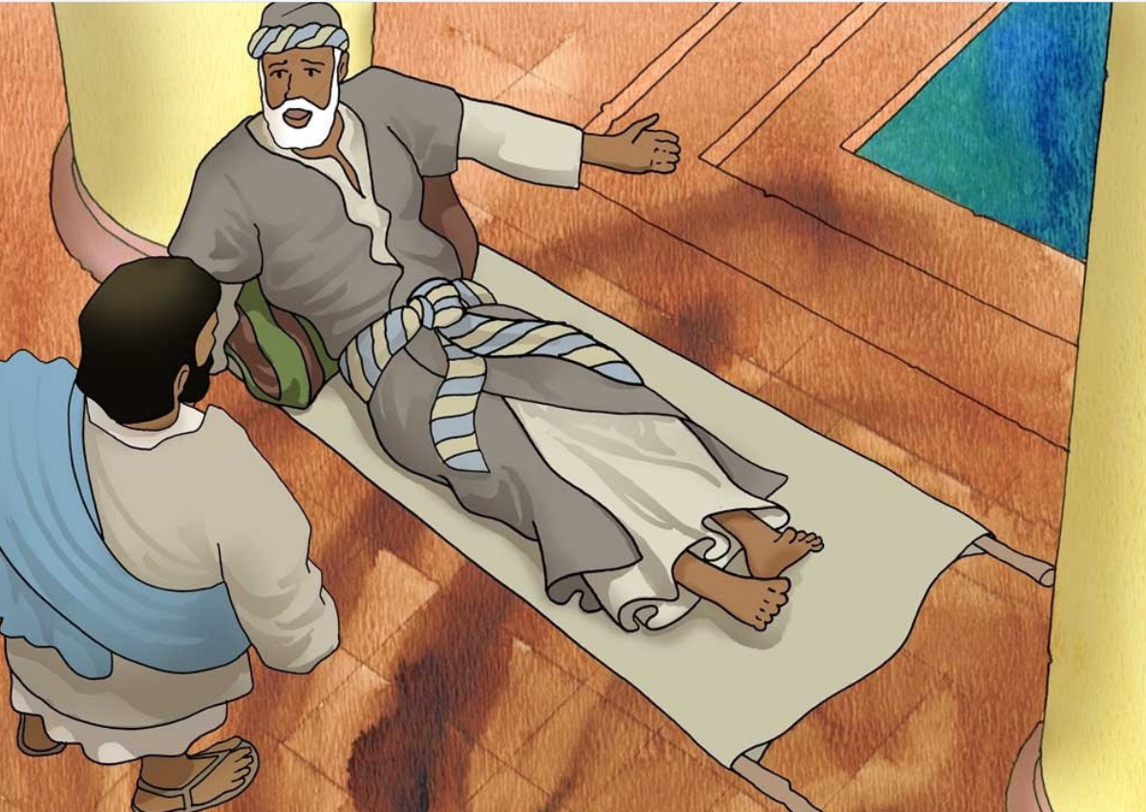
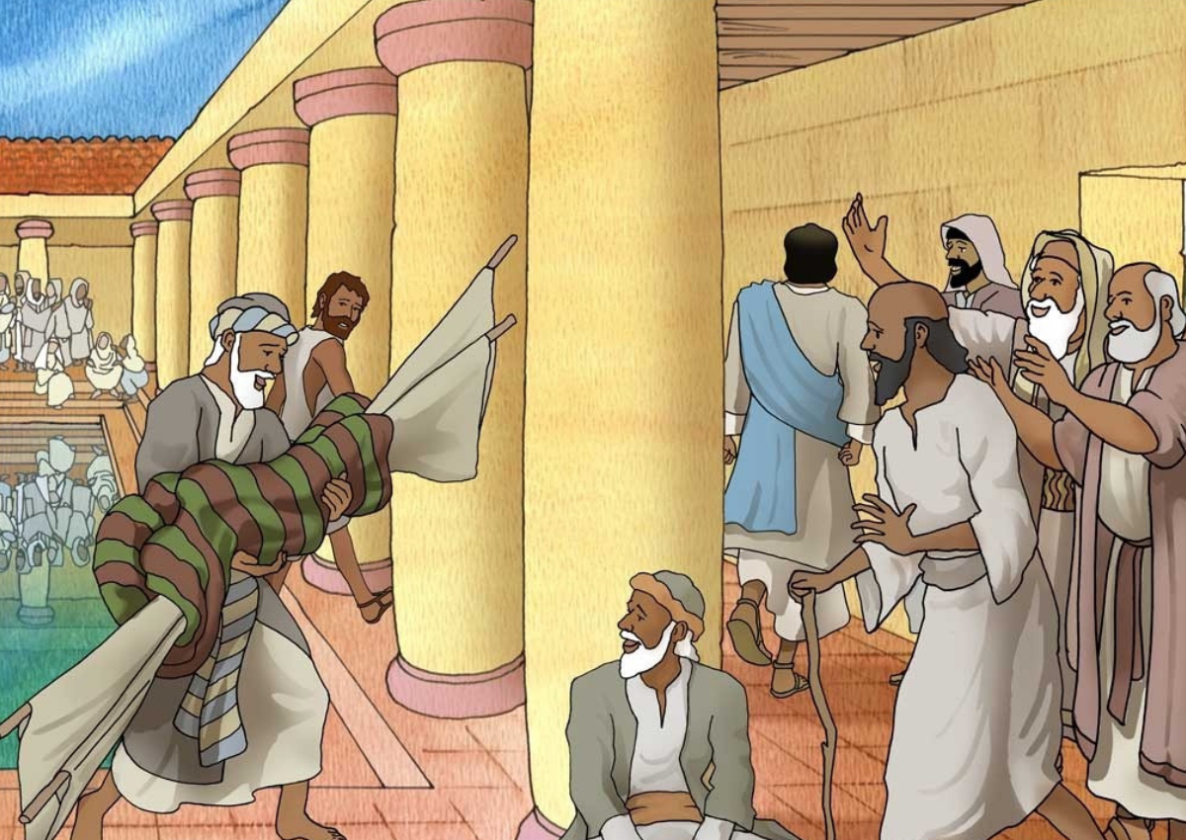
⁸ Jesus said to him, “Get up, take up your bed, and walk.” ⁹ And at once the man was healed, and he took up his bed and walked.
Notes:
Regardless of the lack of faith and the lack of hope, Jesus says to the man “
Get up, take up your bed, and walk.”
⁹ And at once the man was healed, and he took up his bed and walked.
These verses describe the miraculous cure.
The original question in verse 6 focused on the man’s reliance on superstition.
If the pool had really been God’s healing agent, Jesus could have just helped the man in the water first after the angelic stirring.
But the words Get up! Pick up your mat and walk
emphasize that JESUS was the source of divine healing,
not some kind of special pool.
When you are really sick,
miracle is preferable to magic.
a savior is preferable to superstition
Gangel, K. O. (2000). John (Vol. 4, p. 97). Broadman & Holman Publishers.
Images from JESUS HEALS A MAN AT BETHESDA by John Paul Stanley available at FreeBibleimages.org

Slide 22
Royal Official | Invalid
Sought Jesus | Jesus sought him
Pleaded for help | Jesus asked if he wanted help
Expressed the miracle privately | Jesus healed publicly
Man was motivated to believe | Jesus worked without the man’s belief
Notes:
There is quite a stark contrast with this miracle
and the healing of the Royal Official’s son at the end of chapter 4
The royal official sought Jesus,
whereas with the invalid, Jesus sought him
The royal official pleaded for help,
whereas with the invalid, Jesus asked if he wanted help
With the royal official, the miracle was expressed privately
but Jesus healed the invalid publicly
The royal official had hope and was motivated to believe,
Whereas the invalid was hopeless, and Jesus worked without the man’s belief

Slide 23
Jesus demonstrates his divine power and compassion (1-9)
People who are suffering often put their hope in extraordinary and often unbelievable sources (1-5)
Divine healing does not conform to worldly views or need active participation (6-9)
Notes:
All this goes to show that Jesus does it his way for his purpose,
Which tells us that divine healing does not conform to worldly views or need active participation.

Slide 24
Jesus demonstrates his divine power and compassion (1-9)
People who are suffering often put their hope in extraordinary and often unbelievable sources (1-5)
Divine healing does not conform to worldly views or need active participation (6-9)
Jesus’s miracle does not conform to the Jewish leaders view of God’s laws (10-18)
Notes:
We are now ready for the second part of the story, the main event.
Which is the indirect confrontation between Jesus and the Jewish Leaders
Everything thus far is just the preliminaries, setting the stage, getting us ready
for this clash.
Why does this confrontation occur?
Because Jesus’s miracle do not conform
to the Jewish leaders view of God’s laws (10-18)
Why is this an indirect confrontation?
Because it appears that initially,
the Jewish leaders are not addressing Jesus directly,
but rather through the man who was healed

Slide 25
Now that day was the Sabbath. ¹⁰ So the Jews^{[d]} said to the man who had been healed, “It is the Sabbath, and it is not lawful for you to take up your bed.” ¹¹ But he answered them, “The man who healed me, that man said to me, ‘Take up your bed, and walk.’”
Notes:
The genesis of this confrontation is that the healing occurred on the Sabbath.
This is why a turning point occurs in how the Jewish authorities view Jesus.
Starting at the end of verse 9 we read
Now that day was the Sabbath
10 So the Jews said to the man who had been healed, “It is the Sabbath, and it is not lawful for you to take up your bed.” 11 But he answered them, “The man who healed me, that man said to me, ‘Take up your bed, and walk.’”
A couple thoughts come to mind looing at these verses.
Who are the “Jews”?
Why did they say it unlawful to take up your bed on the Sabbath?
And why did they not care about the miraculous healing?

Slide 26
Now that day was the Sabbath. ¹⁰ So the Jews^{[d]} said to the man who had been healed, “It is the Sabbath, and it is not lawful for you to take up your bed.” ¹¹ But he answered them, “The man who healed me, that man said to me, ‘Take up your bed, and walk.’”
Ἰουδαῖος
Ἰουδαῖοι
Ἰουδαίων
Ἰουδαίοις
Footnote
The Greek word Ἰουδαῖοι refers specifically here to Jewish religious leaders, and others under their influence, who opposed Jesus in that time; also verses 15, 16, 18
Notes:
The answer to who are the Jews may be found in your Bible footnotes.
This footnote from the ESV says that the Greek word used for Jews refers specifically here to Jewish religious leaders, and others under their influence, who opposed Jesus in that time;
The root word here is E-You-die’-yas, and the different conjugations are highlighted in yellow, blue, or green on the slide
Let’s walk through the different forms John has used up to this point

Slide 27
Ch 1
Ch 2
Ch 3
Ch 4
Ch 5
Ἰουδαῖοι
¹⁹ . . when the Jews sent priests and Levites
⁶ . . . six stone water jars there for the Jewish rites of purification
¹³ The Passover of the Jews . . .
¹⁸ So the Jews said to him, “What sign do you show
²⁰ The Jews then said, “It has taken forty-six years
¹ Nicodemus, a ruler of the Jews.
²⁵ Now a discussion arose between some of John's disciples and
a Jew over purification
⁹ . . . “How is it that you, a Jew, ask for a drink . . .
(For Jews have no dealings with Samaritans.)
²² . . . for salvation is from the Jews.
¹ After this there was a feast of the Jews . . .
Now that day was the Sabbath. ¹⁰ So the Jews^{[d]} said
Ἰουδαίων

Slide 28
¹ After this there was a feast of the Jews,
Now that day was the Sabbath. ¹⁰ So the Jews^{[d]} said to the man who had been healed, “It is the Sabbath, and it is not lawful for you to take up your bed.”
¹⁵ The man went away and told the Jews that it was Jesus who had healed him. ¹⁶ And this was why the Jews were persecuting Jesus, because he was doing these things on the Sabbath.
¹⁸ This was why the Jews were seeking all the more to kill him, because not only was he breaking the Sabbath, but he was even calling God his own Father, making himself equal with God.
Ἰουδαίων
Ἰουδαῖοι
Ἰουδαίοις
Ἰουδαῖοι
Ἰουδαῖοι

Slide 29
Jesus’s miracle does not conform to the Jewish leaders view of God’s laws (10-18)
The Jewish leaders ended up opposing God by putting rules and expectations on people that God does not (10-11)
Who are “the Jews”
Is it lawful?
Why no concern for the healing?
Notes:
We have answered who are the Jews,
and found it is the Jewish leaders who oppose Jesus.
In their spare time, the predecessors of these Jewish leaders
produced a list of 39 creative activities they felt were necessary
to keep the Sabbath as a day of rest.
By taking up his bed, the man violated the 1st or 39th rule,
depending on which list you look at
which was a rule about carrying something
And now they were so upset that their rules or customs had been broken, they missed the miracle.
The big problem here is that the Jewish leaders lacked compassion
And ended up opposing God
by putting rules and expectations on people that God does not

Slide 30
¹² They asked him, “Who is the man who said to you, ‘Take up your bed and walk’?” ¹³ Now the man who had been healed did not know who it was, for Jesus had withdrawn, as there was a crowd in the place. ¹⁴ Afterward Jesus found him in the temple and said to him, “See, you are well! Sin no more, that nothing worse may happen to you.”
Notes:
These unrealistic expectations only serve to emphasize that the Jewish leaders were not really concerned about the man who had been healed,
They only wanted to know who told him to violate
what they consider an important rule or tradition.
12 They asked him, “Who is the man who said to you, ‘Take up your bed and walk’?” 13 Now the man who had been healed did not know who it was, for Jesus had withdrawn, as there was a crowd in the place.
Although the Jewish leaders do not care about the man who had been healed, evidently Jesus does,
Jesus cares so much that he went looking for the man.
Continuing in vs 14,
14 Afterward Jesus found him in the temple and said to him, “See, you are well! Sin no more, that nothing worse may happen to you.”
Although the man was physically healed, he still needed spiritual healing. That is why Jesus tells him to sin no more.
Is it possible to sin no more?

Slide 31
Repent of your sins and turn to God,
For the forgiveness of your sins (Acts 2:38)
so your sins may be wiped away (Acts 3:19)
Peter
Notes:
If you repent of your sins and turn to God, Peter writes in Acts that
your sins will be forgiven, they will be wiped away.
Does repent and turn to God sound like something Jesus would say?

Slide 32
Repent of your sins and turn to God, for the Kingdom of Heaven is near
Matt 3:2 & 4:17 (NLT)
John the Baptist
Jesus of Nazareth
Notes:
It should. In fact both Jesus and John the Baptist preached,
“Repent of your sins and turn to God, for the Kingdom of Heaven is near
So when Jesus tells the man who was healed to sin no more, he is saying repent of your sins and turn to God.
Will the man do this? I think so. In fact, he was already at the temple!
So not only was the man healed physically, he was also healed spiritually.

Slide 33
Jesus’s miracle does not conform to the Jewish leaders view of God’s laws (10-18)
The Jewish leaders ended up opposing God by putting rules and expectations on people that God does not (10-11)
Jesus is concerned with more than just physical healing (12-14)
Notes:
Jesus’s compassion brought about the physical healing
Jesus’s truth brough about the spiritual healing
Because Jesus is concerned with our spiritual healing as well.
Can you imagine if spiritual healing was like a reality TV show,
only the winner gets into heaven?
That is what the works based religions all teach.
You must work your way into heaven,
there are some rules by which you are measured
Some even say there is a limit and only the first 144,000 get in
But we know that is all false. Jesus’s death on the cross
was sufficient so that there is no limit on the number who can be saved
his call to repentance is open to everyone
so why should someone respond to Jesus’s call to repentance?

Slide 34
Jesus’s miracle does not conform to the Jewish leaders view of God’s laws (10-18)
The Jewish leaders ended up opposing God by putting rules and expectations on people that God does not (10-11)
Jesus is concerned with more than just physical healing (12-14)
Jesus has divine authority (15-18)
Notes:
Because Jesus has divine authority!
As the confrontation between Jesus and the Jewish leaders
goes from indirect to direct,
Jesus makes a direct and obvious claim to be equal with God

Slide 35
¹⁵ The man went away and told the Jews that it was Jesus who had healed him. ¹⁶ And this was why the Jews were persecuting Jesus, because he was doing these things on the Sabbath. ¹⁷ But Jesus answered them, “My Father is working until now, and I am working.”
¹⁸ This was why the Jews were seeking all the more to kill him, because not only was he breaking the Sabbath, but he was even calling God his own Father, making himself equal with God.
Notes:
Back to our story, after being told to sin no more, the man who was healed
Finds the Jewish leaders and tells them that it was Jesus who healed him
You might wonder about the motive of the man who was healed.
Why go back to the Jewish leaders, they obviously did not care about him.
In the man’s defense, John uses a different conjugation of ioudaios, translated as the Jews.
We don’t really know but it make for an interesting study. But we do know that
15 The man went away and told the Jews that it was Jesus who had healed him. 16 And this was why the Jews were persecuting Jesus, because he was doing these things on the Sabbath.
This is where the confrontation seems to be a direct conversation, for Jesus responds 17 But Jesus answered them, “My Father is working until now, and I am working.”
We know that Jesus’s response only infuriated the Jewish leaders more, for 18 This was why the Jews were seeking all the more to kill him, because not only was he breaking the Sabbath, but he was even calling God his own Father, making himself equal with God.

Slide 36
¹⁷ “My Father is working until now, and I am working.”
“making himself equal with God.
=>
Notes:
For the Jewish leaders, Jesus’s statement
that My Father is working until now, and I am working.”
is a direct and obvious claim to be equal with God
That is confirmed in verse 18. This was why the Jews were seeking all the more to kill him, because not only was he breaking the Sabbath, but he was even calling God his own Father, making himself equal with God.
Let me try to explain. It starts with creation, in 6 days God created, on the 7th he rested.
This also forms the basis for the many rules for the Sabbath.
But did God really rest?
This is from the New English Translation footnote and can also be found on the sermon notes
Jewish philosophers and rabbi’s recognized Divine providence remained active on the Sabbath, otherwise, all nature and life would cease to exist
Men were born and dies on the Sabbath. As regards men, divine activity was visible in two ways: Men were born and men died on the Sabbath. Since only God could give life and only God could deal with the fate of the dead in judgment, this meant God was active on the Sabbath. This seems to be the background for Jesus’ words in 5:17. He justified his work of healing on the Sabbath by reminding the Jewish authorities that they admitted God worked on the Sabbath. This explains the violence of the reaction. The Sabbath privilege was peculiar to God, and no one was equal to God. In claiming the right to work even as his Father worked, Jesus was claiming a divine prerogative. He was literally making himself equal to God, as 5:18 goes on to state explicitly for the benefit of the reader who might not have made the connection.
Making himself equal with God meant that Jesus has dine authority (15-18)

Slide 37
ESV
NET
John 5:1-18 footnotes
John 5:2 Or Hebrew
John 5:2 Some manuscripts Bethsaida
John 5:3 Some manuscripts insert, wholly or in part, waiting for the moving of the water; 4for an angel of the Lord went down at certain seasons into the pool, and stirred the water: whoever stepped in first after the stirring of the water was healed of whatever disease he had
John 5:10 The Greek word Ioudaioi refers specifically here to Jewish religious leaders, and others under their influence, who opposed Jesus in that time; also verses 15, 16, 18
John 5:1 sn The temporal indicator After this is not specific, so it is uncertain how long after the incidents at Cana this occurred.
John 5:1 tc The textual variants ἑορτή or ἡ ἑορτή (heortē or hē heortē, “a feast” or “the feast”) may not appear significant at first, but to read ἑορτή with the article would almost certainly demand a reference to the Jewish Passover. The article is found in א C L Δ Ψ ƒ1 33 892 1424 pm, but is lacking in P66,75 A B D T Ws Θ ƒ13 565 579 700 1241 pm. Overall, the shorter reading has somewhat better support. Internally, the known proclivity of scribes to make the text more explicit argues compellingly for the shorter reading. Thus, the verse refers to a feast other than the Passover. The incidental note in 5:3, that the sick were lying outside in the porticoes of the pool, makes Passover an unlikely time because it fell toward the end of winter and the weather would not have been warm. L. Morris (John [NICNT], 299, n. 6) thinks it impossible to identify the feast with certainty.sn A Jewish feast. Jews were obligated to go up to Jerusalem for 3 major annual feasts: Passover, Pentecost, and Tabernacles. If the first is probably ruled out because of the time of year, the last is not as likely because it forms the central setting for chap. 7 (where there are many indications in the context that Tabernacles is the feast in view.) This leaves the feast of Pentecost, which at some point prior to this time in Jewish tradition (as reflected in Jewish intertestamental literature and later post-Christian rabbinic writings) became identified with the giving of the law to Moses on Mount Sinai. Such an association might explain Jesus’ reference to Moses in 5:45-46. This is uncertain, however. The only really important fact for the author is that the healing was done on a Sabbath. This is what provoked the controversy with the Jewish authorities recorded in 5:16-47.
John 5:2 tn Regarding the use of the present tense ἐστιν (estin) and its implications for the dating of the Gospel of John, see the article by D. B. Wallace, “John 5, 2 and the Date of the Fourth Gospel,” Bib 71 (1990): 177-205.
John 5:2 tn The site of the miracle is also something of a problem: προβατικῇ (probatikē) is usually taken as a reference to the Sheep Gate near the temple. Some (R. E. Brown and others) would place the word κολυμβήθρα (kolumbēthra) with προβατικῇ to read “in Jerusalem, by the Sheep Pool, there is (another pool) with the Hebrew name.” This would imply that there is reference to two pools in the context rather than only one. This does not seem necessary (although it is a grammatical possibility). The gender of the words does not help since both are feminine (as is the participle ἐπιλεγομένη [epilegomenē]). Note however that Brown’s suggestion would require a feminine word to be supplied (for the participle ἐπιλεγομένη to modify). The traditional understanding of the phrase as a reference to the Sheep Gate near the temple appears more probably correct.
John 5:2 tc Some mss (א [L] 33 it) read Bethzatha, while others read Bethsaida (P[66],75 B T Ws [Ψ] vg); codex D has Belzetha. A lot of controversy has surrounded the name of the pool itself: The reading of the Byzantine (or majority) text (A C Θ 078 ƒ1,13 M), Bethesda, has been virtually discarded by scholars in favor of what is thought to be the more primitive Bethzatha, even though many recent translations continue to employ Bethesda, the traditional reading. The latter is attested by Josephus as the name of a quarter of the city near the northeast corner of the temple area. He reports that the Syrian Legate Cestius burned this suburb in his attack on Jerusalem in October a.d. 68 (J. W. 2.19.4 [2.530]). However, there is some new archaeological evidence for this problem. 3Q15 (Copper Scroll) from Qumran seems to indicate that in the general area of the temple, on the eastern hill of Jerusalem, a treasure was buried in Bet ’Esdatayin, in the pool at the entrance to the smaller basin. The name of the region or pool itself seems then to have been Bet ’Esda, “house of the flowing.” It appears with the dual ending in the scroll because there were two basins. Bethesda seems to be an accurate Greek rendition of the name, while J. T. Milik suggests Bethzatha is a rendition of the Aramaic intensive plural Bet ’Esdata (DJDJ 3, 271). As for the text of John 5:2, a fundamental problem with the Bethesda reading is that it looks motivated (with an edifying Semitic etymology, meaning “House of Mercy” [TCGNT 178]). Also, apart from the Copper Scroll, the evidence for Bethesda is almost entirely shut up to the Byzantine text (C being the most notable exception, but it often has Byzantine encroachments). On the one hand, this argues the Byzantine reading here had ancient, semitic roots; on the other hand, since both readings are attested as historically accurate, a decision has to be based on the better witnesses. The fact that there are multiple readings here suggests that the original was not well understood. Which reading best explains the rise of the others? It seems that Bethzatha is the best choice.sn On the location of the pool called Bethzatha, the double-pool of St. Anne is the probable site, and has been excavated; the pools were trapezoidal in shape, 165 ft (49.5 m) wide at one end, 220 ft (66 m) wide at the other, and 315 ft (94.5 m) long, divided by a central partition. There were colonnades (rows of columns) on all 4 sides and on the partition, thus forming the five covered walkways mentioned in John 5:2. Stairways at the corners permitted descent to the pool.
John 5:2 tn Grk “in Hebrew.”
John 5:2 tn Or “porticoes,” or “colonnades”; Grk “stoas.”sn The pool had five porticoes. These were covered walkways formed by rows of columns supporting a roof and open on the side facing the pool. People could stand, sit, or walk on these colonnaded porches, protected from the weather and the heat of the sun.
John 5:3 tc The majority of later mss (C3 Θ Ψ 078 ƒ1,13 M) add the following to 5:3: “waiting for the moving of the water. 5:4 For an angel of the Lord went down and stirred up the water at certain times. Whoever first stepped in after the stirring of the water was healed from whatever disease which he suffered.” Other mss include only v. 3b (Ac D 33 lat) or v. 4 (A L it). Few textual scholars today would accept the authenticity of any portion of vv. 3b-4, for they are not found in the earliest and best witnesses (P66,75 א B C* T co), they include un-Johannine vocabulary and syntax, several of the mss that include the verses mark them as spurious (with an asterisk or obelisk), and because there is a great amount of textual diversity among the witnesses that do include the verses. The present translation follows NA28 in omitting the verse number, a procedure also followed by a number of other modern translations.
John 5:5 tn Grk “who had had thirty-eight years in his disability.”
John 5:6 tn Or “knew.”
John 5:6 tn Grk “he.” The referent (the man) has been specified in the translation for clarity.
John 5:7 tn Or “Lord.” The Greek κύριος (kurios) means both “Sir” and “Lord.” In this passage the paralytic who was healed by Jesus never acknowledges Jesus as Lord—he rather reports Jesus to the authorities.
John 5:7 tn Grk “while I am going.”
John 5:7 tn Grk “another.”
John 5:7 tn The word “there” is not in the Greek text but is implied.
John 5:8 tn Or “pallet,” “mattress,” “cot,” or “stretcher.” Some of these items, however, are rather substantial (e.g., “mattress”) and would probably give the modern English reader a false impression.
John 5:9 tn Grk “became well.”
John 5:9 tn Or “pallet,” “mattress,” “cot,” or “stretcher.” See the note on “mat” in the previous verse.
John 5:9 tn Grk “Now it was Sabbath on that day.”sn This is a parenthetical note by the author.
John 5:10 tn Or “the Jewish authorities”; Grk “the Jews.” In NT usage the term ᾿Ιουδαῖοι (Ioudaioi) may refer to the entire Jewish people, the residents of Jerusalem and surrounding territory, the authorities in Jerusalem, or merely those who were hostile to Jesus. Here the author refers to the Jewish authorities or leaders in Jerusalem. (For further information see R. G. Bratcher, “‘The Jews’ in the Gospel of John,” BT 26 [1975]: 401-9).
John 5:10 tn Or “pallet,” “mattress,” “cot,” or “stretcher.” See the note on “mat” in v. 8.
John 5:11 tn Or “pallet,” “mattress,” “cot,” or “stretcher.” See the note on “mat” in v. 8.
John 5:12 tc While a number of mss, especially the later ones (Ac C3 D Θ Ψ ƒ1,13 33 M latt sy), include the words τον κραβ(β)ατ(τ)ον σου (ton krab(b)at(t)on sou, “your mat”) here, the earliest and best (P66,75 א B C* L) do not. Nevertheless, in the translation, it is necessary to supply the words due to the demands of English style, which does not typically allow for understood or implied direct objects as Greek does.
John 5:12 tn Grk “Pick up and walk”; the object (the mat) is implied but not repeated.
John 5:14 tn Since this is a prohibition with a present imperative, the translation “stop sinning” is sometimes suggested. This is not likely, however, since the present tense is normally used in prohibitions involving a general condition (as here) while the aorist tense is normally used in specific instances. Only when used opposite the normal usage (the present tense in a specific instance, for example) would the meaning “stop doing what you are doing” be appropriate.
John 5:15 tn Or “the Jewish authorities”; Grk “the Jews.” See the note on the phrase “Jewish leaders” in v. 10.
John 5:16 sn Note the plural phrase these things which seems to indicate that Jesus healed on the Sabbath more than once (cf. John 20:30). The synoptic gospels show this to be true; the incident in 5:1-15 has thus been chosen by the author as representative.
John 5:16 tn Or “the Jewish authorities”; Grk “the Jews.” See the note on the phrase “Jewish leaders” in v. 10.
John 5:16 tn Or “harassing.”
John 5:17 tc ‡ Most witnesses (P66 A D L Θ Ψ ƒ1,13 33 M latt co) have ᾿Ιησοῦς (Iēsous, “Jesus”) here, while generally better witnesses (P75 א B W {0141} 892 1241 pbo) lack the name. Although it is possible that Alexandrian scribes deleted the name due to proclivities to prune, this is not as likely as other witnesses adding it for clarification, especially since multiple strands of the Alexandrian text are represented in the shorter reading. NA27 places the word in brackets, indicating some doubts as to authenticity.
John 5:17 tn Grk “answered.”
John 5:17 sn “My Father is working until now, and I too am working.” What is the significance of Jesus’ claim? A preliminary understanding can be obtained from John 5:18, noting the Jewish authorities’ response and the author’s comment. They sought to kill Jesus, because not only was he breaking the Sabbath, but he was also calling God his own Father, thus making himself equal with God. This must be seen in the context of the relation of God to the Sabbath rest. In the commandment (Exod 20:11) it is explained that “In six days the Lord made the heavens and the earth…and rested on the seventh day; therefore the Lord blessed the Sabbath day and made it holy.” Philo, based on the LXX translation of Exod 20:11, denied outright that God had ever ceased his creative activity. And when Rabban Gamaliel II, R. Joshua, R. Eleazar ben Azariah, and R. Akiba were in Rome, ca. a.d. 95, they gave as a rebuttal to sectarian arguments evidence that God might do as he willed in the world without breaking the Sabbath because the entire world was his private residence. So even the rabbis realized that God did not really cease to work on the Sabbath: Divine providence remained active on the Sabbath, otherwise, all nature and life would cease to exist. As regards men, divine activity was visible in two ways: Men were born and men died on the Sabbath. Since only God could give life and only God could deal with the fate of the dead in judgment, this meant God was active on the Sabbath. This seems to be the background for Jesus’ words in 5:17. He justified his work of healing on the Sabbath by reminding the Jewish authorities that they admitted God worked on the Sabbath. This explains the violence of the reaction. The Sabbath privilege was peculiar to God, and no one was equal to God. In claiming the right to work even as his Father worked, Jesus was claiming a divine prerogative. He was literally making himself equal to God, as 5:18 goes on to state explicitly for the benefit of the reader who might not have made the connection.
John 5:18 tn Or “the Jewish authorities”; Grk “the Jews.” See the note on the phrase “Jewish leaders” in v. 10.

Slide 38
The Jewish leaders were critical of Jesus
because he violated their understanding of God’s laws.
Jesus claimed he had divine authority
Jesus’s miracle proved his claims true
The Jewish leaders focus on man-made rules
blinded them to seeing Jesus as the Messiah

Slide 39
INNOCENCE?
intolerant,
abusive of power,
anti-progressive
anti-compassionate

Slide 40
When Jesus said, “Get up, take up your bed, and walk.”
Did the man “get up?”
The Samaritan woman at the well said “Come, see a man who told me all that I ever did. Can this be the Christ?”
What did the former invalid say?
After Jesus healed a woman from chronic bleeding, a leper, a blind beggar, and the centurion’s daughter, he says your faith has made you well.
What did Jesus say to the formal invalid?
Why was the invalid waiting by the pool in the first place?

Slide 41
“God overlooked people’s ignorance about these things in earlier times, but now he commands everyone everywhere to repent of their sins and turn to him. (Acts 17:30)
Paul in Athens

Slide 42
“I preached first to those in Damascus, then in Jerusalem and throughout all Judea, and also to the Gentiles, that all must repent of their sins and turn to God—and prove they have changed by the good things they do. (Acts 26:20)
Paul on Trial

Slide 43
prove they have changed by the good things they do. (Acts 26:20)
I will show you my faith by my good deeds.
(James 2:18)
Prove by the way you live that you have repented of your sins and turned to God. (Matt 3:8)
Paul, James, & John the Baptist

