Slide 1
Believing
C H R I S T
Responding to John’s Gospel

Slide 2
John 3:1-21
¹ Now there was a man of the Pharisees named Nicodemus, a ruler of the Jews. ² This man came to Jesus by night and said to him, “Rabbi, we know that you are a teacher come from God, for no one can do these signs that you do unless God is with him.” ³ Jesus answered him, “Truly, truly, I say to you, unless one is born again he cannot see the kingdom of God.” ⁴ Nicodemus said to him, “How can a man be born when he is old? Can he enter a second time into his mother's womb and be born?” ⁵ Jesus answered, “Truly, truly, I say to you, unless one is born of water and the Spirit, he cannot enter the kingdom of God. ⁶ That which is born of the flesh is flesh, and that which is born of the Spirit is spirit. ⁷ Do not marvel that I said to you, ‘You must be born again.’ ⁸ The wind blows where it wishes, and you hear its sound, but you do not know where it comes from or where it goes. So it is with everyone who is born of the Spirit.”

Slide 3
John 3:1-8
Vs 1 - Nicodemus is seeking after/became a follower of Jesus (see John 7:50-52, 19:39)

Slide 4
John 3:1-21
¹ Now there was a man of the Pharisees named Nicodemus, a ruler of the Jews. ² This man came to Jesus by night and said to him, “Rabbi, we know that you are a teacher come from God, for no one can do these signs that you do unless God is with him.” ³ Jesus answered him, “Truly, truly, I say to you, unless one is born again he cannot see the kingdom of God.” ⁴ Nicodemus said to him, “How can a man be born when he is old? Can he enter a second time into his mother's womb and be born?” ⁵ Jesus answered, “Truly, truly, I say to you, unless one is born of water and the Spirit, he cannot enter the kingdom of God. ⁶ That which is born of the flesh is flesh, and that which is born of the Spirit is spirit. ⁷ Do not marvel that I said to you, ‘You must be born again.’ ⁸ The wind blows where it wishes, and you hear its sound, but you do not know where it comes from or where it goes. So it is with everyone who is born of the Spirit.”

Slide 5
John 3:1-8
Vs 1 - Nicodemus is seeking after/in a follower of Jesus (see John 7:50-52, 19:39)
Vs 3 – Born again = Born from above
The Kingdom of God is God’s rule over all (Psalm 103:19). To the Jews, this will be in a future age to come, e.g. Isaiah (9:1-7, 49:1-26); Zechariah (9:9-10) and particularly Daniel (2:44, 7:14, 27).
But Jesus spoke of it here as a present reality.

Slide 6
John 3:1-21
¹ Now there was a man of the Pharisees named Nicodemus, a ruler of the Jews. ² This man came to Jesus by night and said to him, “Rabbi, we know that you are a teacher come from God, for no one can do these signs that you do unless God is with him.” ³ Jesus answered him, “Truly, truly, I say to you, unless one is born again he cannot see the kingdom of God.” ⁴ Nicodemus said to him, “How can a man be born when he is old? Can he enter a second time into his mother's womb and be born?” ⁵ Jesus answered, “Truly, truly, I say to you, unless one is born of water and the Spirit, he cannot enter the kingdom of God. ⁶ That which is born of the flesh is flesh, and that which is born of the Spirit is spirit. ⁷ Do not marvel that I said to you, ‘You must be born again.’ ⁸ The wind blows where it wishes, and you hear its sound, but you do not know where it comes from or where it goes. So it is with everyone who is born of the Spirit.”

Slide 7
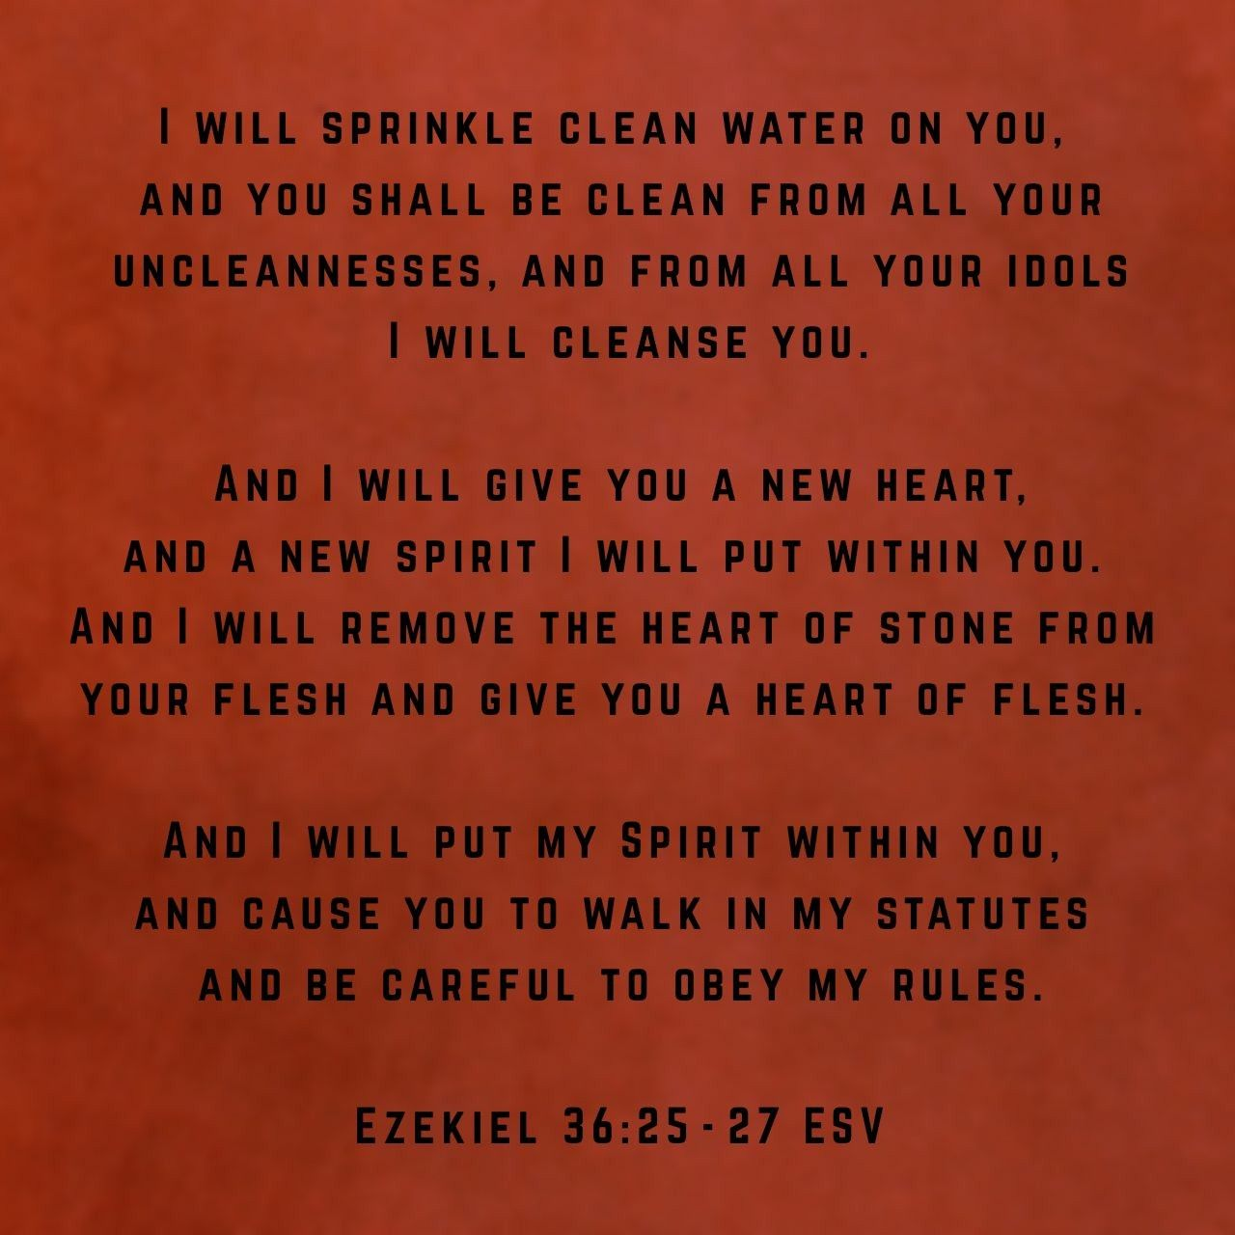

Slide 8
John 3:1-8
Vs 6: Contrasts what is physical (“born of the flesh”) with what is spiritual (“born of the Spirit”).
Vs 8: Like the wind, we can’t control or predict it. This supernatural new birth is the work of God’s Spirit (see John 1:12-13).
We need Him to give life to us by His wind or breath (cf Ezekiel 37:8-10)

Slide 9
John 1:12-13
¹² But to all who did receive him, who believed in his name, he gave the right to become children of God, ¹³ who were born, not of blood nor of the will of the flesh nor of the will of man, but of God.

Slide 10
John 3:1-21
⁹ Nicodemus said to him, “How can these things be?” ¹⁰ Jesus answered him, “Are you the teacher of Israel and yet you do not understand these things? ¹¹ Truly, truly, I say to you, we speak of what we know, and bear witness to what we have seen, but you do not receive our testimony. ¹² If I have told you earthly things and you do not believe, how can you believe if I tell you heavenly things? ¹³ No one has ascended into heaven except he who descended from heaven, the Son of Man. ¹⁴ And as Moses lifted up the serpent in the wilderness, so must the Son of Man be lifted up, ¹⁵ that whoever believes in him may have eternal life.

Slide 11
John 3:9-15
Vs 9 – 10: Jesus was surprised that Nicodemus, who should know the Scriptures, was ignorant of the promises of a new covenant through God’s work (Jeremiah 31:31-34, Ezekiel 36:25-27, 24:22-24, etc.)
Vs 11-12: If they can’t understand Jesus talking of earthly matters, what about heavenly ones?
Note that the “you” in vs 12 and 13 is plural – referring to unbelieving Jews.
Vs 13: Only Jesus has been in heaven and now has come down.

Slide 12
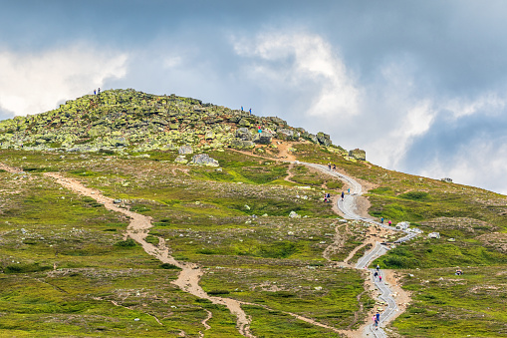

Slide 13
But what if God came down to us from the mountain top?

Slide 14
John 3:9-15
Vs 14-15 – “And as Moses lifted up the serpent in the wilderness, so must the Son of Man be lifted up, that whoever believes in him may have eternal life.”
From Numbers 21:5-9
Jesus will also be ”lifted up”. Greek hypsoō lit. to be exalted, lifted high.
Jesus will be glorified in His crucifixion (John 8:28, 12:23; 32, 34).

Slide 15
John 3:1-21
¹⁶ “For God so loved the world, that he gave his only Son, that whoever believes in him should not perish but have eternal life. ¹⁷ For God did not send his Son into the world to condemn the world, but in order that the world might be saved through him. ¹⁸ Whoever believes in him is not condemned, but whoever does not believe is condemned already, because he has not believed in the name of the only Son of God. ¹⁹ And this is the judgment: the light has come into the world, and people loved the darkness rather than the light because their works were evil. ²⁰ For everyone who does wicked things hates the light and does not come to the light, lest his works should be exposed. ²¹ But whoever does what is true comes to the light, so that it may be clearly seen that his works have been carried out in God.”

Slide 16
LOVE
"The gospel of salvation and life has its source in the love of God."
F. F. Bruce, The Gospel & Epistles of John, Eerdmans: 1983, page 90.

Slide 17
John 3:16-21
Vs 16: 1) God loves the world (i.e. all people)
2) We must not love the world (1 John 2:15-17 cf John 15:18-19)

Slide 18
Redemption love!
"There is no contradiction between this prohibition and the fact that God does love it (the world). Christians are not to love the world with the selfish love of participation; God loves the world with the selfless, costly love of redemption."
D. A Carson, The Gospel According to John. (Grand Rapids:Eerdmans, 1991), pg 205.

Slide 19
John 3:16-21
Vs 16: 1) God loves the world (i.e. all people)
2) We must not love the world (1 John 2:15-17 cf John 15:18-19)
”kosmos” in Greek = all people in the world (used 78 times in John’s Gospel).
Vs 17: Jesus cames not as judge but as saviour!
Vs 18: Our response to him will lead to our acquittal or condemnation.
Vs 19-21: Jesus comes as light – but sinners prefer the dark.
But true believers must come to the light, so all can see God’s work in them.

Slide 20
WHERE ARE YOU STANDING BEFORE GOD TODAY?

