Slide 1
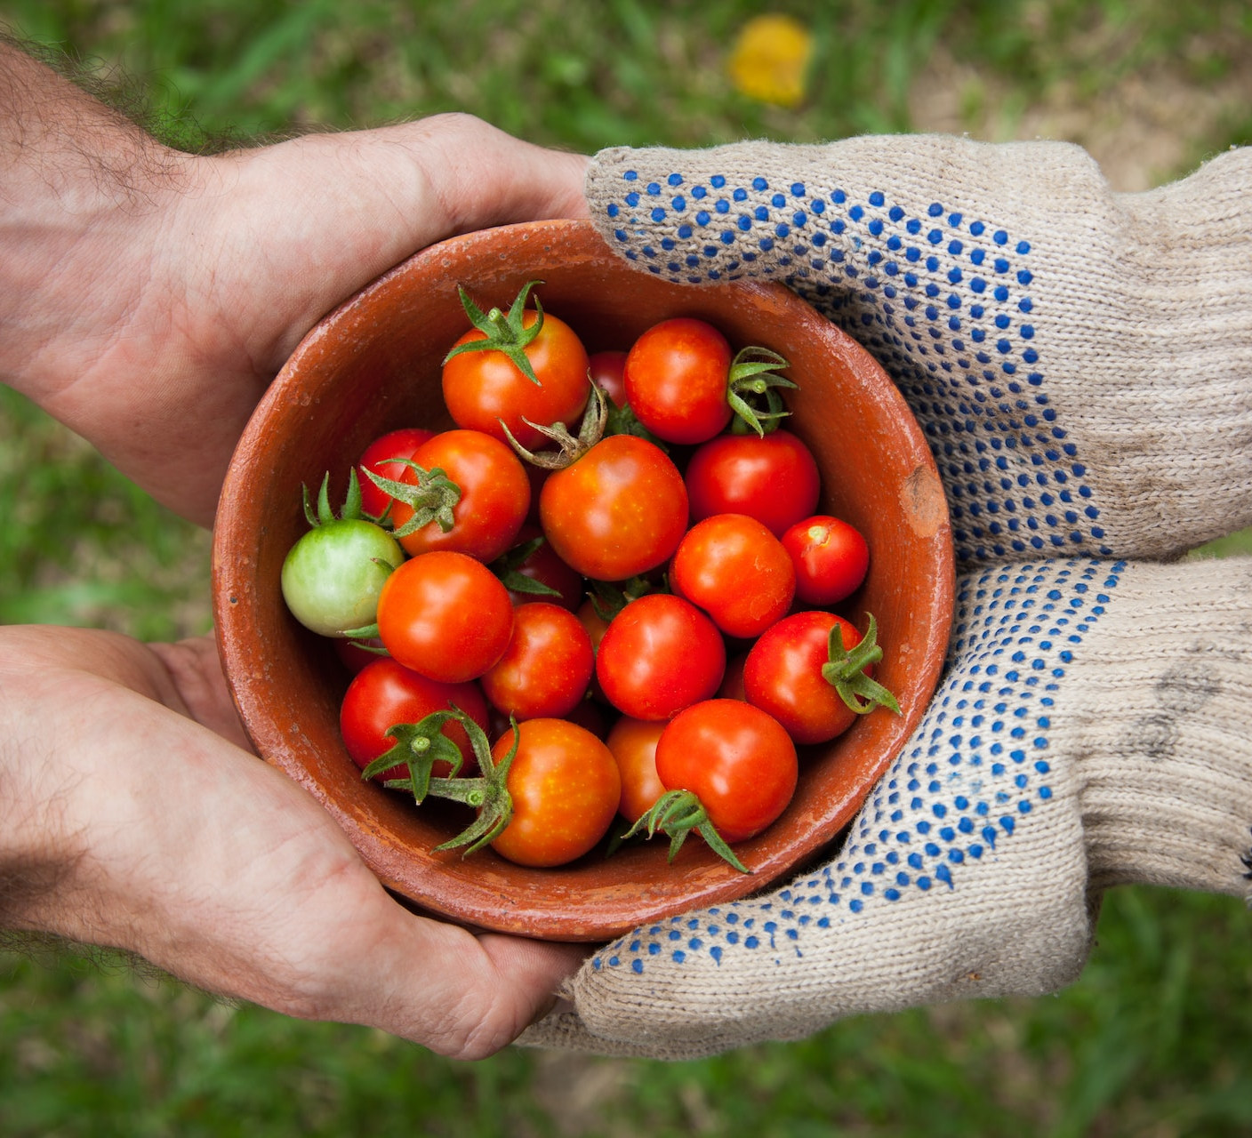
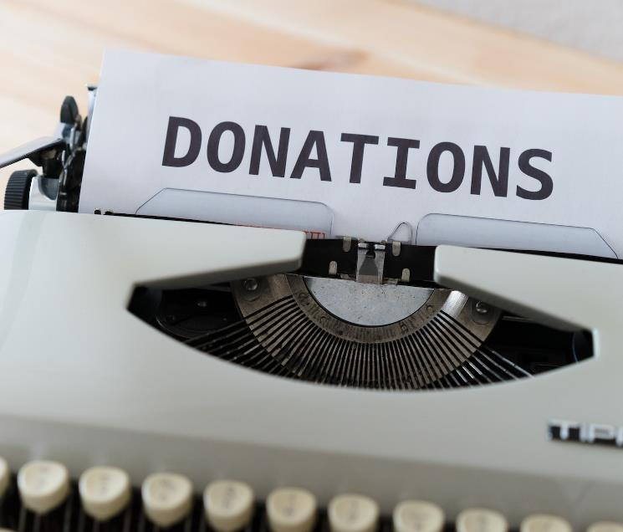
Doing the Right Thing for the Wrong Reason
Notes:
Have you ever heard of someone doing the right thing for the wrong reason?
Some examples include a professional pickpocket
helping an elderly couple cross the street,
only to take the man’s wallet and the woman’s handphone
Or 2nd example - inheritance
Or 3rd example – college admissions
The problem with doing the right thing for the wrong reason
is that it often leads to just doing the wrong thing

Slide 2
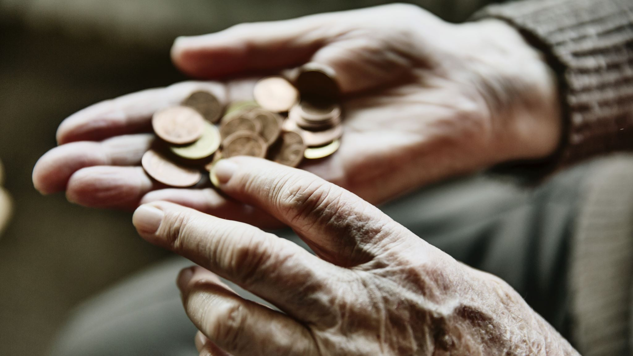
Mind your
Motives!
John 2:12-25
Notes:
Today, we will look at the story of Jesus
turning over tables in the temple marketplace
This story is found in John chapter 2:12-25,
the second half of the second chapter of John
There are 2 stories in this section we are looking at today
Firstly, Jesus turns over tables,
which leads to a discussion with the Jews
in verses 12-22
and then, in vs 23-25, Jesus performed many other signs
and many people “believed” in Jesus’s name
but did they truly believe?
If you are listening to the audio version, I made the “quotation” sign
when I said many people “believed” in Jesus’s name
that is because it is clear they did NOT truly believe.
Jesus knew their motives. That is why this sermon is called
Mind your Motives
What should your motives be? How can you mind your motives?
Let’s look at John chapter 2 and find out.

Slide 3
Believing
C H R I S T
Responding to John’s Gospel
Notes:
Today’s sermon is the fifth in a series called
Believing Christ, Responding to John’s Gospel account.
You can find the audio for the previous sermons on our website,
www.cicfamily.com
The Title of the series “Believing Christ”
seems specifically suited for our sermon today
Especially when you go back and see what John has written about believing:

Slide 4
John 1:8: . . . to bear witness about the light, that all might believe through him.
John 1:12: But to all who did receive him, who believed in his name, he gave the right to become children of God
John 1:50 . . . “Because I said to you, ‘I saw you under the fig tree,’ do you believe? You will see greater things than these.”
John 2:11 This, the first of his signs, Jesus did at Cana in Galilee, and manifested his glory. And his disciples believed in him.
Believing
C H R I S T
Responding to John’s Gospel
Notes:
Back in chapter 1,
John the gospel writer,
Writes about John the Baptist
saying that John the Baptist was sent from God
to bear witness about Jesus,
that all might believe through him.
And that those who heard and received this message,
who believed in the name of Jesus,
he gave the right to become children of God
Later in chapter 1, we see Jesus calling his disciples,
and Nathaniel responds, “Rabbi, you are the son of God
to which Jesus responds
Because I said to you, ‘I saw you under the fig tree,’ do you believe?
You will see greater things than these.”
And then, when Jesus performs his first miracle,
turning water into wine at a wedding,
His disciples believed in him.
This quick review introduces us to the necessity of belief
so that we might become children of God
Showing one of the disciples believing in him,
And finally with Jesus’s first of seven “signs”
which manifest or point to his glory

Slide 5
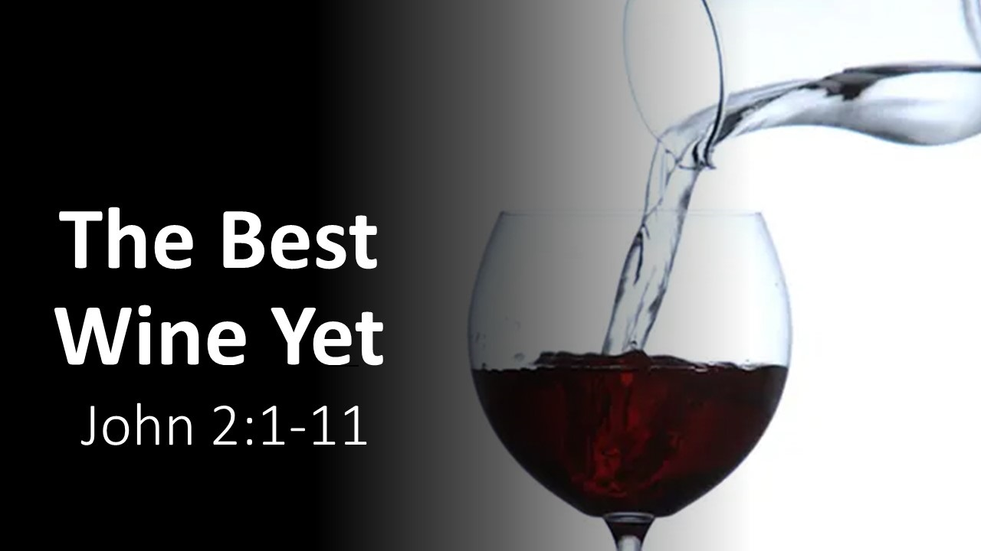
2:1-4
2:5-8
2:9-11
Jesus and . . .
His Mother
His Method
His Miracle
Notes:
Taking a closer look at Manik’s sermon last week,
called The Best Wine Yet
We saw Jesus and his Mother Mary
And she was the model disciple,
humbly leaving it all to Jesus
and trusting in his wisdom,
even when she did not understand.“
Then we saw Jesus and his method of using the water,
provided for purification as laid down by Jewish law and custom,
Something that stands for the whole ancient order of Jewish ceremony,
Finally, we see Jesus and the miracle (or sign).
The water was changed into wine,
Not just any wine, but the best wine
The custom was to serve the best wine first,
followed by a wine of lessor quality
But the miracle shows that
Christianity is an advance over Judaism.
That purification rituals that were performed over and over
Were replaced by believing in Jesus

Slide 6
2:1-4
2:5-8
2:9-11
Jesus and . . .
His Mother
His Method
His Miracle
Mind your
Motives!
John 2:12-25
2:12-16
2:17-22
2:23-25
Jesus and . . .
the Market
His Meaning
His Motive
Notes:
So today, we will learn a little bit more about believing in Jesus as we look at chapter 2
Vs 12-16 Jesus and the market,
Vs 17-22 Jesus and his meaning,
And vs 23-25 And Jesus and his motive.

Slide 7
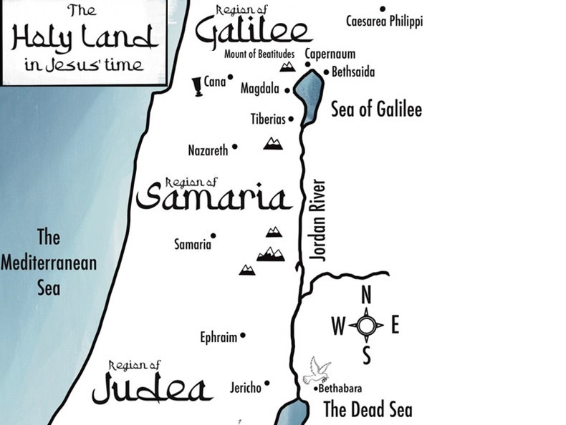
¹² After this he went down to Capernaum, with his mother and his brothers and his disciples, and they stayed there for a few days.
Notes:
Vs 12 starts with After this he went down to Capernaum, with his mother and his brothers and his disciples, and they stayed there for a few days.
“After this” is after the first of seven signs that John’s gospel contains.
These signs point to Jesus as the Messiah.
Along with the signs are public discourses explaining their significance.
So we have to take our text from today
and realize it must be taken together
with the miracle of turning water into wine
in order to fully understand its significance
Before we jump ahead,
note that Jesus is traveling with his mother, brothers, and disciples.
While the three main branches of Christianity
(Catholics, Orthodox, and Protestants)
all believe that Mary was a virgin when she conceived and gave birth to Jesus,
Catholics and the Orthodox believe she remained a virgin afterward as well
Whereas protestants believe she and Joseph had children together after Jesus was born, these would be half brothers of Jesus, same mother, different father,
James and Jude, both authors of books in the NT
are half-brothers of Jesus.
Why the difference? Sola scriptura, is a belief that the Bible is the sole infallible source of authority for Christian faith and practice.
Does it matter to our story today? The concept of sola scriptura does matter, because when you leave scripture behind
and try to apply reason and philosophy to Christian faith and practice,
that faith and practice is eventually impacted by impure motives.

Slide 8
¹³ The Passover of the Jews was at hand, and Jesus went up to Jerusalem.
Notes:
Speaking of impure motives, the Passover of the Jews was a way for the nation to have atonement for all their sins that year.
John has already shown that Jesus was the lamb of God who takes away the sin of the world. Unfortunately, the Jews didn’t recognize Jesus as the Messiah, as the Passover lamb, and therefore continued their annual festivals, including Passover. John is writing many years later, and he refers to it as the Jewish Passover because his audience of Gentiles and Christians don’t celebrate Passover.
So when does this event actually take place?
The synoptic gospels (Matthew, Mark, and Luke) all have this event during the final week of Jesus’s life. Matthew 21:12-17, Mark 11:15-19, Luke 19:45-48. John seems to have it in the beginning.
This presents 3 options: John is right and it was at the beginning of Jesus’ ministry
Jesus overturned the temple table twice, one at the beginning of his ministry, and once at the end
Or John brought forward his account of the temple cleansing for theological or literary reasons. In that case, the arrangement of his material was not meant to be chronological but thematic.
This seems to be the obvious choice. And the theme is clear as well. The previous story targeted the wash basins and purification water. This story targets the temple sacrificial system. In both cases, the old is giving way to the new.
In the new age of fulfillment, Jesus’ once-for-all Passover sacrifice will make atonement for sins

Slide 9
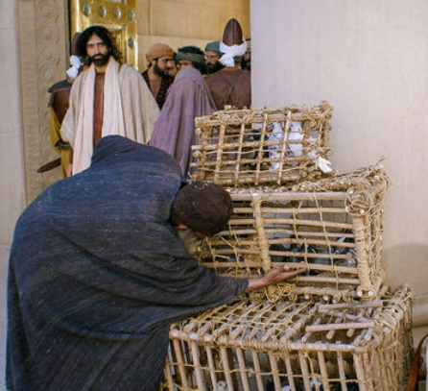
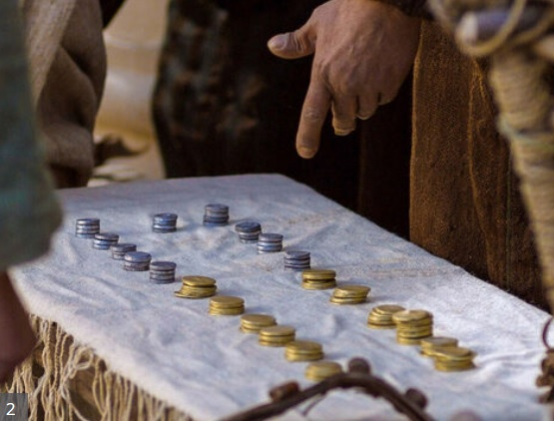
¹⁴ In the temple he found those who were selling oxen and sheep and pigeons, and the money-changers sitting there.
Notes:
Today we imagine a temple as a place of solitude,
where someone can connect be in the presence
of an awesome and mighty God.
Reading the Old Testament descriptions
of the temple design and ceremonies
affirms that to be the case.
But when Jesus entered, he heard a loud ruckus.
A cacophony of sound and sights.
Vs 14 tells us that In the temple he found those who were selling oxen and sheep and pigeons, and the money-changers sitting there.
Try to imagine, a crowded wet market, but instead of fish and meat on ice, there are animals in cages.
There is actually a reason for this
All this was necessary because of Old Testament law
that spelled out specific sacrifices for various offenses.
And if you are traveling a long distance,
it would be difficult to bring along your animal sacrifice.
So, people with pure hearts and genuine motives who wanted to help
Provided animals to sell
Then again, their motives were not pure and genuine,
they took advantage of the poor pilgrims who travelled so far

Slide 10
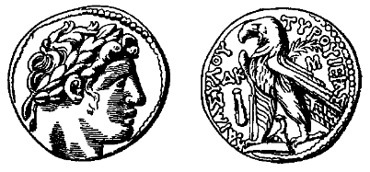
Tyrian Shekel
¹⁴ In the temple he found those who were selling oxen and sheep and pigeons, and the money-changers sitting there.
Notes:
Then there are the money changers who offer the Tyrian Shekel, the only coin you can use to pay the temple tax.
Why was a Tyrian shekel required? Because of the Mishnah. What is Mishnah?
First, it is not the Old Testament. The NT often refers to the OT as the law, prophets, and writings, which are the sections of the OT.
The Mishnah were the oral traditions that eventually were written down ~ 200 years after Jesus’ resurrection. Just as Roman Catholics used extra-biblical ideas to come up with some of their doctrines, the Jews did this as well.
In Singapore, some food centers have a special card that you must use to pay for any food. They do this not to rip you off but to encourage you to come back because you will always have some money left on your card.
But the temple money changers’ motives were not so altruistic. They were greedy and took advantage of the pilgrims. It is said that the temple priests condoned their activity and even took a cut of their earnings.
That is why Jesus then

Slide 11
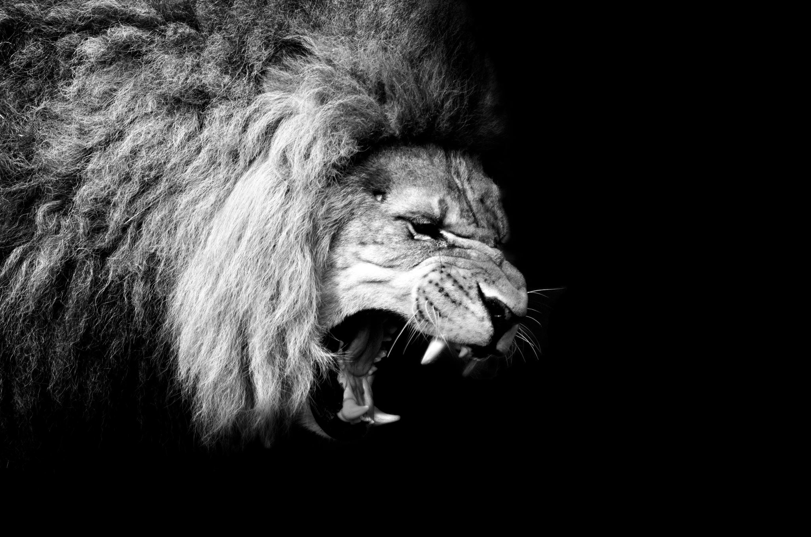
¹⁵ And making a whip of cords, he drove them all out of the temple, with the sheep and oxen. And he poured out the coins of the money-changers and overturned their tables. ¹⁶ And he told those who sold the pigeons, “Take these things away; do not make my Father's house a house of trade.”
Notes:
Starting at vs 15: And making a whip of cords, he drove them all out of the temple, with the sheep and oxen. And he poured out the coins of the money changers and overturned their tables. ¹⁶ And he told those who sold the pigeons, “Take these things away; do not make my Father's house a house of trade.”
Jesus was rightfully angry. He was angry because of the motives of the priests, shopkeepers, and money changers who turned a place of holy worship into a sacrilegious market.
Jesus was angry because the market was in the gentile court, which was the one and only place in the entire temple complex where non-Jews could come and pray and be in the Father’s house.
Looking back, we know Jesus’s anger was righteous anger. What do you think his disciples felt?

Slide 12

¹⁷ His disciples remembered that it was written, “Zeal for your house will consume me.”
Notes:
How would you feel if you were having lunch with your pastor or associate pastor at the Fusion Spoon restaurant located at Singapore’s Botanic Gardens, and he started kicking in chairs and knocking down tables?
You would think he was mad or unstable.
Call the police, there is a madman around.
But Jesus’s disciples instead remembered scripture,
Vs 17 tells us that,
“His disciples remembered that it was written,
“Zeal for your house will consume me.”
This is from Psalm 69:9
the psalmist speaks of being consumed with zeal for God’s house
and how this brought down upon him the antagonism of his fellows.
The disciples recognized that Jesus motive, like the psalmist,
was consumed with zeal to preserve God’s honor.
Let me point out that for our third Sunday after church fellowship, we will be going to the Fusion spoon restaurant at Singapore’s Botanic Gardens. Please note that we don’t want you to go around kicking in chairs or knocking down tables. The police would be called, you would go to jail.
But why wasn’t Jesus arrested?

Slide 13

¹⁸ So the Jews said to him, “What sign do you show us for doing these things?”
Notes:
We are not told why Jesus was not arrested. Was it something supernatural? Were the Jews already aware of what Jesus was saying and doing?
Maybe they had heard about the miracle of turning water into wine.
That could be why they asked in vs 18 “What sign do you show us for doing these things?”
What are their motives for asking his authority rather than throwing him in prison?
Maybe they were profiting from the market activity but knew in their hearts that it just wasn’t right.
Maybe they just wanted to see something cool and different.

Slide 14

¹⁹ Jesus answered them, “Destroy this temple, and in three days I will raise it up.” ²⁰ The Jews then said, “It has taken forty-six years to build this temple, and will you raise it up in three days?” ²¹ But he was speaking about the temple of his body.
Notes:
I’ve seen it quite often in the Bible that God gives you what you ask for.
In this case, the Jews asked for a sign, and Jesus gave them one.
Vs 19 we see that Jesus answered them,
“Destroy this temple, and in three days I will raise it up.”
When God answers us, sometimes it is not the answer we seek
Sometimes we do not understand right away.
The jews wanted some visible manifestation of God’s glory and power,
they did not get the answer they wanted.
Instead, it was a prophecy about his own death and resurrection,
something that even his own disciples did not understand right away
In John’s prologue, he already alluded to Jesus’s death
10 He was in the world, and the world was made through him, yet the world did not know him.
11 He came to his own, and his own people did not receive him.
With this event, although Jesus is affirming that proper temple worship is good,
he then says that he will replace temple worship
As we continue through John’s gospel, we will see that Jesus’s resurrection is the final proof that the whole system of Jewish rituals and ceremonies
has been replaced by believing in Jesus

Slide 15

²² When therefore he was raised from the dead, his disciples remembered that he had said this, and they believed the Scripture and the word that Jesus had spoken.
Notes:
Jesus’s answer confounded the Jews.
But for his disciples, it was a sign that displayed God’s glory and power, but not right away
When therefore he was raised from the dead,
his disciples remembered that he had said this,
and they believed the Scripture and the word that Jesus had spoken.
But we know from John 2 verse 11, after he turned water into wine,
his disciples believed in him.
This shows that our belief grows and changes.
A lot has to do with our motives.
Many Jews were looking for a savior to rescue them from the oppressive rule of the Roman empire.
Like Nathaniel, they read their scriptures, what we call the Old Testament
They saw that God keeps his promises,
That he is always with us, he is faithful, kind, and compassionate
That his presence brings joy
That he will strengthen and help us
I would say these are the right motives

Slide 16
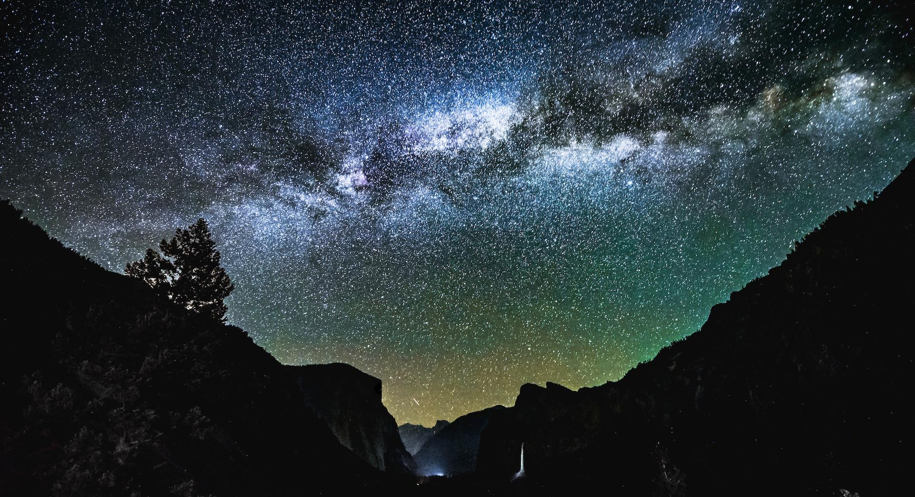
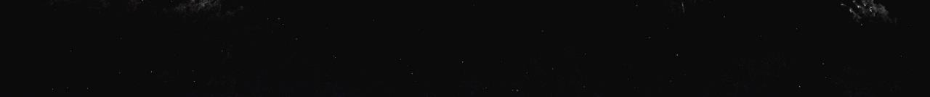
²³ Now when he was in Jerusalem at the Passover Feast, many believed in his name when they saw the signs that he was doing.
Notes:
Looking at vs 23, many Jews were only looking for signs and wonders
So when Jesus was in Jerusalem at the Passover Feast, many believed in his name when they saw the signs that he was doing.
These are not the right motives. And John uses a clever play on words to show this.

Slide 17
²² When therefore he was raised from the dead, his disciples remembered . . .
and they believed the Scripture and the word that Jesus had spoken.
²³ . . . when they saw the signs that he was doing.
many believed in his name
²² . . . ἐπίστευσαν =>
²³ . . . ἐπίστευσαν =>
²⁴ . . . ἐπίστευεν =>
πιστεύω
Notes:
In vs 22 the disciples saw a sign
When therefore he was raised from the dead, his disciples remembered . . .
And the result was they believed the Scripture and the word that Jesus had spoken.
I changed the word order for vs 23, but in this case the people
saw the signs that he was doing.
And the result was many believed in his name
In both cases the word believe is the same Greek word and even in the same tense and form
And looking into vs 24, the same root word is used again, lets take a look

Slide 18
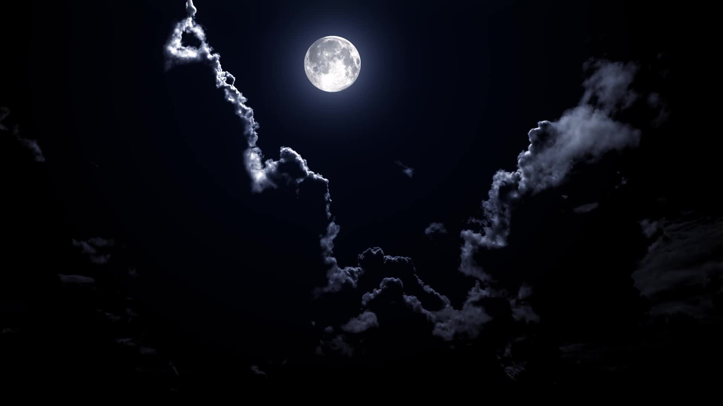
²⁴ But Jesus on his part did not entrust himself to them, because he knew all people ²⁵ and needed no one to bear witness about man, for he himself knew what was in man.
Notes:
24 But Jesus on his part did not entrust himself to them, because he knew all people 25 and needed no one to bear witness about man, for he himself knew what was in man.
This can seem a bit confusing at first, but lets focus on the Greek word pisteo, which in the ESV is translated as entrust.
In the previous verses people saw signs and they “believed”
Some with proper motives, others not so much

Slide 19
²² When therefore he was raised from the dead, his disciples remembered . . .
and they believed the Scripture and the word that Jesus had spoken.
²³ . . . when they saw the signs that he was doing.
many believed in his name
²⁴⁻²⁵ . . . Because Jesus knows all people (he sees their motives)
he did not entrust himself to them,
²² . . . ἐπίστευσαν =>
²³ . . . ἐπίστευσαν =>
²⁴ . . . ἐπίστευεν =>
πιστεύω
Notes:
In this case, John is simply saying the Jesus knows what was in man, he sees into our hearts. He doesn’t need anyone to bear witness for us
And because he knows the hearts of those who just want to see signs and wonders, he does not entrust himself to them.
These last two verses tie together Jesus’s first miracle with the cleansing of the temple.
The old is being replaced with the new.
The new is simply believing in Jesus.
But the belief has to be guided by the right motives.
Ask yourself, what brought you here today?
Are you still suffering under an old system of ceremonies and duties? Or have you seen and recognized the many signs and wonders all around us
And believe scripture and the words that Jesus spoke and are recorded in the Bible?

Slide 20
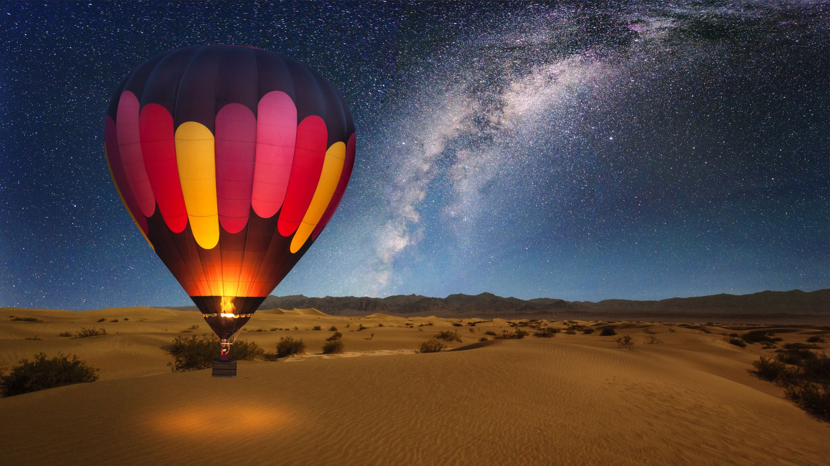
What are you Motives
Notes:
At the beginning of this sermon I asked 2 questions
What should your motives be? How can you mind your motives?
I believe this section of scripture shows us what our motives should be.
We should be motivated to believe in Jesus because
He is the fulfillment of scripture
He is the completion of God’s plan
He is the best wine yet.
The second question, how can we mind our motives, is a bit more difficult to answer.
We have seen glimpses of the answer today. We should be in God’s word, just as Nathaniel was under the fig tree
So that we can be like the disciples who believed the Scripture and the word that Jesus had spoken
In addition, we should be in prayer. Although not evident in our selected scripture today, the entire bible affirms the need to pray.
Finally, we should be in fellowship. We need to be surrounded by other believers.

