Slide 1
Believing
C H R I S T
Responding to John’s Gospel
Notes:
Today’s sermon is the third in a series called Believing Christ, Responding to John’s Gospel account.
And here is a spoiler alert: everyone who hears the gospel, or good news, in our story today, in verses 35-51, responds by believing that Jesus is the Christ.
But, even though we know how they responded, we can still learn something by looking at the various circumstances leading up to,
as well as the differences in their actual reactions.

Slide 2
Summary lessons from last Sunday
1. Following Jesus requires obedience (35-39).
2. Following Jesus means focusing on Him, not ourselves (40).
3. Following Jesus means learning who he is (41).
4. Following Jesus means allowing God to work in our lives (42).
5. Following Jesus means telling others about Him (41 & 43-45).
6. Following Jesus means seeing how He fulfills the promises of the Old Testament (45).
7. Following Jesus means knowing him personally, not just from the testimony of others (46).
8. Following Jesus means meditating on God’s word (47-48).
Following Jesus means knowing he is the son of God (49).
Following Jesus means witnessing great things (50-51).

Slide 3
John 2:1-11
Book of Signs (John chapters 2 to12)
1) Turning Water Into Wine (John 2:1-12) ...
2) Healing the Nobleman's Son (John 4:46-54) ...
3) Healing the Man at the Pool (John 5:1-11) ...
4) Feeding of the 5,000 (John 6:1-15) ...
5) Walking on Water (John 6:16-21) ...
6) Healing a Man Born Blind (John 9:1-12) ...
7) Resurrecting Lazarus (John 11)

Slide 5
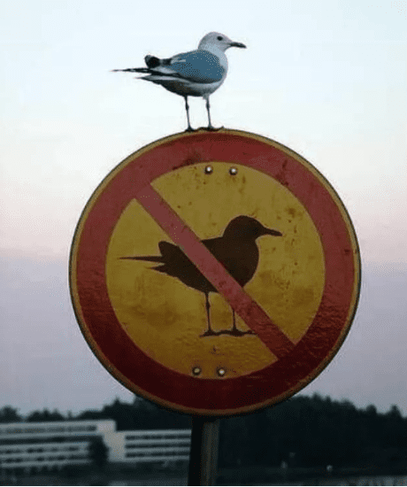

Slide 6
John 2:1-11
Verse 1-5
¹On the third day there was a wedding at Cana in Galilee, and the mother of Jesus was there. ² Jesus also was invited to the wedding with his disciples. ³ When the wine ran out, the mother of Jesus said to him, “They have no wine.” ⁴ And Jesus said to her, “Woman, what does this have to do with me? My hour has not yet come.” ⁵ His mother said to the servants, “Do whatever he tells you.”

Slide 7
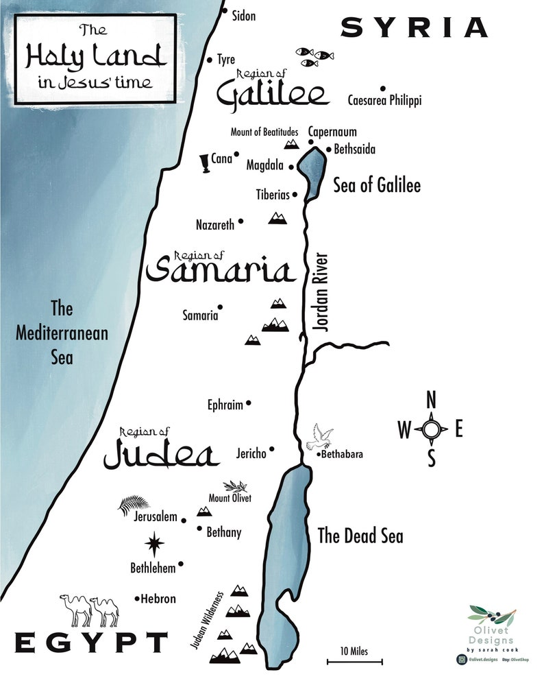

Slide 8
John 2:1-11
Verse 1-5
¹On the third day there was a wedding at Cana in Galilee, and the mother of Jesus was there. ² Jesus also was invited to the wedding with his disciples. ³ When the wine ran out, the mother of Jesus said to him, “They have no wine.” ⁴ And Jesus said to her, “Woman, what does this have to do with me? My hour has not yet come.” ⁵ His mother said to the servants, “Do whatever he tells you.”

Slide 9
John 2:1-11
Verse 1-5
Vs 4 – Jesus calls Mary his mother ‘woman’ – see John 19:26
“My hour has not come” – Jesus walked according to God’s time-table (see John 7:30; 8:20; 12:23; 13:1; 17:1)
Vs 5 – “Do whatever He tells you.”

Slide 10
Model Behavior!
Mary "was the model disciple, humbly leaving it all to Jesus and trusting in his wisdom, even when she did not understand."
John Osborne, The Gospel of John - Tyndale Cornerstone Biblical Commentary, Tyndale House:2007, page 44.

Slide 11
John 2:1-11
Verse 6-10
⁶ Now there were six stone water jars there for the Jewish rites of purification, each holding twenty or thirty gallons. ⁷ Jesus said to the servants, “Fill the jars with water.” And they filled them up to the brim. ⁸ And he said to them, “Now draw some out and take it to the master of the feast.” So they took it. ⁹ When the master of the feast tasted the water now become wine, and did not know where it came from (though the servants who had drawn the water knew), the master of the feast called the bridegroom ¹⁰ and said to him, “Everyone serves the good wine first, and when people have drunk freely, then the poor wine. But you have kept the good wine until now.”

Slide 12
John 2:1-11
Verse 6-10
Vs 6 – Water used for purification – washing of hands and utensils used. (see Mark 7:3)

Slide 13
Water and Wine
"The water, provided for purification as laid down by Jewish law and custom, stands for the whole ancient order of Jewish ceremonial, which Christ was to replace by something better."
F. F. Bruce, The Gospel & Epistles of John, Eerdmans: 1983, page 71.

Slide 14
John 2:1-11
Verse 6-10
Vs 6 – Moses first plague was to turn water into blood (Exodus 7:17-21).
Jesus first miracle was to turn water into wine.

Slide 15
John 2:1-11
Verse 6-10
As the wine was after the water, so the New Covenant comes after the Old Covenant.

Slide 16
John 2:1-11
Verse 6-10
As the wine was after the water, so the New Covenant comes after the Old Covenant.
As the wine came from the water, so the New Covenant comes from the Old Covenant.

Slide 17
John 2:1-11
Verse 6-10
As the wine was after the water, so the New Covenant comes after the Old Covenant.
As the wine came from the water, so the New Covenant comes from the Old Covenant.
And as the wine was better than the water; so the New Covenant is better than the Old Covenant.

Slide 18
Hebrews 8:6
“But as it is, Christ has obtained a ministry that is as much more excellent than the old as the covenant he mediates is better, since it is enacted on better promises.”

Slide 19
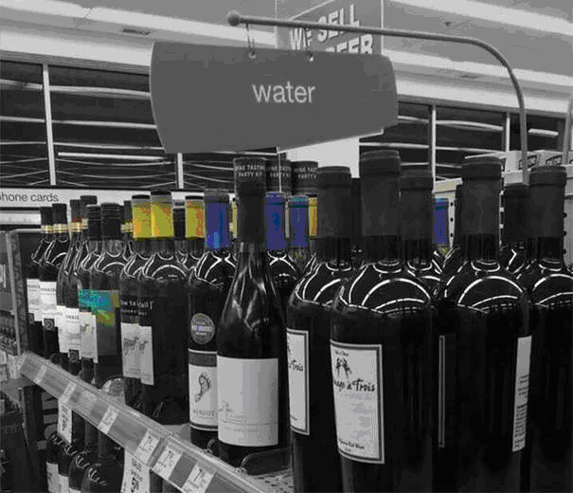

Slide 20
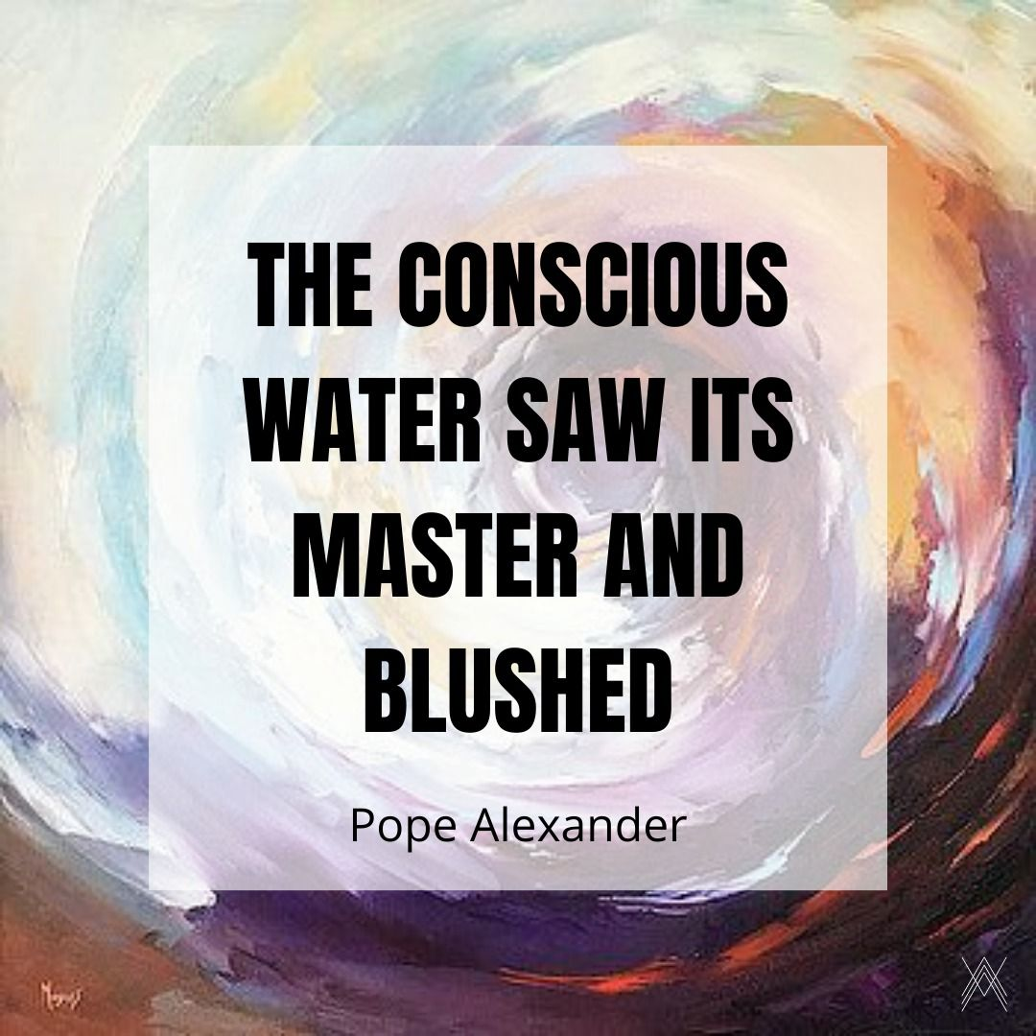

Slide 21
John 2:1-11
Verse11
¹¹ This, the first of his signs, Jesus did at Cana in Galilee, and manifested his glory. And his disciples believed in him.
The Signs were not just a show of His power, but a revealing of His very identity.

Slide 23
John 2:1-11
APPLICATION
Put your faith in Jesus – in Who He is – John 2:11
Obey everything He tells you to – John 2:5

Slide 25
