Slide 1

Believing
C H R I S T
Responding to John’s Gospel

Slide 2


4th Gospel to a new generation
7 Signs
7 Discourses
7 “I Am’s”

Slide 3
Why Follow Jesus at All?
John 1:1-18
Follow Jesus because he is divine authority existing from all eternity (vs. 1-2)
Follow Jesus because he created everything (v. 3)
Follow Jesus because he gives life and light (vs. 4-5)
“It is the function of light to shine precisely in the darkness, to oppose the darkness, to dispel the darkness.”
Leon Morris

Slide 4
Why Follow Jesus at All?
John 1:1-18
Follow Jesus because he is divine authority existing from all eternity (vs. 1-2)
Follow Jesus because he created everything (v. 3)
Follow Jesus because he gives life and light (vs. 4-5)
Follow Jesus because God sent specific individuals to be vocal witnesses of his life (vs. 6-8)
Follow Jesus because he forces people to respond to him (vs. 9-13)

Slide 5
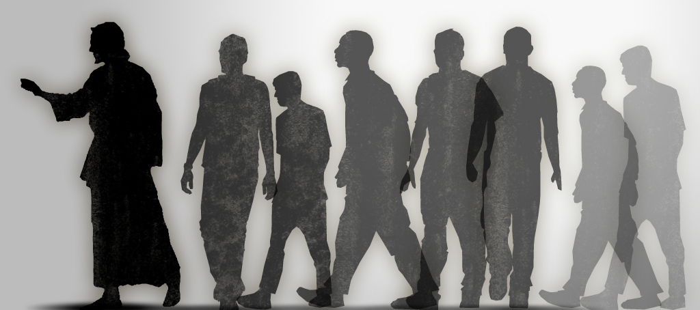
He deliberately shines the light of truth
He was rejected by most people
He was received by some people

Slide 6
Why Follow Jesus at All?
John 1:1-18
Follow Jesus because he is divine authority existing from all eternity (vs. 1-2)
Follow Jesus because he created everything (v. 3)
Follow Jesus because he gives life and light (vs. 4-5)
Follow Jesus because God sent specific individuals to be vocal witnesses of his life (vs. 6-8)
Follow Jesus because he forces people to respond to him (vs. 9-13)
Follow Jesus because he is the only means of completing God’s grace (vs. 14-18)

