Slide 1
Your Faith is My Faith
Joshua 2
Crossroads international church / 6 Aug 2023

Slide 2
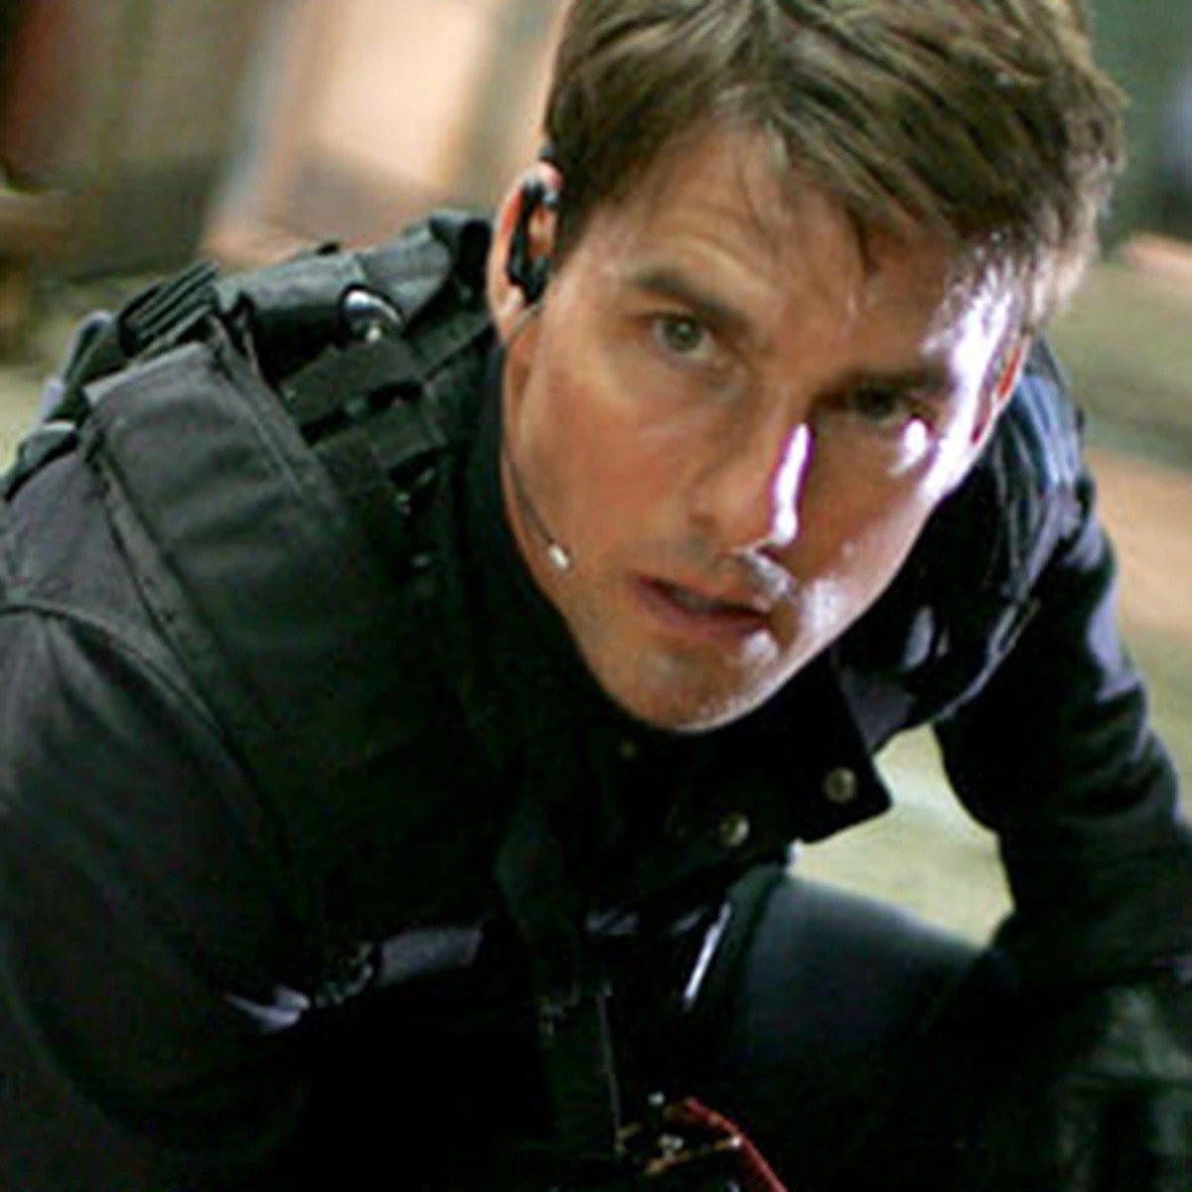
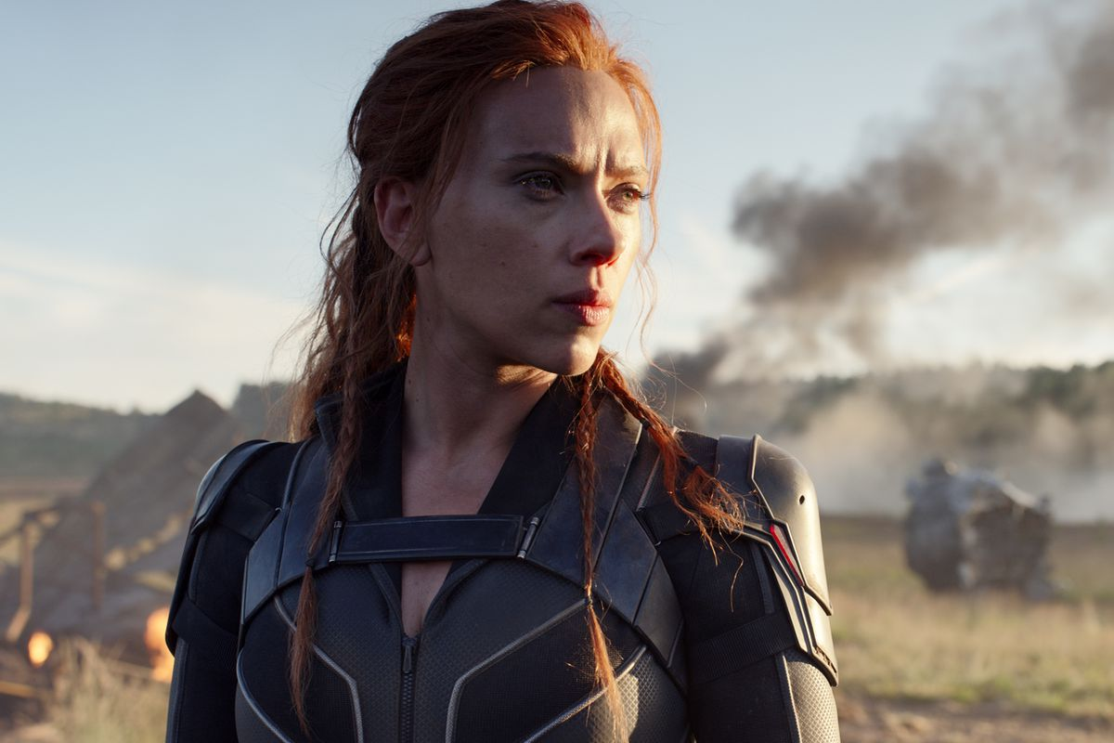
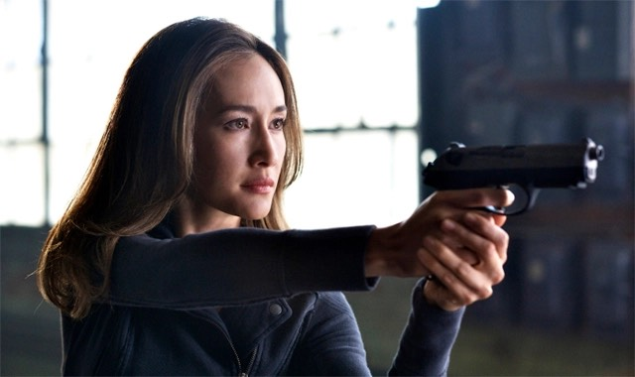

Slide 3
What happened
so far?
Joshua 1:2, 1:11

Slide 4
What’s happening
now?
Joshua 2:1

Slide 5
JOSHUA 2:2-3

Slide 6
I don’t know.
They left not long ago.
chase them!
JOSHUA 2:4-5

Slide 7
JOSHUA 2:4, 6-7

Slide 8
JOSHUA 2:8

Slide 9
Rahab’s Report (v. 9)
a) I know that the LORD has given you the land
b) The people of Jericho are scared of Israel
c) The people of Canaan will be helpless and disorganised

Slide 11
What can we learn from this story?

Slide 12
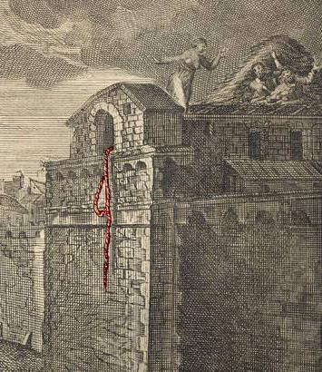
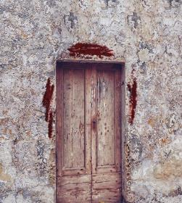

Slide 13
Who is Rahab?
Hebrews 11:31
By faith Rahab the prostitute did not perish with those who were disobedient, because she had given a friendly welcome to the spies.
James 2:25
And in the same way was not also Rahab the prostitute justified by works when she received the messengers and sent them out by another way?
Matthew 1:5-6
…and Salmon the father of Boaz by Rahab, and Boaz the father of Obed by Ruth, and Obed the father of Jesse, and Jesse the father of David the king…

Slide 14
How does this story apply to us?

Slide 15
How does this story apply to us?
God wants everyone to be part of his family - Have Faith
God will use the faithful desires of the unbelievers to shame the unfaithfulness in God’s people - Be Humble

Slide 16
2 The word that Isaiah the son of Amoz saw concerning Judah and Jerusalem.
² It shall come to pass in the latter days
that the mountain of the house of the Lord
shall be established as the highest of the mountains,
and shall be lifted up above the hills;
and all the nations shall flow to it,
³ and many peoples shall come, and say:
“Come, let us go up to the mountain of the Lord,
to the house of the God of Jacob,
that he may teach us his ways
and that we may walk in his paths.”
For out of Zion shall go forth the law,
and the word of the Lord from Jerusalem.
⁴ He shall judge between the nations,
and shall decide disputes for many peoples;
and they shall beat their swords into plowshares,
and their spears into pruning hooks;
nation shall not lift up sword against nation,
neither shall they learn war anymore.
⁵ O house of Jacob,
come, let us walk
in the light of the Lord.

Slide 17
“Instead, God chose things the world considers foolish in order to shame those who think they are wise. And he chose things that are powerless to shame those who are powerful.”
1 Corinthians 1:27 (NLT)

Slide 18
Your faith is my faith
Rahab’s faith in Yahweh became the faith of the two spies and the two spies’ faith in Yahweh’s delivering power became Rahab’s faith to survive

Slide 19
Have Faith & Be Humble

Slide 20
Do we believe in God’s redemption plan and will we act upon it in faith?

Slide 21
Your Faith is My Faith
Joshua 2
Crossroads international church / 6 Aug 2023

