Slide 1
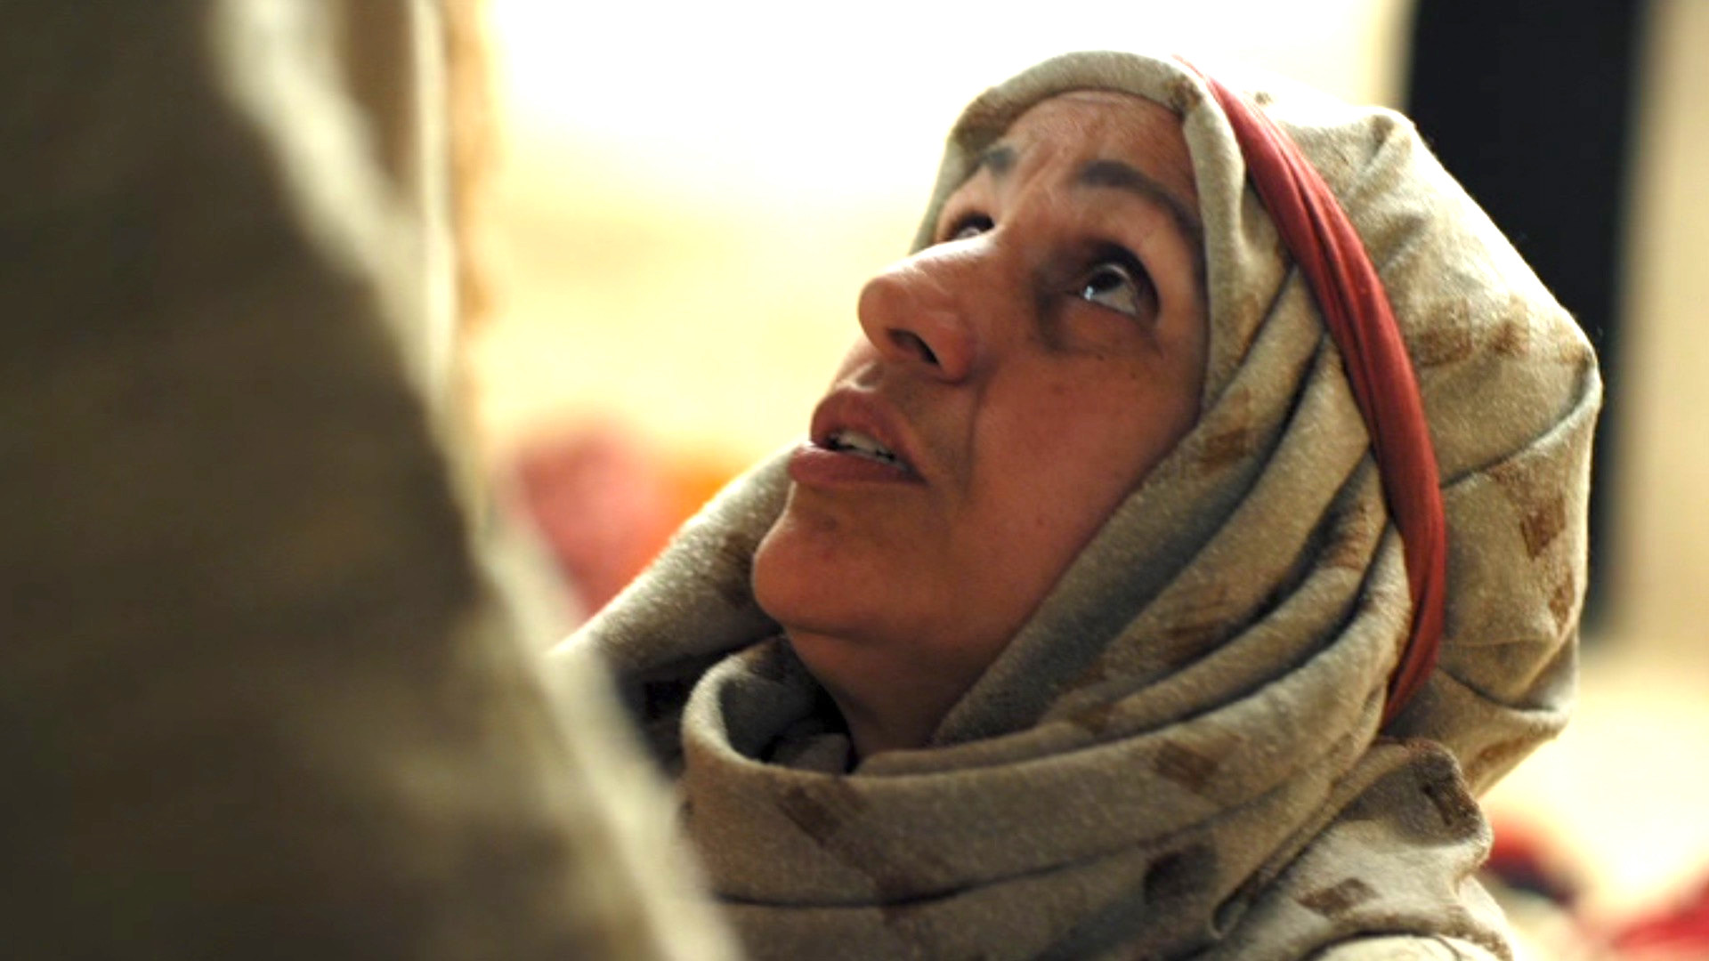
Encounters with Jesus 2
Matthew 15:21-28 “Yes, Lord, yet…”

Slide 2
The Context – Matthew 15:1-20
Pharisees: “Why do your disciples not wash their hands?” – vs 2.
Man’s traditions cannot override God’s commands – vs 3-9.
Uncleanness in people is a matter of their hearts – vs 10-20.

Slide 3
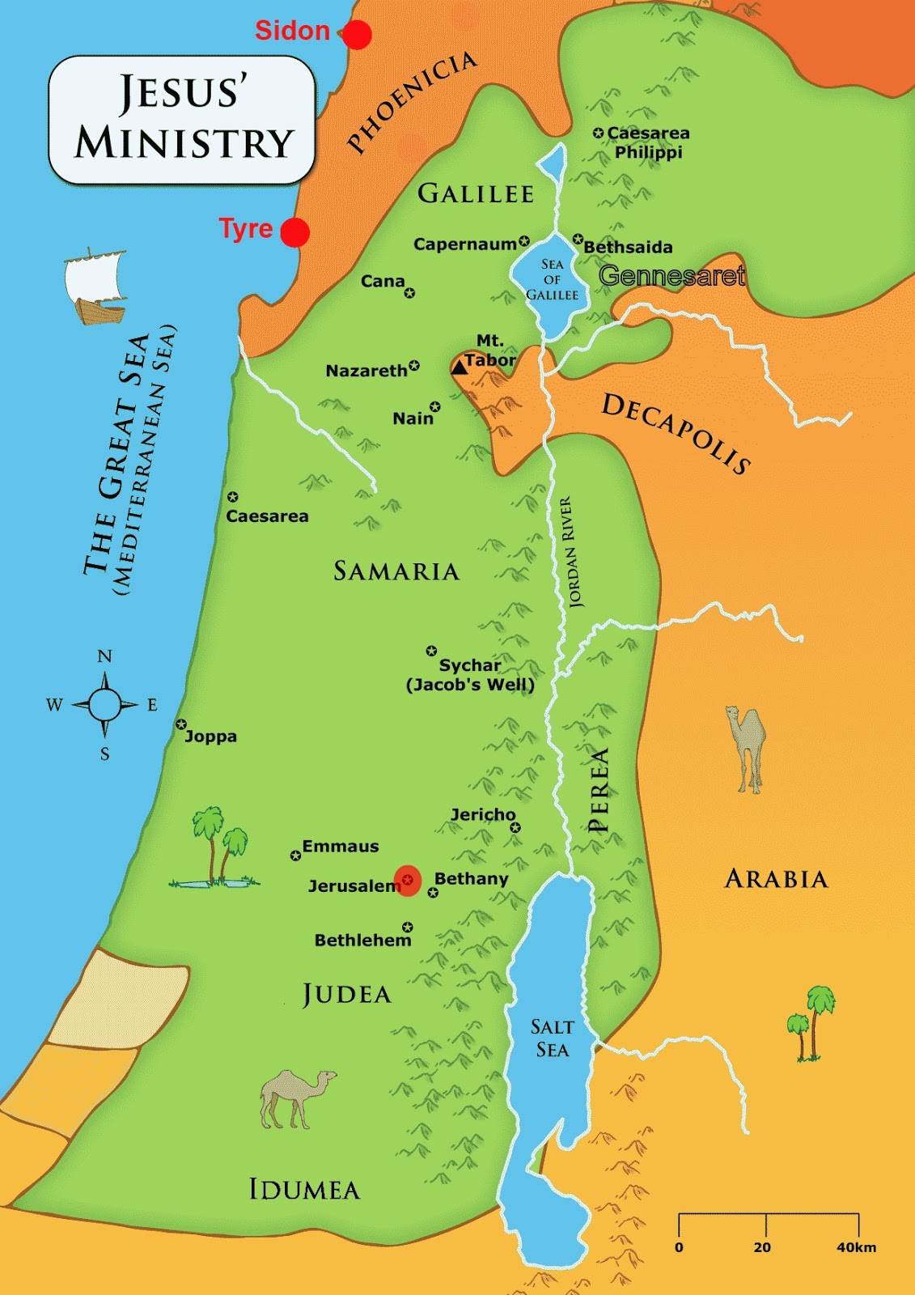
Source: https://www.andrewforrest.org/blog/2019/02/23/jesus-and-the-canaanite-woman

Slide 4
The text – Matthew 15:21-28
Vs 22a – three things the woman had going against her:
1) She was Gentile - Mark 7:26 tells us she was born in Syro-Phonecia;
2) She was a woman;
3) She was Canaanite.

Slide 5
The text – Matthew 15:21-28
Vs 22b: She was desperate for Jesus’ help - her daughter was oppressed by a demon.
Perhaps she had heard that Jesus did heal a few Gentiles (Matthew 4:4:24-25; 8:5-13).
Vs 23-24: Jesus is first silent, then reiterates that his mission was “only to the lost sheep of Israel.”

Slide 6
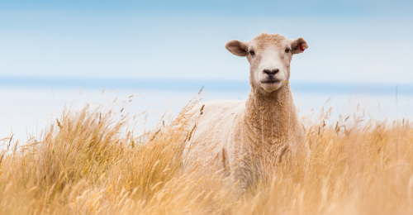
The Lost sheep of Israel
God’s redemptive plan was to send his Messiah first to the people of Israel, and then from there to all the world. (John 4:22 cf Romans 1:16, Galatians 4:4-5).
Jesus also sent his disciples initially to the “lost sheep of Israel.” (Matthew 10:5-6).
In Jeremiah 50:6, God calls his people Israel, "lost sheep." Jesus as the true Shepherd of Israel, fulfilled Messianic prophesy (Ezekiel 34:23-24, Micah 5:4-5; Mark 6:34; 14:27; John 10:11-16 cf Hebrews 13:20, 1 Peter 5:4 and Revelation 7:17).

Slide 8
The text – Matthew 15:21-28
Vs 25 – She kneels before Jesus. “Lord, help me.”
Vs 26 – Dogs carried negative connotations (Psalm 22:16; Revelation 2:15). It was also a common prejudicial term for Gentiles. But Jesus used a milder term for “small household dogs.”
Vs 27 – She responds with faith and humility – “I’ll take the crumbs.”

Slide 9
R. T. France
It is the woman’s bold reply in v. 27 which has turned the scale .... In refusing to accept the traditional Jewish exclusion of Gentiles from the grace of God, she has shown a truly prophetic grasp of the new perspective of the kingdom of heaven, which is now to be open to “people from east and west” (Matthew 8:11–12) on the basis of their faith rather than of their racial identity.
The Gospel of Matthew. (William B. Eerdmans:2007), page 309.

Slide 10
The text – Matthew 15:21-28
Vs 25 – She kneels before Jesus. “Lord, help me.”
Vs 26 – Dogs carried negative connotations (Psalm 22:16; Revelation 2:15). It was also a common prejudicial invective for Gentiles. But Jesus used a milder term for “small household dogs.”
Vs 27 – She responds with faith and humility – “I’ll take the crumbs.”
Vs 28 – Jesus praises her great faith, and her daughter is instantly healed.

Slide 11
The text after – Matthew 15:29-39
Jesus heals the crowds, probably Gentiles – “gloried the God of Israel.” (vs 21).
Vs 32-39: Then feeds them with bread and fish.

Slide 12
TAKE-AWAYS
1. We need to recognise Jesus for Who He truly is. (“Seek the Lord..” – Isaiah 55:6).
2. We need to exercise faith towards Him. (“Without faith, it is impossible to please God.” – Hebrews 11:6).

Slide 13
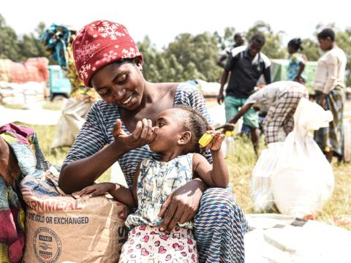
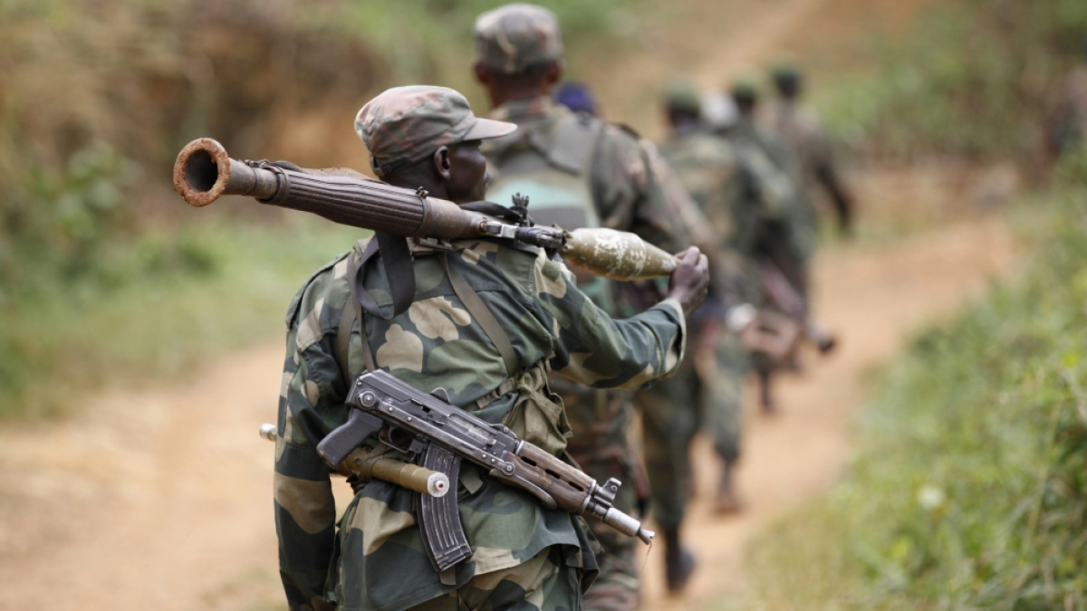
Adam’s Story

Slide 14
TAKE-AWAYS
1. We need to recognise Jesus for Who He truly is. (“Seek the Lord..” – Isaiah 55:6).
2. We need to exercise faith towards Him. (“Without faith, it is impossible to please God.” – Hebrews 11:6).
FAITH IS THE CURRENCY OF THE KINGDOM OF GOD!

