Slide 1
Encounters with Jesus 1
Luke 9:57-62 “Follow Me”

Slide 2
What is a disciple?
Greek word mathētēs – lit. “a learner, a student”.
English word ‘Apprentice’.
In Gospels and Acts, used more than 260 times for believers/followers of Jesus.

Slide 4
What is a disciple?
Greek word mathētēs – lit. “a learner, a student”.
English word ‘Apprentice’.
In Gospels and Acts, used more than 260 times for believers/followers of Jesus.
‘Follow Me’

Slide 5
The Context – The Travel Narrative Luke 9:51-19:47
Luke 9:51: “(Jesus) set his face to go to Jerusalem.”
The shadow of the cross looms large.
Luke 14:25 – Large crowds accompanied him.

Slide 6
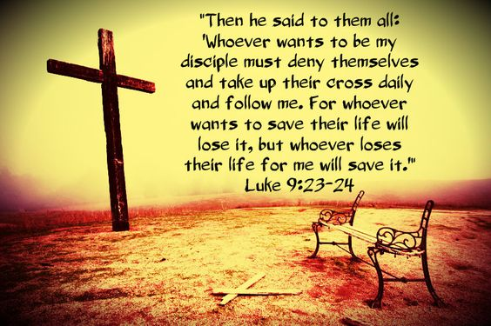

Slide 7
The Context – The Travel Narrative Luke 9:51-19:47
Luke 9:51: “(Jesus) set his face to go to Jerusalem.”
The shadow of the cross looms large.
Luke 14:25 – Large crowds followed him.
"Jesus was not after decisions; He was after disciples." (Bruce Hedman)

Slide 8
Luke 9:57-62
Key word is “follow” – appears in verse 57, 59 and 61.
3 different response to Jesus’ call to follow.
1) Verse 57-58 - First would-be disciple - compare Matthew 8:18-19.
Follow Jesus entails hardships - (see Luke 12:11-12, 21:12-19; John16:1-3, 33; Acts 14:22, etc.).

Slide 9
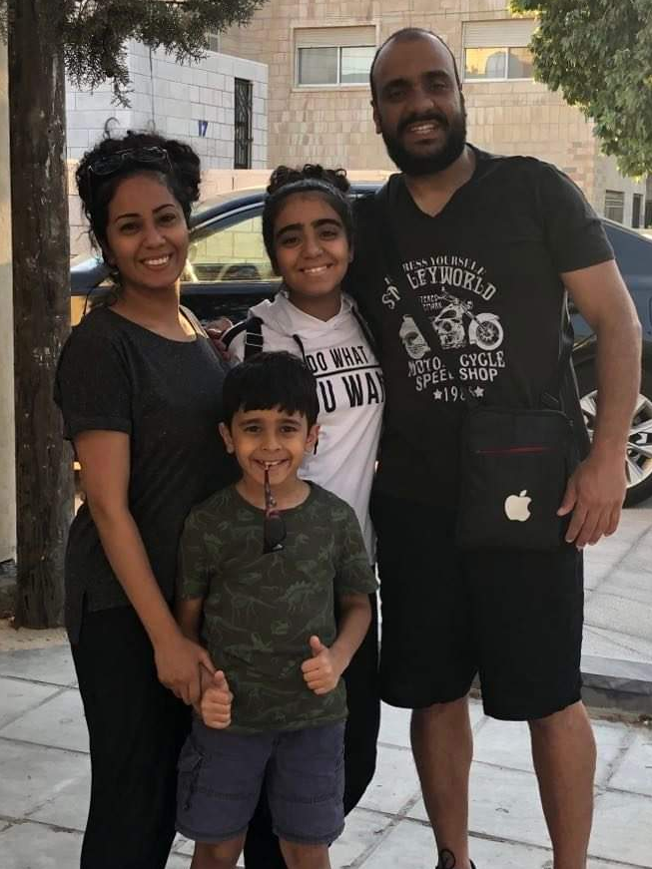

Slide 10
Luke 9:57-62
2) Verse 59-60
“Leave the dead to bury their own dead.”
3) Verse 61-62
No regrets! Look ahead, not back.

Slide 11
Summary
Discipleship is Total! It involves following, imitating and obeying Jesus.
Jesus FIRST before:
a) comfort (1st disciple's challenge),
b) cultural and family demands (2nd disciple's challenge) and
c) your own plans and desires (3rd disciples' challenge).

Slide 12
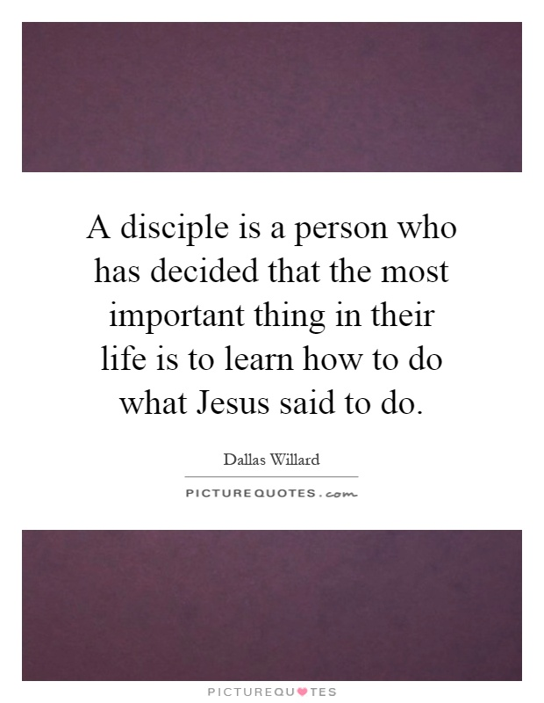

Slide 13
APPLICATION
Salvation is God’s gift to you. Discipleship is your whole-life, all-of-life response.
1) Commit to Following
2) Bring Others With You

Slide 14
