Slide 1
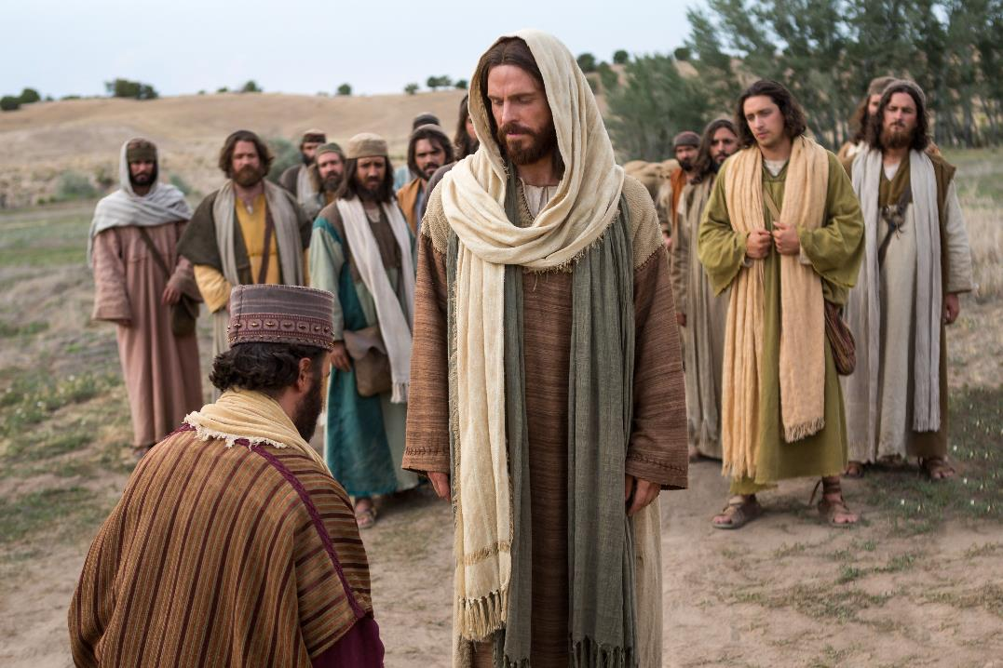
The One Thing Lacking…
Mark 10:17-31

Slide 2
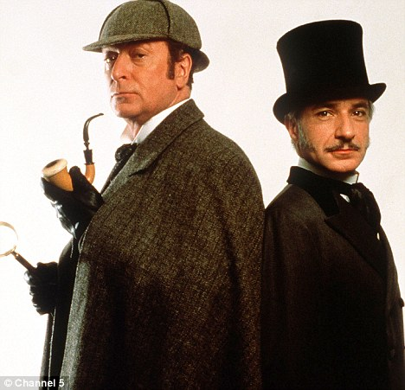

Slide 3
The One Thing Lacking…
Mark 10:17-31

Slide 4
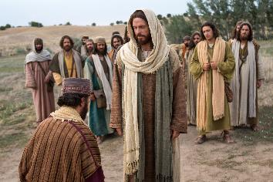
Mark 10:17-31
The Context
Mark 10:13-16: The Kingdom of God must be received like a child – no status, or standing, dependent.
The Text
By contrast, the man in today’s story is young (Matthew 19:22), a ruler (Luke 18:18) and is rich (vs 22).

Slide 5
BIG QUESTION 1: Who determines what is truly good in life ?

Slide 6
Mark 10:17-31
Vs 18 – Jesus questions the questioner.
Only true standard of goodness is God!

Slide 7
Steven A. Crane. Marveling with Mark : A Homiletical Commentary on the Second Gospel (Wipf and Stock:2010), page 120.
Jesus is not denying his own goodness or God-ness, but is probing the young man to see what he believes about Jesus—why would you call me good, if you know God alone is good?

Slide 8
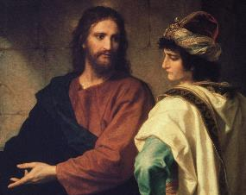
Mark 10:17-31
Vs 19 – Last 6 Commandments.
Vs 21 – “You lack one thing…go, sell…and come, follow me.”

Slide 9
BIG QUESTION 2: Who truly calls the shots in our life?

Slide 10
David E. Garland. Mark: NIV Application Commentary. (Grand Rapids: Zondervan Academic, 1996.)
If one wants eternal life, everything depends on one's response to Jesus.

Slide 11
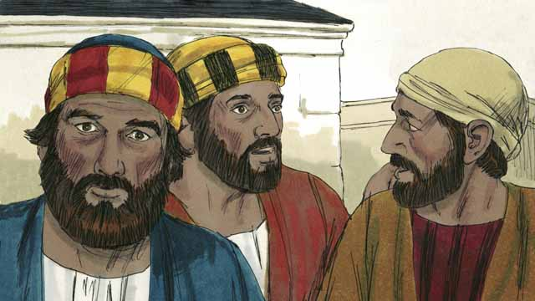
Mark 10:17-31
Vs 22 – Only place where someone walks away from Jesus.
Vs 23-25: How hard for the rich to enter God’s kingdom.
Vs 26: Disciples astonished. To Jews, riches was a sign of God’s blessing (Deut. 28:1-14; Job 1:10; 42:10; Psalm 128; Proverbs 10:22. etc.)
Jesus spoke out against the love of money and riches (Matthew 6:24-26 cf Mark 4:19; Matthew 6:19; Luke 12:15.)

Slide 12
What is the one thing you lack?

Slide 13
Mark 10:17-31
Vs 27: What is impossible to man is possible with God.
Vs 28: Peter: “We left everything and followed you.”
Vs 29-30: No one who left these things for Jesus and Gospel will not receive a hundredfold more in this life (with persecution) and …. eternal life!
Vs 31: “But many who are first will be last, and the last first.”

