Slide 1
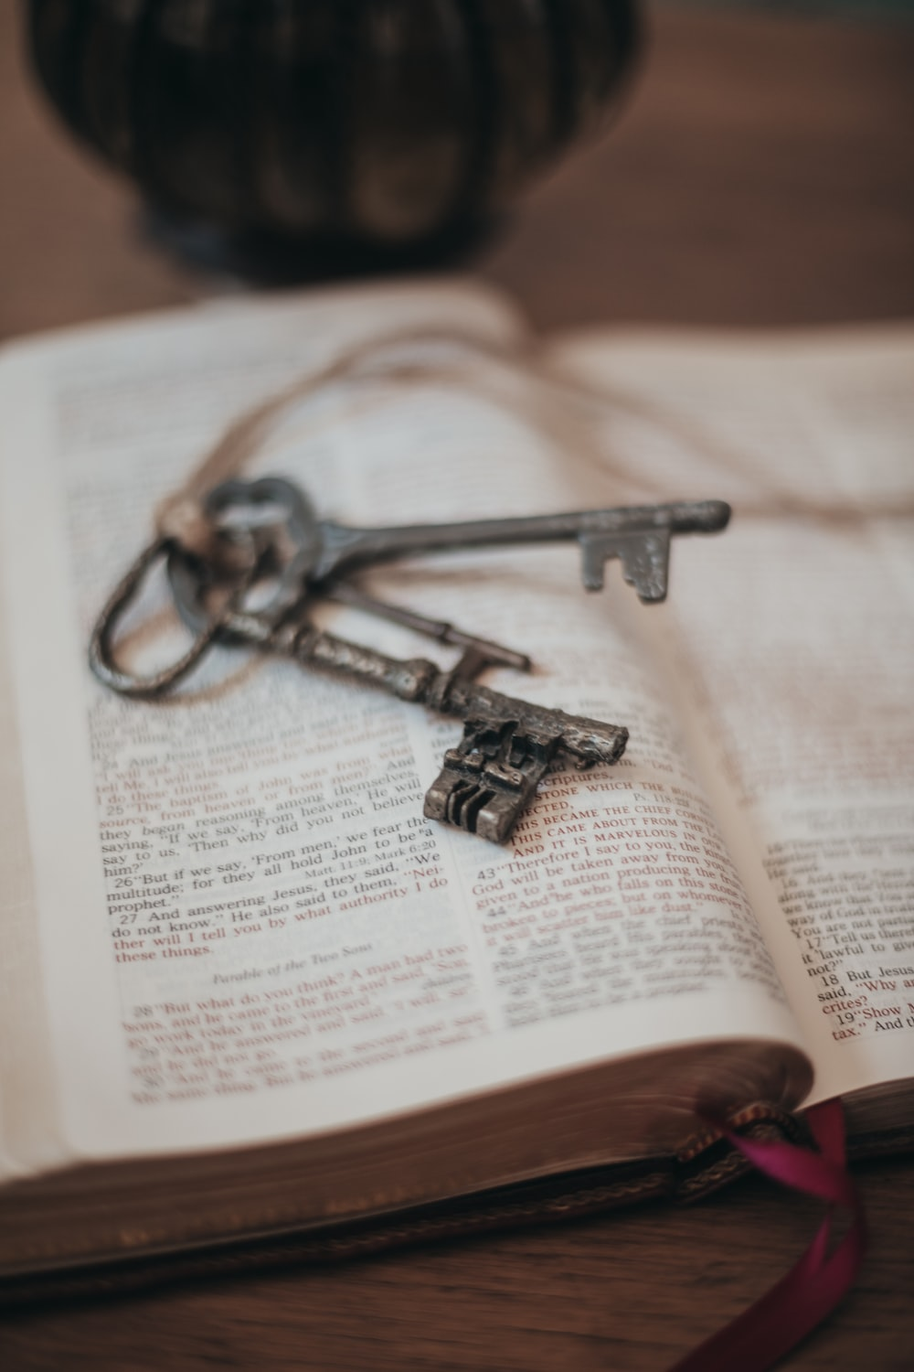
Freed to be free THE LETTER TO THE GALATIANS
Children of Promise

Slide 3
PREVIOUSLY IN Chapter 3
Paul contrasted the Promise God made to Abraham that we inherit by faith, with the purpose of the Law given through Moses, that reveals our sin and leads us to Christ, who frees us.
The Law did not cancel the promise but made it more necessary and urgent. It is meant to drive us to our utter need for Christ.
Notes:
Paul seeing Peter and the others separate from Gentile Christians, decided do something drastic. Here, we have two of the greatest early church Apostles Peter and Paul facing up to each other.

Slide 4
Relationship of old testament to new
.

Slide 5
Relationship of old testament to new
1) Progressive revelation:
- The Old Testament (Covenant) begins with creation and the fall
of man, and traces God’s mission to redeem people to Himself,
beginning with Israel (through Abraham, Moses, King David, the
priesthood and the prophets). It leads into the New Testament which
sees the coming of God’s Kingdom in Jesus, who brought about
redemption by His death, and will usher in the new creation.
Matthew 4:17; Luke 24:27, 44-48; 1 Corinthians 5:20-26; Revelation 21:5.

Slide 6
Relationship of old testament to new
2) Promise vs Fulfilment:
Provision of Old Covenant law through Moses that reveals sin
and outlines God’s commandments, while promising a future
Messiah.
Provision of New Covenant grace that delivers from sin, through
the incarnation, passion and resurrection of the Messiah, our Lord
Jesus Christ. Exodus 19:3-6, 24:7-8; Deuteronomy 9:11; Isaiah 53; Jeremiah
31:31-34; Luke 22:20; John 1:17.

Slide 7
Relationship of old testament to new
3) Flesh vs Spirit
The Old Covenant is an external conformity to God’s law by
human work.
The New Covenant is an internal empowering and fulfilment of
God’s law through faith in the finished work of Jesus with the
coming of the Holy Spirit into believers.
Ezekiel 36:25-32; Acts 2:38-39,13:38-39; 2 Corinthians 3:3-6;

Slide 8
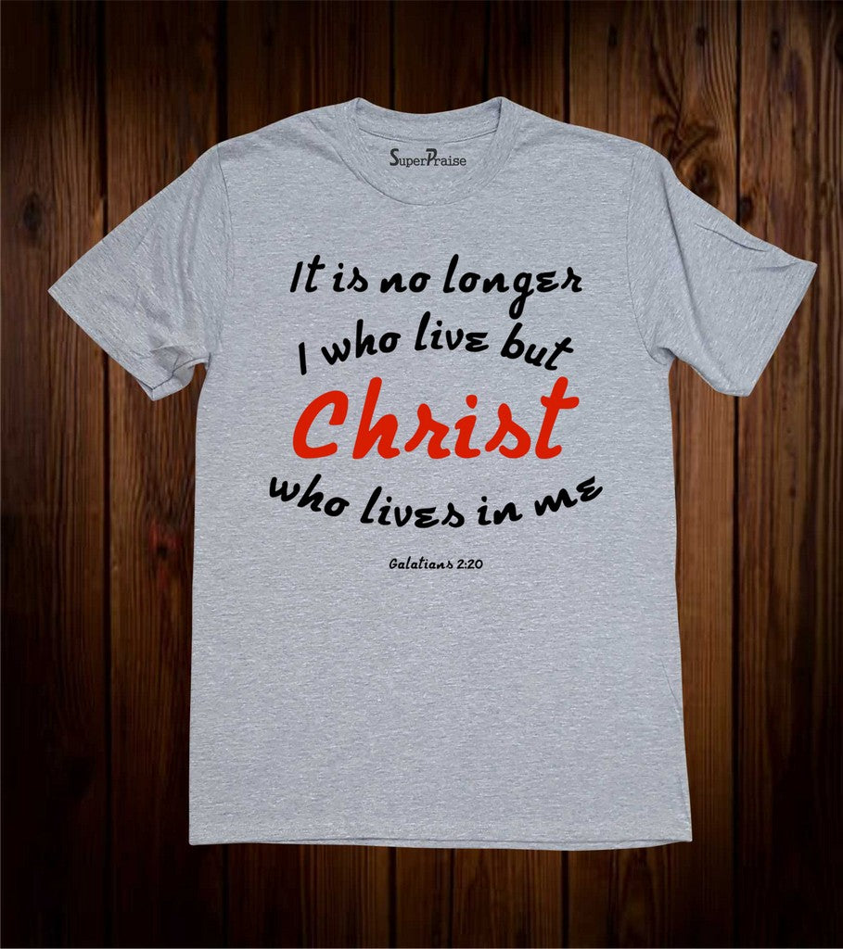

Slide 9
GALATIANS 4:1-11
Paul discusses the true position of a person who is under the law (vs 1-3),
Over against who we are in Christ (vs 4-7).
And finally, he will make a passionate appeal to stay in Christ and the freedom he has won for us (vs 8-11).

Slide 10
GALATIANS 4:1-11
Verse 1-3
Vs 1 – An heir who is not come of age is no better than a slave.
Vs 2 – Under temporary guardianship and management.
Vs 3 – “In the same way”, we who were heirs of the promise of Abraham were under ‘elementary principles of the world.’
“Elementary Principles” in Greek: στοιχεῖον stoicheion Lit. means "basic things," "first principles”, possibly spiritual beings or basic philosophies that enslaved us (see vs 8 and 9).

Slide 12
GALATIANS 4:1-11
Verse 4-7
Vs 4 – “But when fullness of time had come…” – It was a perfectly opportune time in history. Unified Roman empire, language, roads, etc. Also prophetically (Daniel 9:24-26).
Vs 5 – We were redeemed to be adopted.

Slide 13
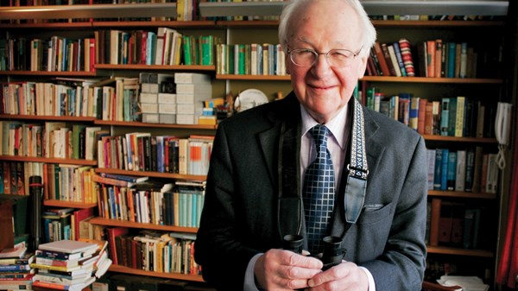
John Stott
"If He had not been man, He could not have redeemed men. If He had not been a righteous man, He could not have redeemed unrighteous men. And if He had not been God's Son, He could not have redeemed men for God or made them the sons of God."
John Stott, The Message of Galatians, (Leicester: InterVarsity, 1984), page 106

Slide 14
GALATIANS 4:1-11
Verse 4-7
Vs 4 – “But when fullness of time had come…” – It was an perfectly opportune time in history. Unified empire, language, roads, etc. Also prophetically (Daniel 9:24-26).
Vs 5 – We were redeemed to be adopted.
Vs 6-7 – We have the Spirit who leads us to call God, “Abba, Father!” We became sons and true heirs.

Slide 16
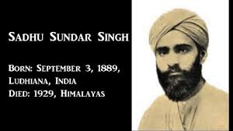

Slide 18
“Let the Law, sin, and the devil cry out against us until their outcry fills heaven and earth. The Spirit of God outcries them all. Our feeble groans, ‘Abba, Father,’ will be heard of God sooner than the combined racket of hell, sin, and the Law.”

Slide 19
GALATIANS 4:1-11
Verse 4-7
Vs 4 – “But when fullness of time had come…” – It was an perfectly opportune time in history. Unified empire, language, roads, etc. Also prophetically (Daniel 9:24-26).
Vs 5 – We were redeemed to be adopted.
Vs 6-7 – We have the Spirit who leads us to call God, “Abba, Father!” We became sons and true heirs.

Slide 20
GALATIANS 4:1-11
Verse 8-11
Vs 8-10: If you were set free by Jesus, why would you want to be a slave again? (cf Numbers 16:13)
Vs 10 – It was the ritualistic duty of the law - to keep holy days and seasons.
Vs 11: Paul is afraid that he has wasted all the time he spent with them preaching the good news.

Slide 21
Galatians 4:12-20
Paul calls them to be consistent and faithful to the original Gospel he preached to them, as he is. Here, we see Paul's genuine care and concern for the Galatians Christians.

Slide 22
Galatians 4:21-27
Gives an allegory based on events described in Genesis 16
Vs 24 – Sarah and Hagar represent two covenants – that of law and grace/promise.

Slide 23
Abraham is our father, but whose our mother?
Ishmael, son of Hagar – Legalism | Isaac, son of Sarah – Faith in Christ
Child of a slave woman. Hagar (vs22) | Child of a free woman, Sarah (vs 22)
Ishmael: born according to the flesh (v 23) | Isaac: born according to God’s promise (vs 23)
Corresponds to earthly Jerusalem (vs 25) | Corresponds to heavenly Jerusalem (vs 26)
Many children (descendants) | More children (descendants) (vs 27)
Persecuting (vs 29) | Persecuted (vs 29)
Inheriting nothing (vs 30) | Inheriting everything (vs 30)
Relationship based on law-keeping | Relationship based on trusting God
(edited from chart in https://enduringword.com/bible-commentary/galatians-4/)

Slide 24
Galatians 4:28-31
Vs 28 – Christians are children of promise. Like Isaac who represents freedom in Christ and unlike Ishmael who represents slavery to the law. The point really is we are either born as Ishmael or born-again as Isaac!
Vs 29 - Those who are legalists like the Judaizers (circumcision party) are always going to attack and ridicule us.

Slide 25
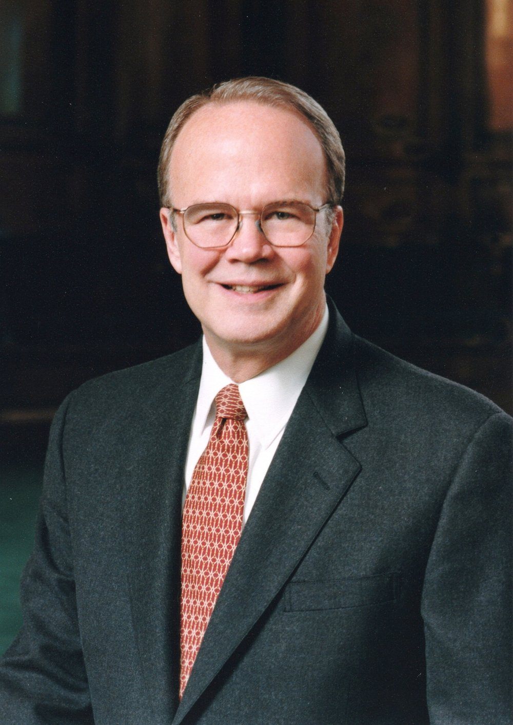
James Montgomery Boice
The persecution that Christians face “will not always be by the world but also and indeed more often by their half-brothers – the unbelieving but religious people in the nominal church. This is the lesson of history… Today the greatest enemies of the believing church are found among the members of the unbelieving church, the greatest opposition emanating from pulpits and church hierarchies.”

Slide 26
Galatians 4:28-31
Vs 31 - But ultimately, we Christians are children of promise and spiritual descendants of Abraham.
We will inherit through Jesus Christ, but the physical descendants of Abraham (the Jews) who reject Jesus and try to keep the law will instead be cast out, as Jesus Himself told us - Matt 8:11,12, Luke 13:28,29.

Slide 27
John Stott
”(W)e must seek to be like Isaac, not like Ishmael. We must put our trust in God through Jesus Christ. For only in Christ can we inherit the promises, receive the grace and enjoy the freedom of God."
John Stott, The Message of Galatians, (Leicester: InterVarsity, 1984), page 129

