Slide 1
Freed to be free THE LETTER TO THE GALATIANS

Slide 2
Galatians 2:20 anyone?
"I have been crucified with Christ. It is no longer I who live, but Christ who lives in me. And the life I now live in the flesh I live by faith in the Son of God, who loved me and gave himself for me."

Slide 3
Freed to be free THE LETTER TO THE GALATIANS
The Purpose of the Law

Slide 4
A unique Gospel Chapter 1-2 | Made righteous through Faith Chapter 3-4 | Freed to be Free Chapter 5-6
Biographical | Doctrinal | Practical
The Message of the Apostle | The Redemption of Christ | The Walk Of the Holy Spirit
The Gospel is true! | The Gospel is superior! | The Gospel is freedom!
Grace Defended | Grace Expounded | Grace Applied
Key Verse: "I have been crucified with Christ. It is no longer I who lives, but Christ who lives in me." (Gal 2:20) | Key Verse: "And because you are sons, God has sent the Spirit of his Son into our hearts, crying, "Abba! Father!" (Gal 4:6) | Key Verse: "For freedom, Christ has set us free; stand firm therefore, and do not submit again to a yoke of slavery." (Gal 5:1)

Slide 5
GALATIANS 1-3 summary
Paul was upset with the Galatians for accepting teaching of Jewish legalists.
Paul defended his divine calling and sanction/recognition as an Apostle in his own.
He show in the rest of Chapter 2 and 3 that God’s promise is received by faith and not by keeping the works of the law.
Notes:
Paul seeing Peter and the others separate from Gentile Christians, decided do something drastic. Here, we have two of the greatest early church Apostles Peter and Paul facing up to each other.

Slide 8
GALATIANS 3:1-14 – Last week
Did you receive the Holy Spirit by faith or by your works?
Were miracles done by faith or by works?
If we live by the law, we will be cursed. By Christ became a curse for us, so that we may be blessed as true spiritual children of Abraham.
Notes:
Paul seeing Peter and the others separate from Gentile Christians, decided do something drastic. Here, we have two of the greatest early church Apostles Peter and Paul facing up to each other.

Slide 9
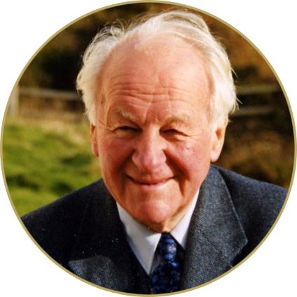
GALATIANS 3:15-29
Notes:
Paul seeing Peter and the others separate from Gentile Christians, decided do something drastic. Here, we have two of the greatest early church Apostles Peter and Paul facing up to each other.

Slide 10
GALATIANS 3:15-22
History
From Abraham (circa 2,000 B.C.) to Moses (circa 1,500 B.C.) – Moses is the "intermediary” mentioned in vs 19.
Genesis 12-end - Abraham promised by God that he would be blessed, that his seed (or posterity) would inherit the land he was sojourning in, and through his seed, all families on earth would be blessed. Abraham had Isaac, then his son Jacob had 12 sons who became the 12 tribes of Israel.
Exodus - After a 430 year period (vs 17) when they become slaves in Egypt, God raised up Moses who delivered them from Egypt and gave them the law at Mount Sinai.
Notes:
Paul seeing Peter and the others separate from Gentile Christians, decided do something drastic. Here, we have two of the greatest early church Apostles Peter and Paul facing up to each other.

Slide 11
GALATIANS 3:15-22
Theology
Two principles at work here. God gave a promise to Abraham - “I will bless you ...all families on earth will be blessed through you” (Genesis 12:1-3). God gave the law to Moses (Exodus 20-23, etc.), epitomised in the 10 commandments of Exodus 20:1-17.
"In the promise of Abraham God said, "I will... I will.... I will..." But in the law of Moses God said, "Thou shalt... thou shalt not...". The promise sets forth a religion of God - God's plan, God's grace, God's initiative. But the law sets forth a religion of man - man's duty, man's works, man's responsibility." (John Stott, The Message of Galatians, (Leicester: InterVarsity, 1984), page 87.)
Notes:
Paul seeing Peter and the others separate from Gentile Christians, decided do something drastic. Here, we have two of the greatest early church Apostles Peter and Paul facing up to each other.

Slide 12
GALATIANS 3:15-22
Theology
The promise of God (standing for the work of God) had to be believed and acted on.
But the law (standing for the works of men) had to be obeyed and worked at.
Therefore, God dealt with Abraham by 'promise', 'grace' and 'faith' but that through Moses, it was 'law' 'commandments' and 'works.
However, God’s purpose in the Promise and the Law are to the SAME end!
Notes:
Paul seeing Peter and the others separate from Gentile Christians, decided do something drastic. Here, we have two of the greatest early church Apostles Peter and Paul facing up to each other.

Slide 13
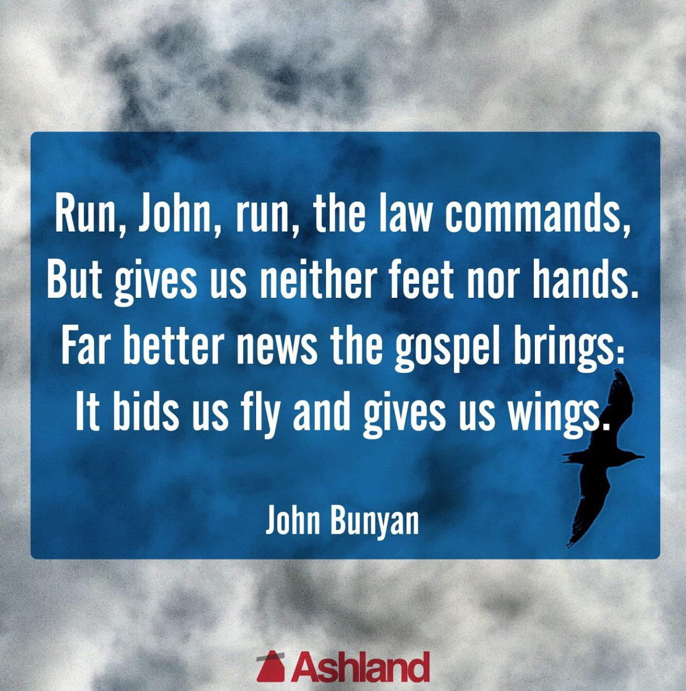

Slide 14
GALATIANS 3:15-22
We can divide the passage into two.
Vs 15-18 shows, negatively, that the law did not annul or cancel the promise of God.
Vs 19-22 shows, positively, that the law actually made the promise of God necessary for us.

Slide 15
GALATIANS 3:15-22
Vs 15 – once a will is ratified, it cannot be changed.
Vs 16 - God's unchanging promise were made to Abraham and to his seed (singular).
Vs 17 The law does not annul the promised covenant.
Vs 19 - Why then was the law given? If God's promise was superior, what was the point of the law? It was added to reveal the depth of our sinfulness (see Romans 3:20).

Slide 16
GALATIANS 3:15-22
Vs 19b-20 – The Law was given through the mediation of angels (Deuteronomy 33:2, Psalm 68:17; Acts 7:53; Hebrews 2:2), but God worked directly to us through His son.
“(T)he promise came to Abraham first-hand from God; and the law comes to people third-hand - God - the angels - Moses the mediator - the people." (Stephen Neil, Paul to the Galatians, (World Christian Books: Lutterworth, 1958), page 44)

Slide 17
GALATIANS 3:15-22
Purpose of the law – to show the futility of our good works and the universality of sin (see Psalm 14:3).

Slide 18
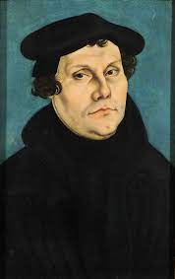
Martin Luther

Slide 19
GALATIANS 3:23-29
Salvation is not only historical and progressive but biographical.
"More simply, everybody is living either in the Old Testament or in the New, and derives his religion either from Moses or from Jesus."
(John Stott, The Message of Galatians, (Leicester: InterVarsity, 1984), page 95.)
Vs 25 – “But now” - a true turning point in our personal histories.
A Christian is one who is "in Christ" - he has been baptised into Christ (vs 27), put on Christ (vs 27), one in Christ (vs 28) and belong to Christ (vs 29).

Slide 20
GALATIANS 3:23-29
Vs 26 - God is no longer our judge or even our guardian - He is now our Father.

Slide 22
GALATIANS 3:23-29
Vs 26 - God is no longer our judge or even our guardian - he is now our Father.
Vs 28 – We all equally need saving by Christ, made one in Him.
Vs 29 - And if we are in Christ, then we are also Abraham's offspring. And heirs equally of the promise.
"(W)e cannot come to Christ to be justified until we have first been to Moses to be condemned...but we must let Moses send us to Christ."
(John Stott, The Message of Galatians, (Leicester: InterVarsity, 1984), page 102.)

