Slide 1
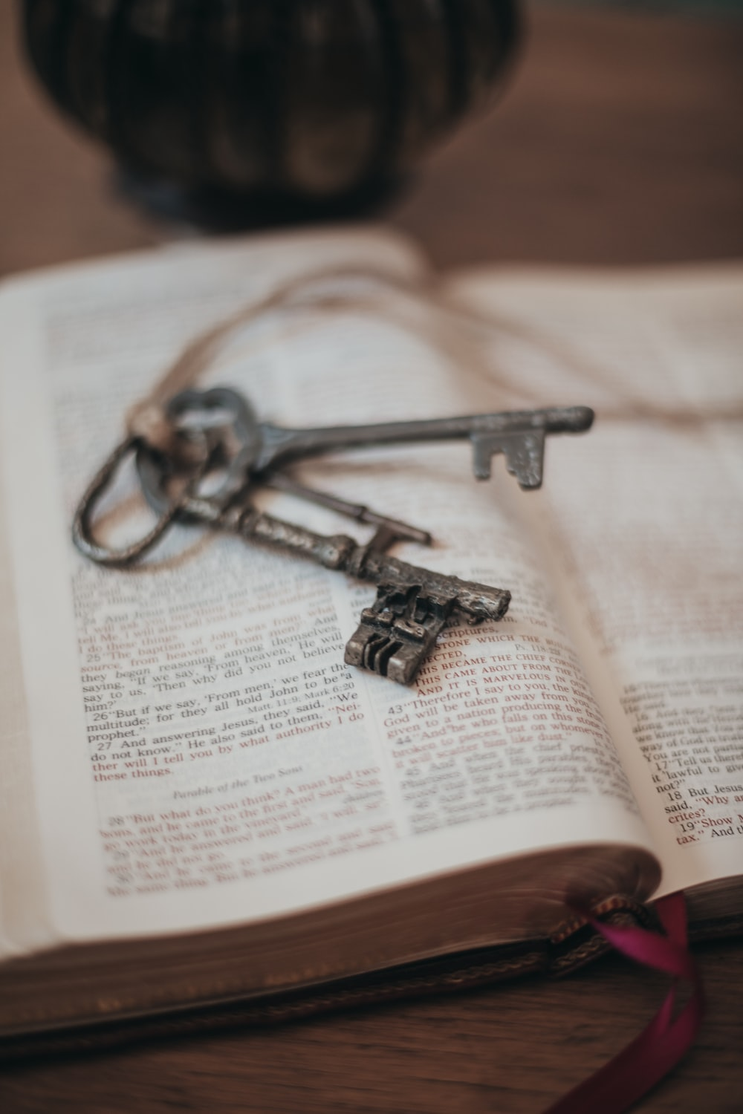
Freed to be free THE LETTER TO THE GALATIANS

Slide 2
Galatians 2:20
"I have been _________ with Christ. It is no longer ___ who _______, but _________ who _____ in me. And the ______ I now live in the ________ I live by _________ in the Son of God, who loved me and _______ _____________ for me."

Slide 3
Galatians 2:20
"I have been (crucified) with Christ. It is no longer ___ who _______, but _________ who _____ in me. And the ______ I now live in the ________ I live by _________ in the Son of God, who loved me and _______ _____________ for me."

Slide 4
Galatians 2:20
"I have been (crucified) with Christ. It is no longer (I) who _______, but _________ who _____ in me. And the ______ I now live in the ________ I live by _________ in the Son of God, who loved me and _______ _____________ for me."

Slide 5
Galatians 2:20
"I have been (crucified) with Christ. It is no longer (I) who (live), but _________ who _____ in me. And the ______ I now live in the ________ I live by _________ in the Son of God, who loved me and _______ _____________ for me."

Slide 6
Galatians 2:20
"I have been (crucified) with Christ. It is no longer (I) who (live), but (Christ) who _____ in me. And the ______ I now live in the ________ I live by _________ in the Son of God, who loved me and _______ _____________ for me."

Slide 7
Galatians 2:20
"I have been (crucified) with Christ. It is no longer (I) who (live), but (Christ) who (lives) in me. And the ______ I now live in the ________ I live by _________ in the Son of God, who loved me and _______ _____________ for me."

Slide 8
Galatians 2:20
"I have been (crucified) with Christ. It is no longer (I) who (live), but (Christ) who (lives) in me. And the (life) I now live in the ________ I live by _________ in the Son of God, who loved me and _______ _____________ for me."

Slide 9
Galatians 2:20
"I have been (crucified) with Christ. It is no longer (I) who (live), but (Christ) who (lives) in me. And the (life) I now live in the (flesh) I live by _________ in the Son of God, who loved me and _______ _____________ for me."

Slide 10
Galatians 2:20
"I have been (crucified) with Christ. It is no longer (I) who (live), but (Christ) who (lives) in me. And the (life) I now live in the (flesh) I live by (faith) in the Son of God, who loved me and _______ _____________ for me."

Slide 11
Galatians 2:20
"I have been (crucified) with Christ. It is no longer (I) who (live), but (Christ) who (lives) in me. And the (life) I now live in the (flesh) I live by (faith) in the Son of God, who loved me and (gave) (himself) for me."

Slide 13
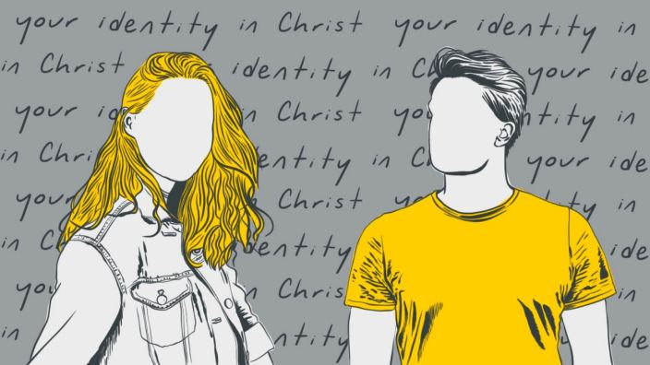

Slide 14
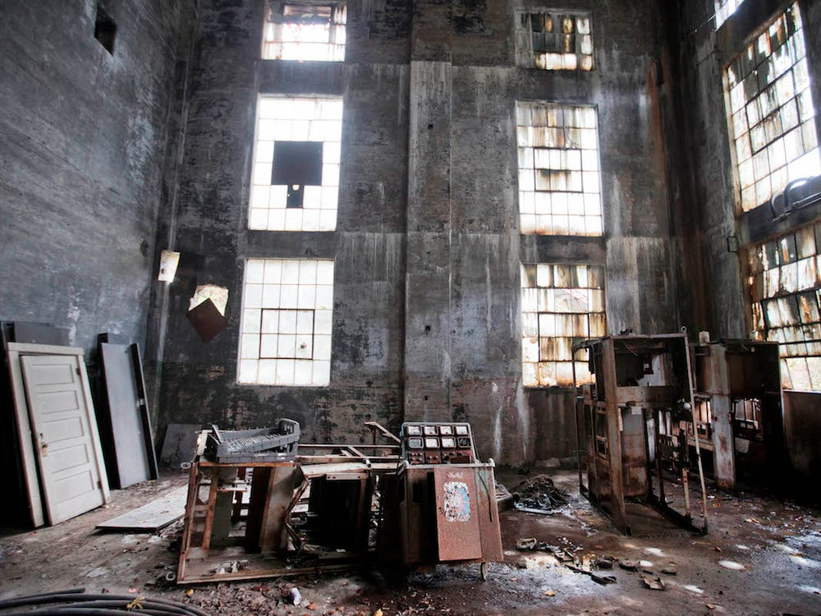

Slide 16
A unique Gospel Chapter 1-2 | Made righteous through Faith Chapter 3-4 | Freed to be Free Chapter 5-6
Biographical | Doctrinal | Practical
The Message of the Apostle | The Redemption of Christ | The Walk Of the Holy Spirit
The Gospel is true! | The Gospel is superior! | The Gospel is freedom!
Grace Defended | Grace Expounded | Grace Applied
Key Verse: "I have been crucified with Christ. It is no longer I who lives, but Christ who lives in me." (Gal 2:20) | Key Verse: "And because you are sons, God has sent the Spirit of his Son into our hearts, crying, "Abba! Father!" (Gal 4:6) | Key Verse: "For freedom, Christ has set us free; stand firm therefore, and do not submit again to a yoke of slavery." (Gal 5:1)

Slide 17
Freed to be free THE LETTER TO THE GALATIANS
Made righteous through faith

Slide 18
GALATIANS 3:1-6
Vs 1a: “Who has bewitched you?”
Vs 1b: The Gospel message centres on the death of Jesus in our place.
Vs 2-6: Paul asks a few rhetorical questions:
- Vs 2 - Did you receive the Holy Spirit by your own efforts, or through
listening with faith?
- Vs 3 – If we had to depend on the Spirit to first be saved, must we
then work by our own strength to complete the job?
- Vs 5 - Did God work miracles and send His Spirit through your
listening with faith to the Gospel, or by your own doing?
Notes:
Paul seeing Peter and the others separate from Gentile Christians, decided do something drastic. Here, we have two of the greatest early church Apostles Peter and Paul facing up to each other.

Slide 19
GALATIANS 3:1-6
"The law requires works of human achievement; the gospel requires faith in Christ's achievement."
John Stott, The Message of Galatians, (Leicester: InterVarsity, 1984), page 71.
Notes:
Paul seeing Peter and the others separate from Gentile Christians, decided do something drastic. Here, we have two of the greatest early church Apostles Peter and Paul facing up to each other.

Slide 20
We are saved, not by human reformation, but by divine transformation.

Slide 21
GALATIANS 3:1-6
"The law requires works of human achievement; the gospel requires faith in Christ's achievement."
John Stott, The Message of Galatians, (Leicester: InterVarsity, 1984), page 71.
Both conversion and our growing up in Christ (i.e. our progression as believers) is dependent on our exercising faith towards God in Christ.
Vs 6: Just like Abraham, who believed God and God made him righteous as a result (see Genesis 15:6).
Notes:
Paul seeing Peter and the others separate from Gentile Christians, decided do something drastic. Here, we have two of the greatest early church Apostles Peter and Paul facing up to each other.

Slide 22
GALATIANS 3:7-9
Vs 7,9: Paul says that just as Abraham the man of faith was blessed by God, so we who have faith are also sons of Abraham.
Vs 8: We see something of the Gospel being foreshadowed in Genesis 12:3, that "all nations would be blessed through Abraham”, and this through “justifying the Gentiles by faith.”
Notes:
Paul seeing Peter and the others separate from Gentile Christians, decided do something drastic. Here, we have two of the greatest early church Apostles Peter and Paul facing up to each other.

Slide 23
GALATIANS 3:7-9
Previously contrasted works of law and faith. Here, Paul contrasts the blessing of faith with the curse of the law.
Notes:
Paul seeing Peter and the others separate from Gentile Christians, decided do something drastic. Here, we have two of the greatest early church Apostles Peter and Paul facing up to each other.

Slide 24
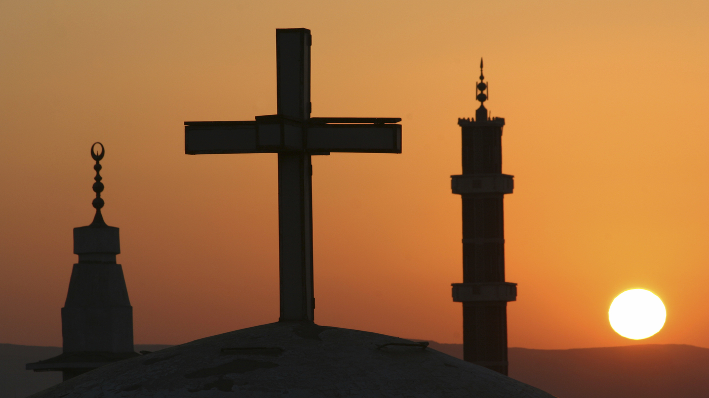

Slide 25
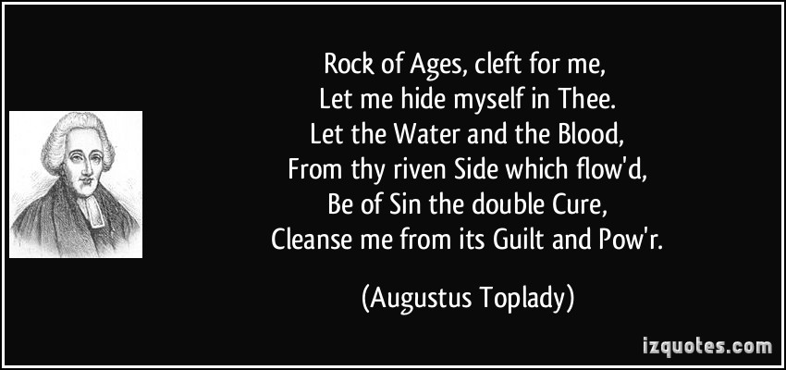
From the hymn, Rock of Ages.

Slide 26
GALATIANS 3:10-14
Paul’s point in vs 10-14: If we try to be saved by our works, we will be cursed because we cannot keep them all. Instead, the just live (and are blessed) by faith.
Vs 11: No one is justified before God by the law (i.e. by keeping it).
Instead the 'just shall live by faith". It is in the present tense - by believing. We live by trusting in Jesus, through knowing him. It is true life that is eternal (see John 17:3).
Through Christ, we receive both favour (justification) and fellowship (relationship) with God.
Notes:
Paul seeing Peter and the others separate from Gentile Christians, decided do something drastic. Here, we have two of the greatest early church Apostles Peter and Paul facing up to each other.

Slide 27
GALATIANS 3:1-14
Vs 12: The law by contrast demands not faith but obedience and keeping of the law. And if we fail, we are cursed.
Vs 13: But Christ took the curse of our sin on Himself, so that we might receive the blessing of God.
Notes:
Paul seeing Peter and the others separate from Gentile Christians, decided do something drastic. Here, we have two of the greatest early church Apostles Peter and Paul facing up to each other.

Slide 28
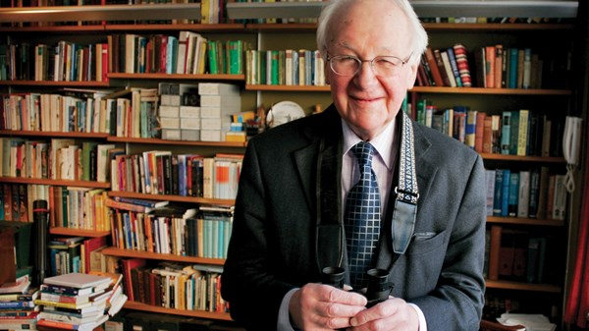
John Stott
"Christ is the bread of life; faith feeds upon Him. Christ was lifted up on the cross; faith gazes at Him there."
John Stott, The Message of Galatians, (Leicester: InterVarsity, 1984), page 82

Slide 29
GALATIANS 3:1-14
Vs 12: The law by contrast demands not faith but obedience and keeping of the law. And if we fail, we are cursed.
Vs 13: But Christ took the curse of our sin on Himself, so that we might receive the blessing of God.
Vs 14: So we come into the blessing promised in Abraham and delivered by Jesus Christ – receiving the promised Holy Spirit through faith.
Notes:
Paul seeing Peter and the others separate from Gentile Christians, decided do something drastic. Here, we have two of the greatest early church Apostles Peter and Paul facing up to each other.

Slide 30
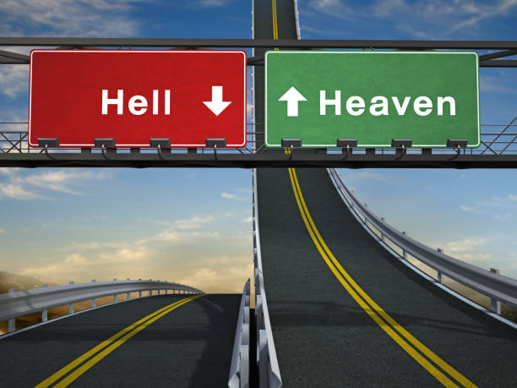
TWO ROADS IN LIFE – Which one are you on?
The Self-Righteous (Legalist) and the Un-Righteous (Lawless)
The Righteous in Christ (Faithful)

