Slide 1
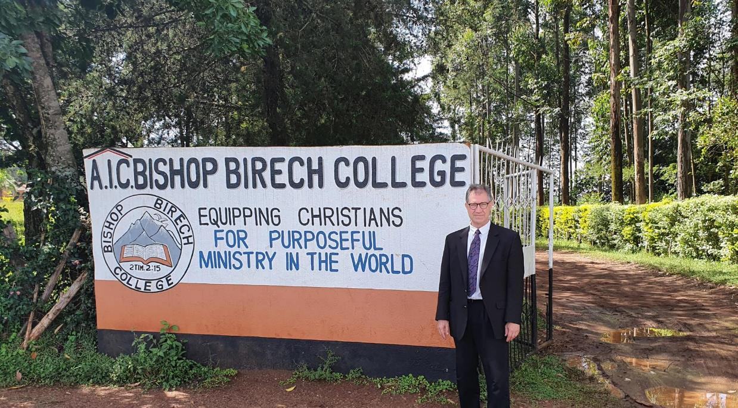

Slide 2
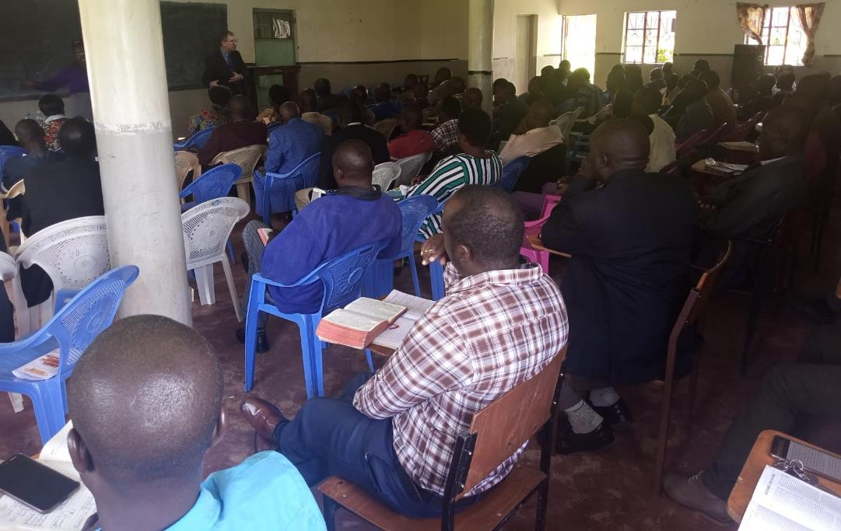

Slide 3
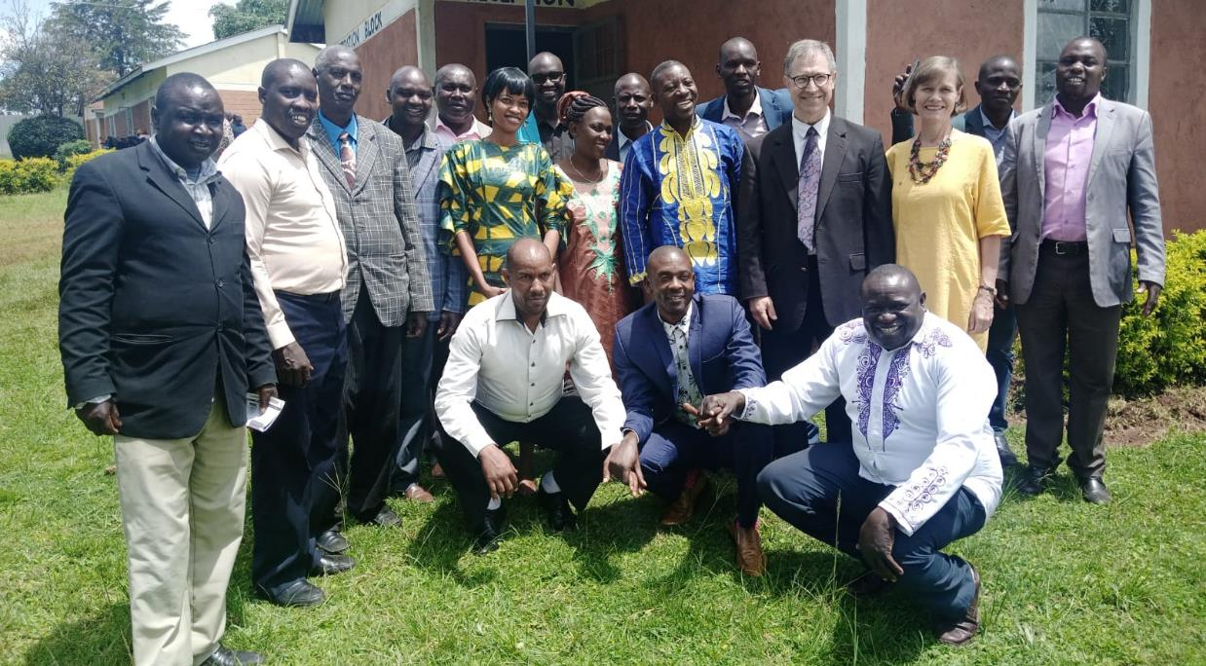

Slide 5
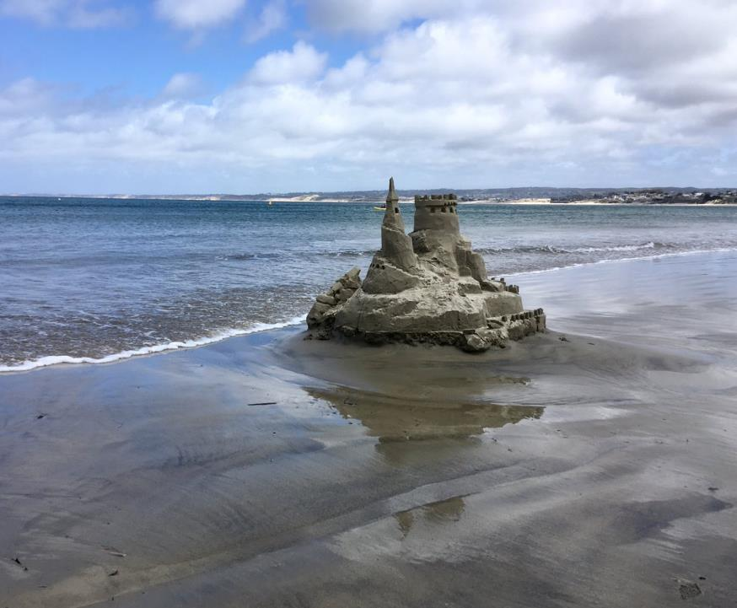
Daniel’s Third Vision Part 2
Sandcastles
Daniel 11-12

Slide 6
A Word from the Director: Yahweh Sabaoth (11:1)
Episode 1 Swoosh (11:2-4)
Episode 2 Beware of the Spurned Wife (11:5-6)
Episode 3 That was my sister . . . and my stuff! (11:7-9)
Episode 4 The Overreach (11:10-20)
Episode 5 The “Contemptible Person” (11:21-35)

Slide 7
A Word from the Director: Yahweh Sabaoth (11:1)
Episode 1 Swoosh (11:2-4)
Episode 2 Beware of the Spurned Wife (11:5-6)
Episode 3 That was my sister . . . and my stuff! (11:7-9)
Episode 4 The Overreach (11:10-20)
Episode 5 The “Contemptible Person” (11:21-35)
Episode 6 The Really Contemptible Person (11:36-45)
He boasts (Dan 7:20, 25)
He defies God
He is only interested in his own ambition
He gains power through military build-up and manipulation

Slide 8
X
King of the North
X
Antichrist
X
King of the South
EGYPT, LIBYA, ETHIOPIA

Slide 9
A Word from the Director: Yahweh Sabaoth (11:1)
Episode 1 Swoosh (11:2-4)
Episode 2 Beware of the Spurned Wife (11:5-6)
Episode 3 That was my sister . . . and my stuff! (11:7-9)
Episode 4 The Overreach (11:10-20)
Episode 5 The “Contemptible Person” (11:21-35)
Episode 6 The Really Contemptible Person (11:36-45)
The Final Word from the Director (12:1-13)
“time, times, and half a time”
1,290 days
1,335 days

Slide 10
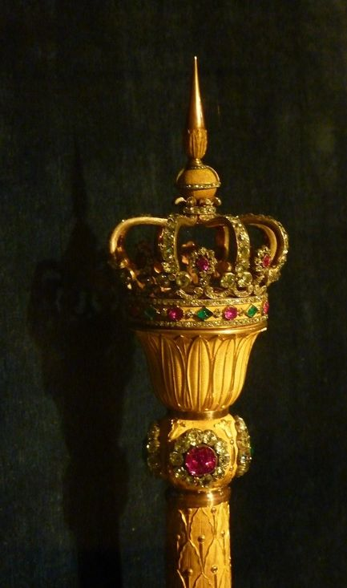
Reviewing the Vision of the Future
10 nation coalition ruling the world (revived Roman empire)
Single ruler emerges from this coalition (antichrist)
Antichrist takes over the world
Jesus takes over the world

Slide 11
What do we know about the

Slide 12
Daniel
He is the face of a 10-nation coalition reviving the ancient Roman empire.
He is a bragging megalomaniac who believes himself to be a god.
He attacks other nations, especially Israel.
He will formulate a treaty with Israel for seven years and allow them to rebuild their temple.
In the middle of that seven-year treaty, he will break it and crack down on the Jews’ worship, desecrate the temple, and cause an offense so severe that no one will enter the temple in true worship.
He will be destroyed by God who utilizes His warrior angels to combat evil spirits using him.

Slide 13
Matthew 24:15-28
¹⁵ “So when you see the abomination of desolation spoken of by the prophet Daniel, standing in the holy place (let the reader understand), ¹⁶ then let those who are in Judea flee to the mountains. ¹⁷ Let the one who is on the housetop not go down to take what is in his house, ¹⁸ and let the one who is in the field not turn back to take his cloak. ¹⁹ And alas for women who are pregnant and for those who are nursing infants in those days! ²⁰ Pray that your flight may not be in winter or on a Sabbath. ²¹ For then there will be great tribulation, such as has not been from the beginning of the world until now, no, and never will be. ²² And if those days had not been cut short, no human being would be saved. But for the sake of the elect those days will be cut short. ²³ Then if anyone says to you, ‘Look, here is the Christ!’ or ‘There he is!’ do not believe it.

Slide 14
Matthew 24:15-28
²⁴ For false christs and false prophets will arise and perform great signs and wonders, so as to lead astray, if possible, even the elect. ²⁵ See, I have told you beforehand. ²⁶ So, if they say to you, ‘Look, he is in the wilderness,’ do not go out. If they say, ‘Look, he is in the inner rooms,’ do not believe it. ²⁷ For as the lightning comes from the east and shines as far as the west, so will be the coming of the Son of Man. ²⁸ Wherever the corpse is, there the vultures will gather.

Slide 15
Jesus
The antichrist will arise during a devastating great tribulation to the entire world.
Do not be deceived by false christs.

Slide 16
2 Thessalonians 2:1-12
¹ Now concerning the coming of our Lord Jesus Christ and our being gathered together to him, we ask you, brothers, ² not to be quickly shaken in mind or alarmed, either by a spirit or a spoken word, or a letter seeming to be from us, to the effect that the day of the Lord has come. ³ Let no one deceive you in any way. For that day will not come, unless the rebellion comes first, and the man of lawlessness is revealed, the son of destruction, ⁴ who opposes and exalts himself against every so-called god or object of worship, so that he takes his seat in the temple of God, proclaiming himself to be God. ⁵ Do you not remember that when I was still with you I told you these things? ⁶ And you know what is restraining him now so that he may be revealed in his time. ⁷ For the mystery of lawlessness is already at work. Only he who now restrains it will do so until he is out of the way.

Slide 17
2 Thessalonians 2:1-12
⁸ And then the lawless one will be revealed, whom the Lord Jesus will kill with the breath of his mouth and bring to nothing by the appearance of his coming. ⁹ The coming of the lawless one is by the activity of Satan with all power and false signs and wonders, ¹⁰ and with all wicked deception for those who are perishing, because they refused to love the truth and so be saved. ¹¹ Therefore God sends them a strong delusion, so that they may believe what is false, ¹² in order that all may be condemned who did not believe the truth but had pleasure in unrighteousness.

Slide 18
Paul
Antichrist is called “man of lawlessness.”
It will be clear who he is when he arrives.
He will perform miraculous wonders by the power of Satan.
People throughout the world will marvel and believe in him as a saviour because they willingly believe a lie.
God reinforces this delusion leading to their sure condemnation.
Someone currently restrains him.
Jesus will terminate him at his coming by the breath of his mouth.

Slide 19
Revelation 13:1-9, 11-18
¹ And I saw a beast rising out of the sea, with ten horns and seven heads, with ten diadems on its horns and blasphemous names on its heads. ² And the beast that I saw was like a leopard; its feet were like a bear's, and its mouth was like a lion's mouth. And to it the dragon gave his power and his throne and great authority. ³ One of its heads seemed to have a mortal wound, but its mortal wound was healed, and the whole earth marveled as they followed the beast. ⁴ And they worshiped the dragon, for he had given his authority to the beast, and they worshiped the beast, saying, “Who is like the beast, and who can fight against it?”

Slide 20
Revelation 13:1-9, 11-18
⁵ And the beast was given a mouth uttering haughty and blasphemous words, and it was allowed to exercise authority for forty-two months. ⁶ It opened its mouth to utter blasphemies against God, blaspheming his name and his dwelling, that is, those who dwell in heaven. ⁷ Also it was allowed to make war on the saints and to conquer them. And authority was given it over every tribe and people and language and nation, ⁸ and all who dwell on earth will worship it, everyone whose name has not been written before the foundation of the world in the book of life of the Lamb who was slain. ⁹ If anyone has an ear, let him hear:

Slide 21
Revelation 13:1-9, 11-18
¹¹ Then I saw another beast rising out of the earth. It had two horns like a lamb and it spoke like a dragon. ¹² It exercises all the authority of the first beast in its presence, and makes the earth and its inhabitants worship the first beast, whose mortal wound was healed. ¹³ It performs great signs, even making fire come down from heaven to earth in front of people, ¹⁴ and by the signs that it is allowed to work in the presence of the beast it deceives those who dwell on earth, telling them to make an image for the beast that was wounded by the sword and yet lived. ¹⁵ And it was allowed to give breath to the image of the beast, so that the image of the beast might even speak and might cause those who would not worship the image of the beast to be slain.

Slide 22
Revelation 13:1-9, 11-18
¹⁶ Also it causes all, both small and great, both rich and poor, both free and slave, to be marked on the right hand or the forehead, ¹⁷ so that no one can buy or sell unless he has the mark, that is, the name of the beast or the number of its name. ¹⁸ This calls for wisdom: let the one who has understanding calculate the number of the beast, for it is the number of a man, and his number is 666.

Slide 23
John
The beast or final kingdom represents all the godless nations and seven empires of the past.
The 10 crowns are the final 10 kings forming a ruling coalition empowered by Satan.
The antichrist becomes the identity of beast and recovers from a mortal wound in battle.
The false prophet performs wonderous signs and binds the world to the antichrist by forcing them to bear his mark, 666.

