Slide 2
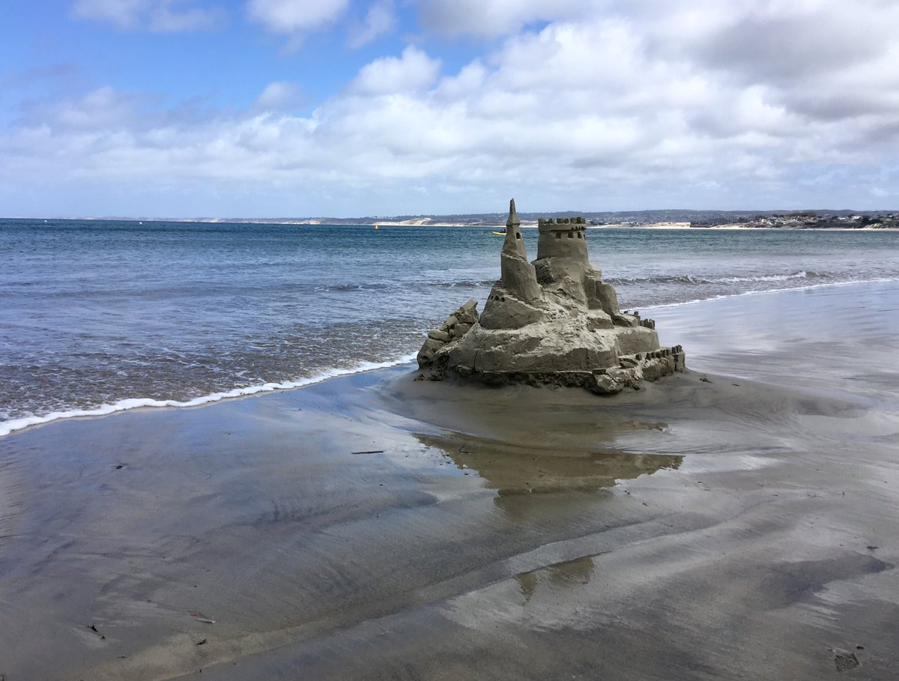
Daniel’s Third Vision Part 2
Sandcastles
Daniel 11-12

Slide 3
A Word from the Director: Yahweh Sabaoth (11:1)

Slide 4
Episode 1
Swoosh (11:2-4)

Slide 5
These 3 Kings . . . Plus 1 More
Cambyses
Pseudo-Smerdis
Darius I
Xerxes
Battle of Marathon
Battle of Thermopylae
Alexander the Great

Slide 6
Alexander the Great
Cassander
Seleucus
Lysimachus
Ptolemy

Slide 7
Huge Persia
Smaller Greece
4 divisions of Greece
2 main divisions of 4 divisions of Greece
1 person of Greece
1 future person like person of Greece

Slide 8
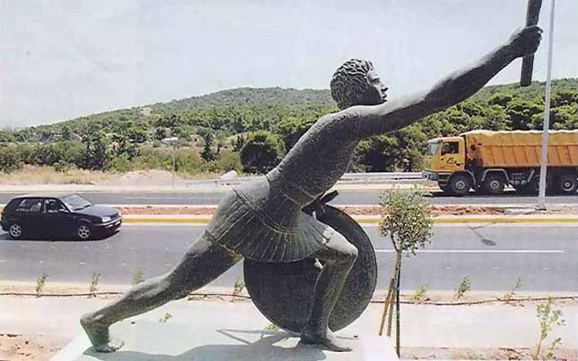
We have conquered!
Nike

Slide 9
Written & Directed by
Yahweh Sabaoth

Slide 10
Episode 2
Beware of the Spurned Wife (11:5-6)

Slide 11
SOUTH
Ptolemy 1
(Ptony 1)
Prince
Seleucus
NORTH
Antiochus 1
(Ty 1)

Slide 12
Peace Treaty
Berenice
SOUTH
Ptony 2
NORTH
Ty 2
Laodice

Slide 13
X
Peace Treaty
X
Berenice
X
NORTH
Ty 2
Laodice

Slide 14
NORTH
Seleucus II
(Selly 2)
Laodice

Slide 15
Written & Directed by
Yahweh Sabaoth

Slide 16
Episode 3
That was my sister . . . and my stuff! (11:7-9)

Slide 17
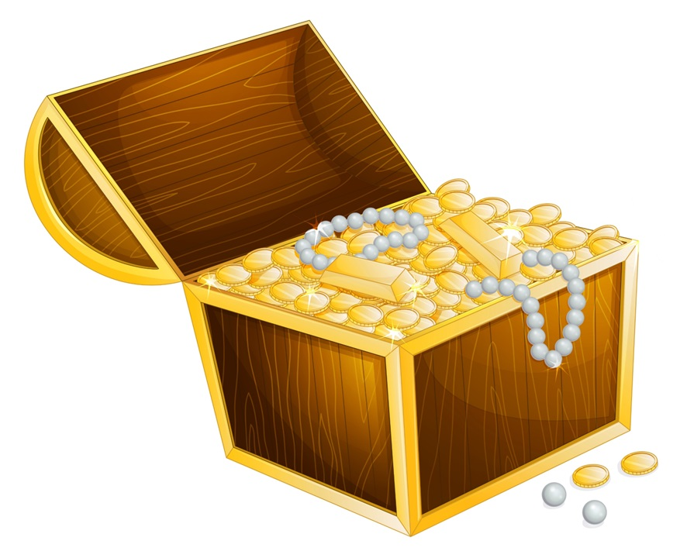
SOUTH
Ptony 3
NORTH
Selly 2
X
Laodice

Slide 18
Written & Directed by
Yahweh Sabaoth

Slide 19
Episode 4
The Overreach
(11:10-20)

Slide 20
SOUTH
Ptony 4
NORTH
Ty 3

Slide 21
Peace Treaty
Cleopatra
X
SOUTH
Ptony 5
NORTH
Ty 3
ROME

Slide 22
X
SOUTH
Ptony 5
NORTH
Selly 4
ROME

Slide 23
Written & Directed by
Yahweh Sabaoth

Slide 24
Episode 5
The “Contemptible Person” (11:20-35)

Slide 25
"Peace" Treaty
SOUTH
Ptony 6
NORTH
Ty 4
ROME
Jerusalem
Notes:
ORTH

Slide 26
Written & Directed by
Yahweh Sabaoth

