Slide 1
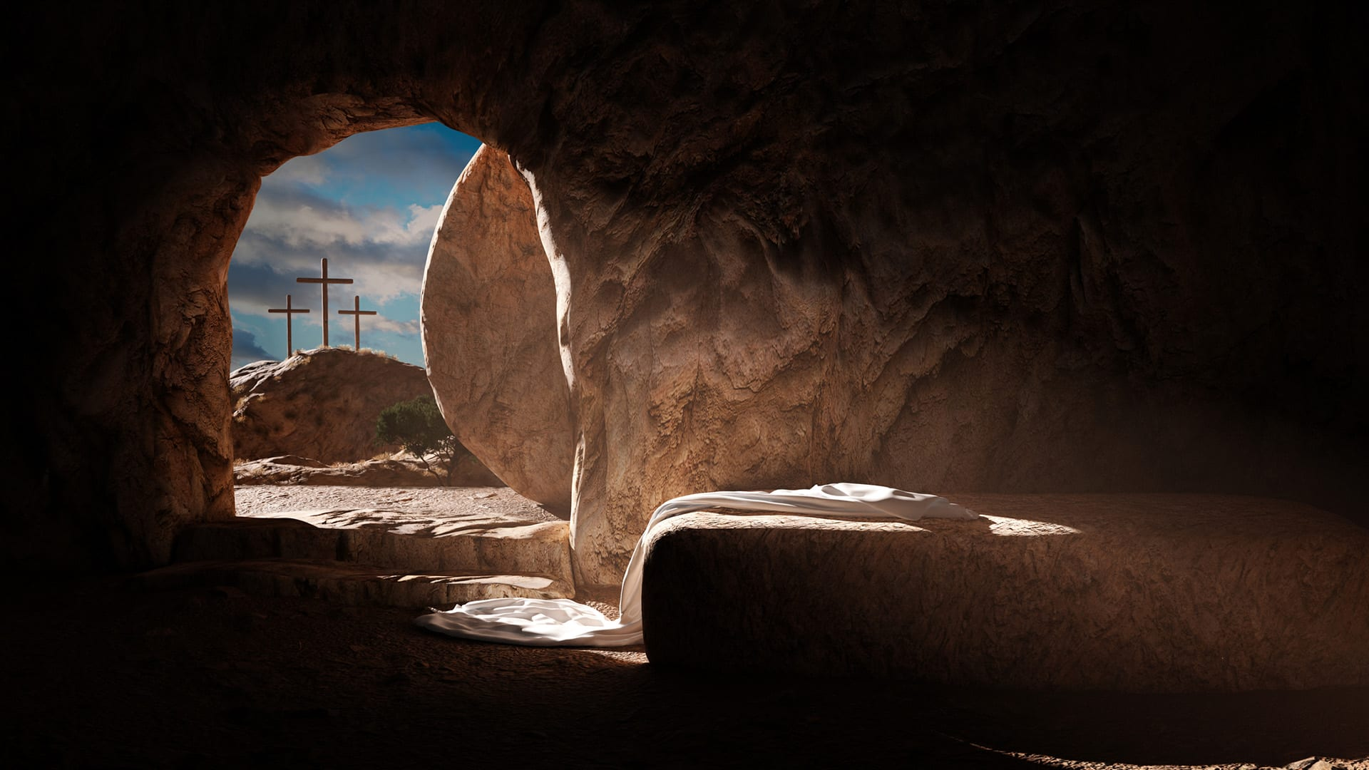
Why is Jesus’ Resurrection Important?

Slide 2
Why is Jesus’ Resurrection Important?

Slide 3
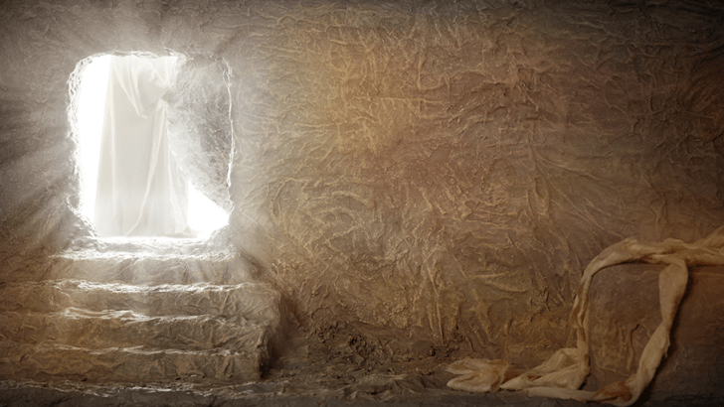
God the Father raised God the Son
Peter (Acts 2:24, 32; 3:15; 4:10; 10:40)
Paul (Acts 13:30-37; 17:31)

Slide 4
Jesus’ resurrection was God’s sign that his death was sufficient to appease His wrath on sin (propitiation)

Slide 5
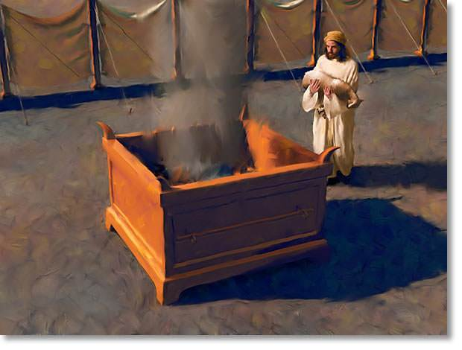
1 John 4:10
In this is love, not that we have loved God but that he loved us and sent his Son to be the propitiation for our sins.
Romans 4:25
“he who was delivered up for our trespasses and raised for our justification.”

Slide 6
Jesus’ resurrection was God’s sign that his death was sufficient to appease His wrath on sin (propitiation)
Jesus’ resurrection is proof that we are officially declared innocent of guilt before God (justification)

Slide 7
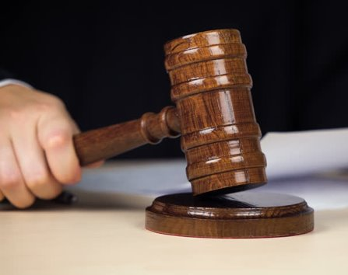
Romans 5:2
Therefore since we have been justified by faith, we have peace with God through our Lord Jesus Christ.

Slide 8
1 Corinthians 15:12-17
¹² Now if Christ is proclaimed as raised from the dead, how can some of you Say that there is no resurrection of the dead? ¹³ But if there is no resurrection of the dead, then not even Christ has been raised. ¹⁴ And if Christ has not been raised, then our preaching is in vain and your faith is in vain.

Slide 9
¹⁵ We are even found to be misrepresenting God, because we testified about God that he raised Christ, whom he did not raise if it is true that the dead are not raised. ¹⁶ For if the dead are not raised, not even Christ has been raised. ¹⁷ And if Christ has not been raised, your faith is futile and you are still in your sins.

Slide 10
Jesus’ resurrection was God’s sign that his death was sufficient to appease His wrath on sin (propitiation)
Jesus’ resurrection is proof that we are officially declared innocent of guilt before God (justification)
Jesus’ resurrection signals our freedom from sin and its consequences (redemption)

Slide 11
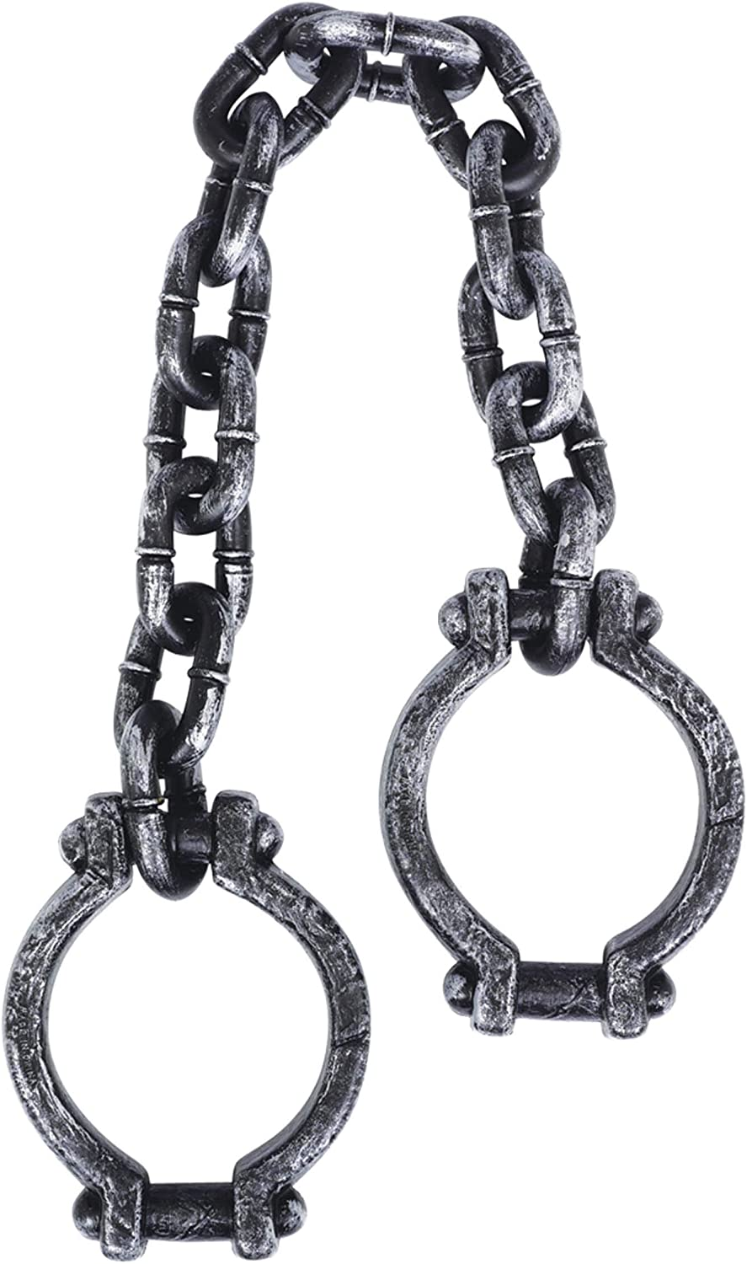
Mark 10:45
For even the Son of Man came not to be served but to serve, and to give his life as a ransom for many.”

Slide 12
1 Peter 1:18-19
¹⁸ knowing that you were ransomed from the futile ways inherited from your forefathers, not with perishable things such as silver or gold, ¹⁹ but with the precious blood of Christ, like that of a lamb without blemish or spot.

Slide 13
Revelation 5:9-10
⁹ And they sang a new song, saying,
“Worthy are you to take the scroll and to open its seals, for you were slain, and by your blood you ransomed people for God from every tribe and language and people and nation,¹⁰ and you have made them a kingdom and priests to our God, and they shall reign on the earth.”

Slide 14
1 Corinthians 6:18-20
¹⁸ Flee from sexual immorality. Every other sin a person commits is outside the body, but the sexually immoral person sins against his own body. ¹⁹ Or do you not know that your body is a temple of the Holy Spirit within you, whom you have from God? You are not your own, ²⁰ for you were bought with a price. So glorify God in your body.

Slide 15
Jesus’ resurrection was God’s sign that his death was sufficient to appease His wrath on sin (propitiation)
Jesus’ resurrection is proof that we are officially declared innocent of guilt before God (justification)
Jesus’ resurrection signals our freedom from sin and its consequences (redemption)
Jesus’ resurrection brings us into the family of God (adoption)

Slide 16
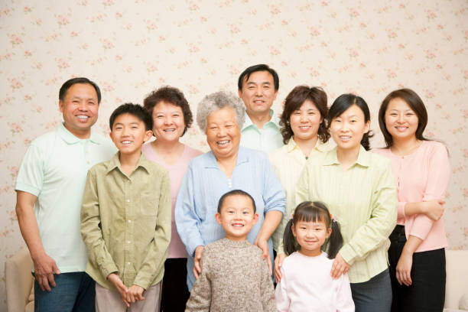
Romans 8:15-17
¹⁵ For you did not receive the spirit of slavery to fall back into fear, but you have received the Spirit of adoption as sons, by whom we cry, “Abba! Father!” ¹⁶ The Spirit himself bears witness with our spirit that we are children of God, ¹⁷ and if children, then heirs—heirs of God and fellow heirs with Christ, provided we suffer with him in order that we may also be glorified with him.

Slide 17
2 Corinthians 5:18-20
¹⁸ All this is from God, who through Christ reconciled us to himself and gave us the ministry of reconciliation; ¹⁹ that is, in Christ God was reconciling the world to himself, not counting their trespasses against them, and entrusting to us the message of reconciliation. ²⁰ Therefore, we are ambassadors for Christ, God making his appeal through us. We implore you on behalf of Christ, be reconciled to God.

