Slide 3
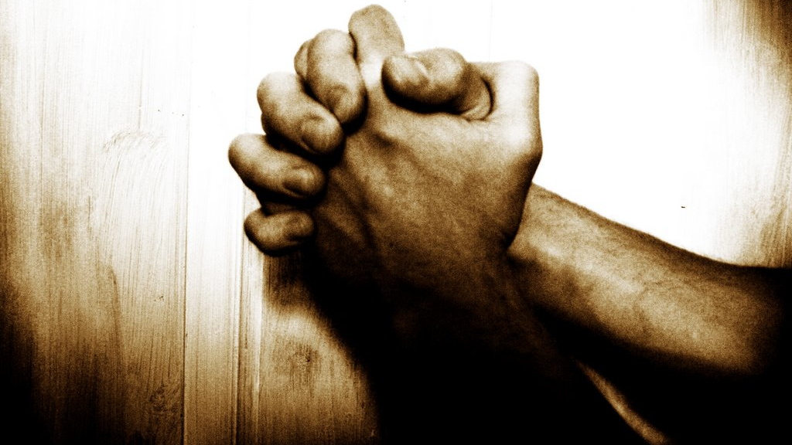
Daniel’s Plea:
The Prayer of Prophecy
Daniel 9

Slide 4
Begin prayer with God’s revelation (9:1-2)
Jeremiah 25:11-12
¹¹ This whole land shall become a ruin and a waste, and these nations shall serve the king of Babylon seventy years. ¹² Then after seventy years are completed, I will punish the king of Babylon and that nation, the land of the Chaldeans, for their iniquity, declares the Lord, making the land an everlasting waste.

Slide 5
Begin prayer with God’s revelation (9:1-2)
Jeremiah 29:10-14
¹⁰ “For thus says the Lord: When seventy years are completed for Babylon, I will visit you, and I will fulfill to you my promise and bring you back to this place. ¹¹ For I know the plans I have for you, declares the Lord, plans for welfare and not for evil, to give you a future and a hope. ¹² Then you will call upon me and come and pray to me, and I will hear you. ¹³ You will seek me and find me, when you seek me with all your heart. ¹⁴ I will be found by you, declares the Lord, and I will restore your fortunes and gather you from all the nations and all the places where I have driven you, declares the Lord, and I will bring you back to the place from which I sent you into exile.

Slide 6
Begin prayer with God’s revelation (9:1-2)
2 Chronicles 36:20-23
²⁰ He took into exile in Babylon those who had escaped from the sword, and they became servants to him and to his sons until the establishment of the kingdom of Persia, ²¹ to fulfill the word of the Lord by the mouth of Jeremiah, until the land had enjoyed its Sabbaths. All the days that it lay desolate it kept Sabbath, to fulfill seventy years.

Slide 7
Begin prayer with God’s revelation (9:1-2)
²² Now in the first year of Cyrus king of Persia, that the word of the Lord by the mouth of Jeremiah might be fulfilled, the Lord stirred up the spirit of Cyrus king of Persia, so that he made a proclamation throughout all his kingdom and also put it in writing: ²³ “Thus says Cyrus king of Persia, ‘The Lord, the God of heaven, has given me all the kingdoms of the earth, and he has charged me to build him a house at Jerusalem, which is in Judah. Whoever is among you of all his people, may the Lord his God be with him. Let him go up.’”

Slide 8
Begin prayer with God’s revelation (9:1-2)
Confess sin before God (9:3-14)
Confession of sin begins by declaring God’s holy character
great and awesome (4)
keeps covenant and steadfast love (4)
to Him belongs righteousness (7)
to Him belongs mercy and forgiveness (9)
God is righteous in all the works that he has done (14)

Slide 9
Begin prayer with God’s revelation (9:1-2)
Confess sin before God (9:3-14)
Confession of sin begins by declaring God’s holy character
Confession of sin includes verbal admission of guilt

Slide 10
“We find that the study of prophecy exercised the heart and the conscience of Daniel; he was not merely interested in it from an intellectual standpoint. The mere computing of times and seasons could not satisfy this devout man of God; but when he learned from his Bible that the time had almost drawn near for the people of Judah to be restored to their land, it stirred him to the very depths of his soul, and brought him down to his knees. . . . Daniel realized that when God is about to work, He begins by exercising His people that they may be restored in soul if they have wandered from Him; and thus blessing would result upon their being brought into the place of self-judgment and humiliation before Him.”
H. A. Ironside

Slide 11
Begin prayer with God’s revelation (9:1-2)
Confess sin before God (9:3-14)
Plea for His mercy concerning our sin (9:15-19)

Slide 12
listen to the prayer of your servant and to his pleas for mercy (17)
make your face to shine upon your sanctuary (17)
incline your ear and hear (18)
Open your eyes and see our desolations (18)
For we do not present our pleas before you because of our righteousness, but because of your great mercy (18)
O Lord, hear; O Lord, forgive. O Lord, pay attention and act (19)
Delay not, for your own sake, O my God, because your city and your people are called by your name (19)

Slide 13
“The thought is that Israel is in no position to mend the relationship and her only possible plea is the character of God.”
Joyce Baldwin

Slide 14
Begin prayer with God’s revelation (9:1-2)
Confess sin before God (9:3-14)
Plea for His mercy concerning our sin (9:15-19)
Receive hope in His answer to our prayer (9:20-27)

Slide 15
70 weeks = 70 sevens
70 weeks of years = 490 years
7 weeks = 49 years
62 weeks = 434 years
1 week = 7 years

Slide 16
70 weeks = 70 sevens
70 weeks of years = 490 years
7 weeks = 49 years
rebuild Jerusalem & temple
62 weeks = 434 years
coming of Christ at Triumphal entry & his death; Rome destroys temple
1 week = 7 years
antichrist makes covenant with Israel for 7 years & rebuilds temple; breaks treaty midway and terminates sacrifice with sacrilege)

