Slide 1
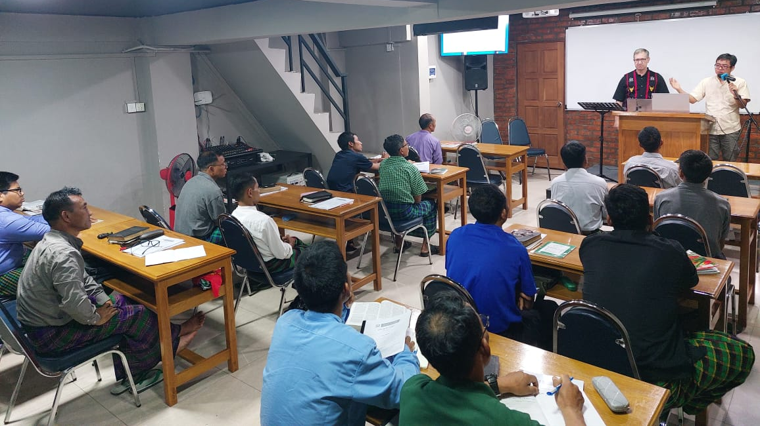

Slide 2
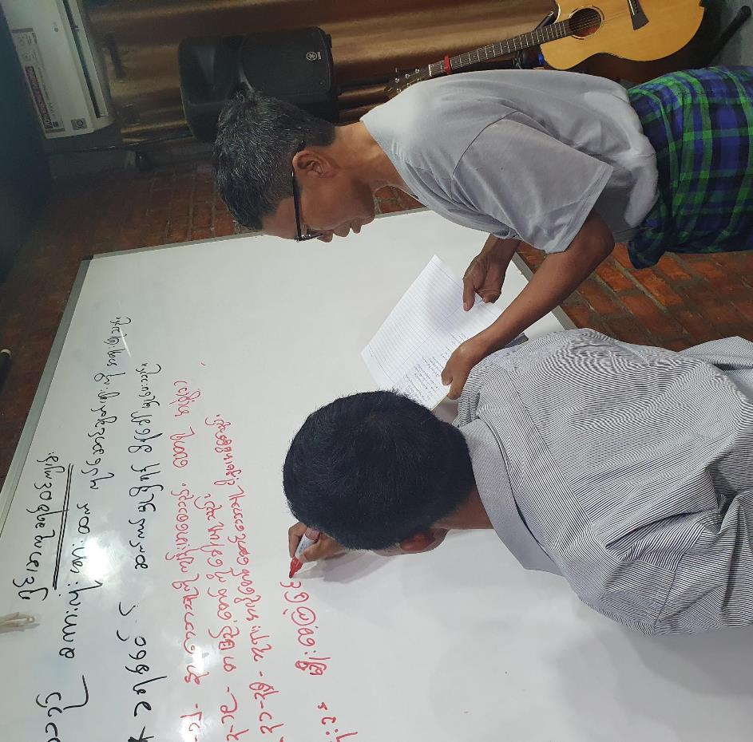
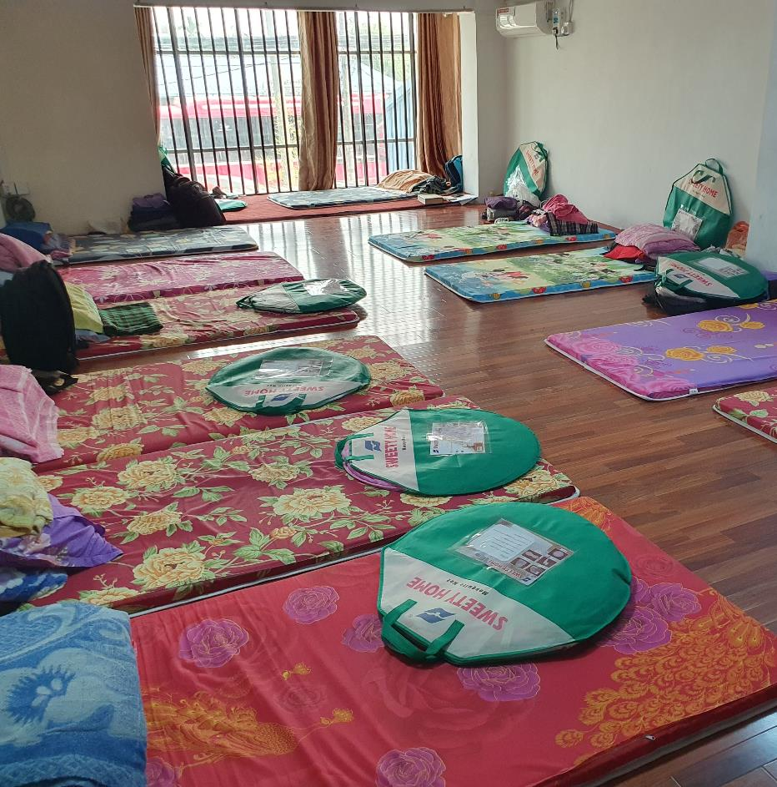

Slide 5
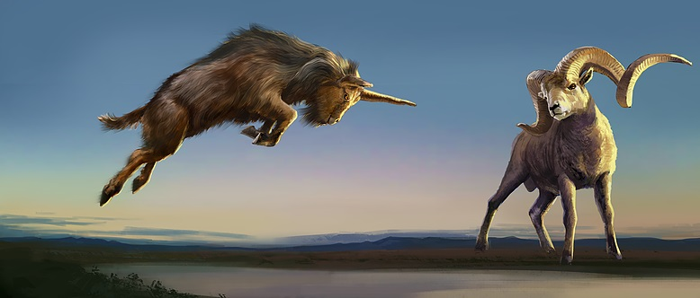
Daniel’s Second Vision: The Ram & Goat
Daniel 8

Slide 6
The Vision at Night (vs. 1-14)

Slide 7
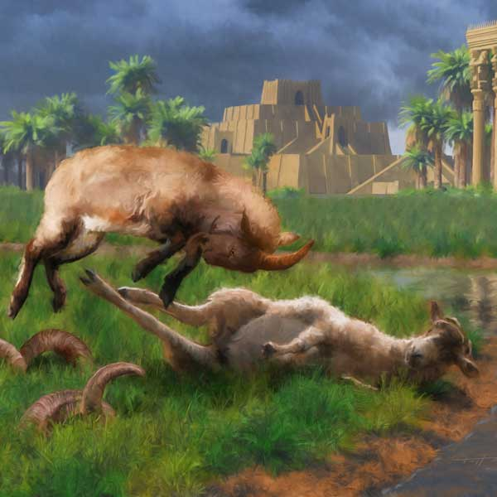
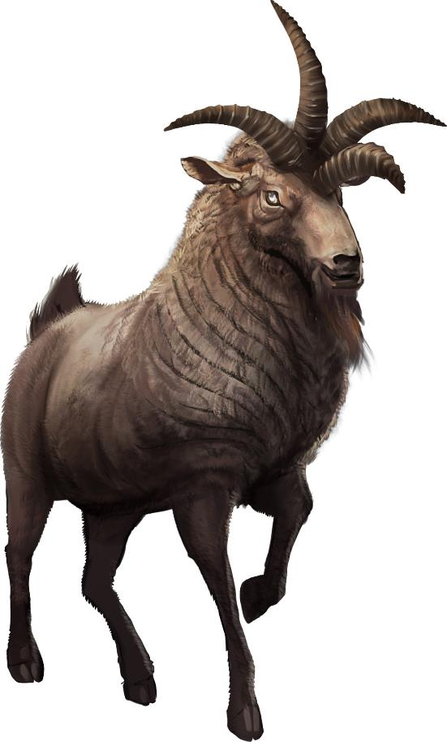

Slide 8
The Meaning of the Vision: The Power of the Little Horn (vs. 15-27)
big horn = Alexander the Great
2 horns = Kings of Media & Persia (larger horn)
Greece
Medo-Persia

Slide 9
4 horns = Alexander’s succeeding commanders: Seleucus (east), Cassander (west), Ptolomy (south), Lysimachus (north)
New little horn = Antiochus IV (“Epiphanes”)

Slide 10
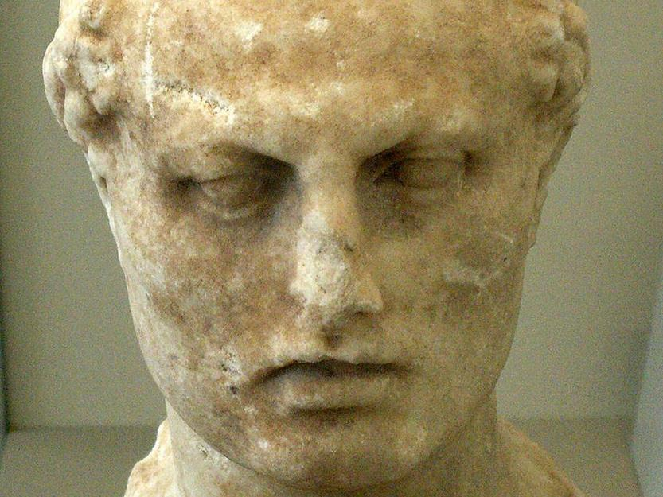
Host = Israel
Prince of the host = God
2,300 mornings & evenings = 6+ years
Judas “Maccabeus”
Parusim = separatists
Hanukkah

Slide 11
Matthew 24:15-16
¹⁵ “So when you see the abomination of desolation spoken of by the prophet Daniel, standing in the holy place (let the reader understand), ¹⁶ then let those who are in Judea flee to the mountains.

Slide 12
Culprit Action Outcome
Pharaoh of Egypt Destroy Israel Victory feast: Passover
Haman of Persia Destroy Israel Victory feast: Purim
Antiochus of Greece Destroy Israel Victory feast: Hanukkah
Antichrist Destroy Israel Wedding feast

