Slide 1
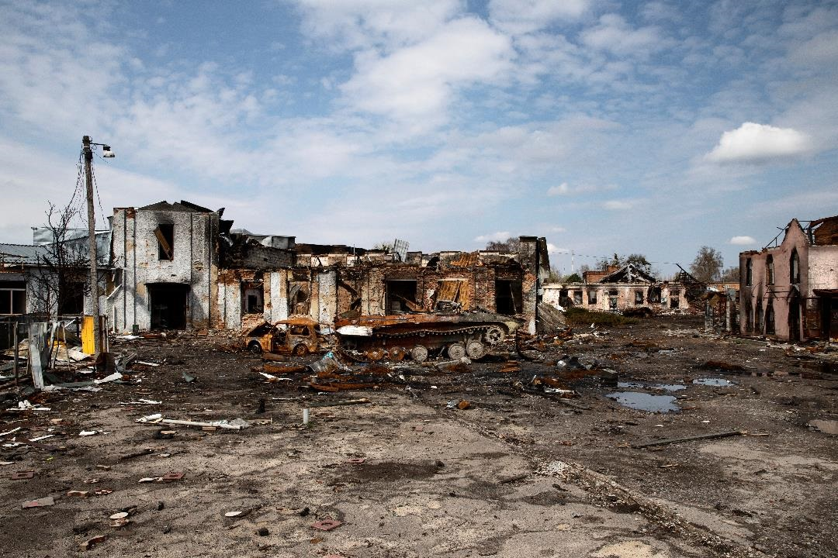
Notes:
Reading the news today can cause a lot of concern.
Stories about
the Russian invasion of Ukraine,
bank failures, market crashes,
companies laying off or retrenching workers,
All highlight the uncertainty we are facing every day.
Image by <a href="https://www.freepik.com/free-photo/demolished-building-russian-s-war-ukraine_32521612.htm#query=demolished-building-russian-s-war-ukraine&position=0&from_view=search&track=sph">Freepik</a>
Image by <a href="https://www.freepik.com/free-vector/hand-drawn-style-bankruptcy-concept_7611215.htm#query=bank%20failure&position=13&from_view=search&track=ais">Freepik</a>

Slide 2
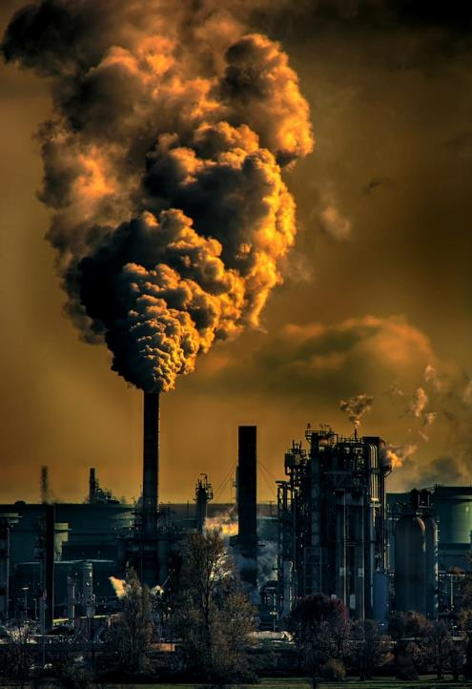
Notes:
Pile on top of that climate change,
aging populations and retirement issues
in almost every country around the world,
It is no wonder people are anxious about the future.
Photo by <a href="https://unsplash.com/@chrisleboutillier?utm_source=unsplash&utm_medium=referral&utm_content=creditCopyText">Chris LeBoutillier</a> on <a href="https://unsplash.com/photos/c7RWVGL8lPA?utm_source=unsplash&utm_medium=referral&utm_content=creditCopyText">Unsplash</a>
<a href="https://www.freepik.com/free-photo/elderly-patients-bed-asian-senior-woman-patients-headache-hands-forehead-medical-healthcare-concept_7813378.htm#query=aging%20problem&position=0&from_view=search&track=ais">Image by jcomp</a> on Freepik

Slide 3
Notes:
In fact, people can be anxious and uncertain about many things.
So the question becomes how do you go from uncertainty and anxiety to understanding and hope?
<a href="https://www.freepik.com/free-vector/anxiety-concept-illustration_21118463.htm#query=anxiety&position=1&from_view=search&track=sph">Image by storyset</a> on Freepik
Image by <a href="https://www.freepik.com/free-vector/hand-drawn-flat-design-overwhelmed-people-illustration_23669507.htm#query=anxious&position=6&from_view=search&track=sph">Freepik</a>

Slide 4
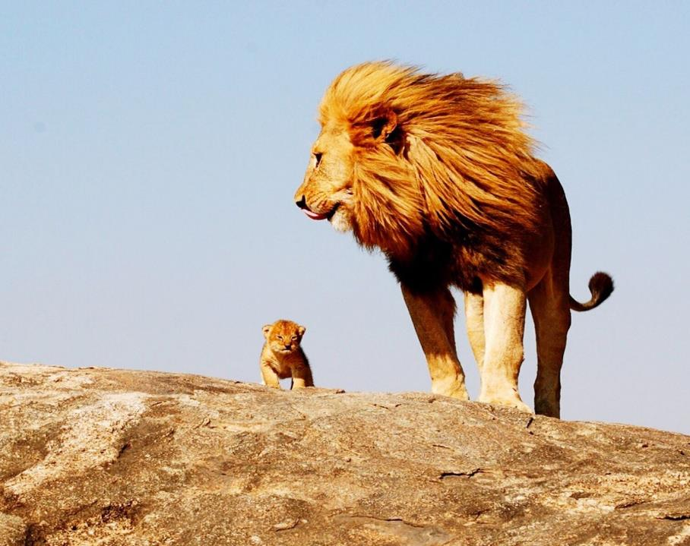
Daniel's Dream: Fantastic Beasts and What they Mean
Daniel Ch 7
Notes:
Today, we will be looking at Daniel chapter 7.
The title is Daniel’s dream: Fantastic Beasts and What they man.
And in this chapter, Daniel has a dream
The dream has four very strange beasts
And one of the strange beasts then exhibits some bizarre behavior.
We will also see that Daniel himself is anxious.
He is alarmed at what he saw in his dream.
He is uncertain about the future.
But Daniel is our hero. Why Daniel is troubled?
And how does that help us when we are facing certainty and experiencing anxiety

Slide 5
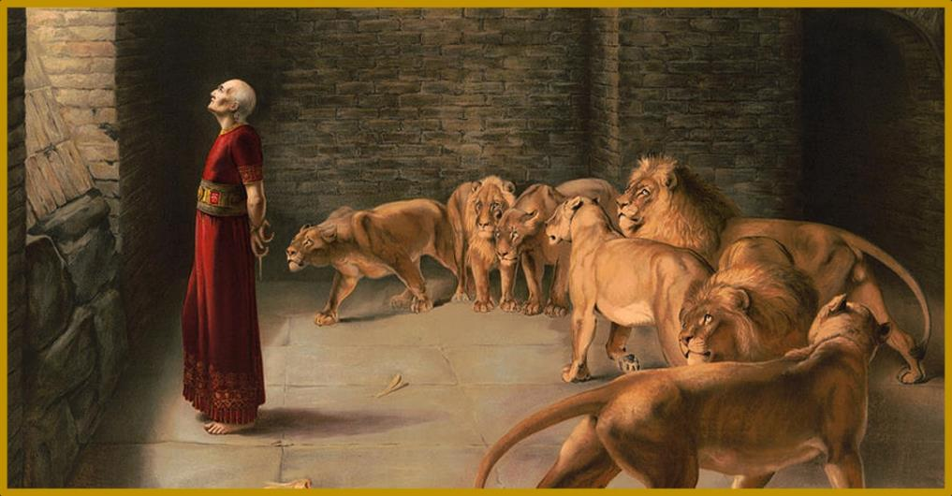
God has a Man – God has a Plan
Trusting in the Providence of God in the book of Daniel
Notes:
In order to answer that question, we must look at the entire book of Daniel.
That is what we have been doing in our series called God has a Man – God has a plan,
Trusting in the Providence of God in the book of Daniel
This entire book is about trusting in God’s sovereignty

Slide 6
God has a Man – God has a Plan
–
–
–
Daniel 1-6
Daniel 7-12
Daniel’s Life
Historical Narrative
Daniel’s Dreams
Apocalyptic
Trusting in the Providence of God in the book of Daniel
Notes:
Today we are at a turning point in the book of Daniel.
The first six chapters are about various events from Daniel’s life.
They are in the form of a narrative, where the author weaves together historical events that tell a story to show us that God is in control.
But there is a shift starting in Daniel chapter 7, which we are looking at today.
Chapters 7 through 12 are about Daniel’s dreams. They are in the form of apocalyptic writing.
Instead of a narrative of historical events, these chapters use vivid and complex symbolism and imagery to show us God’s sovereignty.
Of course, it is all tied together. Understanding the imagery of chapter 7 requires us to look back at the stories in chapters one thru six.

Slide 7
God has a Man – God has a Plan
Nebuchad-
~556 BC
Belshazzar
Jerusalem
Nezzar dies
becomes king
besieged
Babylon
605 BC
561 BC
539 BC
Falls
1:1 Nebuchadnezzar king of Babylon came to Jerusalem and besieged it
Trusting in the Providence of God
in the book of Daniel
Notes:
We know when the stories of chapters one thru six took place. We can show them on a timeline as they relate to historical events.
Historical events such as 605 BC . . .

Slide 8
God has a Man – God has a Plan
Nebuchad-
~556 BC
Belshazzar
Jerusalem
Nezzar dies
becomes king
besieged
Babylon
605 BC
561 BC
539 BC
Falls
Ch 1: Won’t Compromise, abstain from King’s food and drink
Trusting in the Providence of God
in the book of Daniel

Slide 9
God has a Man – God has a Plan
Nebuchad-
~556 BC
Belshazzar
Jerusalem
Nezzar dies
becomes king
besieged
Babylon
605 BC
561 BC
539 BC
Falls
2:1 In the second year of the reign of Nebuchadnezzar
Ch 1: Won’t Compromise, abstain from King’s food and drink
Trusting in the Providence of God
in the book of Daniel

Slide 10
God has a Man – God has a Plan
Nebuchad-
~556 BC
Belshazzar
Jerusalem
Nezzar dies
becomes king
besieged
Babylon
605 BC
561 BC
539 BC
Falls
Ch 2: Nebuchadnezzar’s Dream about future kingdoms
Ch 1: Won’t Compromise, abstain from King’s food and drink
Trusting in the Providence of God
in the book of Daniel

Slide 11
God has a Man – God has a Plan
Nebuchad-
~556 BC
Belshazzar
Jerusalem
Nezzar dies
becomes king
besieged
Babylon
605 BC
561 BC
539 BC
Falls
3:1 made an
image of gold
Ch 2: Nebuchadnezzar’s Dream about future kingdoms
Ch 1: Won’t Compromise, abstain from King’s food and drink
Trusting in the Providence of God
in the book of Daniel

Slide 12
God has a Man – God has a Plan
Nebuchad-
~556 BC
Belshazzar
Jerusalem
Nezzar dies
becomes king
besieged
Babylon
605 BC
561 BC
539 BC
Falls
Ch 3: Rescued from fiery Furnace
Friends Exalted
Ch 2: Nebuchadnezzar’s Dream about future kingdoms
Ch 1: Won’t Compromise, abstain from King’s food and drink
Trusting in the Providence of God
in the book of Daniel

Slide 13
Ch 4:5 “I (Nebuchadnezzar) saw a dream that made me afraid”
Nebuchad-
~556 BC
Belshazzar
Jerusalem
Nezzar dies
becomes king
besieged
Babylon
605 BC
561 BC
539 BC
Falls
Ch 3: Rescued from fiery Furnace
Friends Exalted
Ch 2: Nebuchadnezzar’s Dream about future kingdoms
Ch 1: Won’t Compromise, abstain from King’s food and drink
Trusting in the Providence of God
in the book of Daniel

Slide 14
Ch 4: King Nebuchadnezzar praises God and is restored
Nebuchad-
~556 BC
Belshazzar
Jerusalem
Nezzar dies
becomes king
besieged
Babylon
605 BC
561 BC
539 BC
Falls
Ch 3: Rescued from fiery Furnace
Friends Exalted
Ch 2: Nebuchadnezzar’s Dream about future kingdoms
Ch 1: Won’t Compromise, abstain from King’s food and drink
Trusting in the Providence of God
in the book of Daniel

Slide 15
Ch 4: King Nebuchadnezzar praises God and is restored
Nebuchad-
~556 BC
Belshazzar
Jerusalem
Nezzar dies
becomes king
besieged
Babylon
605 BC
561 BC
539 BC
Falls
Ch 3: Rescued from fiery Furnace
Friends Exalted
Ch 2: Nebuchadnezzar’s Dream about future kingdoms
7:1 In the first year of Belshazzar king of Babylon
Ch 1: Won’t Compromise, abstain from King’s food and drink
Trusting in the Providence of God
in the book of Daniel

Slide 16
Ch 4: King Nebuchadnezzar praises God and is restored
Nebuchad-
~556 BC
Belshazzar
Jerusalem
Nezzar dies
becomes king
besieged
Babylon
605 BC
561 BC
539 BC
Falls
Ch 3: Rescued from fiery Furnace
Friends Exalted
Ch 2: Nebuchadnezzar’s Dream about future kingdoms
Ch 7: Daniel’s dream about future Kingdoms
Ch 1: Won’t Compromise, abstain from King’s food and drink
Trusting in the Providence of God
in the book of Daniel

Slide 17
Ch 4: King Nebuchadnezzar praises God and is restored
5:30 Belshazzar the Chaldean king was killed
Nebuchad-
~556 BC
Belshazzar
Jerusalem
Nezzar dies
becomes king
besieged
Babylon
605 BC
561 BC
539 BC
Falls
Ch 3: Rescued from fiery Furnace
Friends Exalted
Ch 2: Nebuchadnezzar’s Dream about future kingdoms
7:1 In the first year of Belshazzar king of Babylon
Ch 1: Won’t Compromise, abstain from King’s food and drink
Trusting in the Providence of God
in the book of Daniel

Slide 18
Ch 4: King Nebuchadnezzar praises God and is restored
Ch 5: King Belshazzar mocks God and loses his kingdom
Nebuchad-
~556 BC
Belshazzar
Jerusalem
Nezzar dies
becomes king
besieged
Babylon
605 BC
561 BC
539 BC
Falls
Ch 3: Rescued from fiery Furnace
Friends Exalted
Ch 2: Nebuchadnezzar’s Dream about future kingdoms
7:1 In the first year of Belshazzar king of Babylon
Ch 1: Won’t Compromise, abstain from King’s food and drink
Trusting in the Providence of God
in the book of Daniel

Slide 19
Ch 4: King Nebuchadnezzar praises God and is restored
Ch 5: King Belshazzar mocks God and loses his kingdom
Nebuchad-
~556 BC
Belshazzar
Jerusalem
Nezzar dies
becomes king
besieged
Babylon
605 BC
561 BC
539 BC
Falls
Ch 3: Rescued from fiery Furnace
Friends Exalted
6:1 It pleased Darius to set over the kingdom 120 satraps
Ch 2: Nebuchadnezzar’s Dream about future kingdoms
7:1 In the first year of Belshazzar king of Babylon
Ch 1: Won’t Compromise, abstain from King’s food and drink
Trusting in the Providence of God
in the book of Daniel

Slide 20
Ch 4: King Nebuchadnezzar praises God and is restored
Ch 5: King Belshazzar mocks God and loses his kingdom
Nebuchad-
~556 BC
Belshazzar
Jerusalem
Nezzar dies
becomes king
besieged
Babylon
605 BC
561 BC
539 BC
Falls
Ch 3: Rescued from fiery Furnace
Friends Exalted
Ch 6: Rescued from Lions Den
Daniel Exalted
Ch 2: Nebuchadnezzar’s Dream about future kingdoms
7:1 In the first year of Belshazzar king of Babylon
Ch 1: Won’t Compromise, abstain from King’s food and drink
Trusting in the Providence of God
in the book of Daniel

Slide 21
Ch 4: King Nebuchadnezzar praises God and is restored
Ch 5: King Belshazzar mocks God and loses his kingdom
Nebuchad-
~556 BC
Belshazzar
Jerusalem
Nezzar dies
becomes king
besieged
Babylon
605 BC
561 BC
539 BC
Falls
Ch 3: Rescued from fiery Furnace
Friends Exalted
Ch 6: Rescued from Lions Den
Daniel Exalted
Ch 2: Nebuchadnezzar’s Dream about future kingdoms
7:1 In the first year of Belshazzar king of Babylon
Ch 1: Won’t Compromise, abstain from King’s food and drink
Trusting in the Providence of God
in the book of Daniel

Slide 22
Ch 4: King Nebuchadnezzar praises God and is restored
Ch 5: King Belshazzar mocks God and loses is kingdom
Nebuchad-
~556 BC
Belshazzar
Jerusalem
Nezzar dies
becomes king
besieged
Babylon
605 BC
561 BC
539 BC
Falls
Ch 3: Rescued from fiery Furnace
Friends Exalted
Ch 6: Rescued from Lions Den
Daniel Exalted
Ch 2: Nebuchadnezzar’s Dream about future kingdoms
7:1 In the first year of Belshazzar king of Babylon
Ch 1: Won’t Compromise, abstain from King’s food and drink
Trusting in the Providence of God
in the book of Daniel

Slide 23
Ch 4: King Nebuchadnezzar praises God and is restored
Ch 5: King Belshazzar mocks God and loses is kingdom
Nebuchad-
~556 BC
Belshazzar
Jerusalem
Nezzar dies
becomes king
besieged
Babylon
605 BC
561 BC
539 BC
Falls
Ch 3: Rescued from fiery Furnace
Friends Exalted
Ch 6: Rescued from Lions Den
Daniel Exalted
Ch 2: Nebuchadnezzar’s Dream about future kingdoms
Ch 7: Daniel’s dream about future Kingdoms
Ch 1: Won’t Compromise, abstain from King’s food and drink
Trusting in the Providence of God
in the book of Daniel
Notes:
In ch 2, King N. had a dream about future kingdoms.
In ch 7, Daniel also has a dream about future kingdoms.
There are other similarities you will notices as we read chapter 7
But there are also differences.
Nebuchadnezzar was initially anxious and troubled, but after hearing Daniel’s explanation, he felt so sure of himself that he built a giant golden statue. Nebuchadnezzar goes from uncertainty and anxiety to prideful ignorance instead of understanding and hope.
Daniel also has a dream. Daniel already understands the sovereignty of God and the hope of the restoration of God’s people. But Daniel is now anxious. Let's examine why.

Slide 24
Ch 7:1-14 Daniel’s Dream
1-7: 4 Beasts
8, 11-12: The Little Horn
9-10: Ancient of Days
13-14: Son of Man
www.freebibleimages.org
Notes:
Contributed by https://freebibleimages.org/illustrations/daniel-four-beasts/

Slide 25
Dan 7:1-7
www.freebibleimages.org
Notes:
Contributed by https://freebibleimages.org/illustrations/daniel-four-beasts/

Slide 26
1st | 2nd | 3rd | 4th
³² The head of this image was of fine gold, | its chest and arms of silver, | its middle and thighs of bronze, | ³³ its legs of iron, its feet partly of iron and partly of clay.
³⁸ . . . you are the head of gold. | ³⁹ Another kingdom inferior to you shall arise after you | and yet a third kingdom of bronze, which shall rule over all the earth. | 40-42 a fourth kingdom, strong as iron, because iron breaks to pieces . . .
Ch 2: Nebuchadnezzar’s Dream about future kingdoms
Ch 7: Daniel’s dream about future Kingdoms
Ch 7: Daniel’s dream about future Kingdoms

Slide 27
4th
³³ its legs of iron, its feet partly of iron and partly of clay.
⁴⁰ And there shall be a fourth kingdom, strong as iron, because iron breaks to pieces and shatters all things. And like iron that crushes, it shall break and crush all these. ⁴¹ And as you saw the feet and toes, partly of potter's clay and partly of iron, it shall be a divided kingdom, but some of the firmness of iron shall be in it, just as you saw iron mixed with the soft clay. ⁴² And as the toes of the feet were partly iron and partly clay, so the kingdom shall be partly strong and partly brittle.
Ch 2: Nebuchadnezzar’s Dream about future kingdoms
Ch 7: Daniel’s dream about future Kingdoms

Slide 28
1st | 2nd | 3rd | 4th
⁴ like a lion and had eagles' wings. | ⁵ like a bear. It had three ribs in its mouth | ⁶ like a leopard, with four wings of a bird on its back, | ⁷ a fourth beast, terrifying and dreadful
Babylonian Empire
Medo-Persian Empire
Greece
(Alexander the Great)
Part 1: Rome
Part 2: Future
Ch 2: Nebuchadnezzar’s Dream about future kingdoms
Ch 7: Daniel’s dream about future Kingdoms

Slide 29
Ch 7:1-14 Daniel’s Dream
1-7: 4 Beasts
8, 11-12: The Little Horn
9-10: Ancient of Days
13-14: Son of Man
www.freebibleimages.org
Notes:
Contributed by https://freebibleimages.org/illustrations/daniel-four-beasts/

Slide 30
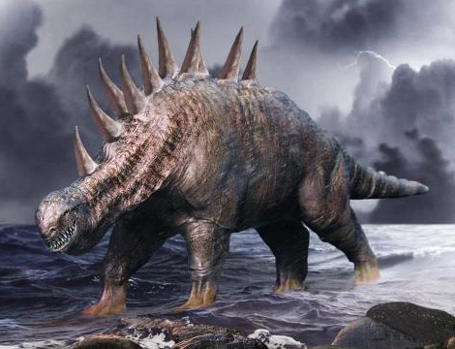
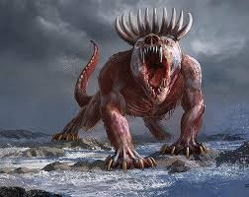
Dan 7:
⁸ I considered the horns, and behold, there came up among them another horn, a little one, before which three of the first horns were plucked up by the roots. And behold, in this horn were eyes like the eyes of a man, and a mouth speaking great things.
great / boastful / arrogant
Dan 2:
No mention of “little horn” equivalent

Slide 31
Ch 7:1-14 Daniel’s Dream
1-7: 4 Beasts
8, 11-12: The Little Horn
9-10: Ancient of Days
13-14: Son of Man
www.freebibleimages.org
Notes:
Contributed by https://freebibleimages.org/illustrations/daniel-four-beasts/

Slide 32
Dan 7 ⁹ “As I looked, thrones were placed,
and the Ancient of Days took his seat;
his clothing was white as snow,
and the hair of his head like pure wool;
his throne was fiery flames;
its wheels were burning fire.
Dan 7:9-10
Ancient of Days
www.freebibleimages.org

Slide 33
Rev 4 ² At once I was in the Spirit, and behold, a throne stood in heaven, with one seated on the throne.
. . . ⁴ Around the throne were twenty-four thrones, and seated on the thrones were twenty-four elders, clothed in white garments, with golden crowns on their heads
Dan 7:9-10
Ancient of Days
www.freebibleimages.org
Notes:
<a href="https://www.freepik.com/free-vector/bright-colorful-royal-armchairs-thrones-flat-pictures-collection_13682982.htm#query=throne%20top%20view&position=25&from_view=search&track=ais">Image by pch.vector</a> on Freepik

Slide 34
Dan 7
¹⁰ A stream of fire issued and came out from before him;
a thousand thousands served him,
and ten thousand times ten thousand stood before him;
the court sat in judgment,
and the books were opened.
Dan 7:9-10
Ancient of Days
www.freebibleimages.org

Slide 35
Isa 66 ¹⁵ For behold, the Lord will come in fire,
and his chariots like the whirlwind,
to render his anger in fury,
and his rebuke with flames of fire.
¹⁶ For by fire will the Lord enter into judgment,
Dan 7:9-10
Ancient of Days
www.freebibleimages.org

Slide 36
Ch 7:1-14 Daniel’s Dream
1-7: 4 Beasts
8, 11-12: The Little Horn
9-10: Ancient of Days
13-14: Son of Man
www.freebibleimages.org
Notes:
Contributed by https://freebibleimages.org/illustrations/daniel-four-beasts/

Slide 37
Dan 7:
¹¹ “I looked then because of the sound of the great words that the horn was speaking. And as I looked, the beast was killed, and its body destroyed and given over to be burned with fire. ¹² As for the rest of the beasts, their dominion was taken away, but their lives were prolonged for a season and a time.

Slide 38
Ch 7:1-14 Daniel’s Dream
1-7: 4 Beasts
8, 11-12: The Little Horn
9-10: Ancient of Days
13-14: Son of Man
www.freebibleimages.org
Notes:
Contributed by https://freebibleimages.org/illustrations/daniel-four-beasts/

Slide 39
Dan 7:13-14 One Like the Son of Man
¹³ “I saw in the night visions,
and behold, with the clouds of heaven there came one like a son of man, and he came to the Ancient of Days and was presented before him.
Notes:
Photo by https://unsplash.com/photos/PEm_sLmJT-w

Slide 40
Dan 7:13-14 One Like the Son of Man
Gen 3:15 I will put enmity . . . between your offspring and her offspring; he shall bruise your head and you shall bruise his heel.”
Gen 12:3 I will bless those who bless you, and him who dishonors you I will curse, and in you all the families of the earth shall be blessed.
2 Sam 7:12-13 I will raise up your offspring after you, who shall come from your body, and I will establish his kingdom. He shall build a house for my name, and I will establish the throne of his kingdom forever
Psalm 104:3 He lays the beams of his chambers on the waters;
he makes the clouds his chariot;
he rides on the wings of the wind;
Notes:
Photo by https://unsplash.com/photos/PEm_sLmJT-w

Slide 41
Dan 7:13-14 One Like the Son of Man
¹⁴ And to him was given dominion and glory and a kingdom, that all peoples, nations, and languages should serve him; his dominion is an everlasting dominion, which shall not pass away, and his kingdom one that shall not be destroyed.
Notes:
Photo by https://unsplash.com/photos/PEm_sLmJT-w

Slide 42
Dan 7:13-14 One Like the Son of Man
Matt 24:30 Then will appear in heaven the sign of the Son of Man, and then all the tribes of the earth will mourn, and they will see the Son of Man coming on the clouds of heaven with power and great glory.
Rev 1:7 Behold, he is coming with the clouds, and every eye will see him, even those who pierced him, and all tribes of the earth will wail on account of him. Even so. Amen.
Notes:
Photo by https://unsplash.com/photos/PEm_sLmJT-w

Slide 43
Everlasting Kingdom
³⁴ As you looked, a stone was cut out by no human hand, and it struck the image on its feet of iron and clay, and broke them in pieces. ³⁵ Then the iron, the clay, the bronze, the silver, and the gold, all together were broken in pieces, and became like the chaff of the summer threshing floors; and the wind carried them away, so that not a trace of them could be found. But the stone that struck the image became a great mountain and filled the whole earth.
⁴⁴ And in the days of those kings the God of heaven will set up a kingdom that shall never be destroyed, nor shall the kingdom be left to another people. It shall break in pieces all these kingdoms and bring them to an end, and it shall stand forever, ⁴⁵ just as you saw that a stone was cut from a mountain by no human hand, and that it broke in pieces the iron, the bronze, the clay, the silver, and the gold. A great God has made known to the king what shall be after this.
Ch 2: Nebuchadnezzar’s Dream about future kingdoms
Ch 7: Daniel’s dream about future Kingdoms

Slide 44
Daniel’s Dream
4 Beasts
The Little Horn
Ancient of Days
Son of Man
Human kingdoms, characterized by death and destruction, come and go. But above all the chaos, God will set up an everlasting Kingdom through the Messiah.
www.freebibleimages.org
Notes:
Contributed by https://freebibleimages.org/illustrations/daniel-four-beasts/

Slide 45
Daniel’s Anxiety
¹⁵ “As for me, Daniel, my spirit within me was anxious, and the visions of my head alarmed me.
Notes:
Image by <a href="https://www.freepik.com/free-vector/hand-drawn-flat-design-overwhelmed-people-illustration_23669507.htm#query=anxious&position=6&from_view=search&track=sph">Freepik</a>

Slide 46
¹⁶ I approached one of those who stood there and asked him the truth concerning all this. So he told me and made known to me the interpretation of the things.
¹⁷ ‘These four great beasts are four kings who shall arise out of the earth.
¹⁸ But the saints of the Most High shall receive the kingdom and possess the kingdom forever, forever and ever.’
Dan 7:16-18 A Simple Explanation

Slide 47
Daniel’s Dream
4 Beasts
The Little Horn
Ancient of Days
Son of Man
Explanation
¹⁷ ‘These four great beasts are four kings who shall arise out of the earth.
¹⁸ But the saints of the Most High shall receive the kingdom and possess the kingdom forever, forever and ever.’
?
?
Dan 7:16-18 A Simple Explanation
Notes:
Contributed by https://freebibleimages.org/illustrations/daniel-four-beasts/

Slide 48
Saints of the Most High
Covenantal Jews?
A holy person known for “heroic sanctity” and recognized by the church?
All NT Christians
Hosea 6:6 For I desire steadfast love and not sacrifice, the knowledge of God rather than burnt offerings.
(Matthew 9:9-12, 12:1-8)
Notes:
Image by <a href="https://www.freepik.com/free-vector/vintage-st-patricks-day-badge-collection_6516571.htm#query=saints&position=1&from_view=search&track=sph">Freepik</a>

Slide 49
¹⁹ “Then I desired to know the truth about the fourth beast, which was different from all the rest, exceedingly terrifying, with its teeth of iron and claws of bronze, and which devoured and broke in pieces and stamped what was left with its feet, ²⁰ and about the ten horns that were on its head, and the other horn that came up and before which three of them fell, the horn that had eyes and a mouth that spoke great things, and that seemed greater than its companions.
Dan 7:19-22
www.freebibleimages.org
Notes:
Contributed by https://freebibleimages.org/illustrations/daniel-four-beasts/

Slide 50
²¹ As I looked, this horn made war with the saints and prevailed over them, ²² until the Ancient of Days came, and judgment was given for the saints of the Most High, and the time came when the saints possessed the kingdom.
Dan 7:19-22
www.freebibleimages.org
Notes:
Contributed by https://freebibleimages.org/illustrations/daniel-four-beasts/

Slide 51
²³ “Thus he said: ‘As for the fourth beast,
there shall be a fourth kingdom on earth, which shall be different from all the kingdoms, and it shall devour the whole earth, and trample it down, and break it to pieces.
²⁴ As for the ten horns, out of this kingdom ten kings shall arise, and another shall arise after them; he shall be different from the former ones, and shall put down three kings.
Dan 7:23-27 A Detailed Explanation

Slide 52
²⁵ He shall speak words against the Most High, and shall wear out the saints of the Most High, and shall think to change the times and the law; and they shall be given into his hand for a time, times, and half a time.
Dan 7:23-27 A Detailed Explanation

Slide 53
Apocalyptic Time Telling
for a time, times, and half a time 3.5 years Dan 7:25,12:7
42 months 3.5 years Rev 11:2
Rev 11:2 and they will trample the holy city for forty-two months.
1290 days 43 months Dan 11:11
70 weeks 490 years Dan 9

Slide 54
²⁶ But the court shall sit in judgment, and his dominion shall be taken away, to be consumed and destroyed to the end. ²⁷ And the kingdom and the dominion and the greatness of the kingdoms under the whole heaven shall be given to the people of the saints of the Most High; his kingdom shall be an everlasting kingdom, and all dominions shall serve and obey him.’
Dan 7:23-27 A Detailed Explanation

Slide 55
Anxiety to Alarm
²⁸ “Here is the end of the matter.
As for me, Daniel,
my thoughts greatly alarmed me,
and my color changed,
but I kept the matter in my heart.”
Dan 7:28 A Detailed Explanation

Slide 56
From Man’s Point of View | From God’s Point of View
A statue of precious metals =>
Impressive and Great
Images of beastly animals =>
Vicious and Destructive
God is still in control
All earthly kingdoms destroyed and replaced by God’s everlasting Kingdom
Saints will suffer a period of intense persecution
Court will sit, Christ will reign, and Saints will rule with him
Ch 2: Nebuchadnezzar’s Dream about future kingdoms
Ch 7: Daniel’s dream about future Kingdoms

Slide 57
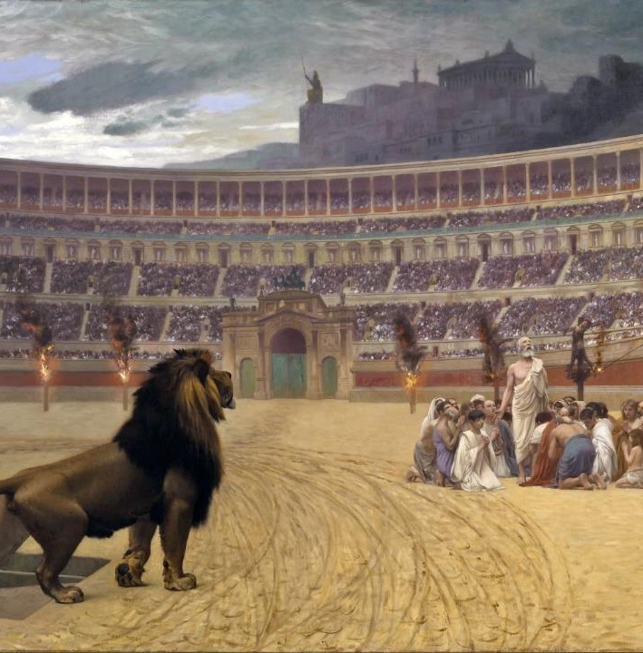
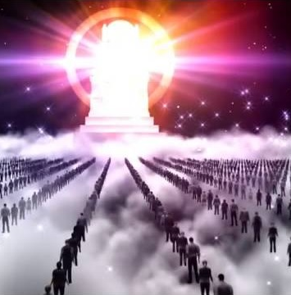
Persecution
Judgment
Notes:
The Christian Martyrs' Last Prayer, by Jean-Léon Gérôme (1883)
https://g3min.org/john-gill-the-great-white-throne-judgment/

Slide 58
Dan 7:25
. . . and the saints shall be given into his hand for a time, times, and half a time
Rev 20:11-15
¹¹ Then I saw a great white throne and him who was seated on it. . . . ¹² And I saw the dead, great and small, standing before the throne, and books were opened. Then another book was opened, which is the book of life. . . . ¹⁵ And if anyone's name was not found written in the book of life, he was thrown into the lake of fire.
2 Tim 3:12
all who desire to live a godly life in Christ Jesus will be persecuted,
Phil 1:29
For it has been granted to you that for the sake of Christ you should not only believe in him but also suffer for his sake,
Persecution
Judgment

Slide 59
Saint of the Most High
Acknowledge “God is the God of gods and Lord of kings, and a revealer of mysteries” (Dan 2:47).
Worship and serve no other God (Dan 3:28).
Tell others what he has done for you (Dan 4:2).

Slide 60
When Facing Persecution
Seek counseling and fellowship with other believers (Dan 2:17)
Seek God’s will from his word (Dan 9:2)
Seek God’s comfort through prayer (Dan 6:2)

Slide 61
Overcome uncertainty and anxiety for today by acknowledging God’s sovereignty and understanding his kingdom is everlasting.

