Slide 2
God has a Man – God has a Plan.
The Book of Daniel So far….
Daniel 1 – I Won’t Compromise A Little
Daniel 2 – God is in Control of the Future
Daniel 3 – I Stand on God’s Word
Daniel 4 – Learning the Truth About the Most
High God
Daniel 5 – Walk Humbly Before God

Slide 3
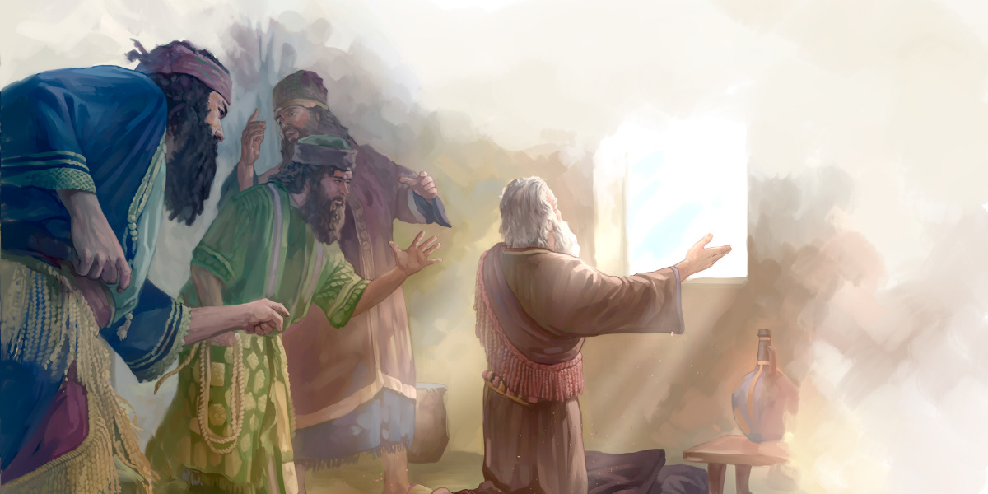
Daniel 6 – Trust in a Den of Despair.

Slide 4
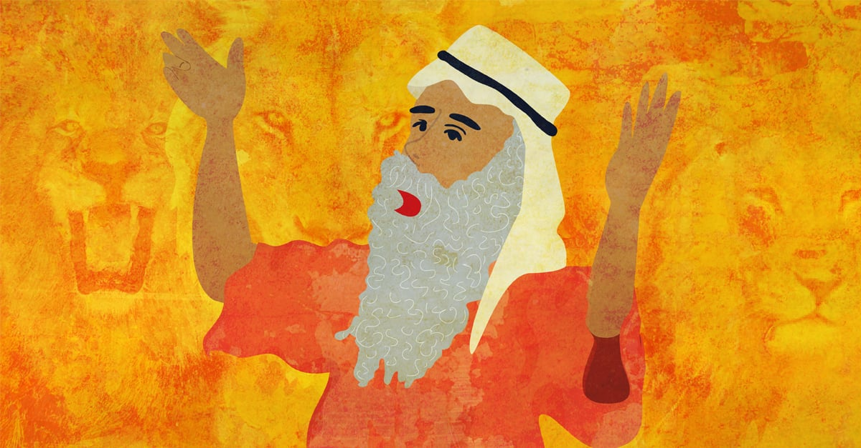
God has a Man – God has a Plan.
Part 1: Dan 6:1-5 – The Setting
Vs 1 – Darius the Mede is real!
Vs 1-2 – Daniel appointed to leadership.
Vs 3 – “an excellent spirit was in (Daniel)”
Vs 4 – Others were jealous but Daniel was faultless.
We are likewise to live as blameless before the world.

Slide 6
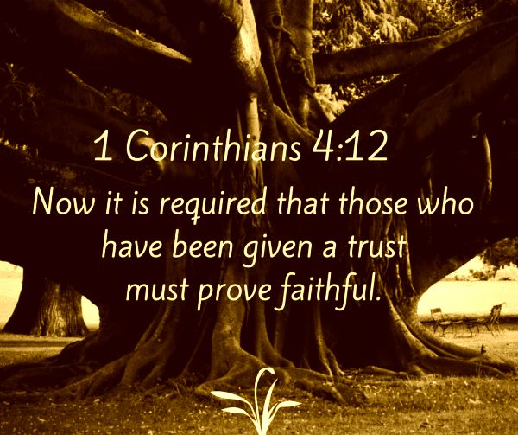

Slide 7
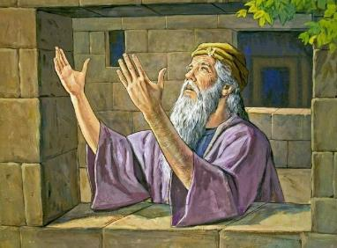
God has a Man – God has a Plan.
Part 2: Dan 6:6-15 – The Trap
Vs 6 – High officials and satraps joined
together against Daniel
Vs 10 – “When Daniel knew….he got down on his knees.... and prayed.”

Slide 8
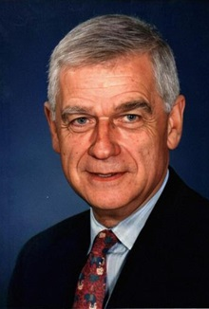
Senator Mark Hatfield, US politician
"A daily relationship with God in prayer helps us not to confuse our will with His will. Any person in public life who think he can "go it alone" is tragically mistaken. No one has enough love, enough concern, enough humility, enough strength, enough courage. In an individual's friendship with God there come each day the humility of having fallen short, the joy of being forgiven, and the strength of being renewed.

Slide 9
God has a Man – God has a Plan.
Part 2: Dan 6:6-15 – The Trap
Vs 6 – High officials and satraps joined
together against Daniel.
Vs 10 – “When Daniel knew….he prayed.”
- ”windows opened towards Jerusalem (see 1 Kings 8:46-52).
- ”…gave thanks before his God, as he had done so previously.” (see Phil 4:6).

Slide 10
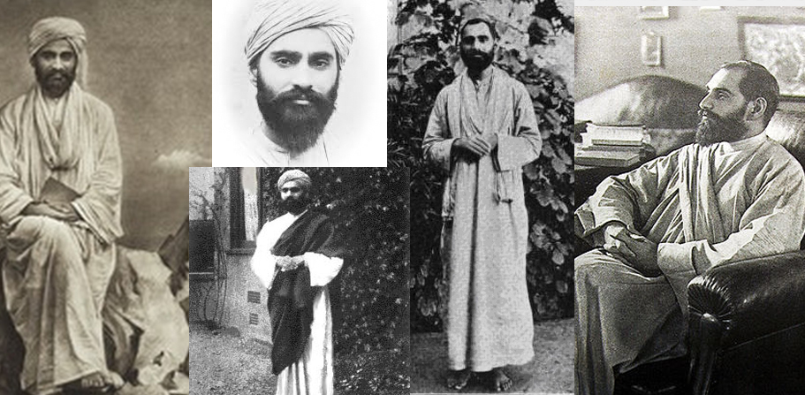
Sadhu Sundar Singh

Slide 11
God has a Man – God has a Plan.
Part 2: Dan 6:6-15 – The Trap
Vs 11 – “Making petition and plea before
his God.”
Vs 13 – Daniel is accused as a foreigner.
Vs 14 – Irony of the king not being able to save Daniel. Only God can.

Slide 12
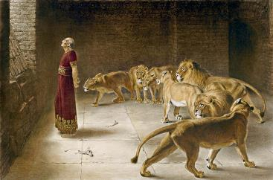
God has a Man – God has a Plan.
Part 3: Dan 6:16-18 – The Den
Vs 16 – King tells Daniel that he hopes
his God, whom he serves continually,
will deliver him.
Vs 17 – Stone laid across the den and sealed. Daniel was assumed to be as good as dead.

Slide 13
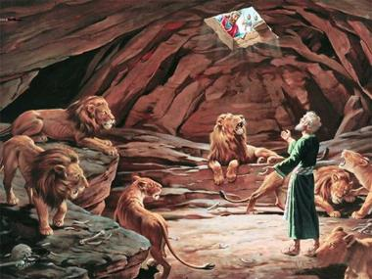
God has a Man – God has a Plan.
Part 4: Dan 6:19-24 – The Deliverance
Vs 19 – At break of day, king rushes to see
if Daniel survived.
Vs 22 – “My God sent his angel and shut the lions’ mouth.”
Vs 23 – Daniel was not harmed ”because he trusted in his God.”

Slide 15
God has a Man – God has a Plan.
Take-aways
Develop Holy Habits for the day of trouble

Slide 16
God has a Man – God has a Plan.
Take-aways
Develop Holy Habits for the day of trouble
Make Prayer your first response to every trial and trouble.
Trust God even when things go south!

