Slide 2
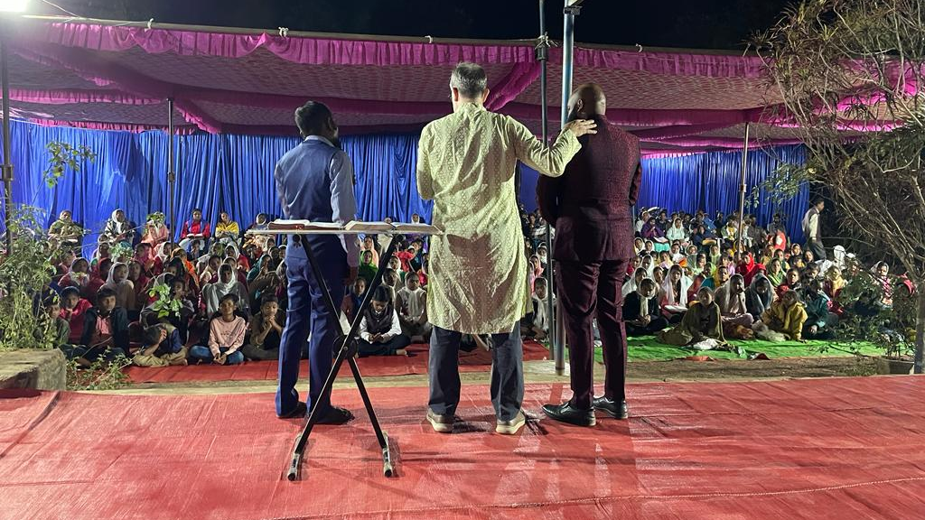

Slide 4
Daniel’s Message:
Walk Humbly Before God
Daniel 5

Slide 5
Babylonian Rulers
Nebuchadnezzar = 43 years
Evil-Merodach (2 Kgs 25:27-30; Jer 52:31-34) = 2 years
Amel-marduk = murdered
Nergal-sar-ezer (Jer 39:3,13) = 4 years
Labashi-marduk = 1 year
Nabonidus = 17 years
Belshazzar

Slide 6
The Crisis: Pride Leads to Destruction (5:1-12)
Pride blinds you to reality
Pride reveals cowardice

Slide 7
The Crisis: Pride Leads to Destruction (5:1-12)
The Resolve: Do Not Challenge God by Neglecting Him or Defying Him (5:13-31)
Conviction of sin
Consequences of sin

Slide 8
= something numbered
= something weighed
= something broken & splitting apart

Slide 9
If God did not spare Israel when their kings defied Him, the rulers of other nations will not stand either when they fail to bow down to him. The true God of Israel, in contrast to other gods, is not limited to the boundaries of the nations that worship them. He moves into the territories of the worldly powers and reduces their monarchs to fearful and cowering men. He enters their dreams, overcomes their fires, removes their reason, and crashes their parties.

