Slide 1

Notes:
The Stuttgart Library in Germany
welcomes almost 2 million visitors each year.
It was completed in 2011
and in 2013, it received the national award as Library of the Year
With its simple cube shape,
open floor plan,
and carefully arranged books,
it represents ORDER.

Slide 2
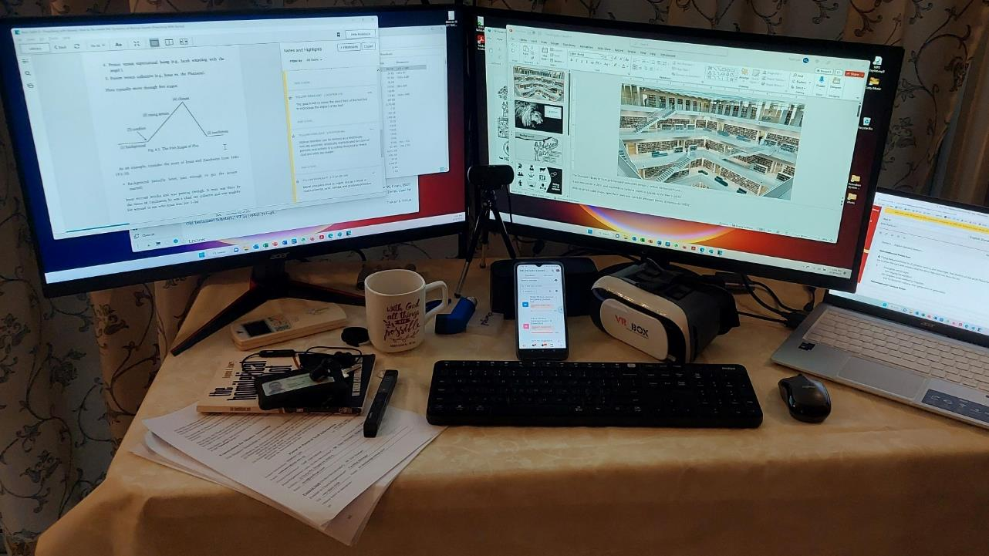
Notes:
Order is often missing in our lives.
If you were to look at my desk while I was preparing this message,
you would have seen CHAOS, not ORDER.

Slide 3
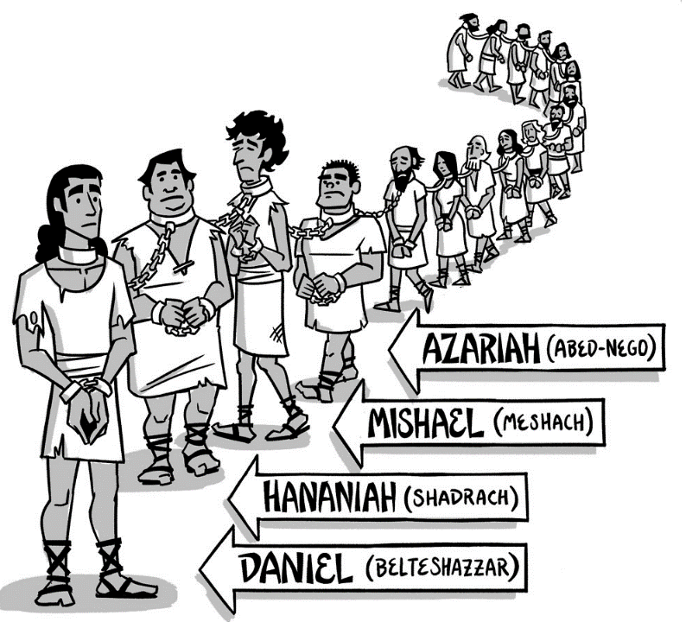
Background
Notes:
In the book of Daniel, the lives of the Jewish exiles
could also be characterized as chaos.
Taken from their land by a foreign king,
marched over 1,000 kilometers to a new home,
their bodies were mutilated,
and they were forced to defile themselves
with the local food and drink.
Yet, in the midst of this chaos,
four young men stand out as righteous heroes
Daniel, Hananiah, Mishael, and Azariah
face various trials and tribulations
but “emerge victorious in every conflict”
---------------
“Legend” in Holm, T. L. (2000). In D. N. Freedman, A. C. Myers, & A. B. Beck (Eds.), Eerdmans dictionary of the Bible (p. 799). W.B. Eerdmans.

Slide 4
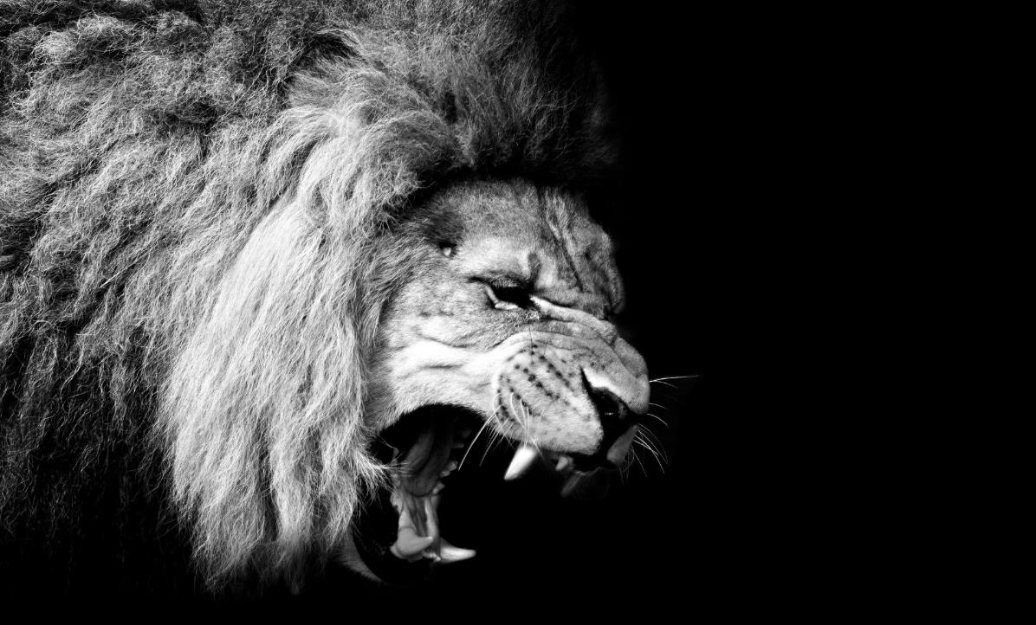
LEGEND
A Biblical narrative whose plot explores the virtue of the righteous hero from all angles in order to present various examples for emulation.
Notes:
In fact, that is how Erdman’s Dictionary of the Bible
defines the genre of Legend
A Biblical narrative whose
“plot explores the virtue of the righteous hero from all angles
in order to present various examples for emulation.
Additionally, the entry goes on to state
that chapters one through six in Daniel are considered “legend”
This is because Daniel and his pious friends
predictably emerge victorious in every conflict or contest
in the courts of foreign kings
---------------
“Legend” in Holm, T. L. (2000). In D. N. Freedman, A. C. Myers, & A. B. Beck (Eds.), Eerdmans dictionary of the Bible (p. 799). W.B. Eerdmans.

Slide 5
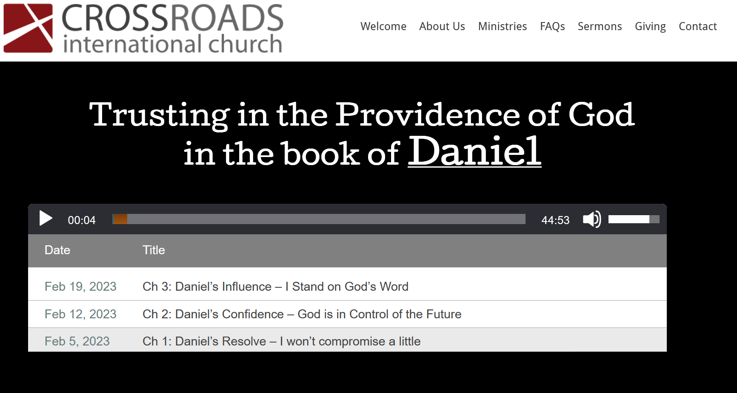
www.cicfamily.com
Notes:
As you know, our church has been preaching through the book of Daniel
in a series called
“trusting in the providence of God in the book of Daniel.
You can easily see this legend motif in the titles of the sermons
Ch 1: Daniel’s Resolve –
Daniel and his friends wouldn’t compromise their diet
but ended up looking healthier than their compatriots.
Ch 2: Daniel’s Confidence –
God used Nebuchadnezzar’s dream to show that God himself is in control of the future
Ch 3: Daniel’s Influence – Daniel’s friends stand firm in God’s word,
whether God rescued them from the fire
or walked with them in the fire

Slide 6
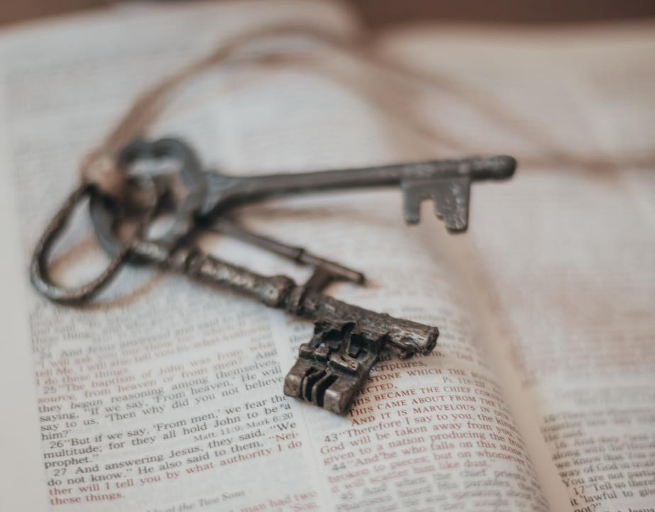
legend ≠ untrue
Daniel 1 – 6
=>more than legend
Notes:
Today we will be looking at Daniel chapter 4.
But before we start into Daniel chapter 4,
let me highlight two key points about this genre of legend
First, the modern definition of legend would be an “untrue or exaggerated story.”
But when it comes to the genre of legend in the bible or other writings,
it doesn’t presume either historical accuracy or inaccuracy.
instead, legend takes place in a real human time frame,
the recent past,
and is believed to be historical by those who transmit it.
Second, even though Daniel chapters one through six
are given as examples of the legend genre,
there are elements to these stories that you might overlook
if your focus is only on the heroes.
---------------
Holm, T. L. (2000). Legend. In D. N. Freedman, A. C. Myers, & A. B. Beck (Eds.), Eerdmans dictionary of the Bible (p. 799). W.B. Eerdmans.

Slide 7
Nebuchadnezzar II
King of
Babylon
Daniel 4:1-3
Notes:
Please follow along in your Bibles or on your apps
as I read from Daniel chapter 4,
I’ll be reading from the ESV, but please follow along
in whatever translation you are most comfortable with.
Starting with verse 1:
¹ King Nebuchadnezzar
to all peoples, nations, and languages, that dwell in all the earth:
Peace be multiplied to you!
² It has seemed good to me
to show the signs and wonders that the Most High God has done for me.
³ How great are his signs,
how mighty his wonders!
His kingdom is an everlasting kingdom,
and his dominion endures from generation to generation.
The first thing you will notice is that this chapter is a letter
or proclamation from King Nebuchadnezzar
You might question,
why is a decree of a pagan king included in the Bible.

Slide 8

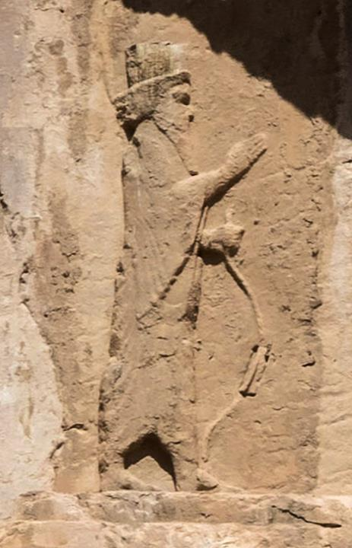
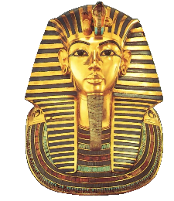
            Pharaoh
Ezra 7:11
¹¹ This is a copy of the letter that King Artaxerxes gave to Ezra the priest, the scribe, a man learned in matters of the commandments of the Lord and his statutes for Israel:
      Artaxerxes
Notes:
But then you recall that many of Pharoah's words
are also recorded in the Bible.
Moses asked “let my people go”
And Pharaoh responded “no!”
While it is just some of Pharaoh's words
that are captured in the Exodus account,
(ANIMATION)
Ezra chapter 7, includes in its entirety,
“a copy of the letter that King Artaxerxes
gave to Ezra the priest, the scribe, . . .
So, there is a precedent for having an edict of a foreign king in the Bible.

Slide 9
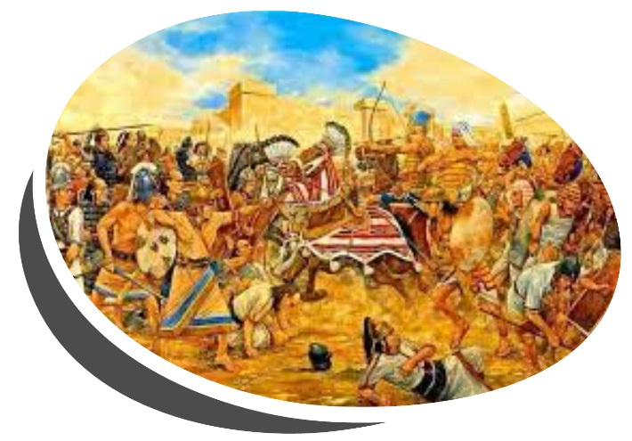
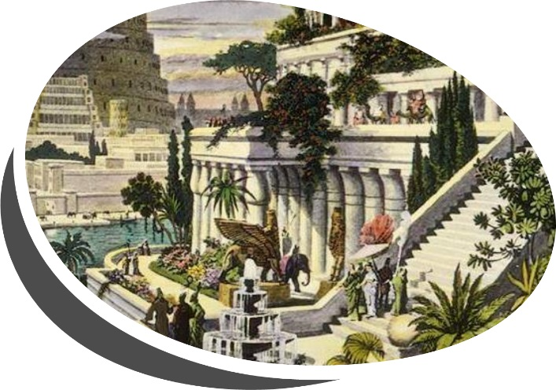
Nebuchadnezzar’s accomplishments
Notes:
King Nebuchadnezzar wasn’t just any foreign King,
he is regarded as the greatest king of the Neo-Babylonian empire
There are two things that he is well known for.
First are his military conquests.
The most prominent was his victory at the Battle of Carchemish,
where he defeated the Egyptians in 605 BC.
Second, are his grand construction projects
which include the hanging gardens of Babylon,
one of the ancient wonders of the world.

Slide 10
ORDER
Notes:
He ruled as King for forty-three years.
You might say Nebuchadnezzar represented ORDER.
Nebuchadnezzar’s worldview would have been shaped
by his successful military conquests and his massive building projects
His military conquests demonstrated
that his gods were more powerful than his opponents.
His building projects were a visible reminder of the ORDER he brought.

Slide 11
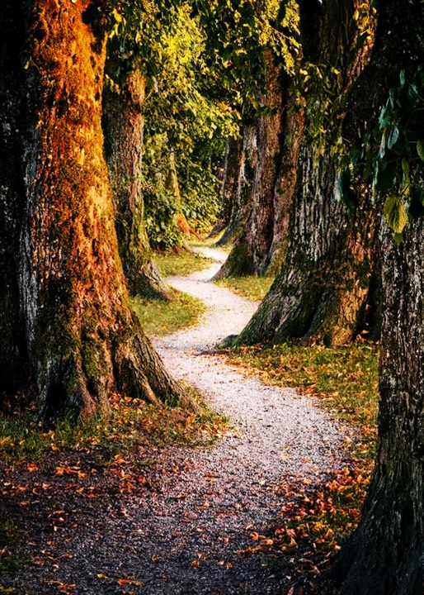
Nebuchadnezzar’s Journey
Daniel Ch 4
Notes:
So, as we look at Daniel chapter four today,
The first thing we notice is that this is not
just another hero or legend story
This is a story about King Nebuchadnezzar.
That is why this sermon is called Nebuchadnezzar’s Journey.
But King Nebuchadnezzar’s journey didn’t start in chapter four.
Instead, chapter four is the culmination of his story.
Chapter four is the season finale of a four-part drama.
that tells the story of King Nebuchadnezzar's journey
to learn the truth about the most high God

Slide 12

Daniel Ch 1: Standing before the King
²⁰ And in every matter of wisdom and understanding about which the king inquired of them, he found them ten times better than all the magicians and enchanters that were in all his kingdom.
Notes:
Growing and training a bonsai tree is a slow gradual process.
King Nebuchadnezzar's journey was also
a gradual process of realization and transformation.
Daniel Chapter 1 begins with Nebuchadnezzar
conquering Judah and pillaging the temple,
but ends with Daniel and his friends
being questioned while standing before the King
What does Nebuchadnezzar learn?
Daniel chapter 1 verse 20 tells us that
“in every matter of wisdom and understanding
about which the king inquired of them,
he found them ten times better than all the magicians and enchanters
that were in all his kingdom.
This incident planted a seed
that would challenge his orderly worldview
Because the vanquished foe
is shown to have superior knowledge

Slide 13

Daniel Ch 2: Interpreting a Dream
²⁷ “No wise men, enchanters, magicians, or astrologers can show to the king the mystery that the king has asked, ²⁸ but there is a God in heaven who reveals mysteries, and he has made known to King Nebuchadnezzar what will be in the latter days.
Notes:
In Daniel chapter 2, Nebuchadnezzar had a dream that troubled him.
He called upon his magicians and wise men to interpret it,
But he didn’t tell them the dream,
They responded that no one could tell him the dream’s meaning
without being given its contents.
But then Daniel came
He was able to tell the King about his dream.
And he was also able to reveal its meaning
But Daniel didn’t take credit.
Starting in Daniel chapter 2 verse 27, he explained to the King that,
No wise men, enchanters, magicians, or astrologers
“can show to the king the mystery that the king has asked,
28 but there is a God in heaven who reveals mysteries,
and he has made known to King Nebuchadnezzar
what will be in the latter days.
This event opened Nebuchadnezzar's mind to the possibility
that the God of the Jews was more powerful and wise
than any of his own gods.

Slide 14

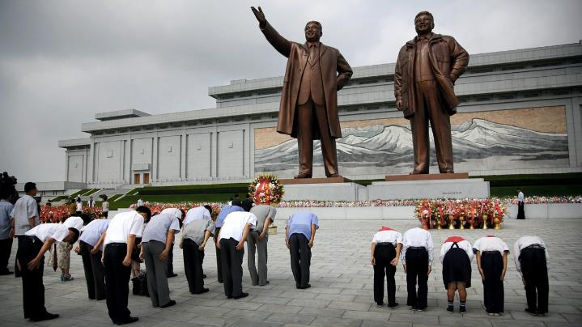
Daniel Ch 3: The Fiery Furnace
²⁸ “Blessed be the God of Shadrach, Meshach, and Abednego, . . . ²⁹ for there is no other god who is able to rescue in this way.
Notes:
In Daniel chapter 3, we see that Nebuchadnezzar
seems to forget what he previously learned
Another explanation would be that he got the wrong application.
Matthew Kim writes that
“ More heresy is preached in application than in Bible exegesis . . . .
Although Nebuchadnezzar was told that God had given him a Kingdom
that will be superior to all the kingdoms that follow
What he heard was (ANIMATION)
I am so great
All must bow down and worship this giant statue of me.
But three heroes refuse to bow
they are thrown into a fiery furnace
they survive
This further demonstrated to Nebuchadnezzar
the power of the God of the Jews
Listen to how he responded starting in Daniel chapter 3 verse 28
²⁸ “Blessed be the God of Shadrach, Meshach, and Abednego,
who has sent his angel and delivered his servants,
. . . He goes on and finally concludes by acknowledging:
“for there is no other god who is able to rescue in this way.”
--------
Matthew D. Kim, Preaching with Cultural Intelligence: Understanding the People Who Hear Our Sermons, Ebook ed. (Grand Rapids, MI: Baker Academic, 2017) 26.

Slide 15
Notes:
Unfortunately, as we continue reading chapter 4,
we will see that Nebuchadnezzar still hasn’t quite put it all together yet.
He still comes out with the wrong answer.
So how does Nebuchadnezzar finally get rescued?

Slide 16

Another Dream
Daniel 4:4-7
Notes:
It all started with another dream
Listen to what he says starting in verse 4
⁴ I, Nebuchadnezzar, was at ease in my house
and prospering in my palace.
⁵ I saw a dream that made me afraid.
As I lay in bed the fancies and the visions of my head alarmed me.
⁶ So I made a decree that all the wise men of Babylon
should be brought before me,
that they might make known to me the interpretation of the dream.
Historians say this takes place many years after the first dream,
but the magicians and wise men probably remember
that in the first dream
Nebuchadnezzar didn’t even tell them the contents of the dream,
And then threatened to kill all of them when they couldn’t interpret it.
But this time is different. As we see in verse 7
⁷ Then the magicians, the enchanters,
the Chaldeans, and the astrologers came in,
and I told them the dream,
I can imagine everyone breathing a sigh of relief.
At least he told them the dream.
But then we read,
“but they could not make known to me its interpretation.”

Slide 17
Another Dream
Daniel 4:4-7
Interpreting Dreams
Notes:
You have to admit
that interpreting the dreams found in stories in the Bible
can be extremely difficult
This is partly because of all the rich imagery.
And of course, they are messages from God,
And often, people don’t want to hear what God is telling them.
Think about Joseph and the seven cows.
Or even Nebucadnezzar’s first dream
about a giant statue made of mismatched parts
that get destroyed by a giant rock
The difficulty in interpreting dreams is why Daniel gives God the credit
as the one who ultimately reveals what the dream means.

Slide 18
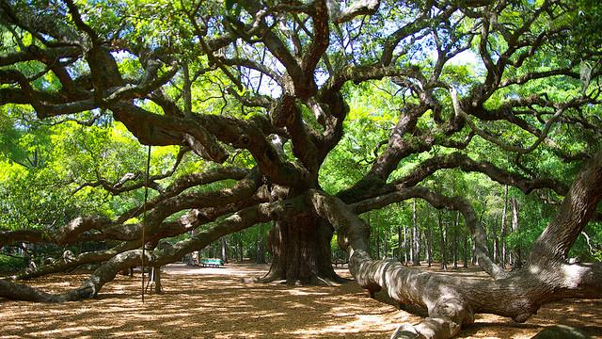
Nebuchadnezzar's Second Dream
Daniel 4:10-12
Notes:
Is this second dream just as difficult to understand as the first?
We don’t get to hear its contents until Daniel arrives.
When Daniel arrives, the King probably breathes a sigh of relief.
He states that the spirit of the holy gods is in Daniel.
And he says this not just once but three times!
Three times he says the Spirit of the Holy God is in Daniel
He fully expects Daniel to be able to interpret the dream.
Nebuchadnezzar starts describing the dream to Daniel in vs 10:
¹⁰ The visions of my head as I lay in bed were these:
I saw, and behold, a tree in the midst of the earth,
and its height was great.
¹¹ The tree grew and became strong, and its top reached to heaven,
and it was visible to the end of the whole earth.
¹² Its leaves were beautiful and its fruit abundant,
and in it was food for all.
The beasts of the field found shade under it,
and the birds of the heavens lived in its branches,
and all flesh was fed from it.
I see similarities between this dream and Nebuchadnezzar’s first dream,
In the 1st dream, Nebuchadnezzar was told he was the head of gold
and that God placed
all mankind
and the beasts of the field
and the birds in the sky under his control.

Slide 19

Nebuchadnezzar's Second Dream
__________
Daniel 4:13-16
Notes:
But then the dream takes a dark turn:
Starting with verse 13 we read
¹³ “I saw in the visions of my head as I lay in bed,
and behold, a watcher, a holy one, came down from heaven.
¹⁴ He proclaimed aloud and said thus:
‘Chop down the tree and lop off its branches,
strip off its leaves and scatter its fruit.
Let the beasts flee from under it and the birds from its branches.
¹⁵ But leave the stump of its roots in the earth,
bound with a band of iron and bronze,
amid the tender grass of the field.
Let him be wet with the dew of heaven.
Let his portion be with the beasts in the grass of the earth.
¹⁶ Let his mind be changed from a man’s,
and let a beast's mind be given to him;
and let seven periods of time pass over him.
So far in the dream, we have a vision and an announcement.
The vision is of a giant tree that gets chopped down,
and its stump gets wrapped in a chain.
But then there is a transition, there is the announcement
The stump of the tree is no longer just a thing,
it becomes personified.
Let Him be wet from staying outside,
Let Him live among animals
Let him go crazy for seven years.

Slide 20
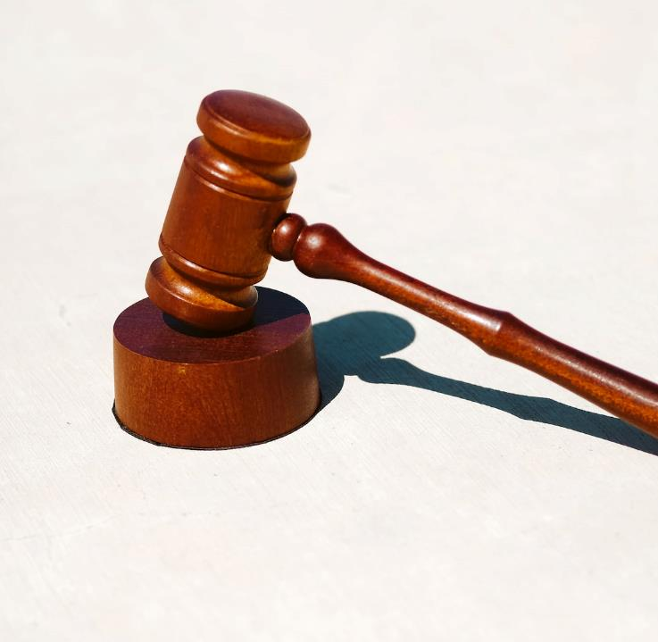
to the end that the living may know that the Most High rules the kingdom of men and gives it to whom he will and sets over it the lowliest of men.’
Daniel 4:17
Notes:
What does this announcement mean?
What comes next is different from most other dreams in the Bible.
Typically, the meaning is not given in the dream itself.
But here in Nebuchadnezzar’s second dream,
the dream itself, specifically verse 17, seems to tell us its meaning
It says:
¹⁷ The sentence is by the decree of the watchers,
the decision by the word of the holy ones,
The ESV then has to the end that
But you can translate it as “so that”
‘To the end that’ or ‘so that’ the living may know
that the Most High rules the kingdom of men
and gives it to whom he will and sets over it the lowliest of men.’
So even though his dream has an announcement
that includes an explanation,
and this explanation is even repeated 2 more times in this chapter,
Nebuchadnezzar himself does not know what it means
neither do all his wise men.

Slide 21
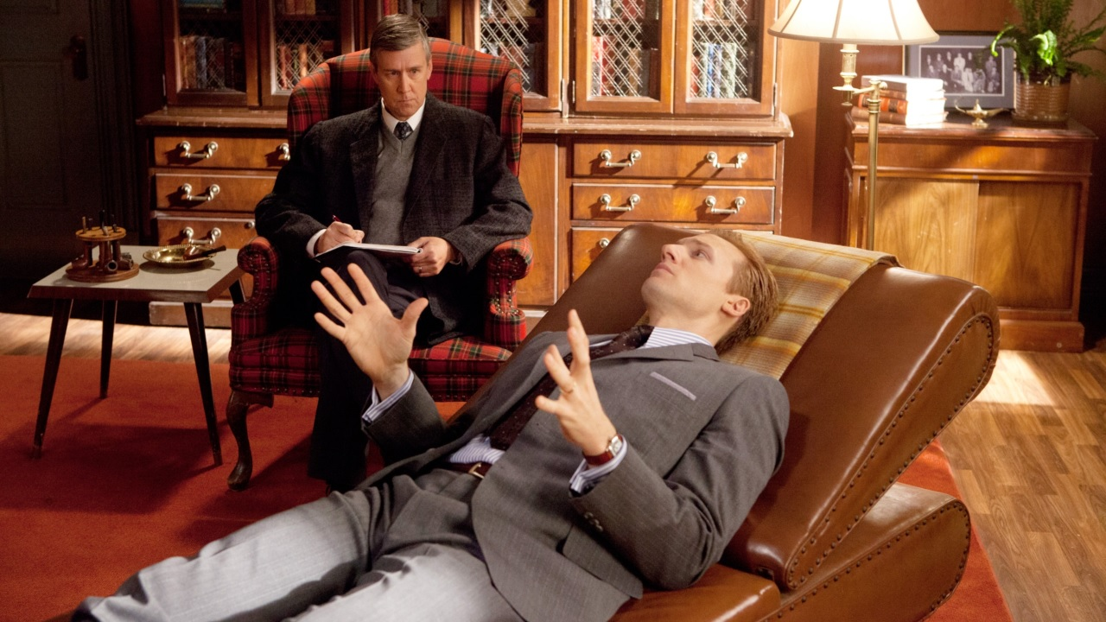
_________
Daniel 4:18-19
Notes:
So, it is up to Daniel to explain to the King the meaning of the dream.
The King expects Daniel to be able to interpret the dream,
as he says in verse 18
¹⁸ all the wise men of my kingdom
are not able to make known to me the interpretation,
but you are able, (and why is Daniel able)
for the spirit of the holy gods is in you.”
Some have speculated that the wise men knew the interpretation
but were afraid to say it to the King
because he doesn’t take bad news well
Daniel is also initially hesitant to interpret the dream for the King.
Do you think he is afraid?
Looking at vs 19, we see,
¹⁹ Then Daniel, whose name was Belteshazzar, was dismayed for a while,
and his thoughts alarmed him.
The king answered and said,
“Belteshazzar, let not the dream or the interpretation alarm you.”
Belteshazzar answered and said,
“My lord, may the dream be for those who hate you
and its interpretation for your enemies!
It is pretty straightforward; Daniel is not afraid; he is concerned
He is worried for his friend,
He knows that the dream is a warning for the King
And that if the King does not change, he will suffer the consequences

Slide 22
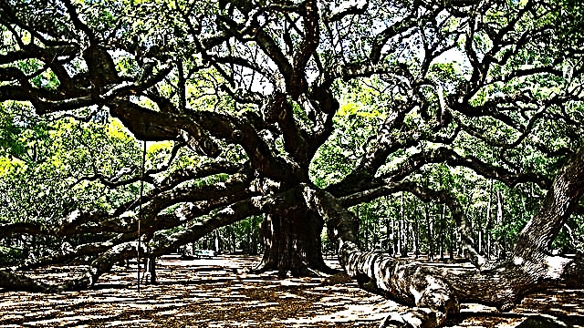
Nebuchadnezzar's Second Dream
Daniel 4:20-22
Notes:
Let’s look at Daniel’s interpretation :
²⁰ The tree you saw, which grew and became strong,
so that its top reached to heaven,
and it was visible to the end of the whole earth. . . —
²² it is you, O king, who have grown and become strong.
Your greatness has grown and reaches to heaven,
and your dominion to the ends of the earth.
At this point, I can’t help but wonder if Daniel is thinking
Now don’t go build a statue of a giant tree

Slide 23

you shall be driven from among men, . . .
till you know that the Most High rules the kingdom of men and gives it to whom he will.
Daniel 4:23-26
Notes:
On a more serious note, how do you warn someone you care about?
How do you let them know you are concerned
about the path they are taking?
First, you must help them see the hazard.
That is what Daniel does.
He describes the dream and then explains the danger.
Daniel begins by repeating the dream back to Nebuchadnezzar
that’s in verse 23.
Jumping to verse 24, he then explains:
²⁴ this is the interpretation, O king: It is a decree of the Most High, which has come upon my lord the king, ²⁵ that you shall be driven from among men, and your dwelling shall be with the beasts of the field. You shall be made to eat grass like an ox, and you shall be wet with the dew of heaven, and seven periods of time shall pass over you,
till you know that the Most High rules the kingdom of men
and gives it to whom he will.
²⁶ And as it was commanded to leave the stump of the roots of the tree, your kingdom shall be confirmed for you from the time that you know that Heaven rules.
One thing I found interesting about Daniel’s explanation,
he mostly repeated what Nebuchadnezzar told him,
Including what seems to be the meaning or reason for the vision:
He will be cut down, he will be driven from among men . . .
Until he knows that the Most High rule the Kingdom of men
and gives it to whom he will.

Slide 24
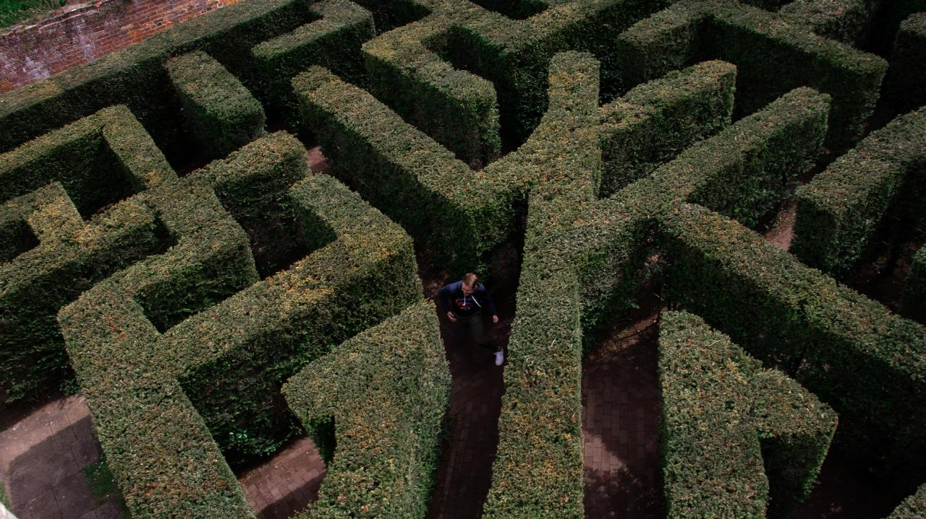
_________
Daniel 4:27
Notes:
Daniel has now described and explained to
the King the danger that he faces.
So what is the second thing Daniel does because he cares for the King?
He tells him how to avoid this danger. He provides a way out.
²⁷ Therefore, O king, let my counsel be acceptable to you:
break off your sins by practicing righteousness,
and your iniquities by showing mercy to the oppressed,
that there may perhaps be a lengthening of your prosperity.”
The way out for the King is to practice righteousness and show mercy.
At this point, you may ask,
I thought the way out was simply
“to know that the Most High rules the kingdom of men
and gives it to whom he will.”
That is what the watcher tells Nebuchadnezzar in the dream,
and that is what Daniel repeats back in his description
and explanation of the danger.
I believe Daniel is highlighting both cause and effect in his exhortation.
The cause would be knowing that God, who is the Most High,
rules the kingdom of men and gives it to whom he will.
When you know that, it will affect you,
you will then practice righteousness and show mercy.
But what happens when you don’t acknowledge God as supreme,
but try to then practice righteousness and show mercy

Slide 25

Daniel 4:28-33
Notes:
Look at what happens to Nebuchadnezzar.
He doesn’t get mad at Daniel and try to throw him in a furnace.
It seems like he attempts to do what Daniel told him.
He is trying to practice righteousness and show mercy
How long can he keep it up? The answer starts in verse 29, which tells us that twelve months later as the king was walking on the roof of the royal palace of Babylon, he said:
“Is not this great Babylon, which I have built by my mighty power as a royal residence and for the glory of my majesty?” ³¹ While the words were still in the king's mouth, there fell a voice from heaven,
“O King Nebuchadnezzar, to you it is spoken: The kingdom has departed from you, ³² and you shall be driven from among men, and your dwelling shall be with the beasts of the field. And you shall be made to eat grass like an ox, and seven periods of time shall pass over you, until you know that the Most High rules the kingdom of men and gives it to whom he will.”
³³ Immediately the word was fulfilled against Nebuchadnezzar. He was driven from among men and ate grass like an ox, and his body was wet with the dew of heaven till his hair grew as long as eagles' feathers, and his nails were like birds' claws.
So if you try to practice righteousness and show mercy
but still, hold on to the fallacy that you are in control,
and that everything you have is the result of your accomplishments, your own majesty,
You will fail, just like Nebuchadnezzar

Slide 26
 | Knowing | Doing
Jesus | Matt 4:17 “Repent of your sins and turn to God | Matt 5:14 let your good deeds shine out for all to see, so that everyone will praise your heavenly Father.
Peter | Acts 2:38 & 3:19 Repent of your sins and turn to God . . . | 2 Peter 2:10 work hard to prove that you really are among those God has called and chosen
Paul | Acts 26:20 all must repent of their sins and turn to God | and prove they have changed by the good things they do.
James | James 2:18 I will show you my faith | by my good deeds
Bible verses are taken from the NLT
Notes:
Another way to look at knowing vs doing can be seen throughout the New Testament.
Jesus, Peter, and Paul all state Repent of your sins and turn to God.
This would be a “knowing’ statement since there is no visible action.
For the action or doing,
Jesus says to let your good deeds shine out for all to see,
so that everyone will praise your heavenly Father.
Peter says to work hard to prove that you really are among those God has called and chosen
Paul says to prove you have changed by the good things you do.
I like how James puts it all together I will show you my faith by my good deeds.”
If you try to prove you have changed by doing good deeds,
showing righteousness, and having mercy
without first repenting and turning to God
Like Nebuchadnezzar, you too will fail

Slide 27

⁸ . . . Let everyone call urgently on God.
Let them give up their evil ways and their violence.
¹⁰ When God saw what they did and how they turned from their evil ways,
he relented and did not bring on them the destruction he had threatened.
Jonah 3:7-12
Notes:
Are judgment and condemnation inevitable when we fail?
When God told Jonah to go to the great city of Nineveh
and preach against it, because of its wickedness
Was there any hope for the city?
In that case, when the King of Nineveh heard Jonah’s proclamation
that Nineveh would be destroyed,
He issued his own decree
that you can read about in Jonah chapter 3, starting in verse 7:
(ANIMATION)
Do not let people or animals, herds or flocks, taste anything;
do not let them eat or drink.
⁸ But let people and animals be covered with sackcloth.
Let everyone call urgently on God.
Let them give up their evil ways and their violence.
¹⁰ When God saw what they did
and how they turned from their evil ways,
he relented and did not bring on them
the destruction he had threatened.
------------------
Image by <a href="https://www.freepik.com/free-photo/domino-made-with-wooden-pieces-representing-finances-struggles_11071829.htm#query=dominos&position=2&from_view=keyword&track=sph">Freepik</a>

Slide 28

Daniel 4:34-36
Notes:
In the same manner, there is still hope of rescue for Nebuchadnezzar.
Going back to Daniel chapter 4, we read in vs 34
³⁴ At the end of the days
I, Nebuchadnezzar, lifted my eyes to heaven,
and my reason returned to me,
and I blessed the Most High,
and praised and honored him who lives forever,
He repented of his sins and turned to God. And what was the result?
Look down starting at verse 36:
³⁶ At the same time my reason returned to me,
and for the glory of my kingdom,
my majesty and splendor returned to me.
My counselors and my lords sought me,
and I was established in my kingdom,
and still more greatness was added to me.
³⁷ Now I, Nebuchadnezzar,
praise and extol and honor the King of heaven,
for all his works are right and his ways are just;
and those who walk in pride he is able to humble.

Slide 29
When God punishes, the punishment is swift and sure;
when God restores, the restoration is complete.
Gangel, Kenneth. Daniel. Edited by Max Anders. Vol. 18. Holman Old Testament Commentary. Nashville, TN: Broadman & Holman Publishers, 2001.
Notes:
Nebuchadnezzar was rescued in the same manner
that Shadrack, Meshack, and Abednego were rescued.
I like how one of the commentaries puts it:
When God punishes, the punishment is swift and sure;
when God restores, the restoration is complete.
Not only was his sanity restored,
So was his kingdom!

Slide 30

Notes:
King Nebuchadnezzar's journey to learn the truth about the most high God
was a gradual process of realization and transformation,
marked by various events that challenged his beliefs and perceptions,
and ultimately led him to acknowledge
the power and sovereignty of the God of the Jews.
We may not identify ourselves with a mighty King
who conquered many foreign lands
and built many great projects
But we are also on a journey similar to the King’s.
---------
Image by <a href="https://www.freepik.com/free-photo/truth-concept-arrangement-with-magnifier_16691260.htm#query=journey%20to%20truth&position=0&from_view=search&track=ais">Freepik</a>

Slide 31

Notes:
Where are you on your journey?
Are you seeking to be restored?
Do you know people who seem to have a feeling of inner peace,
even though the world around them may be in chaos?
Maybe you realize that your orderly worldview
cannot account for all the chaos in the world
Or all the chaos in your life.
Maybe you sort of know that God exists,
But you don’t really practice righteousness and show mercy
Maybe you feel trapped and in need of rescue.
---------
<a href="https://www.freepik.com/free-photo/man-dressed-with-arrows-his-head_961259.htm#query=directions&position=2&from_view=search&track=sph">Image by creativeart</a> on Freepik

Slide 32
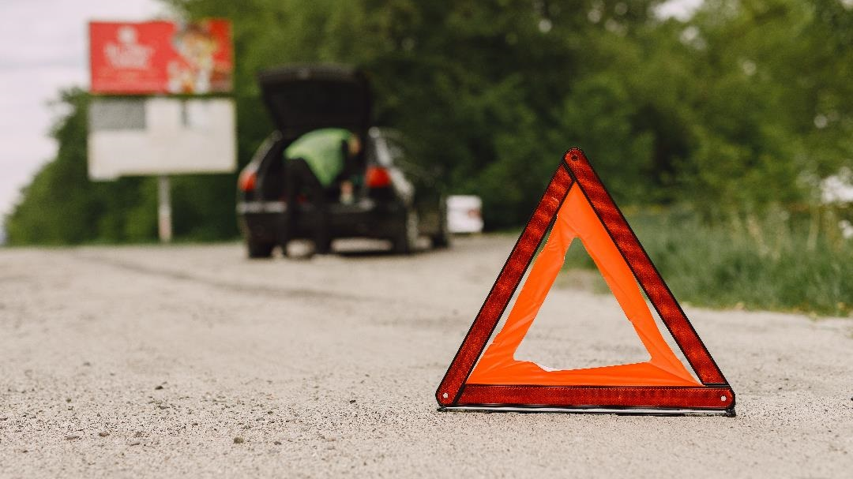
Notes:
Because I care for you, I need to warn you, just like Daniel warned Nebuchadnezzar.
We have a God who created an ordered and perfect world.
And we were created in God’s image to fellowship with him.
But until we acknowledge his authority over our lives,
we are separated from him
When we are separated from God, our lives will be filled with chaos.
When we are separated from God, the Bible warns us that
we will be given over to
sinful desires, shameful lusts, and depraved minds.
You may not go as crazy as Nebuchadnezzar,
but the longer you turn your back on God,
the harder it is to repent and turn to him.
But God will still be waiting to restore you.
--------------
<a href="https://www.freepik.com/free-photo/car-with-problems-red-triangle-warn-other-road-users_8897457.htm#query=warning&position=23&from_view=search&track=sph">Image by prostooleh</a> on Freepik

Slide 33

Notes:
What happens when we turn to God?
Do we just sit back and eat, drink, and be merry
as only good things come our way?
No, but what happens is even better.
We become part of a universal body of believers.
All of us proclaiming what the Lord has done for us
All of us proclaiming
How great are his signs,
how mighty his wonders!
His kingdom is an everlasting kingdom,
and his dominion endures from generation to generation.
Instead of experiencing chaos in our lives
We experience order,
We experience comfort
We experience fellowship
So when we look up to heaven, when we repent and turn to God,
do we become heroes like Daniel, Shadrack, Meshack, and Abednego?
--------------
<a href="https://www.freepik.com/free-photo/teamwork-partnership-corporate-business-concept_15665023.htm#query=fellowship&position=0&from_view=search&track=sph">Image by rawpixel.com</a> on Freepik

Slide 34
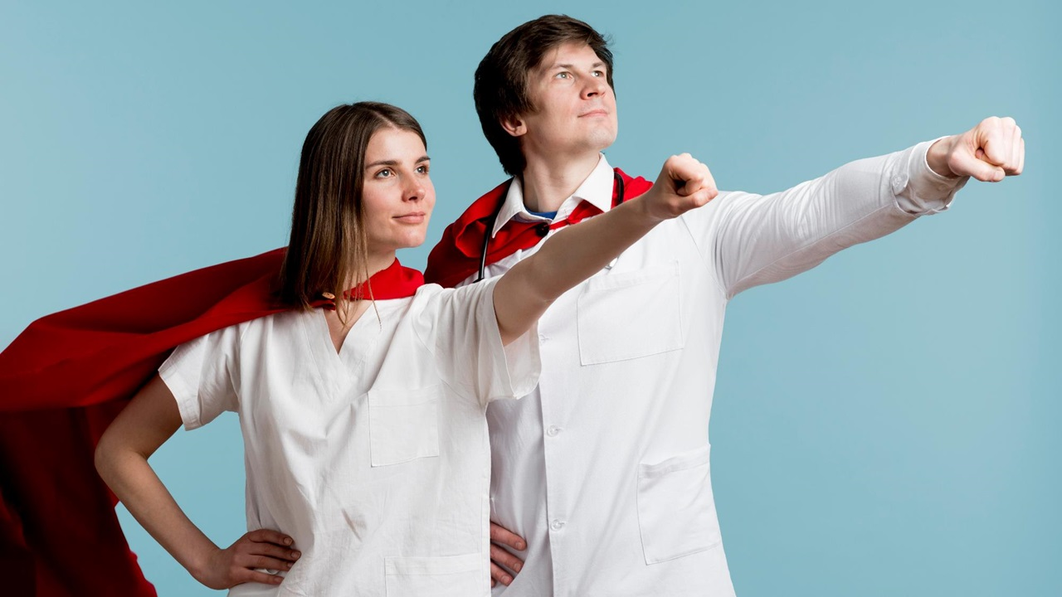
Notes:
Yes, we will be heroes!
Let me qualify what I mean by that,
We will not be 10 times better in every matter of wisdom and understanding
But we will be like Daniel,
As King Nebuchadnezzar said about Daniel,
I know that the spirit of the holy gods is in you
When we look up to heaven, when we repent and turn to God,
we are also filled with the Holy Spirit.
And although we still experience trials and suffering,
And sometimes even persecution for our beliefs,
We are comforted knowing that ultimately
we will be permanently and perfectly restored
and part of the everlasting kingdom.
How does this happen?
--------------
Image by <a href="https://www.freepik.com/free-photo/doctors-posing-as-super-heroes_8104187.htm#query=heroes&position=0&from_view=search&track=sph">Freepik</a>

Slide 35
Peter | Acts 2:38 Repent of your sins and turn to God . . . | and be baptized in the name of Jesus Christ for the forgiveness of your sins.
Peter | Acts 3:19 Repent of your sins and turn to God . . . | so that your sins may be wiped away
Paul | Rom 10:9-10 If you openly declare that Jesus is Lord and believe in your heart that God raised him from the dead, you will be saved. For it is by believing in your heart that you are made right with God, and it is by openly declaring your faith that you are saved. | and prove they have changed by the good things they do.
Bible verses are taken from the NLT
Notes:
There is no magic formula.
In Acts 2:38, Peter says Repent of your sins and turn to God . . .
and be baptized in the name of Jesus Christ
for the forgiveness of your sins.
But Baptism is not necessary to wash our sins away,
it is simply a reminder,
which is why in the next chapter Peter simply says
Repent of your sins and turn to God . . .
so that your sins may be wiped away.
Baptism isn’t a requirement to be saved,
neither is a public confession.
But both are important to demonstrating one’s faith,
which is why Paul says that
If you openly declare that Jesus is Lord
and believe in your heart that God raised him from the dead,
you will be saved.
For it is by believing in your heart that you are made right with God,
and it is by openly declaring your faith that you are saved.
I said there is no magic formula,
but there is Jesus.

Slide 36
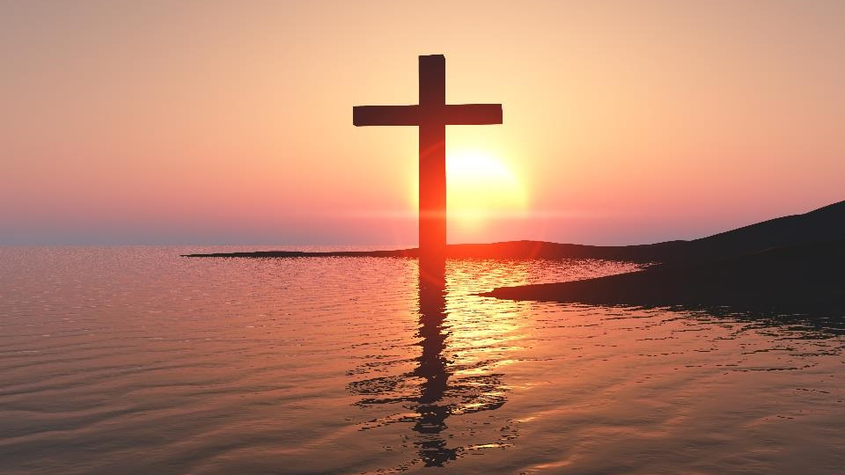
Notes:
It is because of Jesus, our Lord,
who came into the world that he created,
and lived a perfect sinless life,
but then suffered the penalty for all our sins
with his death on the cross
But then God resurrected him in glory
And has promised to do the same
for all those who call on the name of Jesus
and acknowledge his rule over our hearts and over the world
The same restoration that Nebuchadnezzar experienced,
Is available for you, right here, right now.
But restoration requires something on your part.
This is not just an acknowledgment, but a change in direction.
You just need to look up to heaven,
You just need to repent and turn to God
You are on a journey just like Nebuchadnezzar
God has placed many heroes in your path
How do you respond?
If you’ve already responded, are you living the life of a hero?
Are you practicing righteousness and showing mercy?
And helping those still on their journey
to learn the truth about the most high God
Let us pray.
------------
<a href="https://www.freepik.com/free-photo/3d-good-friday-background-with-cross-against-sunset-sky_37780237.htm#query=jesus&position=0&from_view=search&track=sph">Image by kjpargeter</a> on Freepik

