Slide 1
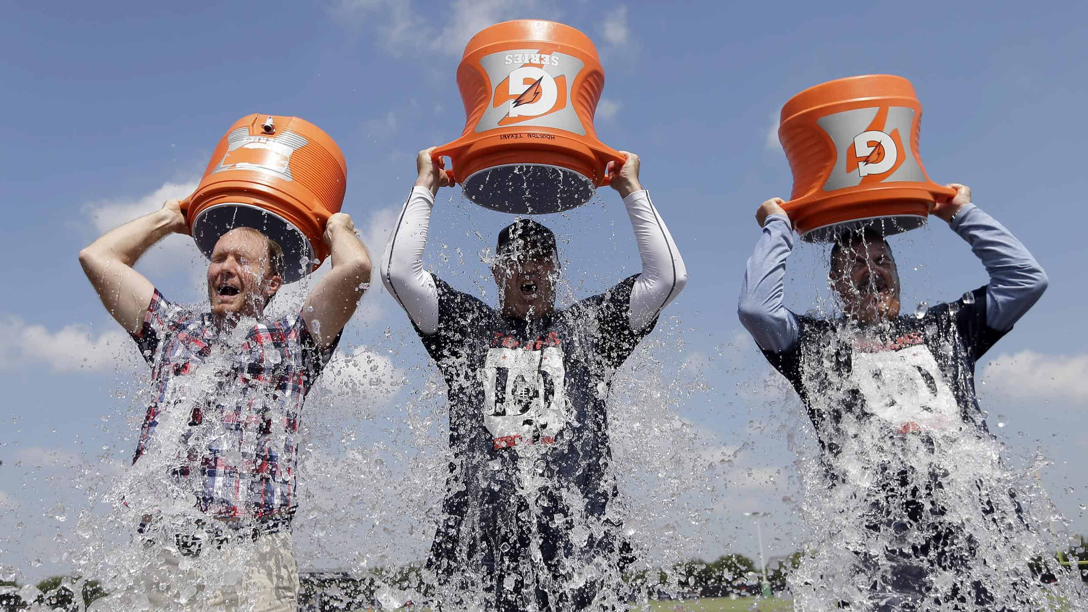

Slide 2
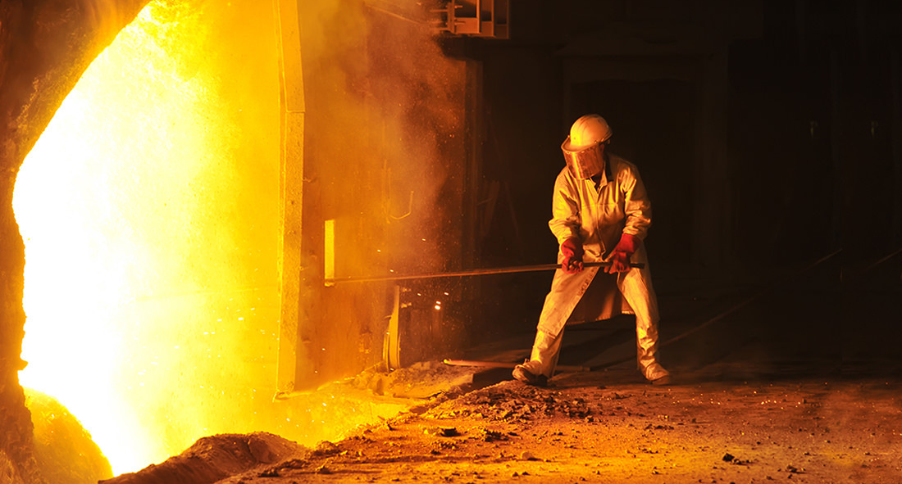

Slide 4
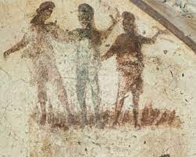
Daniel’s Influence
I Stand on God’s Word
Daniel 3

Slide 5
The Crisis: God May Allow Matters to Get Worse Before They Get Better
(vs. 1-15)

Slide 6
“Many there are who have a certain admiration for the ministry and the word of God, but yet who themselves go on practically all through their lives strangers to Him whose word His ministers declare. This was Nebuchadnezzar’s condition exactly at this time. For in this third chapter we see that, instead of his being humbled by the revelation made, it simply served to exalt himself as one especially favored of heaven, and to magnify his thoughts of the human mind and his own greatness.”
Harry Ironside

Slide 7
The Resolve: Trust in God’s Power and Wait for His Will
(vs. 16-23)

Slide 8
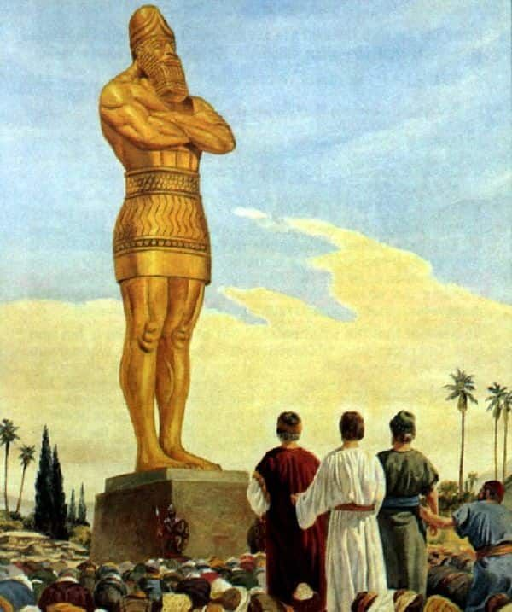
Weigh the options
Accept the consequences

Slide 9
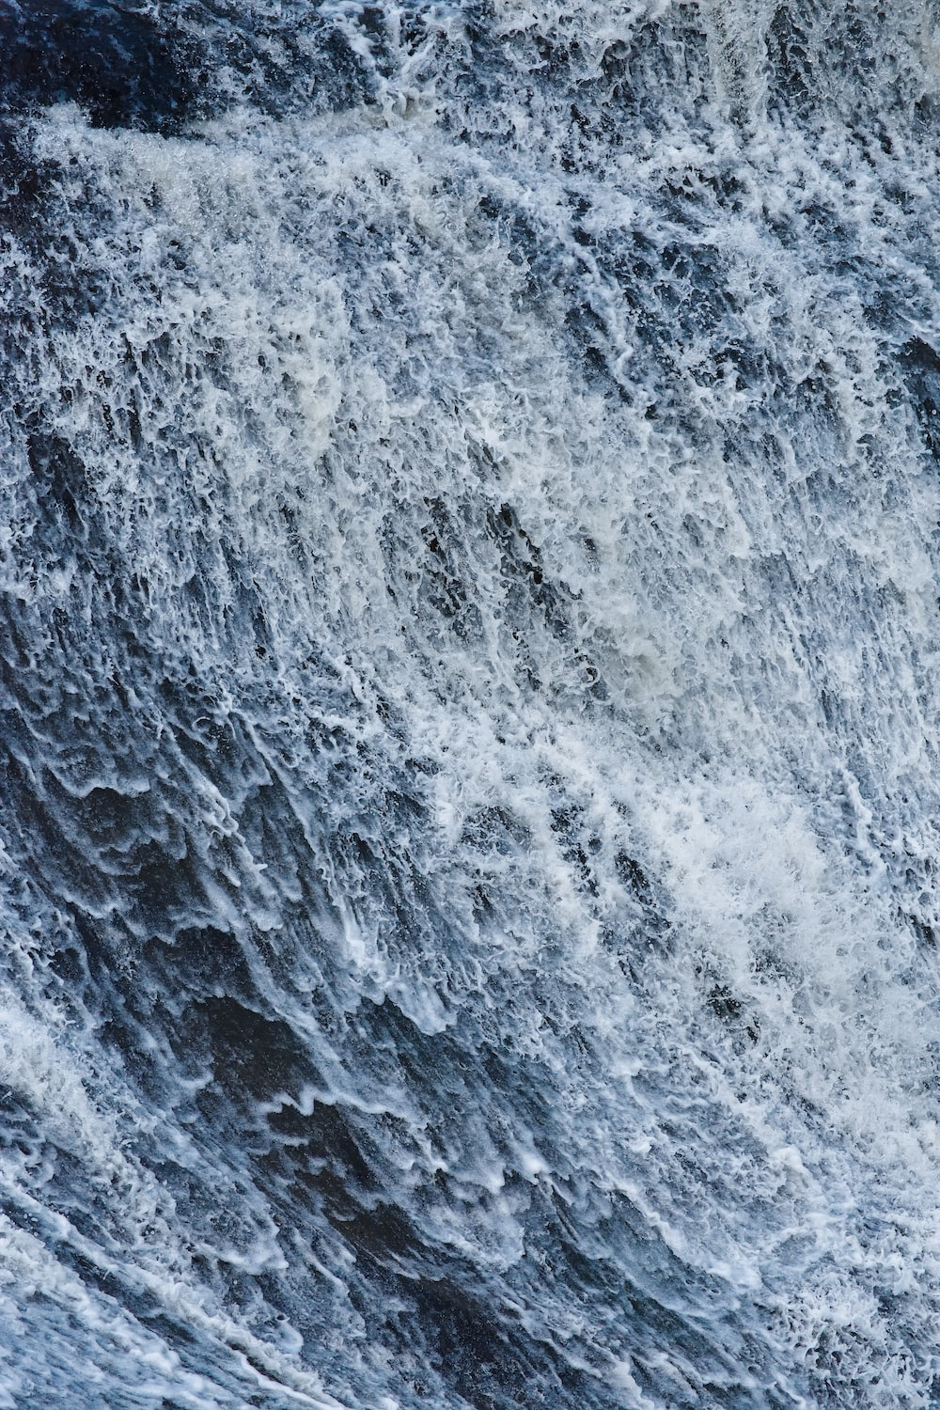
² When you pass through the waters,
I will be with you; and through the rivers,
they shall not overwhelm you; when you walk through fire
you shall not be burned, and the flame shall not consume you. ³ For I am the Lord your God, the Holy One of Israel, your Savior.
Isaiah 43:2-3

Slide 10
The Rescue: Recognize That God Joins Us in the Fire
(vs. 24-30)

Slide 11
“Paradoxical as it was, the soldiers who fell outside, where there was no fire, died because of the fire; while those who fell inside, where the fire raged, continued to live without harm.”
Leon Wood

Slide 12
³² And what more shall I say? For time would fail me to tell of Gideon, Barak, Samson, Jephthah, of David and Samuel and the prophets— ³³ who through faith conquered kingdoms, enforced justice, obtained promises, stopped the mouths of lions, ³⁴ quenched the power of fire, escaped the edge of the sword, were made strong out of weakness, became mighty in war, put foreign armies to flight. ³⁵ Women received back their dead by resurrection. Some were tortured, refusing to accept release, so that they might rise again to a better life. ³⁶ Others suffered mocking and flogging, and even chains and imprisonment.

Slide 13
³⁷ They were stoned, they were sawn in two, they were killed with the sword. They went about in skins of sheep and goats, destitute, afflicted, mistreated— ³⁸ of whom the world was not worthy—wandering about in deserts and mountains, and in dens and caves of the earth. ³⁹ And all these, though commended through their faith, did not receive what was promised, ⁴⁰ since God had provided something better for us, that apart from us they should not be made perfect.
Hebrews 11:32-40

Slide 14
fear not, for I am with you; be not dismayed, for I am your God; I will strengthen you, I will help you, I will uphold you with my righteous right hand.
Isaiah 41:10

