Slide 2
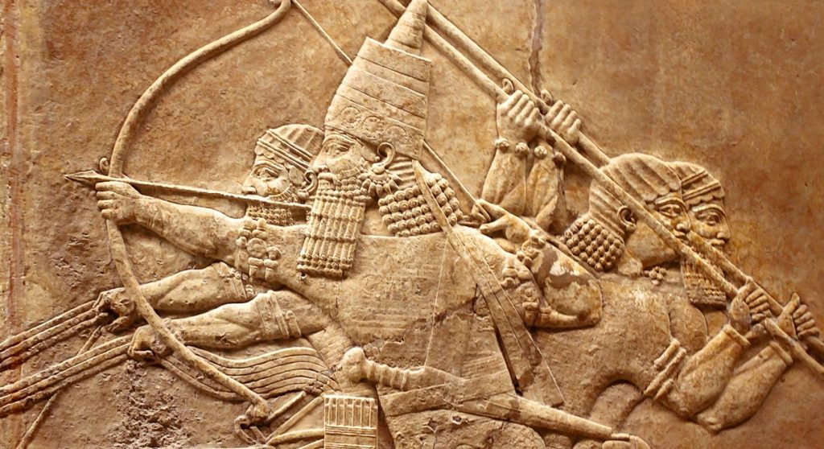
Introduction: Is there a man? Is there a plan?
To the North
19 kings & 200 years = ALL EVIL
To the South
21 kings & 300 years = 7 GOOD
Combined
40 kings & 500 years = LEADERSHIP CRISIS

Slide 3
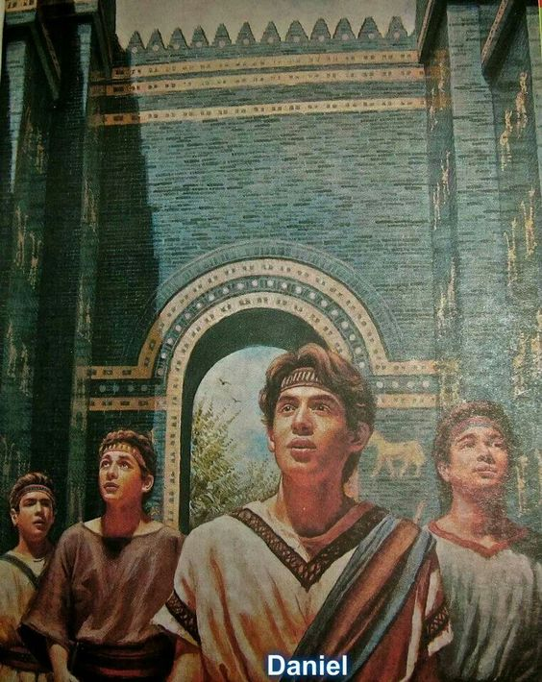
Daniel’s Resolve:
I won’t compromise a little
-Daniel 1-

Slide 4
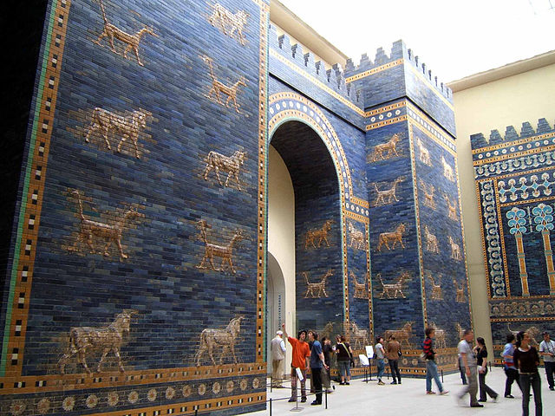
Daniel Counters Israel’s Legacy of Bad Leadership
Israel’s bad kings Daniel
Ahaz compromised and capitulated Daniel was resolved
Manasseh did evil from his youth for Daniel was righteous from his youth for a long time for a long time
Jehoiakim cut up and burned Scripture Daniel obeyed Scripture
especially from Jeremiah especially from Jeremiah

Slide 5
The Test of Integrity (1:1-7)
“This Mesopotamian worldview was polytheistic in nature, superstitious in character, and pluralistic in practice.”
Andrew Hill

Slide 6
The Test of Integrity (1:1-7)
The Response of Integrity (1:8-16)
Build convictions in the heart
Know your boundaries
Recognize where to negotiate

Slide 7
The Test of Integrity (1:1-7)
The Response of Integrity (1:8-16)
The Provision of God (1:17-21)

Slide 8
“Daniel’s longevity testified both to God’s sovereignty over the nations and his faithfulness to his people Israel. Even as Daniel outlasted the kings of the Babylonian Empire, so God’s people were sustained in captivity and eventually permitted to return to their homeland of covenantal promise . . . Likewise, the presence of the Israelite named Daniel in the royal court of seven Babylonian monarchs and the first king of Persia was a tangible reminder that God is the one who sets up kings and deposes them.”
Andrew Hill

