Slide 2
God Owns It All
God Invests in Us
Work Hard
Plan What You Get
PRINCIPLES

Slide 3
Plan for the Future

Slide 4
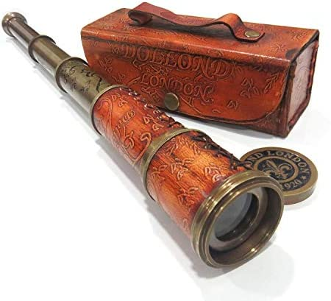
Pay off debts
⁷ Pay to all what is owed to them: taxes to whom taxes are owed, revenue to whom revenue is owed, respect to whom respect is owed, honor to whom honor is owed. ⁸ Owe no one anything, except to love each other, for the one who loves another has fulfilled the law.
Romans 13:7-8

Slide 5
She came and told the man of God, and he said, “Go, sell the oil and pay your debts, and you and your sons can live on the rest.”
2 Kings 4:7
“The wicked borrows but does not pay back, but the righteous is generous and gives.”
Psalm 37:21

Slide 6
Pay off debts
Prepare reserve funds
But if anyone does not provide for his relatives, and especially for members of his household, he has denied the faith and is worse than an unbeliever.
1 Timothy 5:8

Slide 7
⁶ Go to the ant, O sluggard; consider her ways, and be wise. ⁷ Without having any chief, officer, or ruler, ⁸ she prepares her bread in summer and gathers her food in harvest. ⁹ How long will you lie there, O sluggard? When will you arise from your sleep? ¹⁰ A little sleep, a little slumber, a little folding of the hands to rest, ¹¹ and poverty will come upon you like a robber, and want like an armed man.
Proverbs 6:6-11

Slide 8
Pay off debts
Prepare reserve funds
Save to achieve goals

Slide 9
“Wealth gained hastily will dwindle,
but whoever gathers little by little will increase it.”
Proverbs 13:11
“Precious treasure and oil are in a wise man’s dwelling,
but a foolish man devours it”
Proverbs 21:20
“An inheritance gained hastily in the beginning will not be blessed in the end.”
Proverbs 20:21

Slide 10
“Unless the LORD builds the house, those who build it labor in vain. Unless the LORD watches over the city, the watchman stays awake in vain. It is in vain that you rise up early and go late to rest, eating the bread of anxious toil; for he gives to his beloved sleep”
Psalm 127:1-2
Avoid High Risk Investments

Slide 11
¹⁹ Whoever works his land will have plenty of bread,
but he who follows worthless pursuits will have plenty of poverty
²⁰ A faithful man will abound with blessings,
but whoever hastens to be rich will not go unpunished.
Proverbs 28:19-20

Slide 12
Whoever puts up security for a stranger will surely suffer harm, but he who hates striking hands in pledge is secure.
Proverbs 11:15

Slide 13
Guard Against Sinful Attitudes

Slide 14
Sinful Attitude 1: Arrogance

Slide 15
Be not wise in your own eyes;
fear the Lord, and turn away from evil.
Proverbs 3:7
A rich man is wise in his own eyes,
but a poor man who has understanding will find him out.
Proverbs 28:11

Slide 16
¹³ Come now, you who say, “Today or tomorrow we will go into such and such a town and spend a year there and trade and make a profit”— ¹⁴ yet you do not know what tomorrow will bring. What is your life? For you are a mist that appears for a little time and then vanishes. ¹⁵ Instead you ought to say, “If the Lord wills, we will live and do this or that.” ¹⁶ As it is, you boast in your arrogance. All such boasting is evil. ¹⁷ So whoever knows the right thing to do and fails to do it, for him it is sin.
James 4:13-15

Slide 17
Sinful Attitude 1: Arrogance
Sinful Attitude 2: Resentment

Slide 18
“A man of quick temper acts foolishly,
and a man of evil devises is hated
Proverbs 14:17
Whoever is slow to anger is better than the mighty,
and he who rules his spirit than he who takes a city.
Proverbs 16:32

Slide 19
Sinful Attitude 1: Arrogance
Sinful Attitude 2: Resentment
Sinful Attitude 3: Covetousness

Slide 20
Whoever is greedy for unjust gain troubles his own household, but he who hates bribes will live.
Proverbs 15:27
⁹ But those who desire to be rich fall into temptation, into a snare, into many senseless and harmful desires that plunge people into ruin and destruction. ¹⁰ For the love of money is a root of all kinds of evils. It is through this craving that some have wandered away from the faith and pierced themselves with many pangs.
1 Timothy 6:9-10

Slide 21
¹¹ Not that I am speaking of being in need, for I have learned in whatever situation I am to be content. ¹² I know how to be brought low, and I know how to abound. In any and every circumstance, I have learned the secret of facing plenty and hunger, abundance and need. ¹³ I can do all things through him who strengthens me.
Philippians 4:11-13

Slide 22
Sinful Attitude 1: Arrogance
Sinful Attitude 2: Resentment
Sinful Attitude 3: Covetousness
Sinful Attitude 4: Favoritism

Slide 23
We work hard
We plan what we receive
We invest in the future
We avoid high risk investments
We guard against sinful attitudes
God owns everything
God invests in us

