Slide 2
16 of Jesus’ 38 parables deal with handling money and possessions
1 in 10 verses in the gospels (288 total) focus directly on money and possessions
The Bible offers 500 verses on prayer and 500 verses on faith, but it devotes over 2000 passages to money and possessions.

Slide 3
“Unless the LORD builds the house, those who build it labor in vain. Unless the LORD watches over the city, the watchman stays awake in vain. It is in vain that you rise up early and go late to rest, eating the bread of anxious toil; for he gives to his beloved sleep”
Psalm 127:1-2

Slide 4
God Owns It All

Slide 5
“The silver is mine, and the gold is mine, declares the LORD of hosts.”
Haggai 2:8
“The earth is the LORD's and the fullness thereof, the world and those who dwell therein.”
Psalm 24:1

Slide 6
“What do you have that you did not receive?”
1 Corinthians 4:7
Every good gift and every perfect gift is from above, coming down from the Father of lights, with whom there is no variation or shadow due to change.
James 1:17

Slide 7
God Invests in Us

Slide 8
10 He who supplies seed to the sower and bread for food will supply and multiply your seed for sowing and increase the harvest of your righteousness. 11 You will be enriched in every way to be generous in every way, which through us will produce thanksgiving to God.
2 Corinthians 9:10-11

Slide 9
Divine Investment 1: God gives us the ability to earn finances

Slide 10
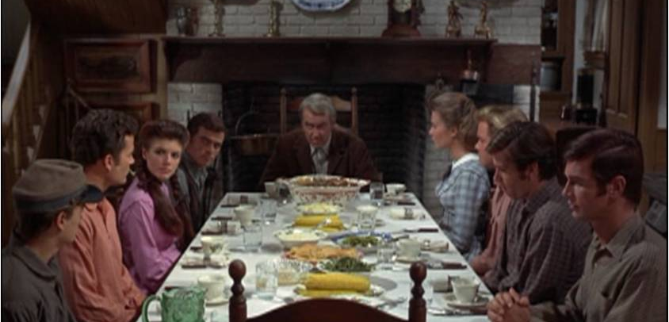
“Lord, we cleared the land. We plowed it, sowed it, and harvested it. We cooked the harvest. It wouldn’t be here, we wouldn’t be eatin’ it if we hadn’t done it all ourselves. We worked dog-bone hard for every crumb and morsel, but we thank you just the same anyway, Lord, for the food we’re about to eat. Amen.”

Slide 11
17 Beware lest you say in your heart, “My power and the might of my hand have gotten me this wealth.” 18 You shall remember the LORD your God, for it is he who gives you power to get wealth, that he may confirm his covenant that he swore to your fathers, as it is this day.
Deuteronomy 8:17-18

Slide 12
Divine Investment 2: God bestows money to meet needs

Slide 13
Every good gift and every perfect gift is from above, coming down from the Father of lights, with whom there is no variation or shadow due to change.
James 1:17
And my God will supply every need of yours according to his riches in glory in Christ Jesus.
Philippians 4:19

Slide 14
What am I doing with God’s money

Slide 15
Work Hard

Slide 16
Whoever is slack in his work is a brother to him who destroys.
Proverbs 18:9

Slide 17
⁶ Now we command you, brothers, in the name of our Lord Jesus Christ, that you keep away from any brother who is walking in idleness and not in accord with the tradition that you received from us. ⁷ For you yourselves know how you ought to imitate us, because we were not idle when we were with you, ⁸ nor did we eat anyone's bread without paying for it, but with toil and labor we worked night and day, that we might not be a burden to any of you. ⁹ It was not because we do not have that right, but to give you in ourselves an example to imitate. ¹⁰ For even when we were with you, we would give you this command: If anyone is not willing to work, let him not eat. ¹¹ For we hear that some among you walk in idleness, not busy at work, but busybodies. ¹² Now such persons we command and encourage in the Lord Jesus Christ to do their work quietly and to earn their own living
2 Thessalonians 3:6-12

Slide 18
“In all toil there is profit, but mere talk tends only to poverty.”
Proverbs 14:23
A slack hand causes poverty,
but the hand of the diligent makes rich.
Proverbs 10:4
He who gathers in summer is a prudent son,
but he who sleeps in harvest is a son who brings shame.
Proverbs 10:5
The sluggard does not plow in the autumn;
he will seek at harvest and have nothing.
Proverbs 20:4

Slide 19
Plan What You Get

Slide 20
Plan for expenses

Slide 21
The plans of the diligent lead surely to abundance,
But everyone who is hasty comes only to poverty.
Proverbs 21:5

Slide 22
“Most of us are responders rather than planners. We respond to friends, advertising, and our emotions rather than plan our spending.”

Slide 23
Spend less than you make

Slide 24
Whoever loves pleasure will be a poor man;
he who loves wine and oil will not be rich.
Proverbs 21:17
One pretends to be rich, yet has nothing; another pretends to be poor, yet has great wealth.
Proverbs 13:7

Slide 25
¹³ Someone in the crowd said to him, “Teacher, tell my brother to divide the inheritance with me.” ¹⁴ But he said to him, “Man, who made me a judge or arbitrator over you?” ¹⁵ And he said to them, “Take care, and be on your guard against all covetousness, for one's life does not consist in the abundance of his possessions.”
Luke 12:13-15

Slide 26
“The problem is not with earning a lot. The problem is the constant accumulation of luxuries that are soon felt to be needs. If you want to be a conduit of God’s grace, you don’t have to be lined with gold. Copper will do.”

Slide 27
What causes quarrels and what causes fights among you? Is it not this, that your passions are at war within you? ² You desire and do not have, so you murder. You covet and cannot obtain, so you fight and quarrel. You do not have, because you do not ask. ³ You ask and do not receive, because you ask wrongly, to spend it on your passions.
James 4:1-3

