Slide 1
By Thinking Backward

Slide 2
James 1:2-4
² Count it all joy, my brothers, when you meet trials of various kinds, ³ for you know that the testing of your faith produces steadfastness. ⁴ And let steadfastness have its full effect, that you may be perfect and complete, lacking in nothing.

Slide 3
Romans 5:3-5
³ Not only that, but we rejoice in our sufferings, knowing that suffering produces endurance, ⁴ and endurance produces character, and character produces hope, ⁵ and hope does not put us to shame, because God's love has been poured into our hearts through the Holy Spirit who has been given to us.

Slide 4
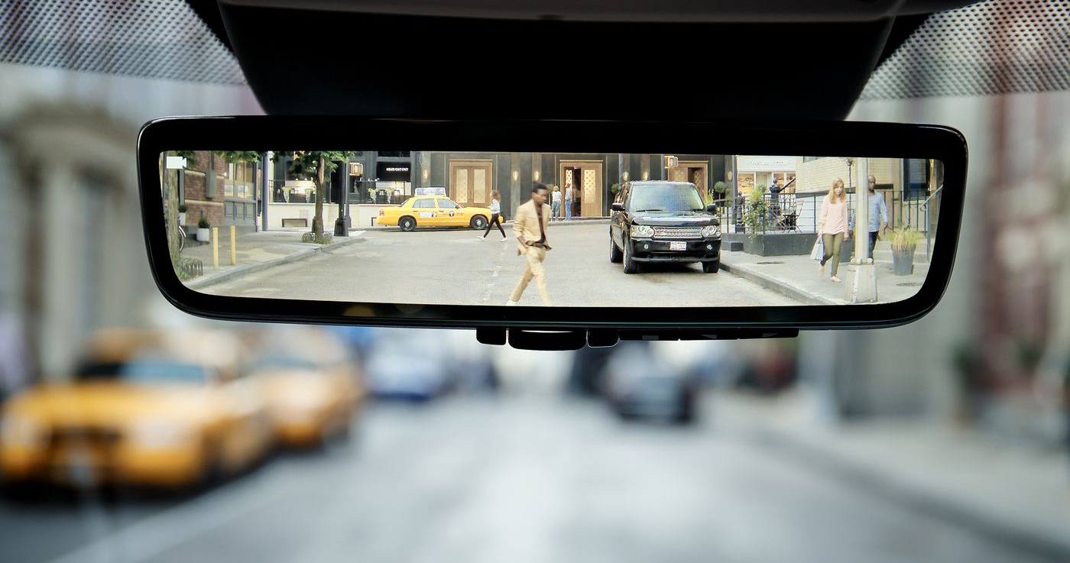
What does this mean?
Consider it joy when struggling to grow mature in faith
Understand the work of the Holy Spirit within you

Slide 5
Philippians 2:12-13
¹² Therefore, my beloved, as you have always obeyed, so now, not only as in my presence but much more in my absence, work out your own salvation with fear and trembling, ¹³ for it is God who works in you, both to will and to work for his good pleasure.

Slide 6
1 Timothy 4:7
Have nothing to do with irreverent, silly myths. Rather train yourself for godliness.

Slide 7
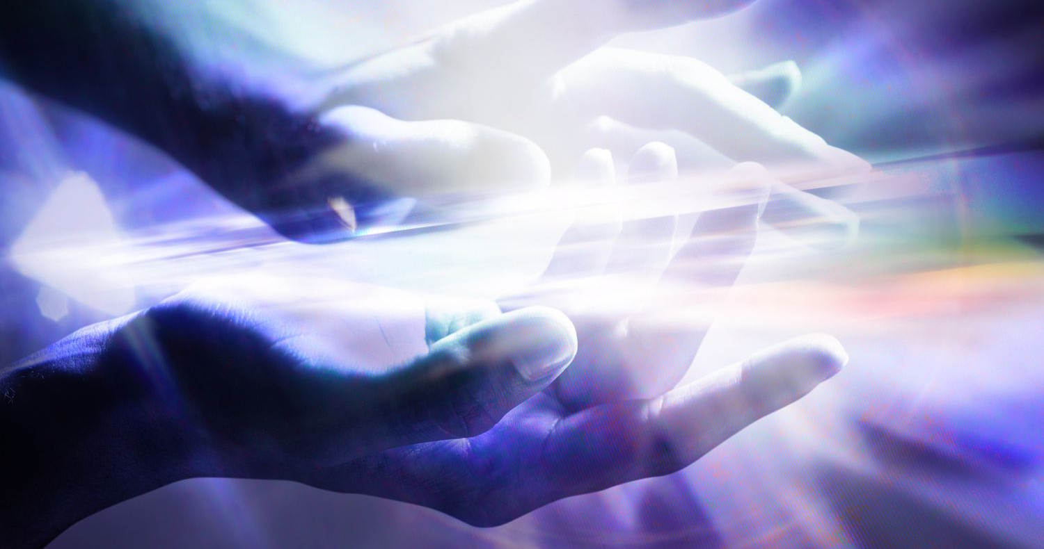
God’s Spirit
He is our “helper” (John 16:7)
He convicts us of sin (John 16:8)
He helps us to put sinful habits to death (Rom 8:13)
He intercedes on our behalf when we are weak (Rom 8:26-27)
He leads us (Rom 8:14)
He gifts us to help others (1 Cor 12:4-7)

Slide 8
What does this mean?
Consider it joy when struggling to grow mature in faith
Understand the work of the Holy Spirit within you
Be reassured that Jesus intercedes for us

Slide 9
Luke 22:31-32
³¹ “Simon, Simon, behold, Satan demanded to have you, that he might sift you like wheat, ³² but I have prayed for you that your faith may not fail. And when you have turned again, strengthen your brothers.”

Slide 10
Hebrews 7:25
Consequently, he is able to save to the uttermost those who draw near to God through him, since he always lives to make intercession for them.

Slide 11
Romans 8:34
Who is to condemn? Christ Jesus is the one who died—more than that, who was raised—who is at the right hand of God, who indeed is interceding for us.

Slide 12
What does this mean?
Consider it joy when struggling to grow mature in faith
Understand the work of the Holy Spirit within you
Be reassured that Jesus intercedes for us
Recognize we will not receive trials harder than they need to be

Slide 13
1 Corinthians 10:13
No temptation has overtaken you that is not common to man. God is faithful, and he will not let you be tempted beyond your ability, but with the temptation he will also provide the way of escape, that you may be able to endure it.

Slide 14
What does this mean?
Consider it joy when struggling to grow mature in faith
Understand the work of the Holy Spirit within you
Be reassured that Jesus intercedes for us
Recognize we will not receive trials harder than they need to be
Anticipate eternal rewards beyond comparison

Slide 15
Romans 8:18
For I consider that the sufferings of this present time are not worth comparing with the glory that is to be revealed to us.

